Slide 1
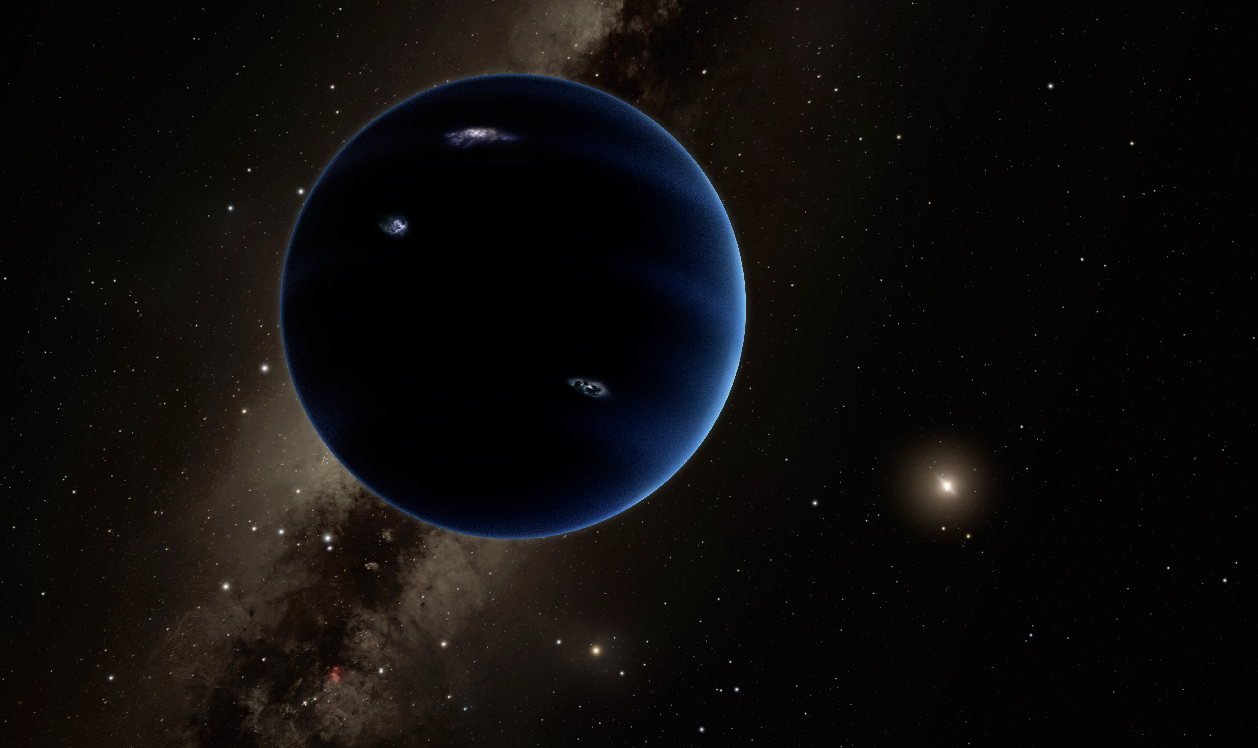
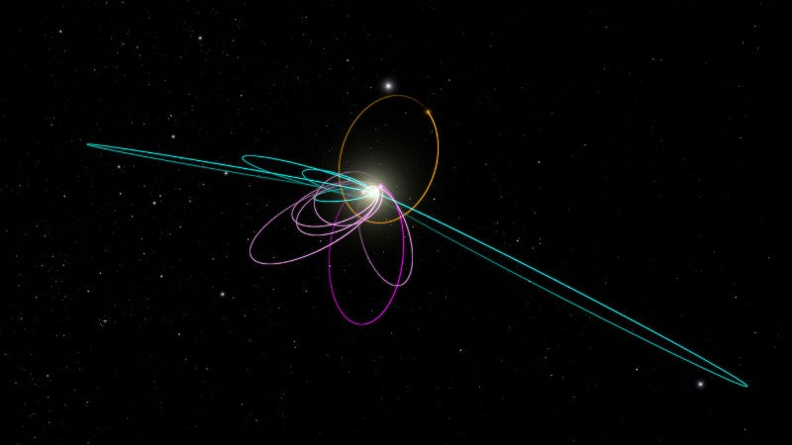
Konstantin Batygin // Mike Brown (Caltech)

Slide 2
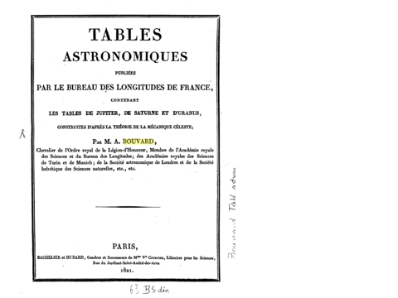

Slide 3
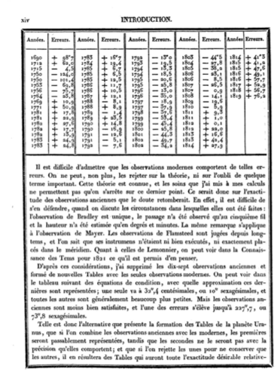
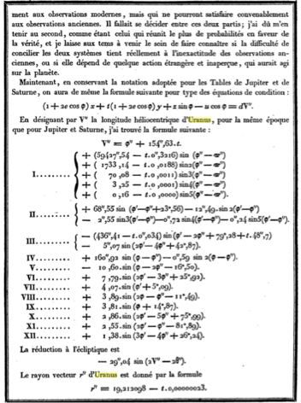

Slide 4
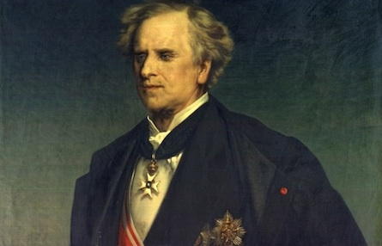
Urbain J. J. LeVerrier (1811-1877)

Slide 5
Urbain J. J. LeVerrier (1811-1877)

Slide 6
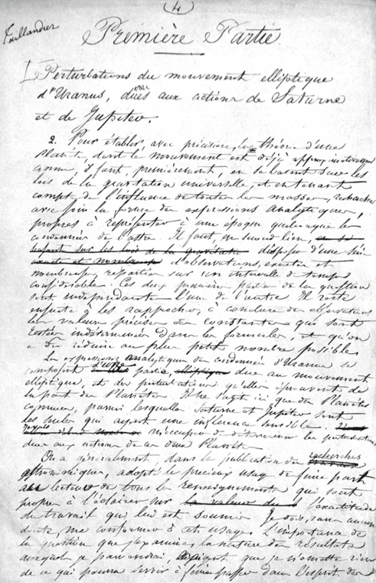
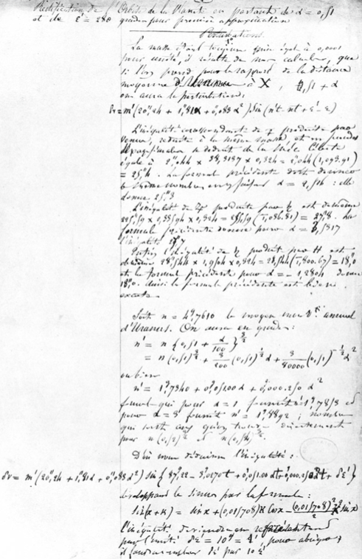

Slide 8
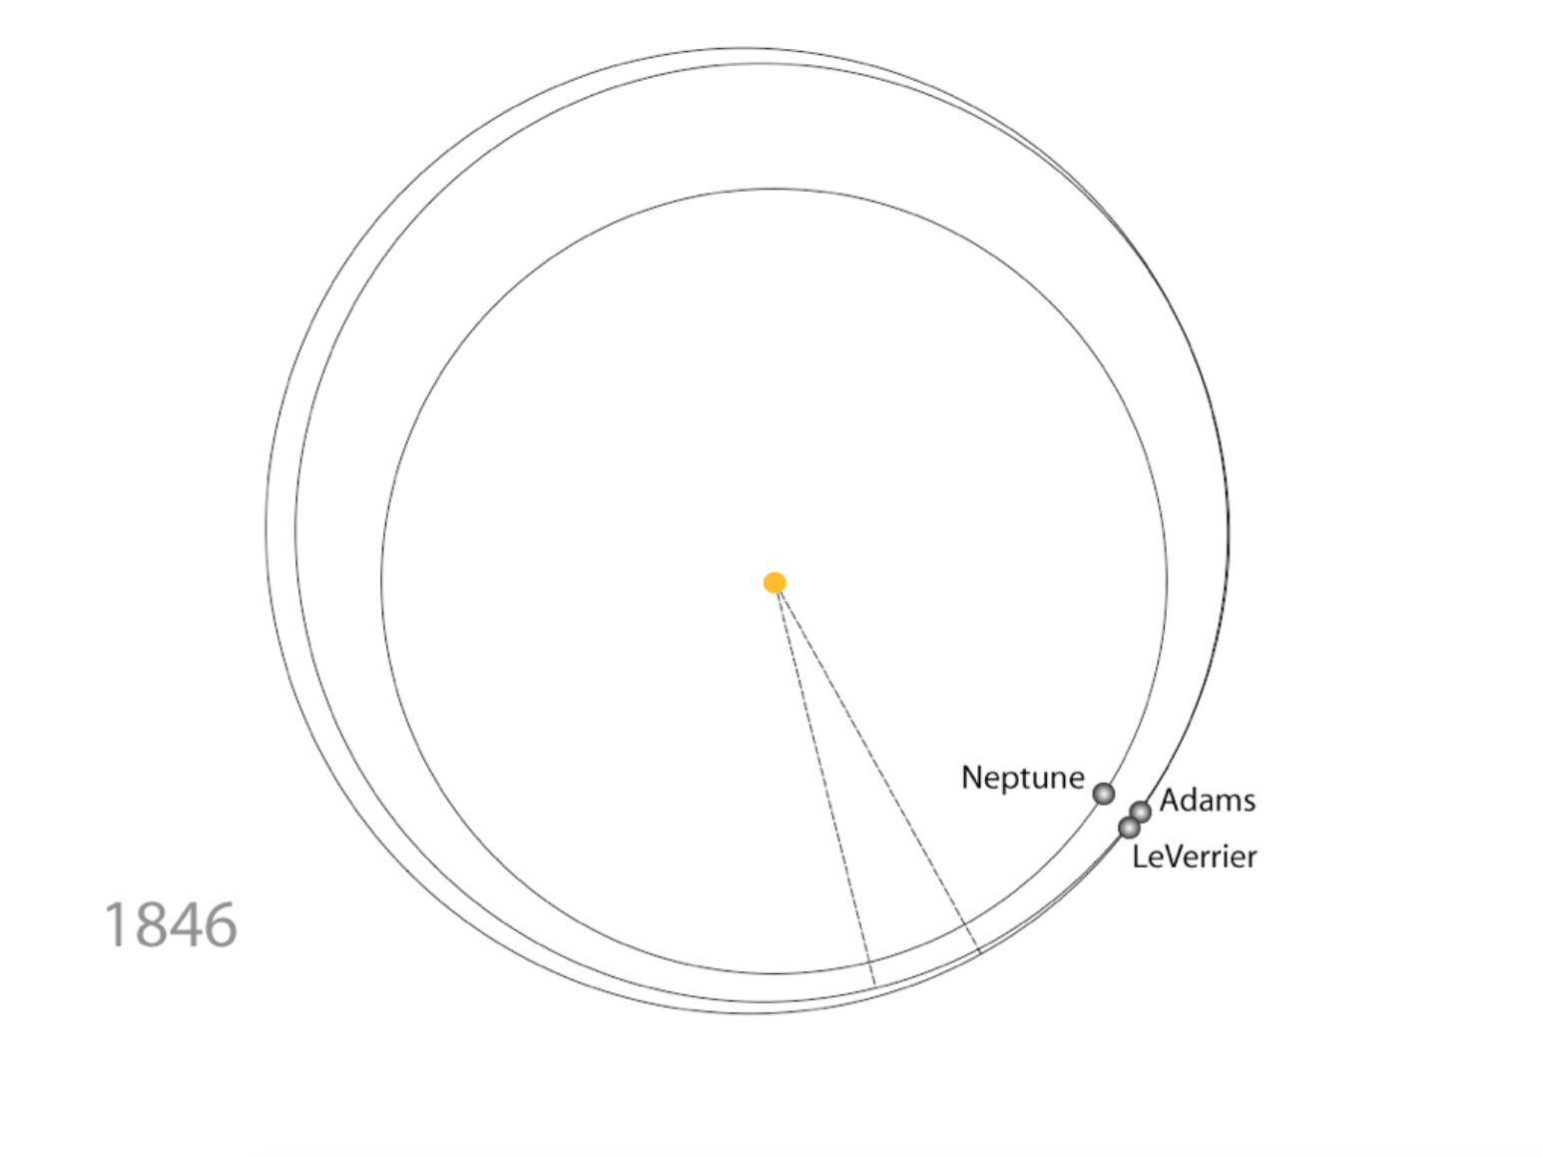

Slide 9
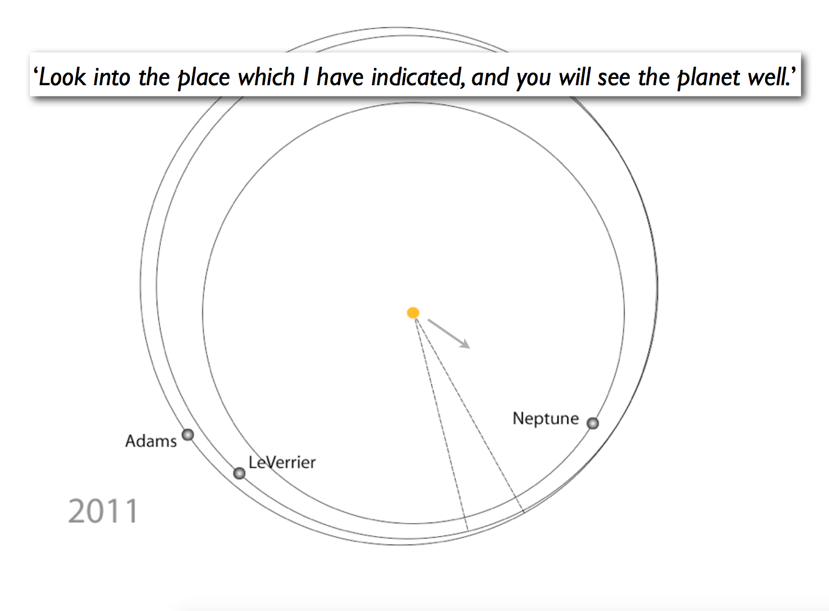

Slide 11
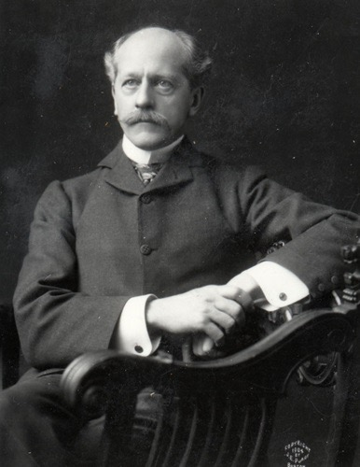
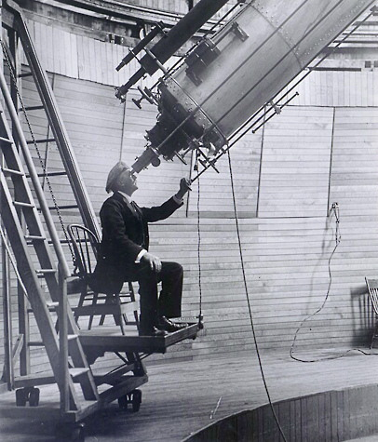
Percival Lowell (1855-1916)

Slide 12
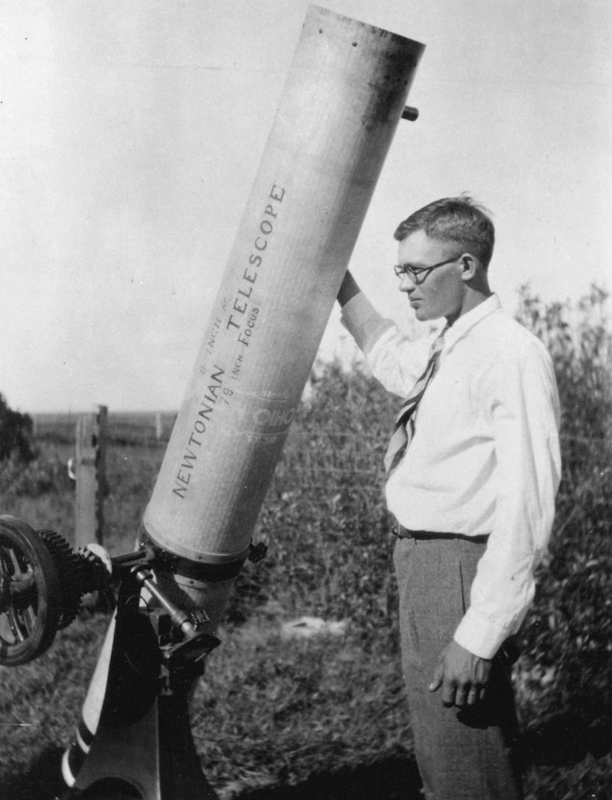
Clyde Tombaugh (1906-1997)

Slide 13
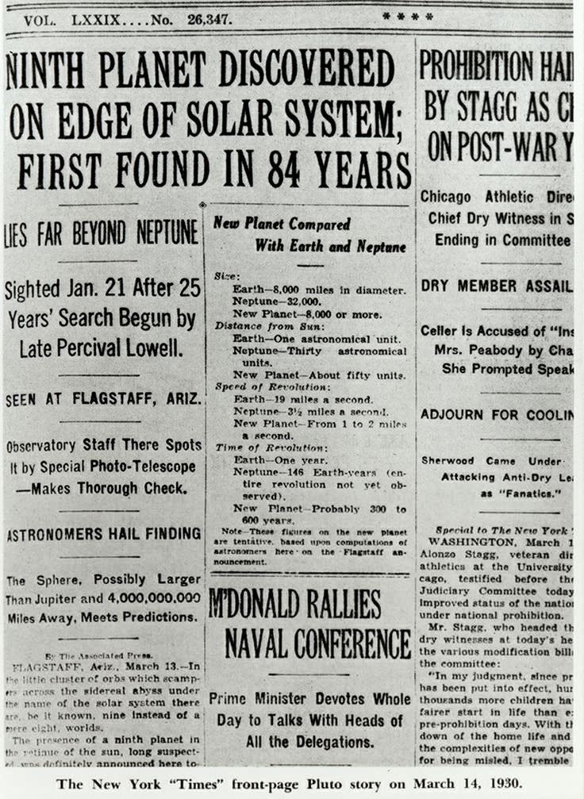

Slide 15
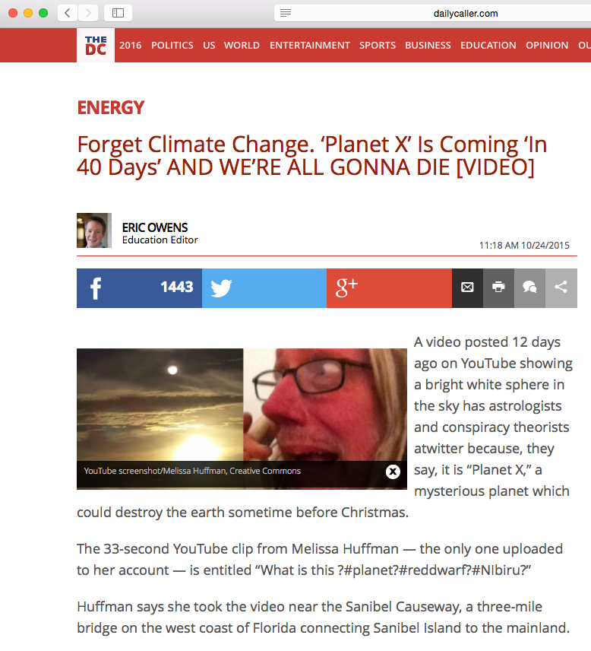

Slide 17
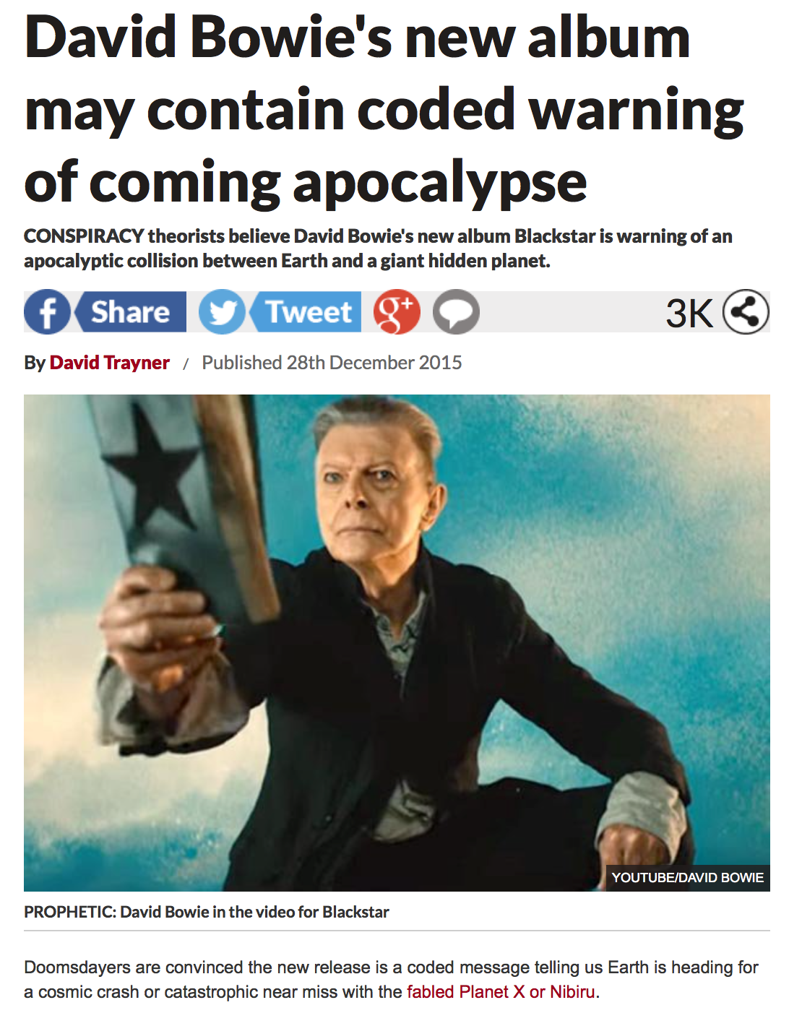

Slide 18
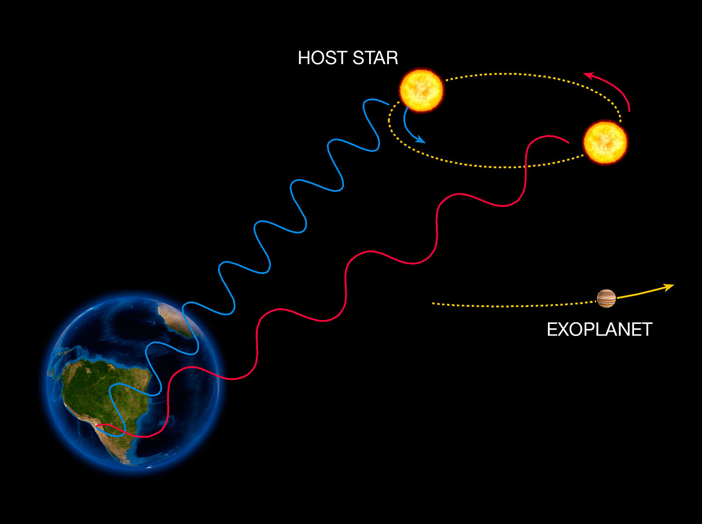

Slide 20
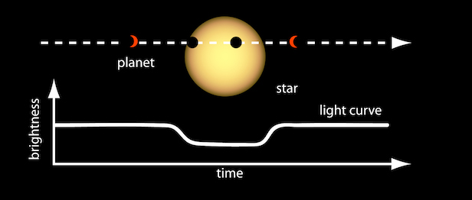

Slide 21
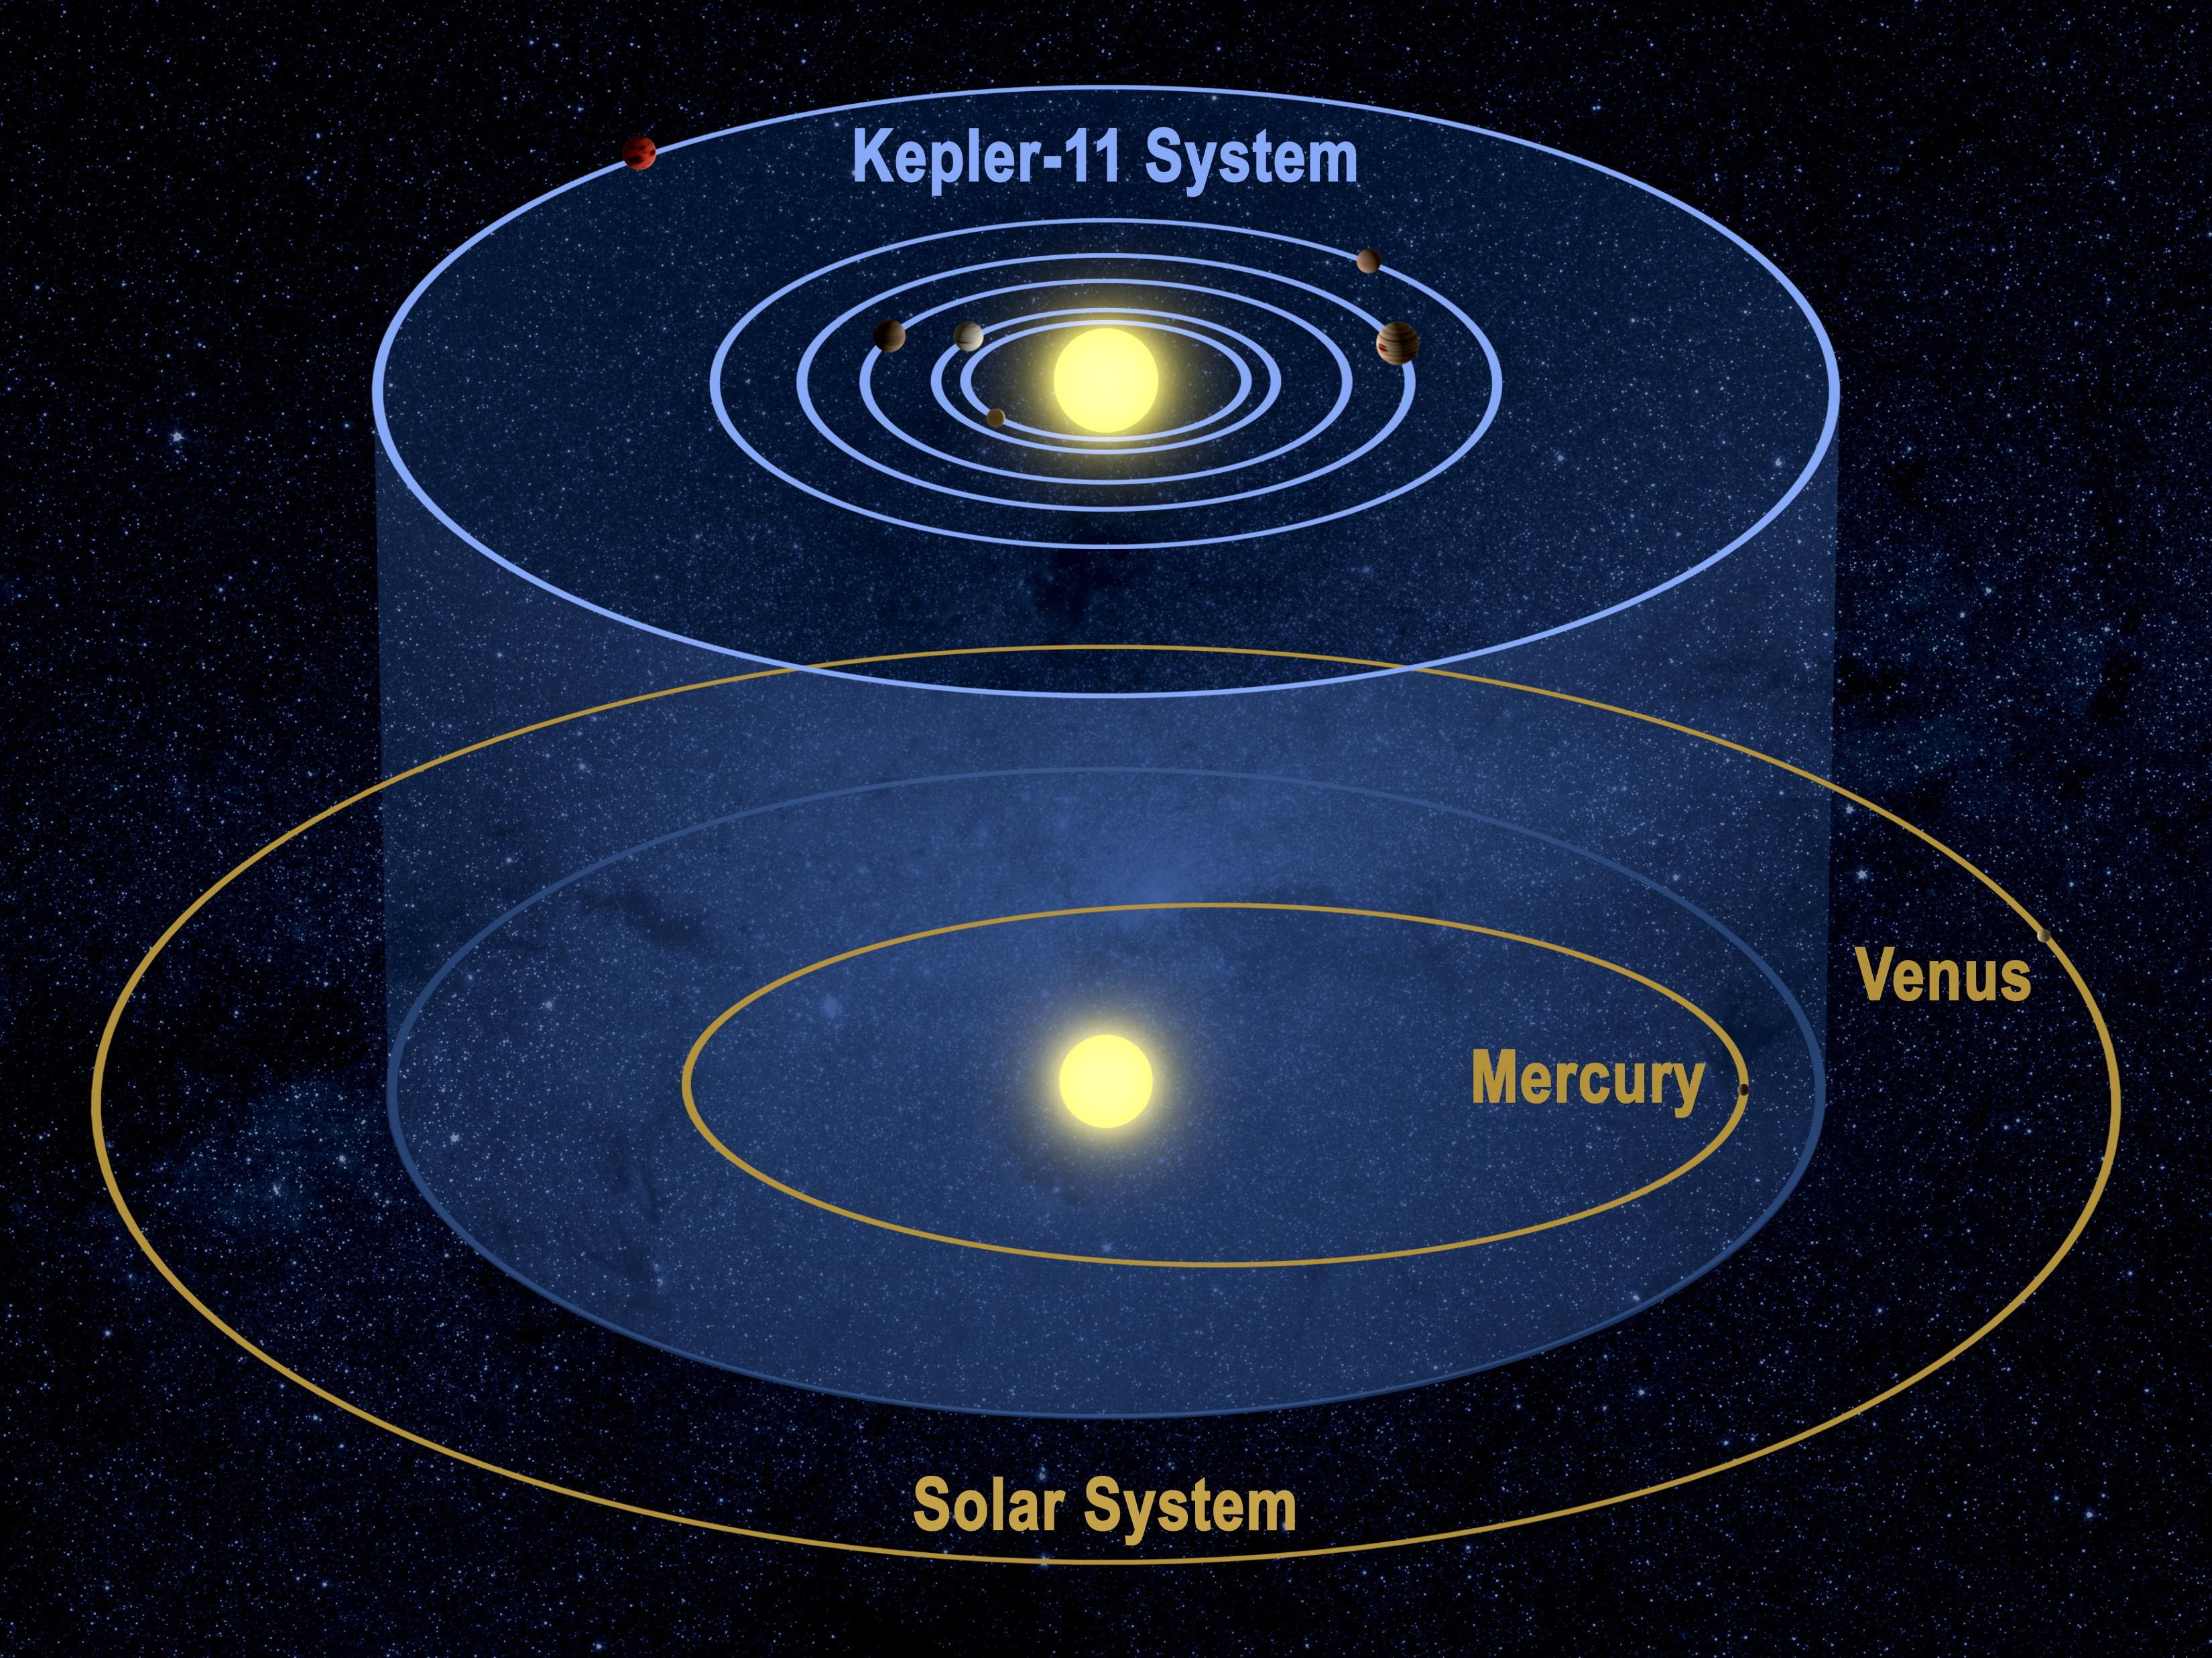

Slide 22
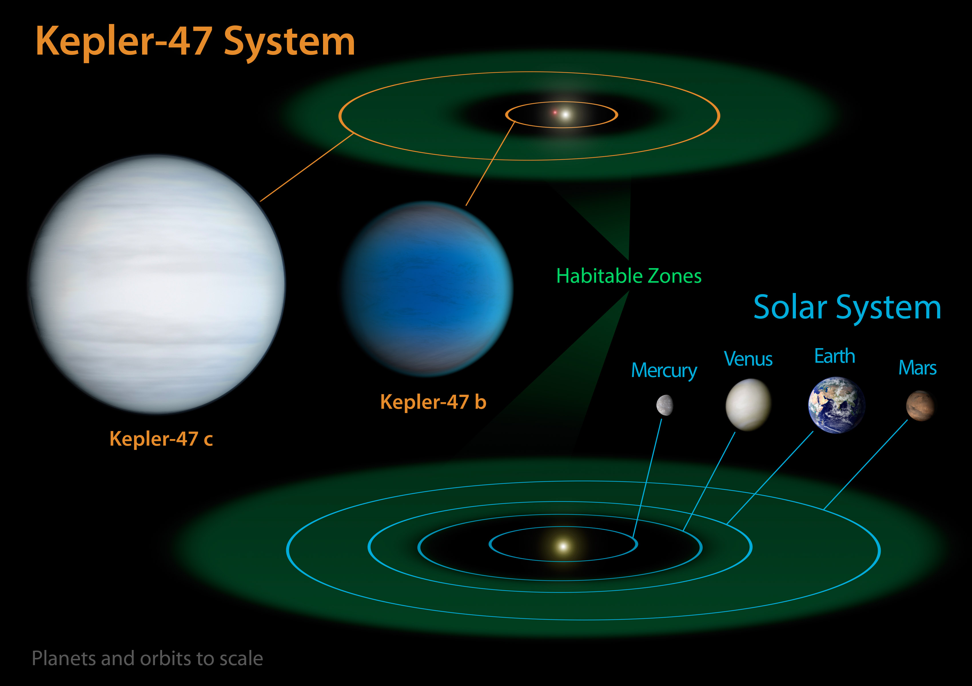

Slide 23
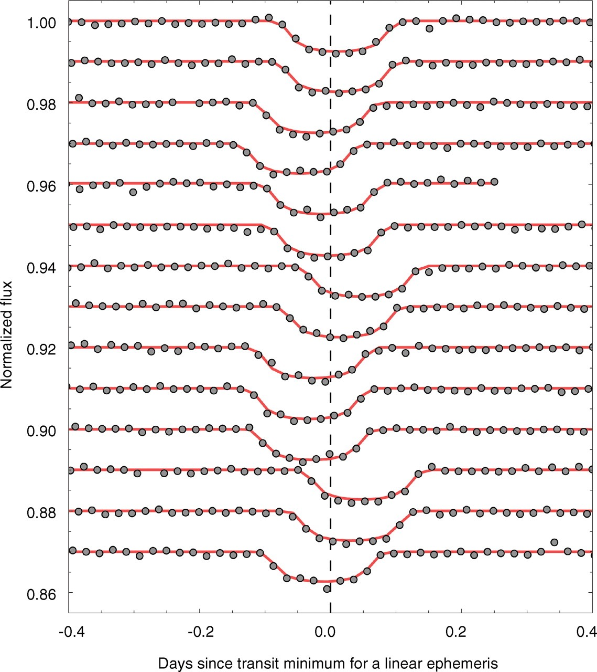
time

Slide 24
Meanwhile in the solar system….

Slide 25
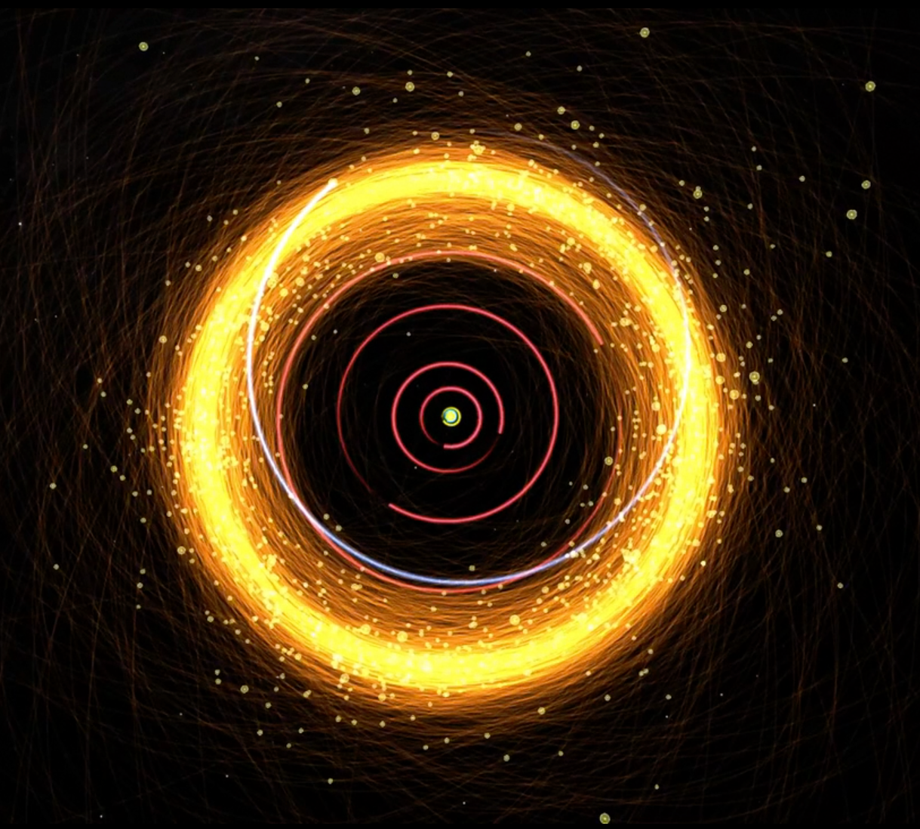

Slide 26
Sedna
(2003 VB12)

Slide 27
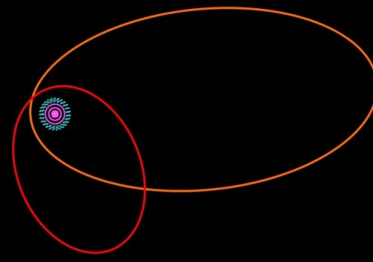
Sedna
(2003 VB12)
Biden
(2012 VP113)

Slide 28
BEYOND ~250 AU

Slide 29
Q
A
observational bias? | objects found by different surveys. same bias applies to other things
small # stats? coincidence? | probability = 0.007%
self gravity? | see Madigan & McCourt (2016)
Kozai? | need one planet per KBO. why same plane?
galactic tides? | too close to J/S/U/N
stellar encounter? | alignment randomizes on geologically short timescales
Gandalf? | maybe…

Slide 30
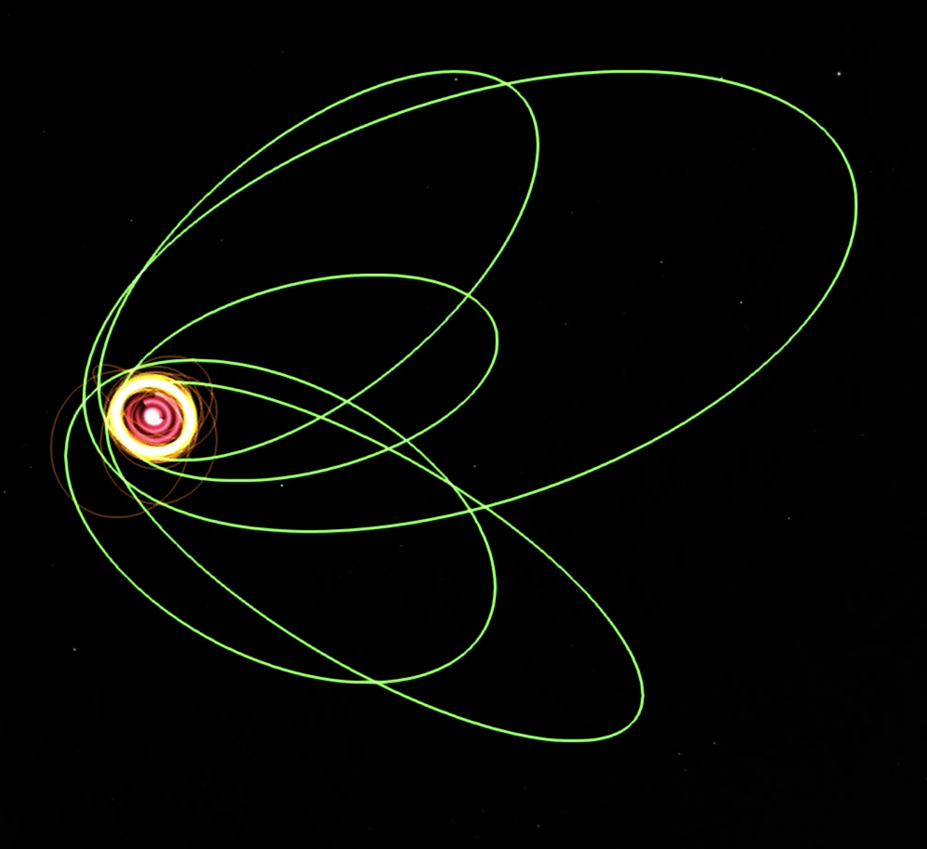

Slide 31
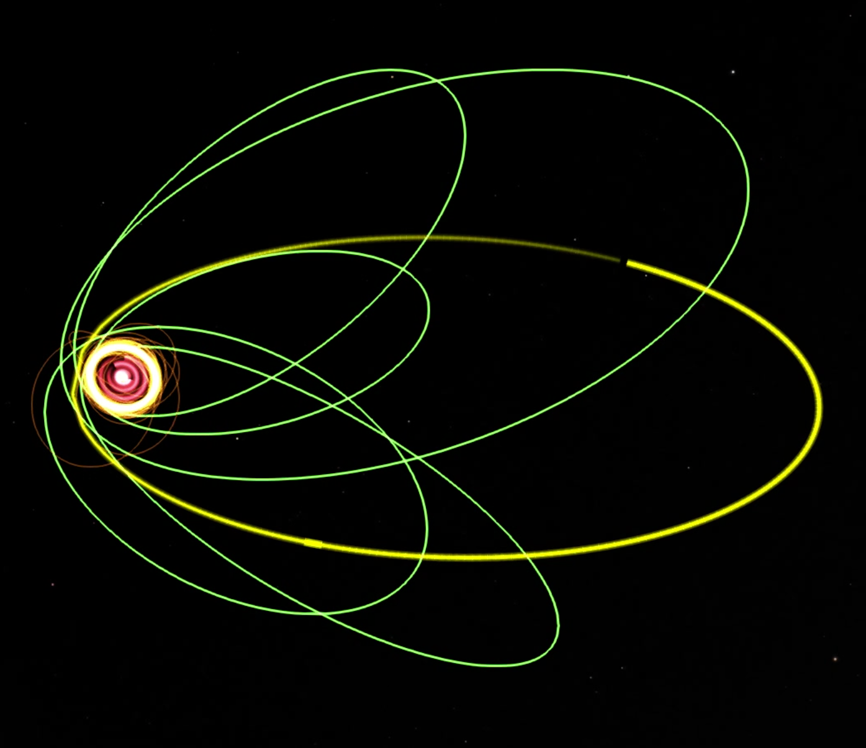

Slide 32
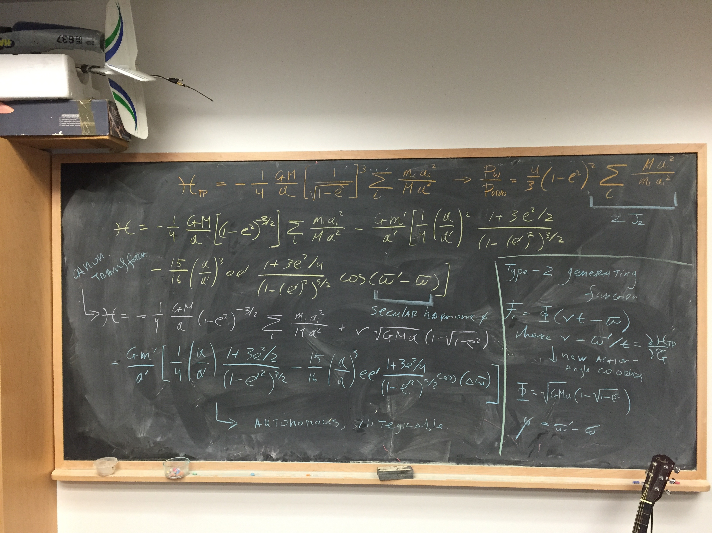

Slide 34
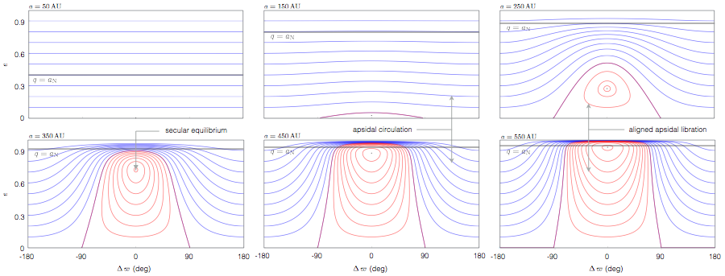

Slide 35
analytical phase-space portraits

Slide 36
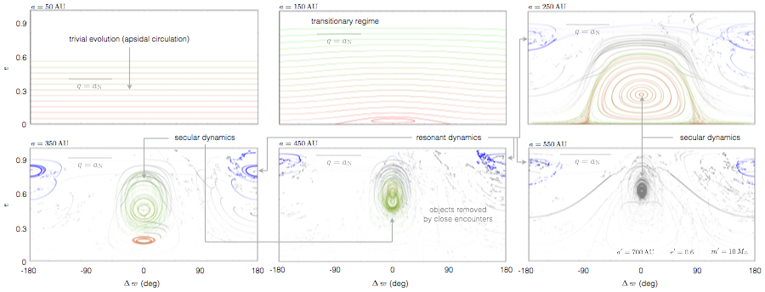
numerical phase-space portraits

Slide 37
???

Slide 38
Planet Nine
confinement in orbital orientation
generation of ‘sedna’ type orbits

Slide 39
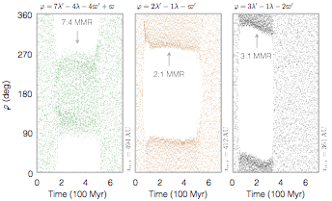
confinement in orbital orientation
generation of ‘sedna’ type orbits
* Physical mechanism behind orbital confinement is resonant interactions. KBOs are stuck on a chaotic web of overlapped resonances and ‘skip’ around in semi-major axis unpredictably.

Slide 40
an inclined P9 orbit leads to confinement
in orbital orientation and the plane

Slide 41
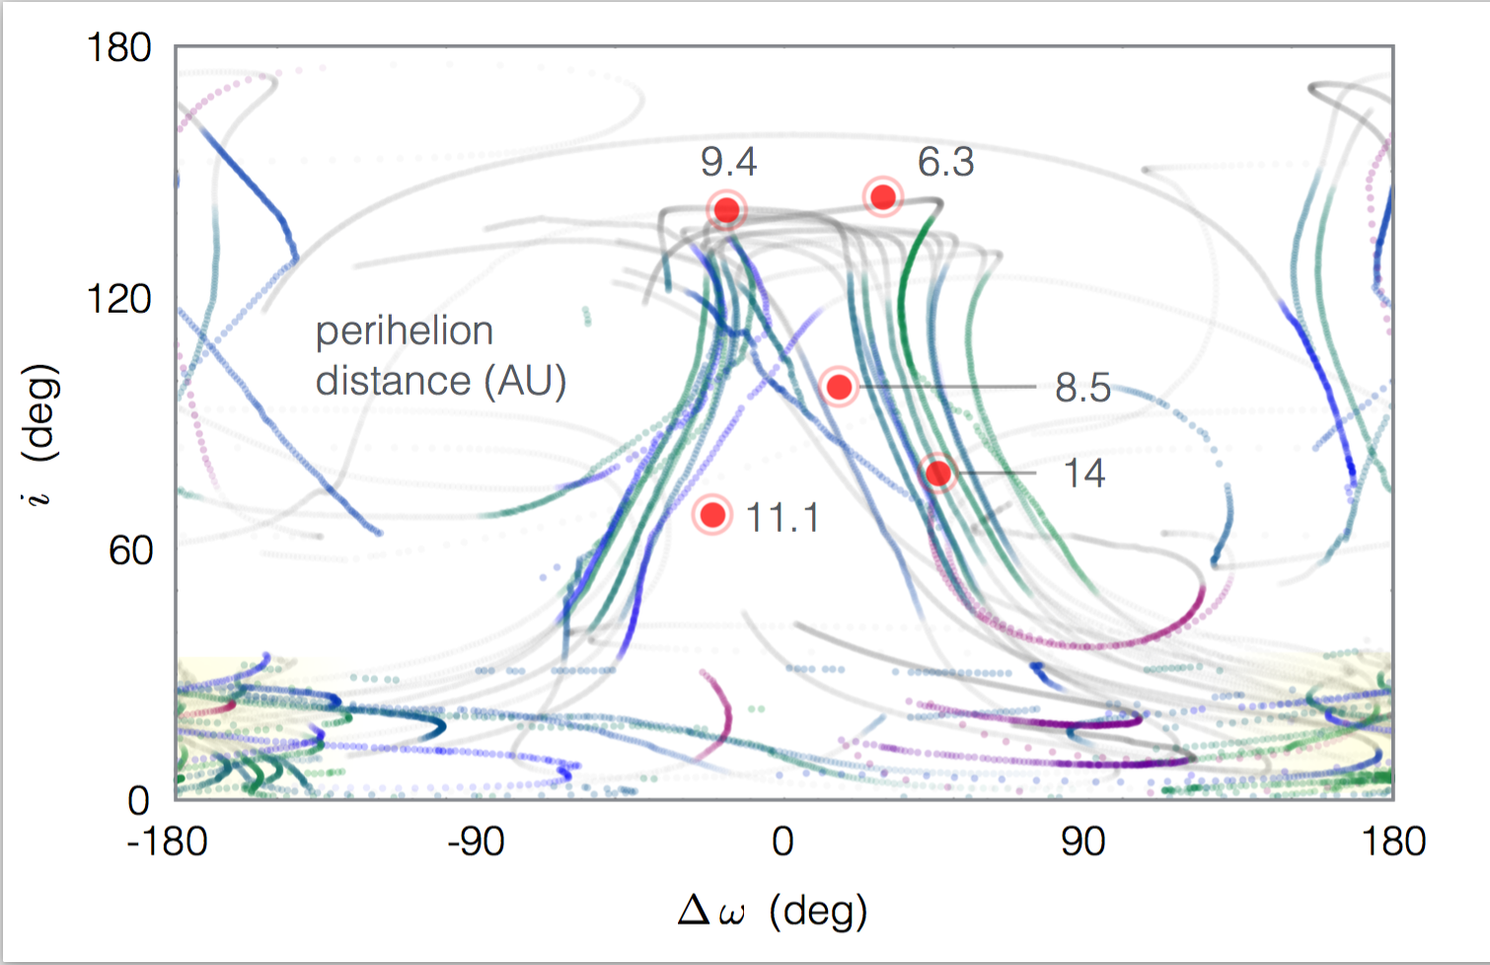

Slide 42
Planet Nine
explains:
alignment of KBO orbits with a > 250AU
‘detached’ Sedna- type orbits
perpendicular orbits
predicts:
~10 MEARTH planet (V~24) at r~1000AU (direct)
population of high-perihelion apsidally aligned KBOs

Slide 44
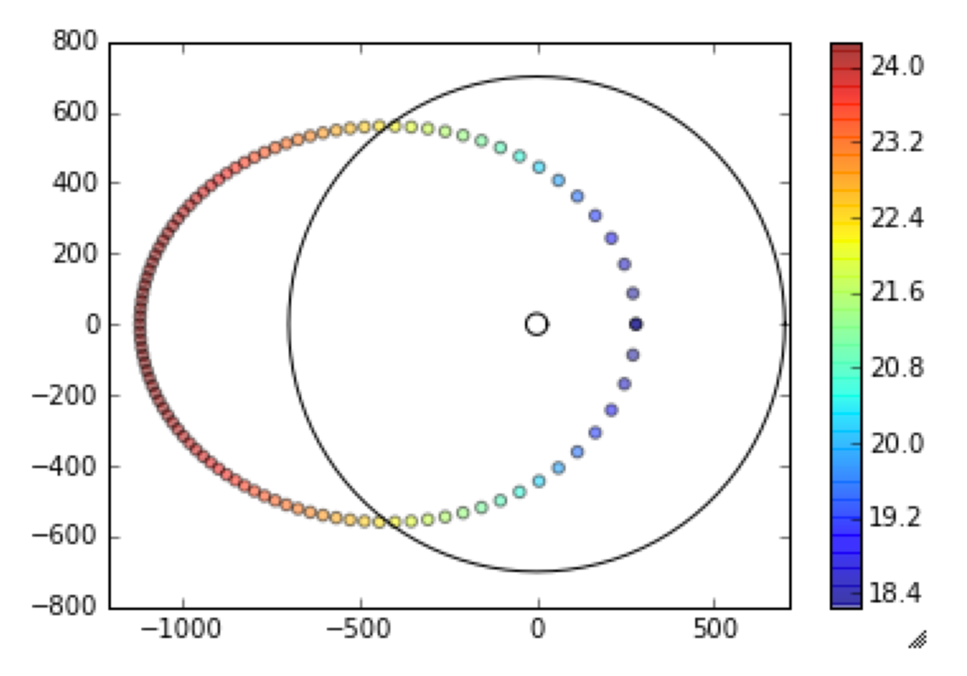
P9

Slide 45
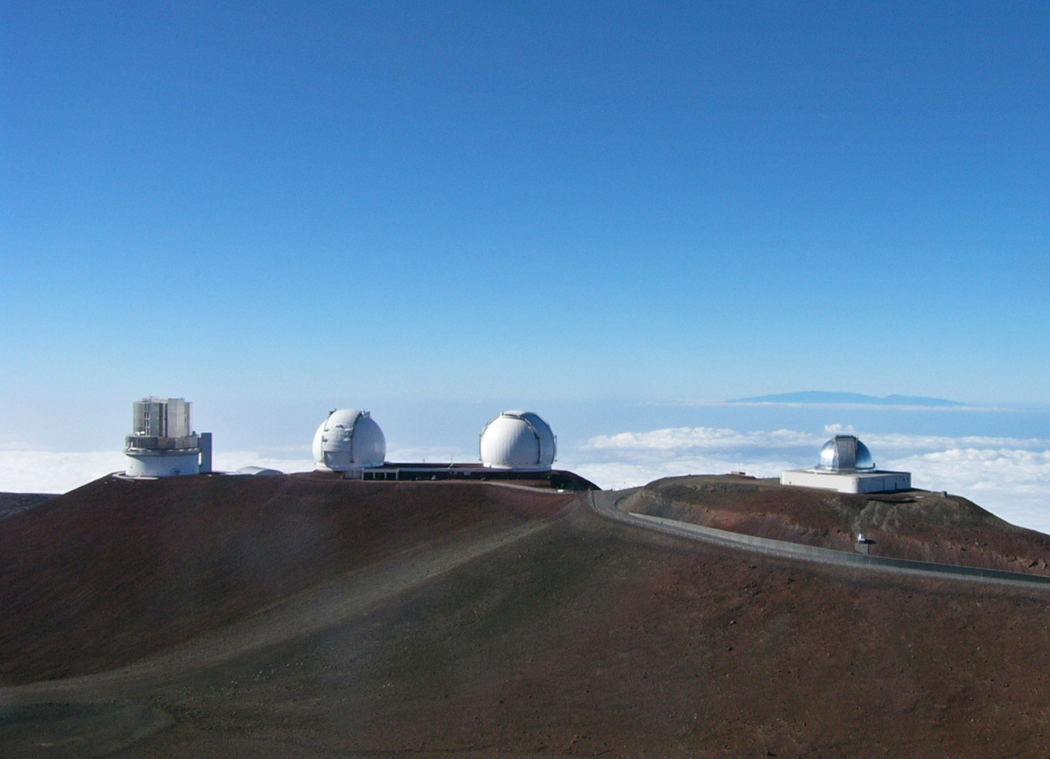

Slide 46
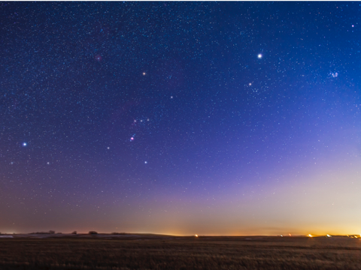

Slide 47
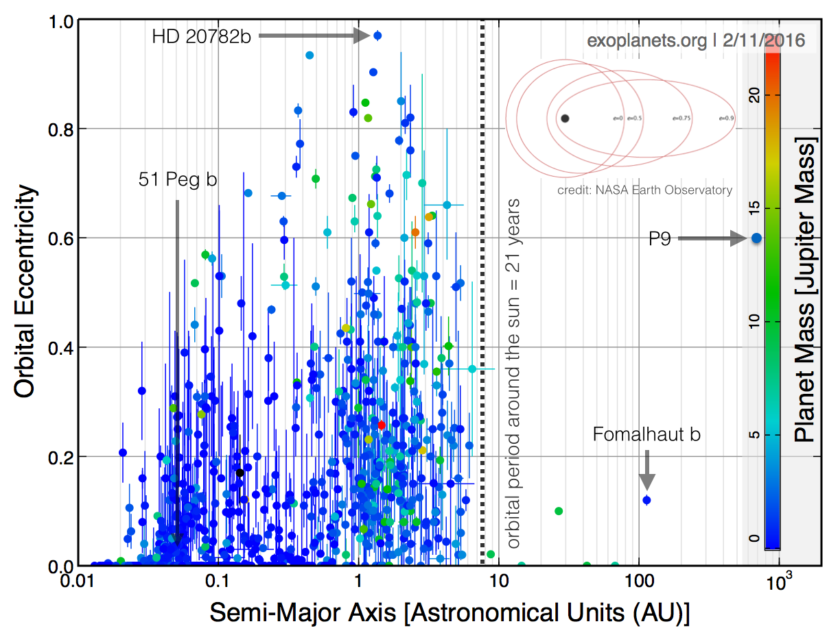

Slide 48
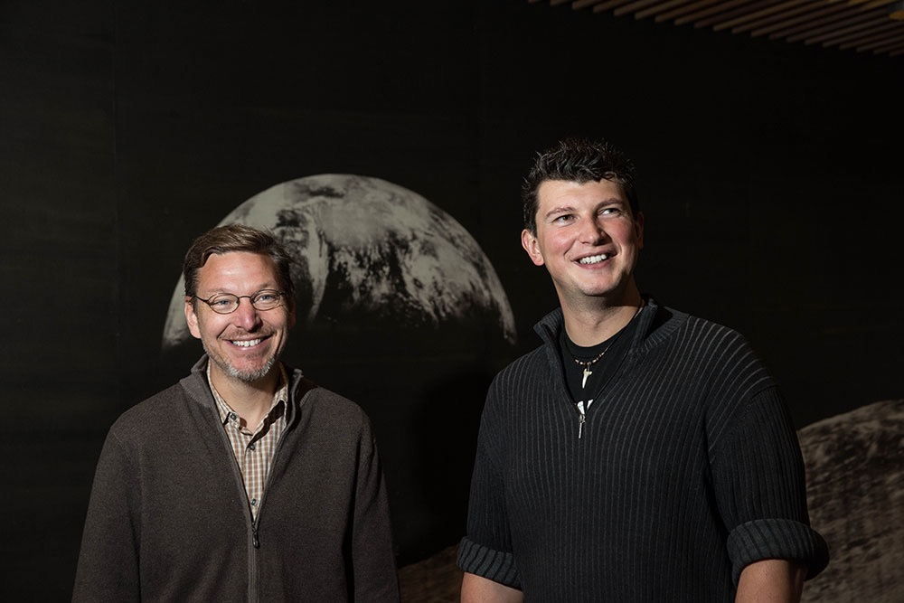
Mike Brown
K. Deck C. Spalding H. Ngo N. Storch P. Buhler E. Bailey

