Slide 1
Beneficial Microbes vs
Harmful Antibiotics
Stanley Maloy
San Diego State University

Slide 2
Overview
Microbiome and human health
Personalized microbiomes
Broad-spectrum antibiotics
Antibiotic resistance
Pipeline of new antibiotics
Precision antibiotics
Notes:
Many antibiotics are made by microbes, bacteria and fungi presumably to protect their own territory

Slide 3
Why now?
Metagenomics:
Feces → Extract DNA → Sequence → Bioinformatics
…ATGC…
Computer
reassembly of data
to infer “who” the
microbes are and
“what” they are
doing
Mixture of
DNA from all
of the microbes
Complex sample
with many different
types of microbes

Slide 4



To be, or not to be: that is the question: Whether 'tis nobler in the mind to suffer the slings and arrows of outrageous fortune, or to take arms against a sea of troubles,
And by opposing end them? To die: to sleep;
No more; and by a sleep to say we end the heart-ache and the thousand natural shocks that flesh is heir to, 'tis a consummation
And bed, he thought. Bed is my friend. Just bed, he thought. Bed will be a great thing. It is easy when you are beaten, he thought. I never knew how easy it was. And what beat you, the thought.
Good is the enemy of great. And that is one of the key reasons why we have so little that becomes great. We don't have great schools, principally because we have good schools. We don't have great government, principally because we have good government. Few people attain great lives, in large part because it is just so easy to settle for a good life

Slide 5
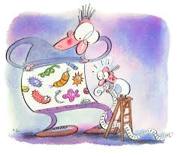
Human Microbiome
We are mostly microbes!
Microbes ≈ human cells [… 10x ???]
10x more viruses than microbes
100x more microbial genes than human genes
Schaechter & Maloy, 2010; Ed Yong, 2016
Notes:
Schaechter & Maloy, Small Things Considered blog = http://schaechter.asmblog.org/schaechter/2010/07/power-of-ten.html
Ed Yong, The Atlantic = http://www.theatlantic.com/science/archive/2016/01/youre-probably-not-mostly-microbes/423228/

Slide 6
Microbiome Communities
Complex:
  Thousands of different types of microbes
  10¹² skin
  10¹⁰ mouth
  10¹⁴ intestine i.e. 100 trillion microbes = highest population density of any environment on earth
Dynamic:
  Varies with age, sex, diet, exercise, nutrition
  Community determined by nutrients, physical conditions, and host cells
Notes:
In contrast to what was thought prior to metagenomic approaches, very few (if any) sites in the human body are sterile – this includes the stomach, lungs, and sinuses.

Slide 7
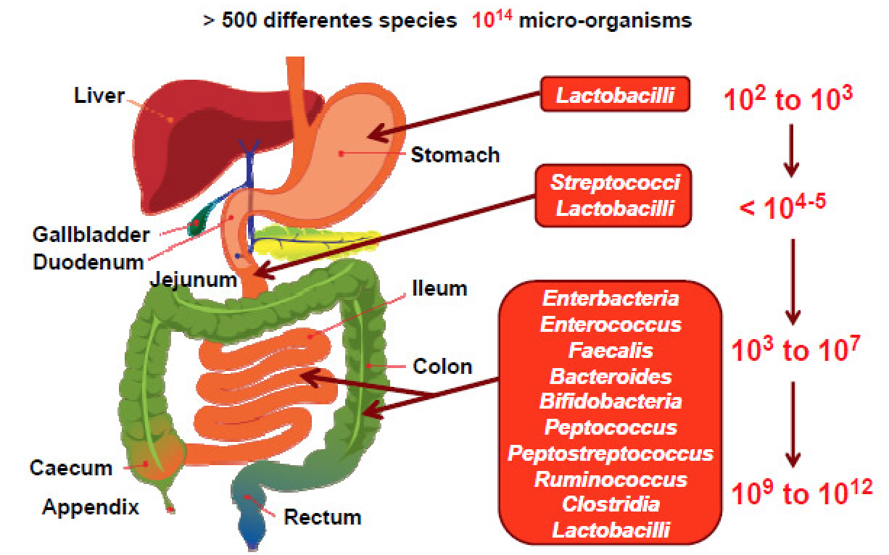
Gut Microbiome
Notes:
Helicobacter pylori first recognized microbe capable of living in the stomach, a site with pH = 2 previously thought inhospitable to life.
For more information on the Nobel Prize for the discovery of Helicobacter pylori as a cause of stomach ulcers, see http://www.nobelprize.org/nobel_prizes/medicine/laureates/2005/press.html

Slide 8
Mutualistic
Host provides stable environment, temperature, nutrients
Microbes:
  Provide vitamins and micronutrients (retinol, riboflavin, folate, biotin, niacin)
  Reduced sensitivity to pathogens
  Promote host development (intestine, immunity, endocrine system, etc) and pathophysiology (asthma, kidney disease, cancer, diabetes, obesity, behavior, etc)
  Influence metabolism (bile) and drug interactions (e.g. Tylenol)
Notes:
Some microbes in the microbiome also produce toxic proteins, short-chain fatty acids, etc that modulate host functions and the microbial community
The microbiome also stimulates development of Peyer’s patches in the host intestine.
Presence of the microbiome early in life stimulates immune recognition that distinguishes the normal microbiome from pathogens.
Bacteroides play important role in degrading complex polysaccharides and host mucosal polysaccharides.
Firmicutes use simpler compounds and produce butyrate that is used by the host; butyrate influences host metabolism, gene expression, and development

Slide 9
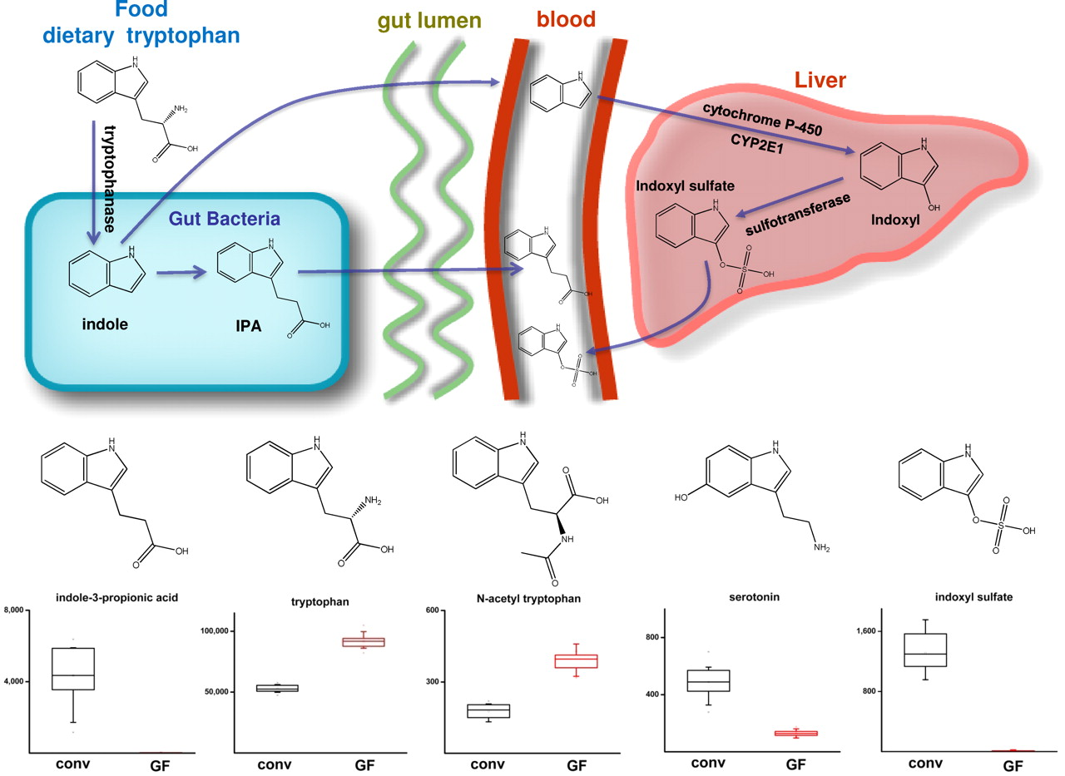
Gut Microbiota and Host Blood Metabolites
William R. Wikoff et al. (2009) PNAS 106:3698-3703
©2009 by National Academy of Sciences
Notes:
The diversity of indole-containing compounds in serum is affected by the microbiome. (Upper) Various indole-containing molecules arise only in the presence of the microbiome and ultimately enter the plasma by means of different routes. (Lower) Differences in the plasma levels of indole-containing compounds attributed to the action of the microbiome. The integrated signal intensities plotted on the y axes are reduced by a factor of 1,000.
Figure from Wikoff et al. 2009. Metabolomics analysis reveals large effects of gut microflora on mammalian blood metabolites. Proc Natl Acad Sci USA 106: 3698-3703.
Also see Nicholson et al. 2012. Host-gut microbiota metabolic interactions. Science 336: 1262-1267.

Slide 10
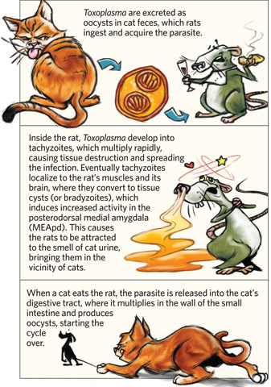
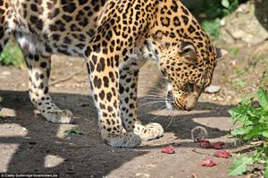
Cats, Rats, and Toxoplasma gondii
Akst 2012; Neidhardt 2009
Notes:
Cartoon from: Akst J. 2012 Animal mind control. The Scientist (http://www.the-scientist.com/?articles.view/articleNo/31536/title/Animal-Mind-Control/)
Leopard and mouse from Fred Neidhardt (2009) Small Things Considered (http://schaechter.asmblog.org/schaechter/2009/11/the-leopard-and-the-mouse-a-microbiologists-take.html)
Also see: http://www.nature.com/news/parasite-makes-mice-lose-fear-of-cats-permanently-1.13777

Slide 11
How do we know?
Comparisons of healthy and ill humans – difficult to distinguish cause vs correlation
Humans with disrupted microbiome due to surgery, severe diarrhea, antibiotics, etc
Germ-free mice vs mice with normal or reconstituted microbiome – allows direct test (but mice are not humans!)
e.g. Salmonella infection:
  Germ free mice LD₅₀ = 10
  Normal mice LD₅₀ = 10⁶
Notes:
Effects of the microbiota on host biology: Germ-free (GF) vs conventionally-raised (CONV-R) rodents (Modified from Bäckhead et al. 2005)
Gut structure and function – GF mice/rats vs normal animals
Enlarged ceca; Accumulation of undegraded polysaccharides that bind water
Villi are thinner
Slower epithelial renewal rates
Slower gut motility
Reduced bile acid deconjugation; Impaired excretion of bile acids
Produce more bile acids; This effect, together with deconjugation defect, results in increased bile acid pools; impact on cholesterol homeostasis
Fewer enteroendocrine cells
Mesenteric microvaculture that is hyporesponsive to norepinephrine and pitressin
Reduced capillary network complexity in their villus mesenchymal cores Potential influence on nutrient absorption and mucosal barrier functions
Cardiac function
Lower cardiac weight
Lower cardiac output
Endocrine system
More insulin sensitive than CONV-R animals
Lower circulating levels of leptin and adiponectin; Associated with reduced fat stores.
Nutrition/metabolism
Vulnerable to vitamin deficiencies The gut microbiota produces vitamin K, B₆, B₁₂, biotin, folic acid, and pantothenate.
Do not extract as much energy from their diet
Lower metabolism (VO₂) Hexose monophosphate shunt and TCA cycle activity reduced.
Absorb more cholesterol
Large bile acid pools
Immune system development
Reduced immunity
B-cells and immunoglobulin secretion; GF mice have 40-1000 fold less serum IgM/IgG and intestinal IgA
Natural immunogobulin
Anti-‘commensal’ IgA The segmented filamentous bacteria (SBF; Clostridia) are stronger inducers of intestinal IgA than other bacteria (including Bacteroidetes)
Intraepithelial Lymphocytes Both γδ and αβ T-cells are significantly decreased in the intraepithelial lymphocyte population of GF mice: γδ>αβ.
T-cells (γδ) Decreased number of mesenteric lymph node γδ T-cells in GF mice.
Mucosal-associated invariant T-cells Invariant Vα19-Jα33 TCR+ cells located in lamina propria, fail to develop in GF mice.
Modulation of Immunity and Disease
Resistant to developing inflammatory bowel disease GF mice with aberrations in T-cell development and function (IL2-/-, bowel disease IL10-/-, TCRα-/-) do not develop spontaneous colitis, unlike their CONV-R counterparts.
Reduced susceptibility to arthritis CONV-R β2-microglobulin-HLA-B27 transgenic rats develop spontaneous colitis and arthritis; B10.BR mice develop enthesopathy. GF counterparts do not.
GF NOD mice have higher rate of autoimmune diabetes
Xenobiotic metabolism
Gut microbiota metabolizes dietary oxalates 50% of GF rats have kidney stones versus 0% for CONV-R. Oxalate-degrading Oxalobacter formigenes reduces kidney stone formation in a rat model (potential probiotic)
Gut microbiota is required for nitro-reduction of xenobiotics; microbiota influence bioavailability of orally administered drugs.

Slide 12
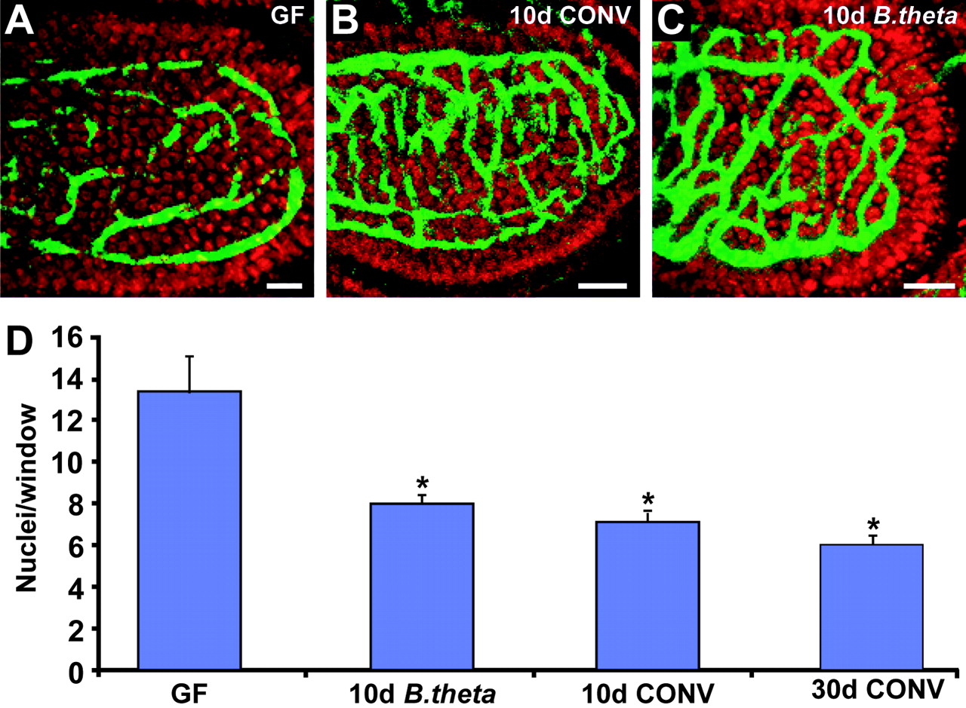
Rapid microbial induction of angiogenesis in small intestinal villi of adult ex-germ-free mice
Thaddeus S. Stappenbeck et al. PNAS 2002;99:15451-15455
©2002 by National Academy of Sciences
Notes:
Development of intestine blood vessels in:
Germ-free mice (GF)
10 days after colonization with normal microbiota (CONV)
10 days after colonization with B. thetaiotamicron
From Stappenbeck TS, Hooper LV, and Gordon JI. 2002. Developmental regulation of intestinal angiogenesis by indigenous microbes via Paneth cells. Proc. Natl. Acad. Sci. USA 99: 15451-15455.

Slide 13
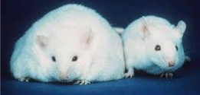
Obesity
Germ free mice lower weight and greater chow consumption ➡︎ microbiome can influence weight gain by modulating energy released to host from food
Human twins and mice:
  Firmicutes > Bacteroidetes = obese
  Bacteroidetes > Firmicutes = thin
Transfer intestinal microbes
from obese mice to thin mice
can confer obesity
Jeff Gordon
Notes:
Figure from http://www.bodyrecomposition.com/wp-content/uploads/2008/08/fatmouse.jpg
Turnbaugh PJ, Gordon JI.2009. The core gut microbiome, energy balance and obesity. J Physiol. 587: 4153-8. doi: 10.1113/jphysiol.2009.174136
Ridaura et al. 2013. Gut microbiota from twins discordant for obesity modulate metabolism in mice. Science 341: 1241214. doi: 10.1126/science.1241214.

Slide 14

Want to know more about your
gut microbiome?
americangut.org
Rob Knight

Slide 15
Microbiome and Personalized Medicine
Can we improve a person’s microbiome?
What happens when we disrupt the microbiome?
Can we restore a disrupted microbiome?
Can we develop better ways to avoid disrupting the microbiome?
Notes:
Ecological principles critical – what happens when you disrupt population / re-establishing normal population? (Lemon K, Armitage G, Relman D, Fischbach M. 2012. Microbial targeted therapies: An ecological perspective. Sci Transl Med. 4: doi: 10.1126/scitranslmed.3004183)

Slide 16
Manipulating the Microbiome
President Obama’s precision medicine initiative (OSTP):
Stabilizing the microbiome via prebiotics and probiotics
Modifying the microbiome to prevent adverse drug reactions
Restoring microbial populations of the microbiome after disruption
Disruption of the microbiome by antibiotics
Jo Handelsman
Notes:
Probiotics = non-pathogenic living microbes that when administered in adequate amounts confer a health benefit on the host. For example:
(a) Yogurt – Lactobacillus acidophilis, L. rhamnosus, L. casei, and L. johnsonii, Bifidobacter lactis, etc; ACTIVIA Bifidus regularus; beneficial but transient effects
(b) E. coli Nissle 1917 – aka Mutaflor; Isolated from healthy soldier during outbreak of Shigella during WWI, clinical trials indicate protection against variety of enteric pathogens (Maltby et al. 2013.
Nutritional basis for colonization resistance by human commensal E. coli strains HS and Nissle 1917 against E. coli O157:H7 in the mouse intestine. PLoS One. 8: e53957. doi: 10.1371/journal.pone.0053957.)

Slide 17
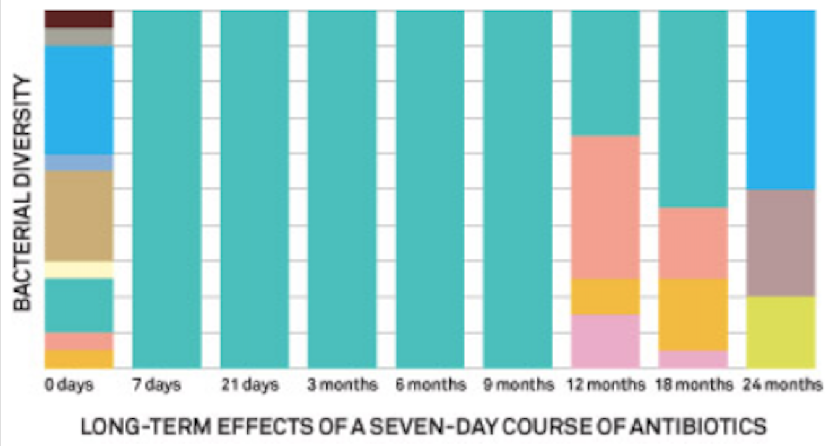
Antibiotics can Disrupt the Microbiome
Clindamycin treatment for one week
Reduced microbiome to single antibiotic resistant strain of Bacteriodes
Original microbiome diversity not recovered in 2 years following treatment
Notes:
From Jansson 2010. http://www.wired.com/magazine/2011/09/mf_microbiome
Broad spectrum antibiotics don’t discriminate between pathogens and the microbiome. This figure shows diversity of Bacteroides in the microbiome of a patient who took a weeklong course of the antibiotic clindamycin. Different colors represent different types of Bacteroides. For 9 months after exposure the only strain present was a single clindamycin-resistant strain of B. thetaiotaomicron. Within two years the microbiome had not regained the original diversity.

Slide 18
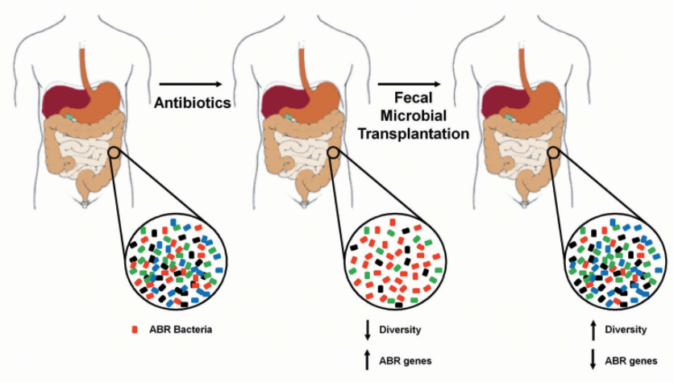
Restoring the Microbiome via Fecal Therapy
(ABR = Antibiotic Resistance)
Notes:
For an interesting story about fecal transplants, see “The Excrement Experiment” by Emily Eakin in the New Yorker (http://www.newyorker.com/magazine/2014/12/01/excrement-experiment)
Fecal transplants (Kelly CP. 2013. Fecal microbiota transplantation--an old therapy comes of age. N Engl J Med. 368:474-5. doi: 10.1056/NEJMe1214816)
Fecal transplantation for C. difficile in 1958 in Denver – feces enema to treat life threatening pseudomembranous enterocolitis → Immediate and dramatic response of patient
Recent randomized clinical trials (van Nood et al. 2013) 81% response rate of patients to fecal transplantation therapy with low reoccurrence; much more affective than antibiotics

Slide 19
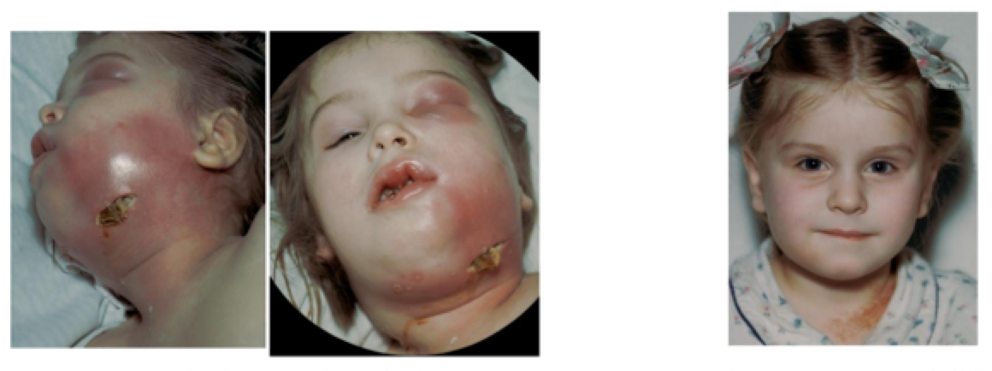
Broad Spectrum Antibiotics
“The miracle of penicillin” (1942)
Four yr old girl, sudden infection
Swelling made it difficult to swallow or breath
Penicillin treatment started
9 days later
Antibiotics have saved millions of lives,
allowed surgery, chemotherapy, etc
Notes:
Sulfa drugs 1935
Penicillin discovered 1928, first patient 1941 (policeman with severe face infection, ran out of penicillin and he died), 10 patients received full course of treatment in 1942, available for general public in 1945

Slide 20
Problems with Current Antibiotics
Broad spectrum:
Cross-resistance within class
Disruption of normal microbiota of host
- promotes antibiotic^{R} pathogens
- allows establishment of harmful microbes
Selection for transfer of resistance between bacteria in nature
Limited targets that are common between bacteria, but do not impact eukaryotic cells

Slide 21
Notes:
Note importance of host immune system

Slide 22
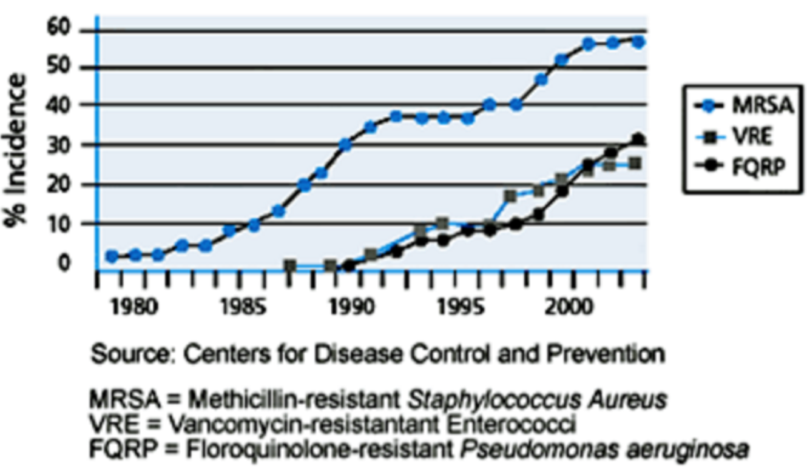
Antibiotic^{R} Spreads Rapidly

Slide 23
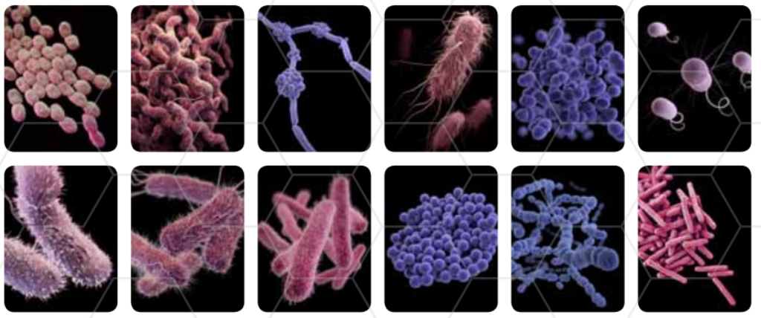
“Superbugs”
XDR Tuberculosis
MDR Acinetobacter
MRSA Staphylococcus
MDR Gonorrhea
Van^{R} Enterococcus
Carbapenem^{R} E. coli
ESBL Entrobacteriacae
MDR Salmonella
MDR Pseudomonas
Clostridium difficile
Notes:
http://www.cdc.gov/drugresistance/pdf/ar-threats-2013-508.pdf

Slide 24
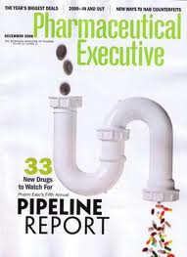
What about new antibiotics?
Return on investment:
Cost of R&D
Regulations
Limited treatment
Limited lifetime

Slide 25
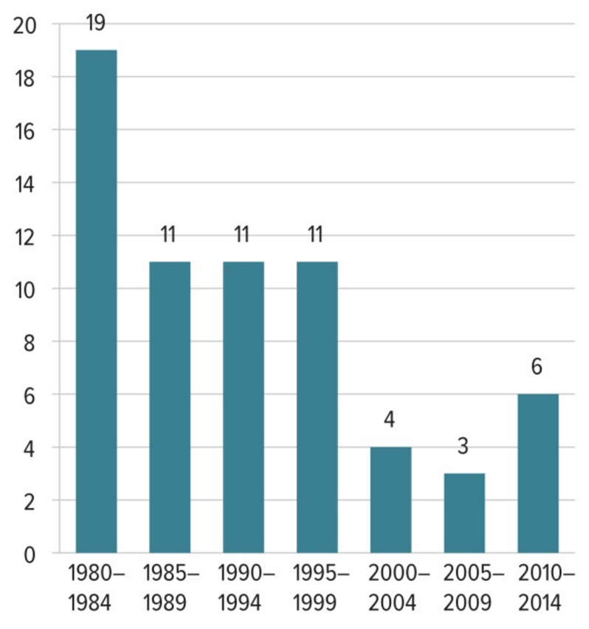

New drug application approvals (NDA)
for antibacterials (US FDA)
Number

Slide 26
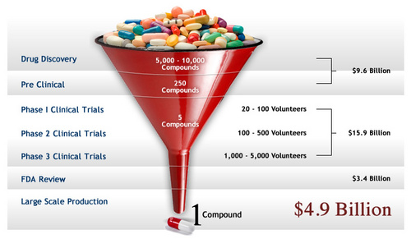
Typically takes 10-15 years before a
new antibiotic is on the market

Slide 27
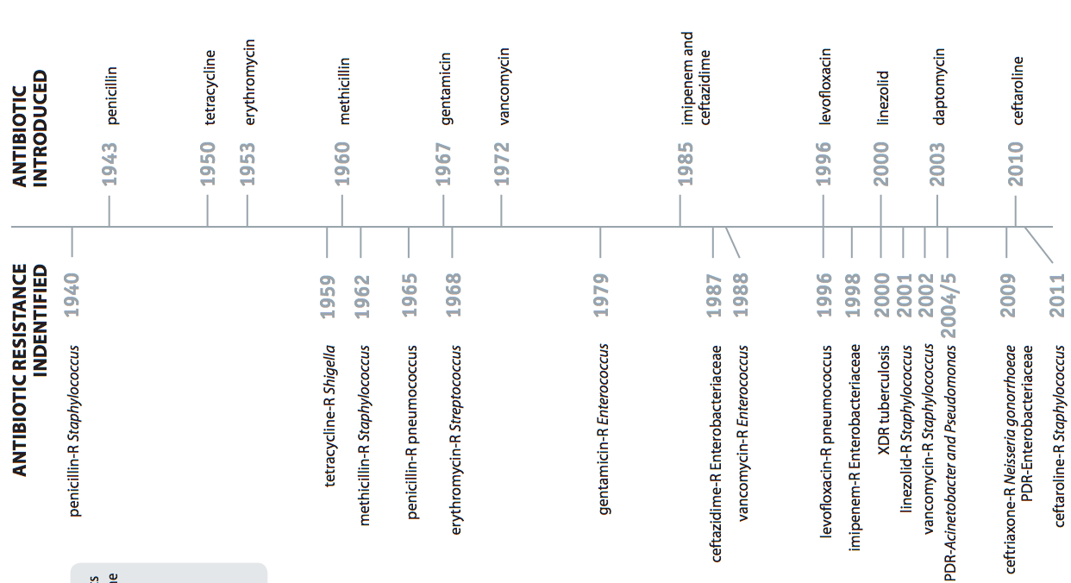
Antibiotic introduced
2008
daptomycin-R Enterococci
Antibiotic^{R} observed

Slide 29
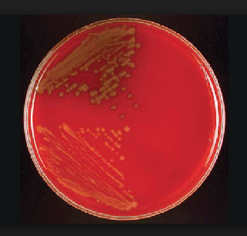
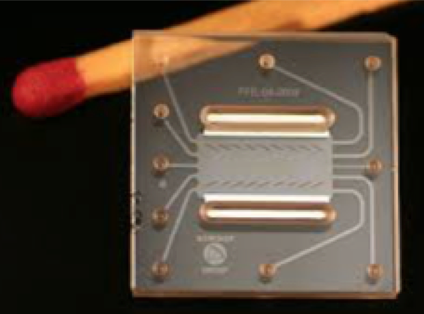
Problem = Need to identify the cause of infection very quickly!
24-72 hours
< 1 Minute
New approaches provide rapid, accurate diagnostics

Slide 30
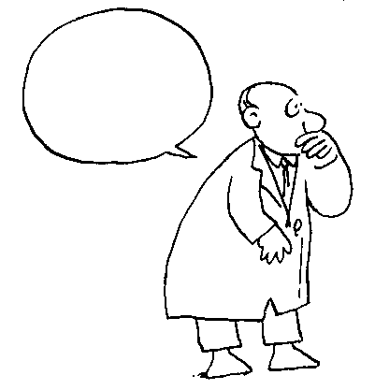
Can We Design Effective
Narrow Spectrum Antimicrobials?
Phage therapy (Aerosmith)
Bacteriocins
Genome-based approaches
?
Notes:
R Young and JJ Gill 2015. Phage therapy redux – What is to be done? Science 350: 1163-1164.

Slide 31
Precision Antimicrobials
Design = Narrow spectrum, genome-directed
Specific for particular pathogens
Targets identified via comparative genomics
Targets absent in microbiome sequences
Inhibitory oligonucleotides and peptides
Delivery = nanoengineered virus-like particles
Efficient loading in vitro
Effective delivery of antibiotic into bacteria
Potential for oral treatment
Notes:
Exceptional, Unconventional Research for Knowledge Acceleration
Jakobsson,

Slide 32
Eureka: Antisense RNA
…
…
DNA
…
…
mRNA
Protein
Synthesis
Antisense
RNA
ON
OFF
Maloy, Jakobsson, Brinker

Slide 33
Step 1: Identify specific targets
Narrow spectrum, genome-directed antibiotics:
Targets specific for particular pathogens
First step = comparative genomics
Subtract
targets
present in
human &
microbiome
databases
Identify
sequences
unique to
bacterial
pathogen
Identify
potential
inhibitory
antisense
oligonucleotides
Jakobsson

Slide 34
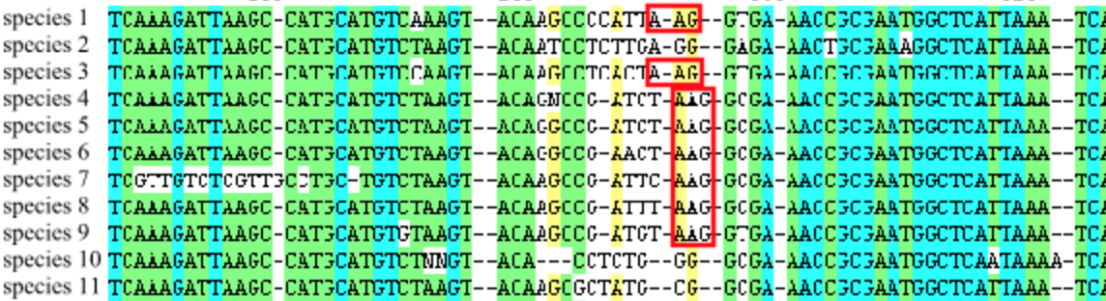
Comparative Genomics
Identify DNA sequences that are unique to a particular pathogen, but are absent in the rest of the human microbiome and in the human genome
Among these unique DNA sequences, predict those where antisense sequences are likely to inhibit important functions in the pathogen

Slide 35
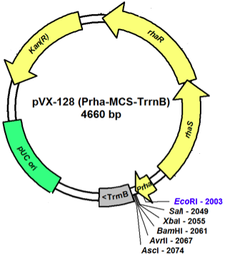

Step 2: Produce and Test
Narrow spectrum, genome-directed antibiotics:
Test inhibition by antisense sequences
Express antisense
oligonucleotide
Monitor growth
“on”
“off”
Casas & Maloy

Slide 36
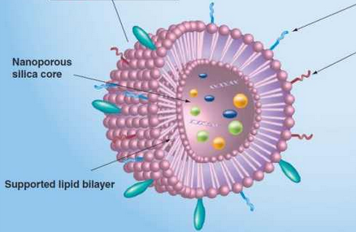
Step 3: Delivery
Nanoengineered virus-like particles
Efficiently load peptide or oligonucleotide in vitro
Effective delivery of contents to host
Can be delivered orally
Brinker
Notes:
OTHER APPROACHES:
Avidbiotics = R-bacteriocins
Teixobactin = lipid binding small molecule

Slide 37
Step 4: When resistance occurs, rapidly identify new targets
Identify effective targets
Expression of new inhibitor
Test effectiveness in vivo
Evolution of resistance

Slide 38
Take-Home Points
Microbiome influences many aspects of human health and disease
Protects against pathogens by occupying niche (e.g. Clostridium difficile)
Stimulates host immune response (innate and acquired)
Promotes development (gut vasculature)
Produces essential host metabolites
Converts certain nutrients to toxic compounds

Slide 39
Take-Home Points (con’t)
Disruption of microbiome can result in chronic (metabolic syndrome) or acute diseases (C. diff)
Broad-spectrum antibiotics promote resistance and disrupt the microbiome
New precision antibiotics can designed to overcome these challenges
“New truths become evident when new tools
become available”
Rosalyn Yalow (Nobel Prize, 1977)
Notes:
Development of radioimmunoassays

Slide 40
