Slide 1
Happy Thanksgiving!

Slide 2
Agenda for 11/23/16
Reminder: please turn off or mute cell phones
Announcements and Introductions
Pete’s Lynx
Upcoming Scheduled Talks
“Beneficial Microbes and Harmful Antibiotics”, Professor Stanley Maloy

Slide 3
Upcoming Talks
SUBJECT TO CHANGE
This information is also on the website under
“Upcoming Talks”
Date | Speaker | Topic
11/23/16 | Stanley Maloy Dean of Sciences, SDSU and Past President of the American Society for Microbiology | The Human Microbiome and Human Health Considerations
1/11/17 | Richard Moore UCSD/SDSC Deputy Director (recently retired) | Supercomputing and the San Diego Supercomputer Center – Looking Back, Looking Ahead
2/15/17 | Keith Wahl Facial plastic surgeon, artist, and founder of Wahl2Wahl Glass Designs (http://www.wahl2wahl.com) | The Science and Art of Glass

Slide 4
Upcoming Talks
SUBJECT TO CHANGE
This information is also on the website under
“Upcoming Talks”
Date | Speaker | Topic
3/29/17 | Tom Soifer Former Chair of the Physics, Math, and Astronomy Division (PMA), Caltech | IR Astronomy: The Connections between Caltech, Palomar, IRAS, and Spitzer
5/10/17 | Ray Ashley President and CEO of the San Diego Maritime Museum | TBA
6/21/17 | Barbara Durrant Henshaw Endowed Director of Reproductive Physiology, San Diego Zoo Global | San Diego Zoo’s Frozen Zoo®

Slide 5
Southwestern Yacht Club, San Diego
Pete’s nuclear powered submarine

Slide 6
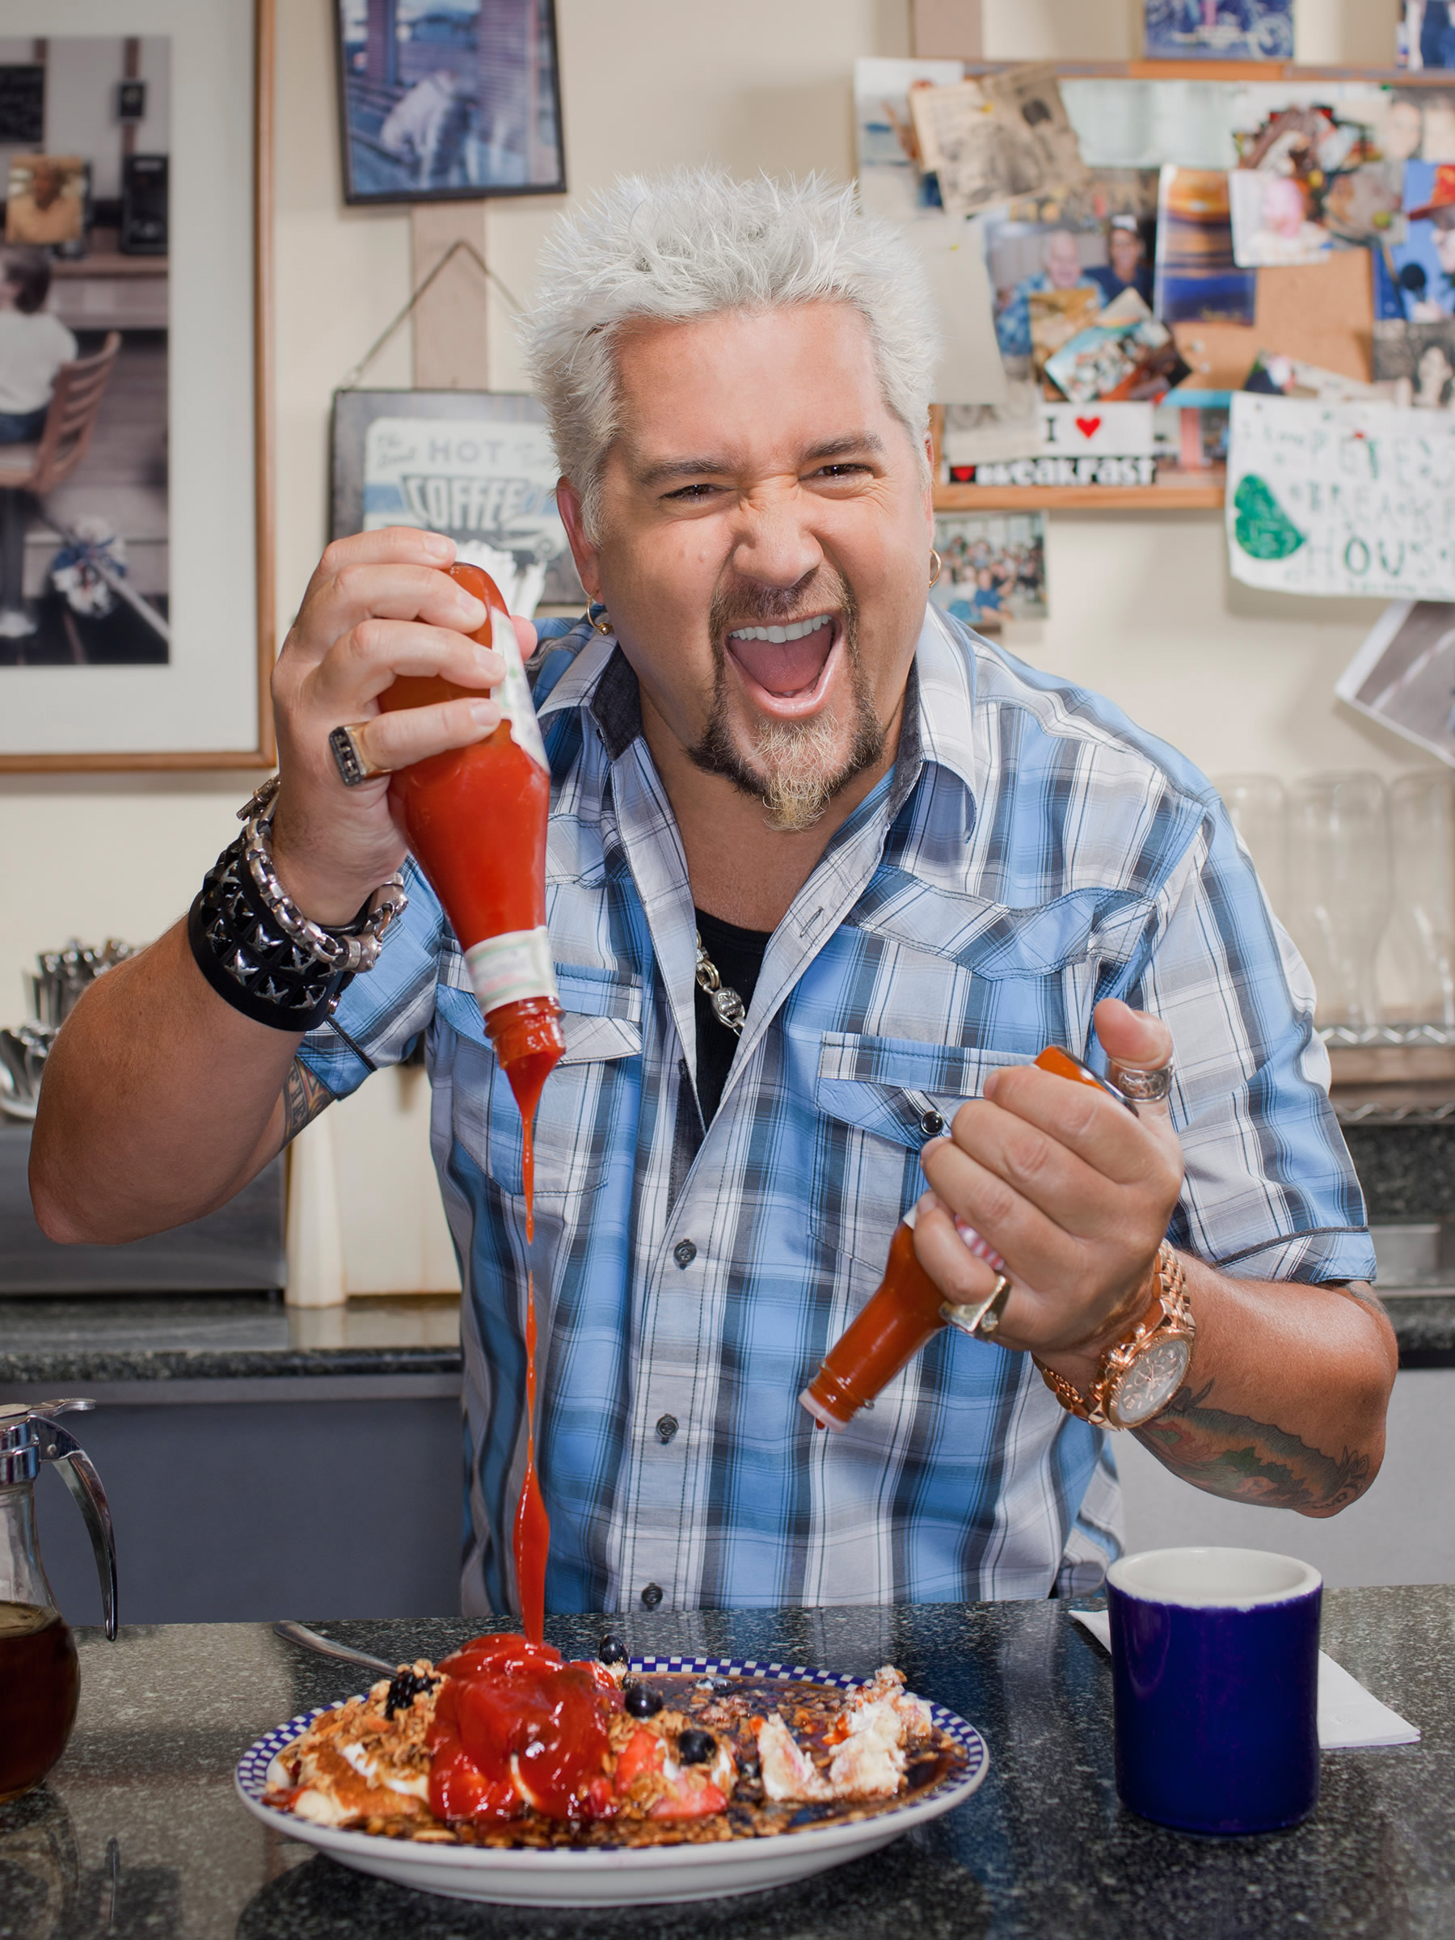
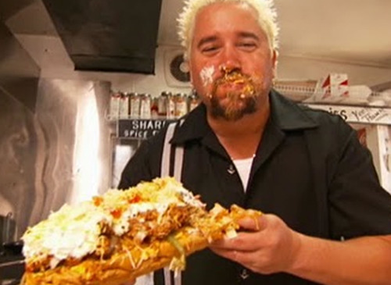
Guy Fieri

Slide 7
Guy Fieri Initiates Bacterial Microbe Coating Process

Slide 8
Bacterial Microbe Coating System

Slide 9
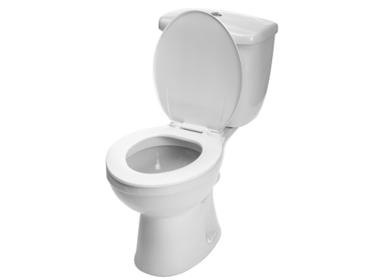
Coin Extraction and Rinsing Station

Slide 10
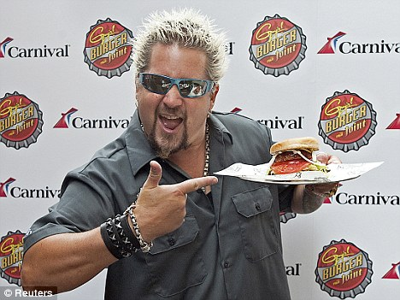
Process Complete!

Slide 11
Happy Thanksgiving!

