Slide 1
ANTHROPOGENIC GLOBAL WARMING
UNSETTLED SCIENCE
Presented to the Lyncean Group 24 February 2010
by
Hugh Kendrick

Slide 2
OUTLINE
GREENHOUSE GAS PHYSICS
TEMPERATURE RECORDS
TEMPERATURE PREDICTIONS
CO2 RECORDS
WEATHER TRENDS
REFERENCES

Slide 3
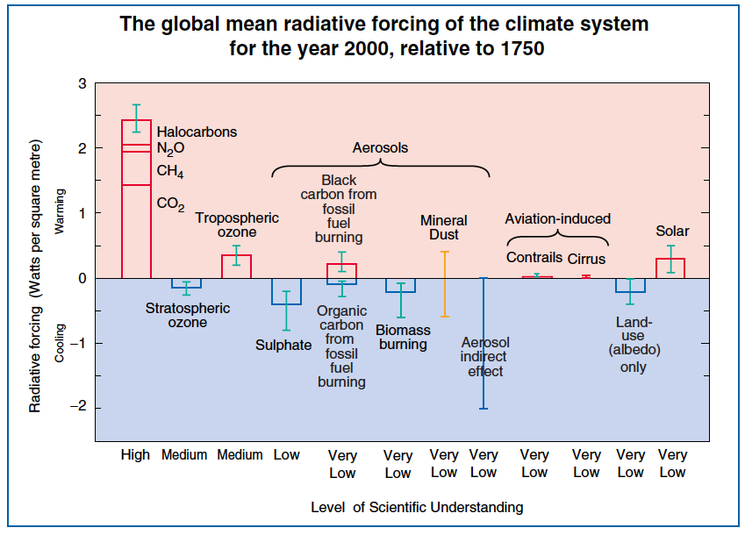
Source:Summary for Policymakers of the 2001 UN IPCC report. See http://www.ipcc.ch/pdf/climate-changes-2001/scientific-basis/scientific-spm-en.pdf
Notes:
These radiative forcings arise from changes in the atmospheric composition, alteration of surface reflectance by land use, and variation in the output of the sun. Except for solar variation, some form of human activity is linked to each. The rectangular bars represent estimates of the contributions of these forcings − some of which yield warming, and some cooling. Forcing due to episodic volcanic events, which lead to a negative forcing lasting only for a few years, is not shown. The indirect effect of aerosols shown is their effect on the size and number of cloud droplets. A second indirect effect of aerosols on clouds, namely their effect on cloud lifetime, which would also lead to a negative forcing, is not shown. Effects of aviation on greenhouse gases are included in the individual bars. The vertical line about the rectangular bars indicates a range of estimates, guided by the spread in the published values of the forcings and physical understanding. Some of the forcings possess a much greater degree of certainty than others. A vertical line without a rectangular bar denotes a forcing for which no best estimate can be given owing to large uncertainties. The overall level of scientific understanding for each forcing varies considerably, as noted. Some of the radiative forcing agents are well mixed over the globe, such as CO2, thereby perturbing the global heat balance. Others represent perturbations with stronger regional signatures because of their spatial distribution, such as aerosols. For this and other reasons, a simple sum of the positive and negative bars cannot be expected to yield the net effect
on the climate system.

Slide 4
GREENHOUSE GAS PHYSICS

Slide 5
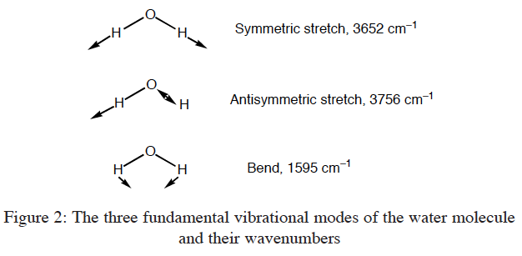
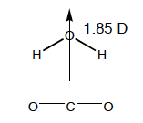
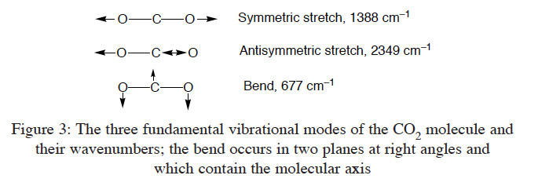
Source: Jack Barrett, Energy & Environment · Vol. 16, No. 6, 2005

Slide 6
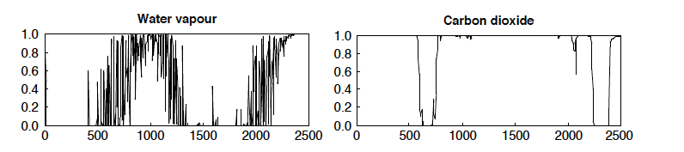
HITRAN database Contains parameters for about 2.8 million spectra of 39 molecules
Source: Jack Barrett, Energy & Environment · Vol. 16, No. 6, 2005

Slide 7
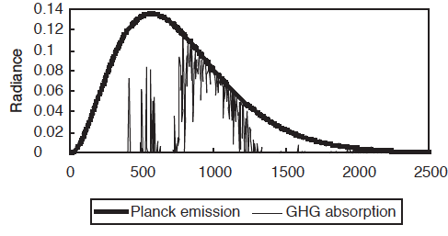
RADIANCE OF EARTH’S SURFACE and GHG ABSORPTION
Earth’s surface radiance at 288 K. Radiance in watts/sq.m/cm-1/steradian.
Source: Jack Barrett, Energy & Environment · Vol. 16, No. 6, 2005

Slide 8
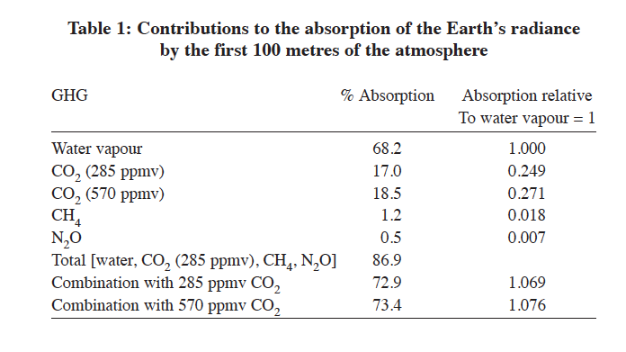
Source: Jack Barrett, Energy & Environment · Vol. 16, No. 6, 2005
Notes:
Source: Jack Barrett, Energy & Environment · Vol. 16, No. 6, 2005

Slide 9
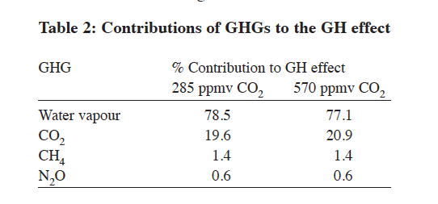
Source: Jack Barrett, Energy & Environment · Vol. 16, No. 6, 2005
Notes:
Source: Jack Barrett, Energy & Environment · Vol. 16, No. 6, 2005

Slide 10
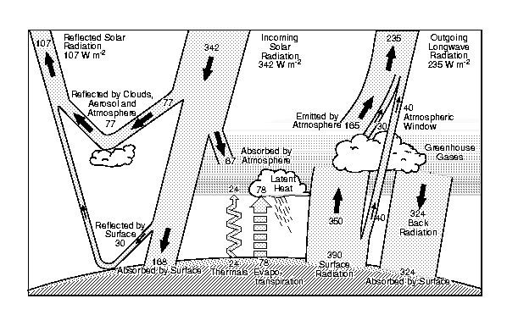
Earth’s Annual Global Mean Energy Budget
Source: J.T.Kiehl and K.E.Trenberth, Bull.Am.Met.Soc., 78, 197 (1997)

Slide 11
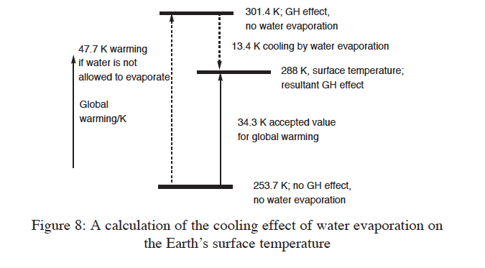
Source: Jack Barrett, Energy & Environment · Vol. 16, No. 6, 2005

Slide 12
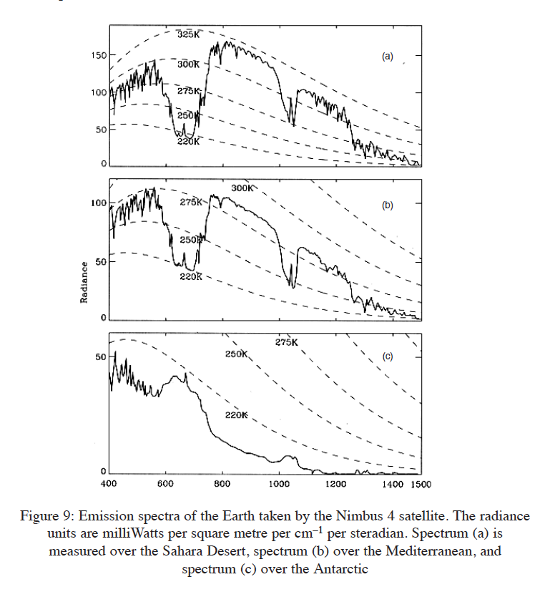
Source: Jack Barrett, Energy & Environment · Vol. 16, No. 6, 2005

Slide 13
HITRAN
Zastawny calculated GHG contributions in the atmosphere: clouds 66%;
water vapour 25%; CO2 6.7%; CH4 0.7%
Doubling CO2 yielded ‘forcing” of 2.5 w/m2, or about 0.5K; 60% IPCC value
Source: A.Zastawny, Meteorology and Atmospheric Physics, 92. 2006

Slide 14
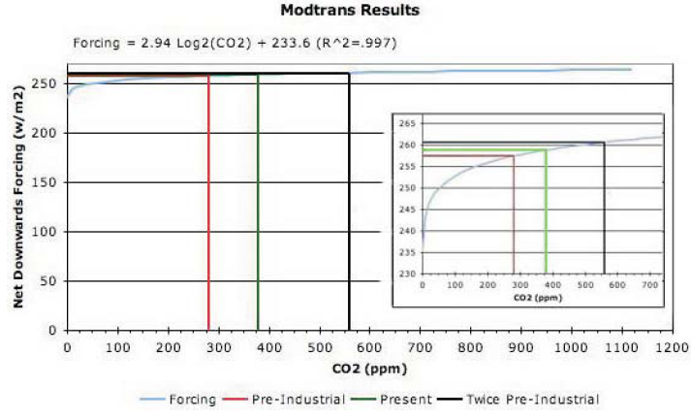
Source: R.M.Carter “The Myth of Dangerous Human-caused Climate Change,” The Australian Institute of Mining and Metallurgy New Leaders’ Conference. 2007 and references therein.
See http://icecap.us/images/uploads/200705-03AusIMMcorrected.pdf

Slide 15
TEMPERATURE RECORDS

Slide 16
TEMPERATURE ISSUES
LONG TERM
SITING
URBAN HEAT ISLAND
DIRECT HEAT SOURCE
AUTOMATION
TECHNOLOGY
REVISION & UPDATING
TEMPERATURE RECORDS
US HISTORICAL CLIMATE NETWORK
CLIMATE RESEARCH UNIT (IPCC)
RADIOSONDE (1958)
SATELLITE (1979)
See discussions in: CLIMATE OF EXTREMES By Patrick Michaels and Robert Ballings Jr. Cato Institue, 2009, and Joseph D’Aleo and Anthony Watts . SURFACE TEMPERATURE RECORDS: POLICY DRIVEN DECEPTION? Science and Public Policy Institute. January 27, 2010.9
Data Bases at: http://www.cru.uea.ac.uk/cru/data/temperature (SURFACE) http://ncdc.noaa.gov/oa/climate/ratpac/index.php (BALLOON) http;//vortex.nsstc.uah.edu/msu/t2lt/tlglhmam_5.2 (SATELLITE)

Slide 17
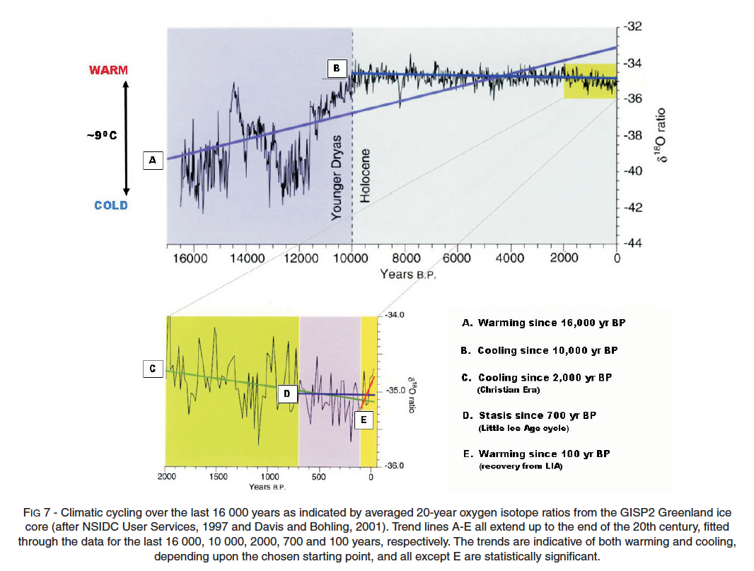
Source: R.M.Carter “The Myth of Dangerous Human-caused Climate Change,” The Australian Institute of Mining and Metallurgy New Leaders’ Conference. 2007 and references therein
. see http://icecap.us/images/uploads/200705-03AusIMMcorrected.pdf

Slide 18
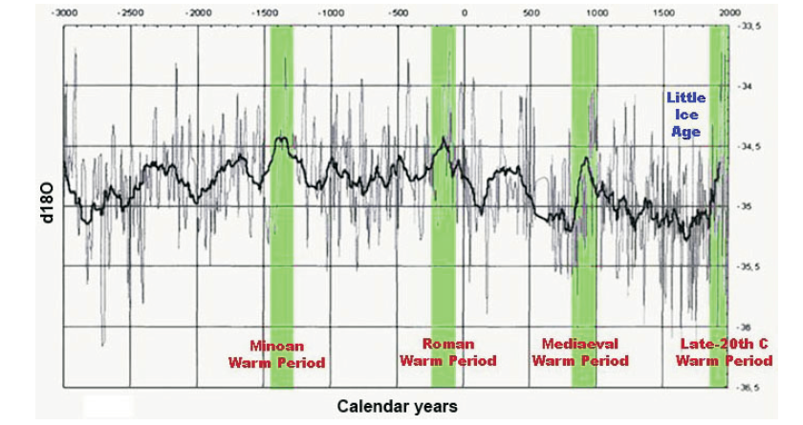
Source: R.M.Carter “The Myth of Dangerous Human-caused Climate Change,” The Australian Institute of Mining and Metallurgy New Leaders’ Conference. 2007 and references therein
. see http://icecap.us/images/uploads/200705-03AusIMMcorrected.pdf

Slide 19
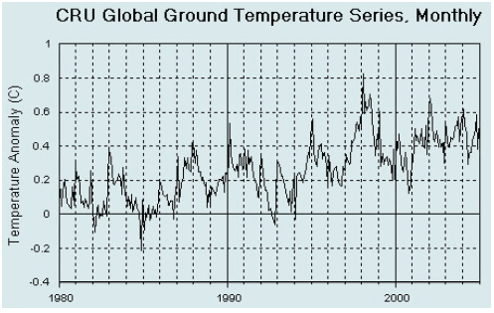
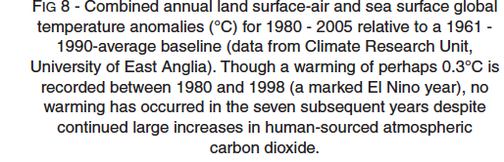
Source: R.M.Carter “The Myth of Dangerous Human-caused Climate Change,” The Australian Institute of Mining and Metallurgy New Leaders’ Conference. 2007 and references therein
. see http://icecap.us/images/uploads/200705-03AusIMMcorrected.pdf

Slide 20
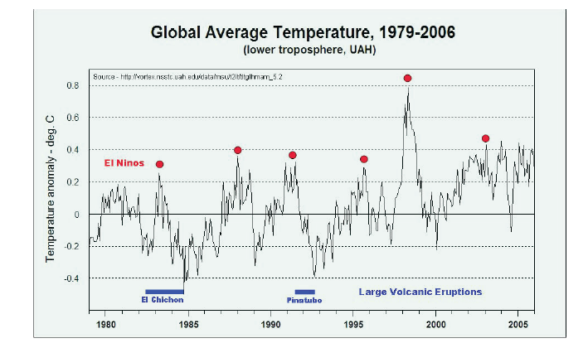
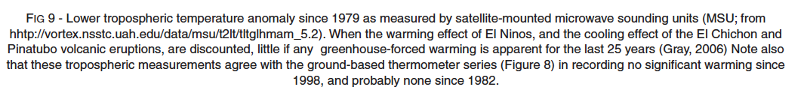
Source: R.M.Carter “The Myth of Dangerous Human-caused Climate Change,” The Australian Institute of Mining and Metallurgy New Leaders’ Conference. 2007 and references therein
. see http://icecap.us/images/uploads/200705-03AusIMMcorrected.pdf

Slide 21
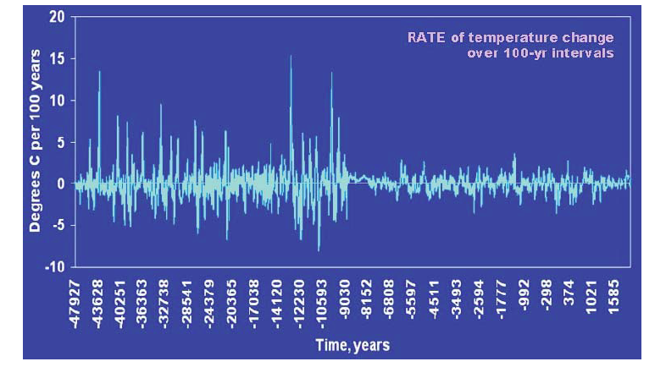
Source: R.M.Carter “The Myth of Dangerous Human-caused Climate Change,” The Australian Institute of Mining and Metallurgy New Leaders’ Conference. 2007 and references therein
. see http://icecap.us/images/uploads/200705-03AusIMMcorrected.pdf

Slide 22
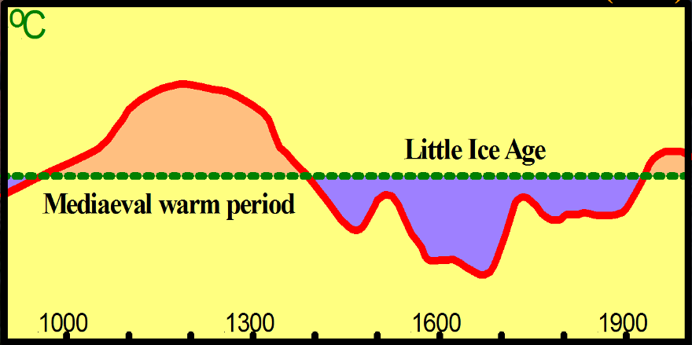
IPCC 1990
I
IPCC 2001
W. Happer Amherst 2009

Slide 23
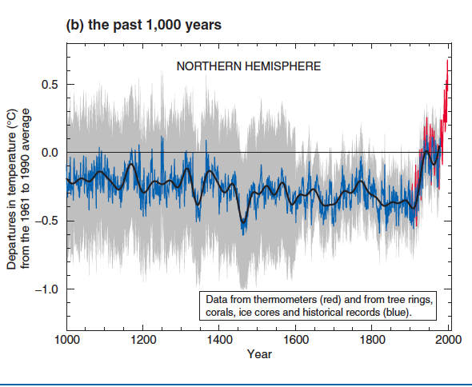
Source:Summary for Policymakers of the 2001 UN IPCC report. See: http//www.ipcc.ch/pdf/climate-changes-2001//scientific-basis/scientific
Notes:
Source:Summary for Policymakers of the 2001 UN IPCC report. See: http//www.ipcc.ch/pdf/climate-changes-2001//scientific-basis/scientific

Slide 24
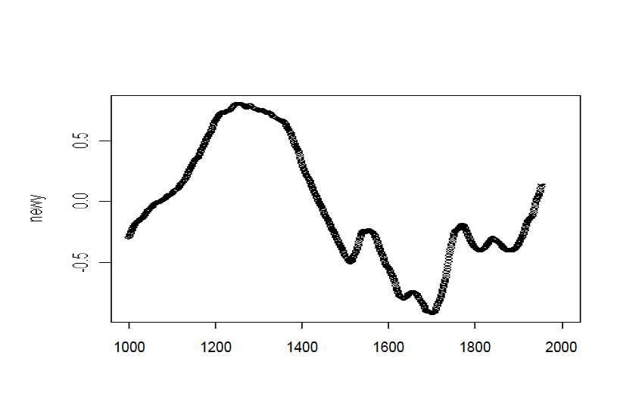
Source:Edward J.Wegman, David W.Scott, and Yasmin Said, “Ad Hoc Committee Report on the “Hockey Stick” Global Climate Reconstruction.” 2006.
See: http//www.uoguelph.ca/~rmckitri/research/WegmanReport.pdf

Slide 25
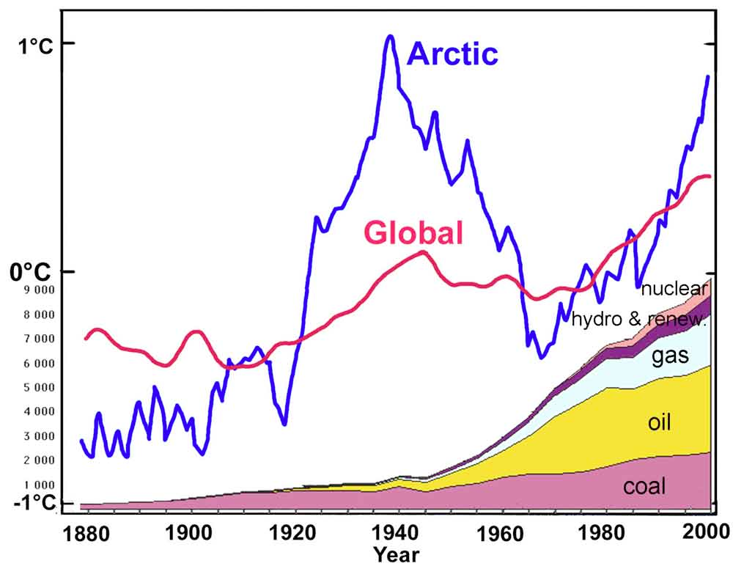
Source: “Is the Earth still recovering from the Little Ice Age? A Possible cause of global warming”: Syun-Ichi Akasofu, International Arctic Research Center, University of Alaska Fairbanks, 2009.
Red – global average change (IPCC Reports). Blue – data from stations along the coastline of the Arctic Ocean (Polyakov et al., 2002).
The figure shows also the amount of various sources of energy used during the last century; gas, oil, and coal all release CO2.

Slide 26
TEMPERATURE PREDICTIONS

Slide 27
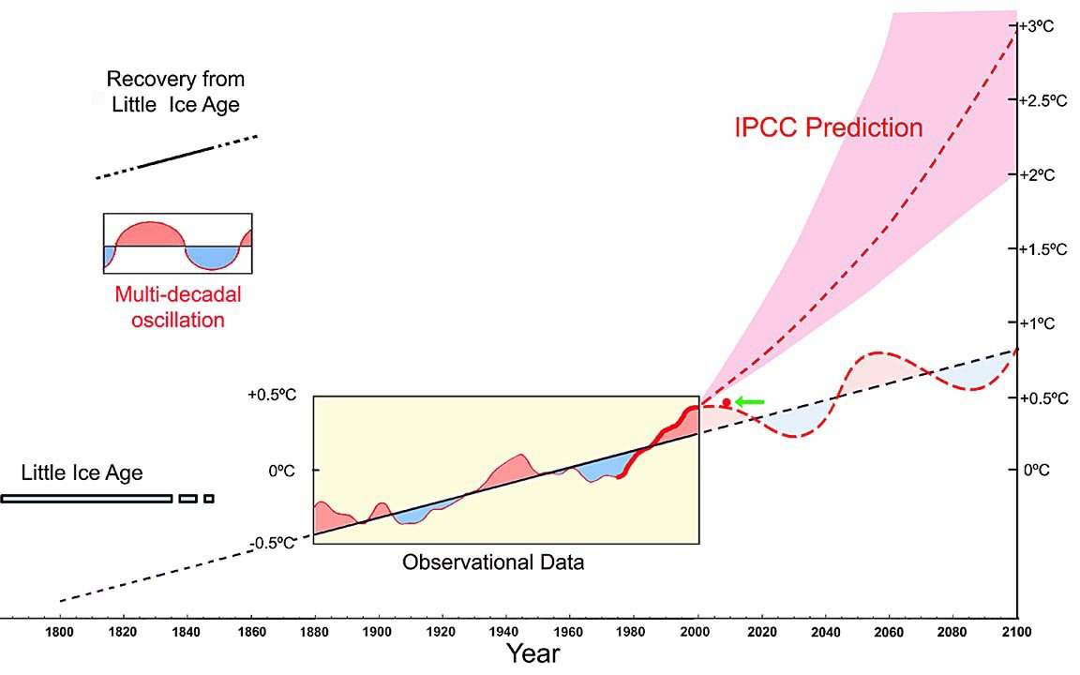
Source:”Is the Earth still recovering from the Little Ice Age? A Possible cause of global warming”: Syun-Ichi Akasofu, International Arctic Research Center, University of Alaska Fairbanks, 2009.

Slide 28
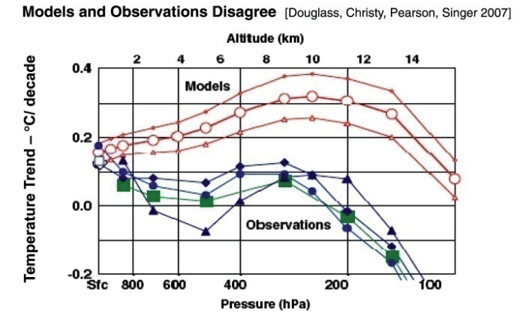
Models show an increase in the warming trend with altitude, but
balloon and satellite observations do not.
Source: Nature, Not Human Activity, Rules the Climate. 2008 The Heartland Institute.
See Douglass et al. 2007. A Comparison of tropical temperature trends with model predictions. Intnl. Journal of Climatology (Royal Meteorology Soc.) DOI;10.1002/joc.1651

Slide 29
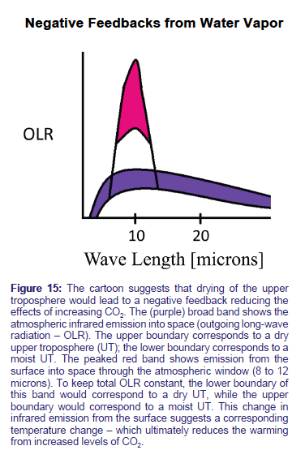
Source: Nature, Not Human Activity, Rules the Climate. 2008 The Heartland Institute.

Slide 30
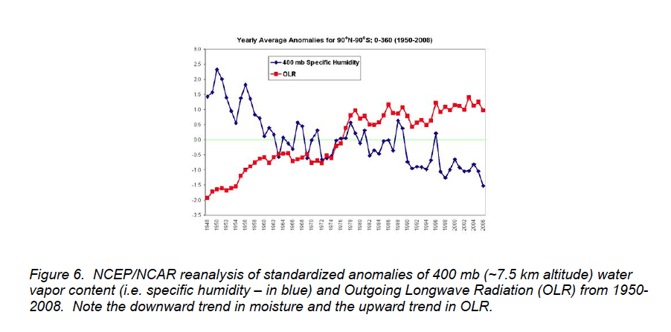
NCEP/NCAR:National Centers for Environmental Prediction/National Center for Atmospheric Research
Source: “Climate Change: Driven by the Ocean not Human Activity” by William M. Gray Professor Emeritus, Dept of Atmospheric Science, Colorado State University
Prepared for the 2nd Annual Heartland Institute sponsored conference on Climate Change. New York City, March 8-10, 2009 See also: http://tropical.atmos.colostate.edu

Slide 31
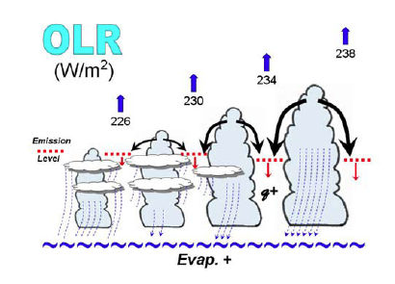
Source: “Climate Change: Driven by the Ocean not Human Activity” by William M. Gray Professor Emeritus, Dept of Atmospheric Science, Colorado State University
Prepared for the 2nd Annual Heartland Institute sponsored conference on Climate Change. New York City, March 8-10, 2009. See also: http://tropical.atmos.colostate.edu

Slide 32
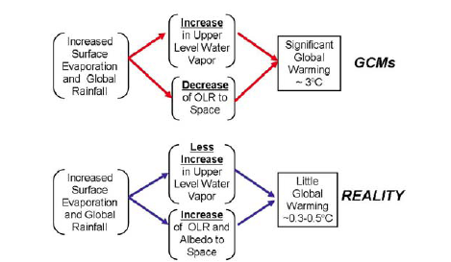
Source: “Climate Change: Driven by the Ocean not Human Activity” by William M. Gray Professor Emeritus, Dept of Atmospheric Science, Colorado State University
Prepared for the 2nd Annual Heartland Institute sponsored conference on Climate Change. New York City, March 8-10, 2009. See also: http://tropical.atmos.colostate.edu

Slide 33
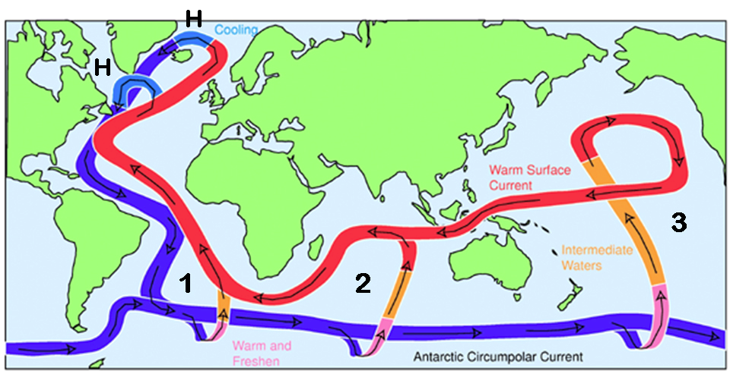
Idealized estimate of the deep water Global Ocean Conveyor Belt showing the typical locations in the Southern Hemisphere of the required return cold upwelling circulation (areas 1, 2, 3) to balance the North Atlantic thermohaline ocean subsidence (H areas). Figure courtesy of John Marshall, of MIT.
Source: Hurricanes and Climate Change: Assessing the Linkages Following the 2006 Season . William M. Gray Professor Emeritus of Atmospheric Science Department of Atmospheric Science Colorado State University. The George Marshall Institute

Slide 34
1. With a weaker Atlantic Ocean thermohaline circulation (THC) for some decades,
the Southern Hemisphere oceans upwell less cold water into their upper mixed layer, and the globe gradually warms.
2. With a stronger than normal Atlantic thermohaline circulation (THC),
the cold global deep water upwelling circulation into the Southern Hemisphere upper-mixed layer is enhanced for long periods and the globe gradually cools
Source: Hurricanes and Climate Change: Assessing the Linkages Following the 2006 Season . William M. Gray Professor Emeritus of Atmospheric Science Department of Atmospheric Science Colorado State University. The George Marshall Institute

Slide 35
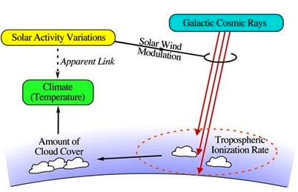
SOLAR WIND CAN MODULATE CLOUD COVER
Increased solar wind reduces cosmic ray flux, reduces cloud cover, increases temperature
Source: Nir J.Shaviv (2009). Cosmic Rays and Climate. PHYSICAPLUS. Issue No. 5 See: http://physicaplus.org.il/zope/home/en/1105389911/1113511992_en
Notes:
/Figure 2: The cosmic ray link between solar activity and the terrestrial climate. The changing solar activity is responsible for a varying solar wind strength. A stronger wind will reduce the flux of cosmic ray reaching Earth, since a larger amount of energy is lost as they propagate up the solar wind. The cosmic rays themselves come from outside the solar system (cosmic rays with energies below the "knee" at 10¹⁵eV, are most likely accelerated by supernova remnants). Since cosmic rays dominate the tropospheric ionization, an increased solar activity will translate into a reduced ionization, and empirically (as shown below), also to a reduced low altitude cloud cover. Since low altitude clouds have a net cooling effect (their "whiteness" is more important than their "blanket" effect), increased solar activity implies a warmer climate. Intrinsic cosmic ray flux variations will have a similar effect, one however, which is unrelated to solar activity variations.

Slide 36
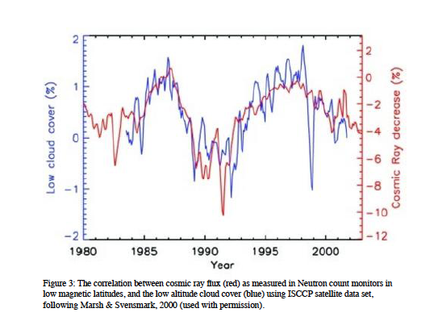
Source: Nir J.Shaviv (2009). Cosmic Rays and Climate. PHYSICAPLUS. Issue No. 5 See: http://physicaplus.org.il/zope/home/en/1105389911/1113511992_en

Slide 37
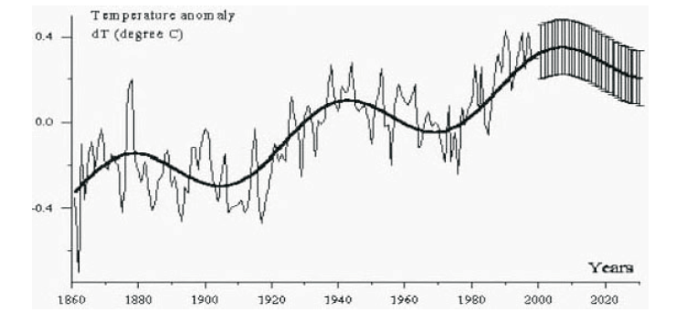
Source: R.M.Carter “The Myth of Dangerous Human-caused Climate Change,” The Australian Institute of Mining and Metallurgy New Leaders’ Conference. 2007. and references therein,
see http://icecap.us/images/uploads/200705-03AusIMMcorrected.pdf

Slide 38
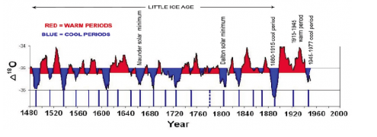
Source: New geologic evidence of past periods of oscillating, abrupt warming, and cooling 10 11 2009
Guest post by Dr. Don J. Easterbrook, Emeritus Professor at Western Washington University. See http://wattsupwiththat/2008/

Slide 39
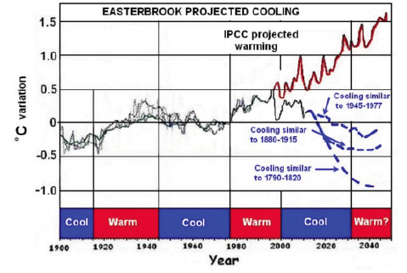
Source: New geologic evidence of past periods of oscillating, abrupt warming, and cooling 10 11 2009
Guest post by Dr. Don J. Easterbrook, Emeritus Professor at Western Washington University. See http://wattsupwiththat/2008/

