Slide 1
CO2 RECORDS

Slide 2
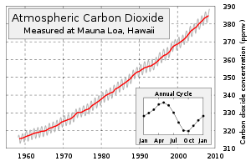
Source: ^ Trends in Atmospheric Carbon Dioxide - Mauna Loa. National Oceanic & Atmospheric Administration.
See also: The Keeling Curve Turns 50 - Scripps Institution of Oceanography
.

Slide 3
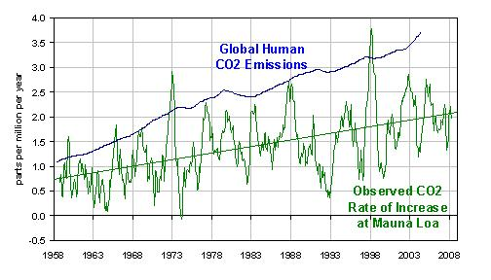
There are two main natural influences on the CO2 levels of the atmosphere:
1. the temperature of the ocean's surface waters,
2. the uptake of CO2 by plants in spring/summer
and the release of CO2 by the decay of dead plant material in fall/winter
Source: IPCC 2007 See also: http://wattsupwiththat.com/2009/05/12/spencer-on-an-alternate-view-of-co2-increases/
See http://www.ferdinand-engelbeen.be/klimaat/co2_measurements.html for a good discussion on measuring CO2.
See Carbon Dioxide Information Analysis Center for data on measurements of CO2 and many other trace atmospheric gases at http://cdiac.ornl.gov/trends/co2/
See also “Atmospheric CO2 and Global Warming—A Critical Review, Second Edition. Z.Jaworowski, T.V.Segelstad & V.Hisdal. Meddelelser Nr.119. Oslo 199
See also http://www.ferdinand-engelbeen.be/klimaat/jaworowski.html for an excellent discussion of CO2 in ice core and atmospheric data

Slide 4
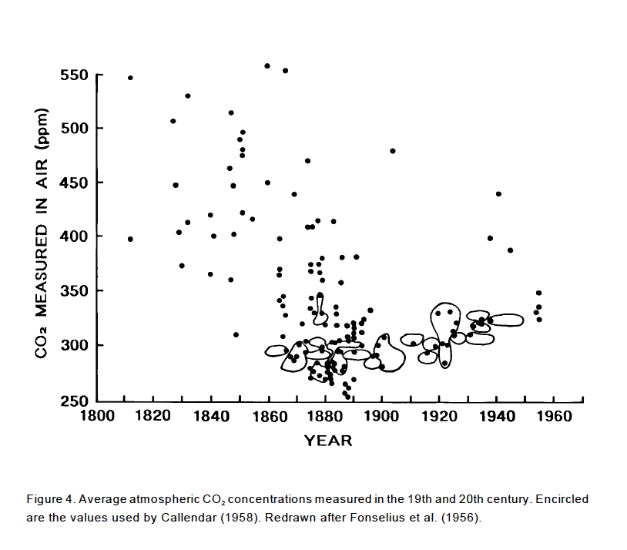
Source: Z.Jaworowski, T.Segalstad, & V.Hisdal. Atmospheric CO2 and Global Warming: A Critical Review. Second Revision. Norsk Polarinstitutt Meddelelser NR.119. Oslo 1992 and references therein.
See http://co2web.info

Slide 5
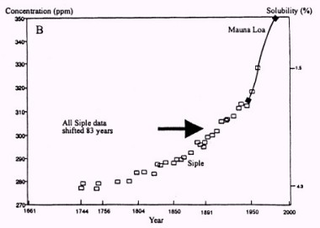
For Ice core data see e.g.
Neftel, A., et al., Evidence from polar ice cores for the increase in atmospheric CO2 in the past two centuries. Nature, 1985. 315: p. 45-47.
Friedli, H., et al., Ice core record of the 13C/12C ratio of atmospheric CO2 in the past two centuries. Nature, 1986. 324: p. 237-238.
Source: Statement written for the Hearing before the US Senate Committee on Commerce, Science, and Transportation Climate Change: Incorrect information on pre-industrial CO2. March 19, 2004
Statement of Prof. Zbigniew Jaworowski. Chairman, Scientific Council of Central Laboratory for Radiological Protection ,Warsaw, Poland
Notes:
Source: Statement written for the Hearing before the US Senate Committee on Commerce, Science, and Transportation
Climate Change: Incorrect information on pre-industrial CO2. March 19, 2004
Statement of Prof. Zbigniew Jaworowski. Chairman, Scientific Council of Central Laboratory for Radiological Protection ,Warsaw, Poland

Slide 6
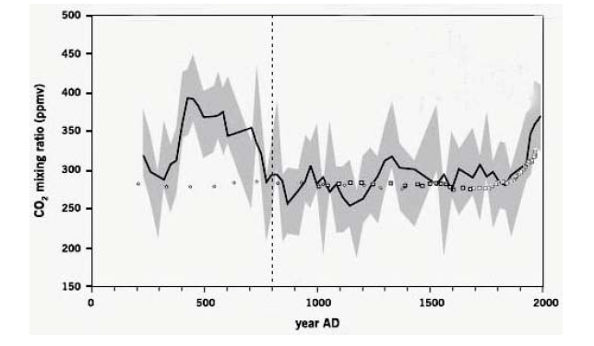
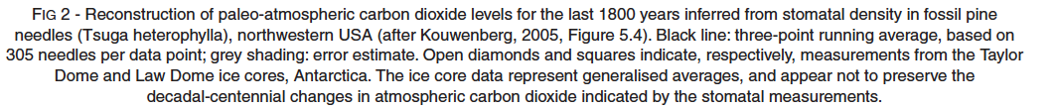
Source: R.M.Carter “The Myth of Dangerous Human-caused Climate Change,” The Australian Institute of Mining and Metallurgy New Leaders’ Conference. 2007 and references therein.
see http://icecap.us/images/uploads/200705-03AusIMMcorrected.pdf

Slide 7
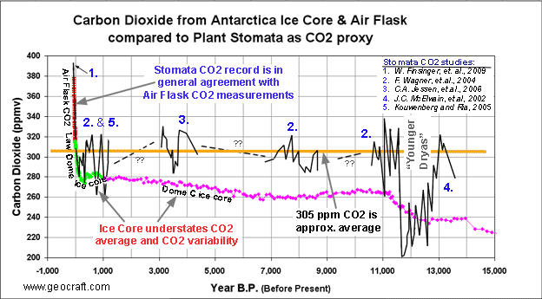
Illustrated here are results from seven stomata studies which show that CO2 variability and the CO2 average were significantly higher during our Holocene interglacial period (last 11,000 years) than is indicated by the ice core record. A precipitous drop in CO2 during the "Younger Dryas" was captured nicely by the stomata record, but missed by the CO2 record in ice cores
Source: see http://geocraft.com/WVFossils/stomata.html and references therein

Slide 8
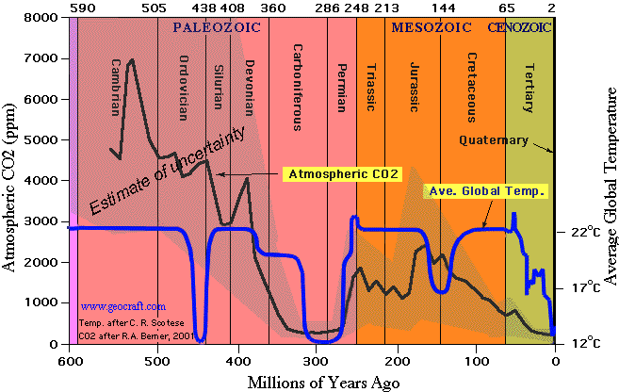
Global Temperature and Atmospheric CO2 over Geologic Time
Source: CO2 Berner,R and Kothavala,Z.Department of Geology and Geophysics, Yale University,
GEOCARB III: A REVISED MODEL OF ATMOSPHERIC CO2 OVER PHANEROZOIC TIME. American Journal of Science, Vol. 301, February, 2001, P. 182–204]
Temp C.R. Scotese http://www.scotese.com/climate.htm
Chart from http://www.geocraft.com/WVFossils/Carboniferous_climate.html
Notes:
Source: http://www.geocraft.com/WVFossils/Carboniferous_climate.html
Average global temperatures in the Early Carboniferous Period were hot- approximately 20° C (68° F). However, cooling during the Middle Carboniferous reduced average global temperatures to about 12° C (54° F). As shown on the chart, this is comparable to the average global temperature on Earth today.
Similarly, atmospheric concentrations of carbon dioxide (CO2) in the Early Carboniferous Period were approximately 1500 ppm (parts per million), but by the Middle Carboniferous had declined to about 350 ppm -- comparable to average CO2 concentrations today.
Earth's atmosphere today contains about 380 ppm CO2 (0.038%). Compared to former geologic times, our present atmosphere, like the Late Carboniferous atmosphere, is CO2- impoverished. In the last 600 million years of Earth's history only the Carboniferous Period and our present age, the Quaternary Period, have witnessed CO2 levels less than 400 ppm. Late Carboniferous to Early Permian time (315 mya -- 270 mya) is the only time period in the last 600 million years when both atmospheric CO2 and temperatures were as low as they are today (Quaternary Period ).
There has historically been much more CO2 in our atmosphere than exists today. For example, during the Jurassic Period (200 mya), average CO2 concentrations were about 1800 ppm or about 4.7 times higher than today. The highest concentrations of CO2 during all of the Paleozoic Era occurred during the Cambrian Period, nearly 7000 ppm -- about 18 times higher than today.
The Carboniferous Period and the Ordovician Period were the only geological periods during the Paleozoic Era when global temperatures were as low as they are today.

Slide 9
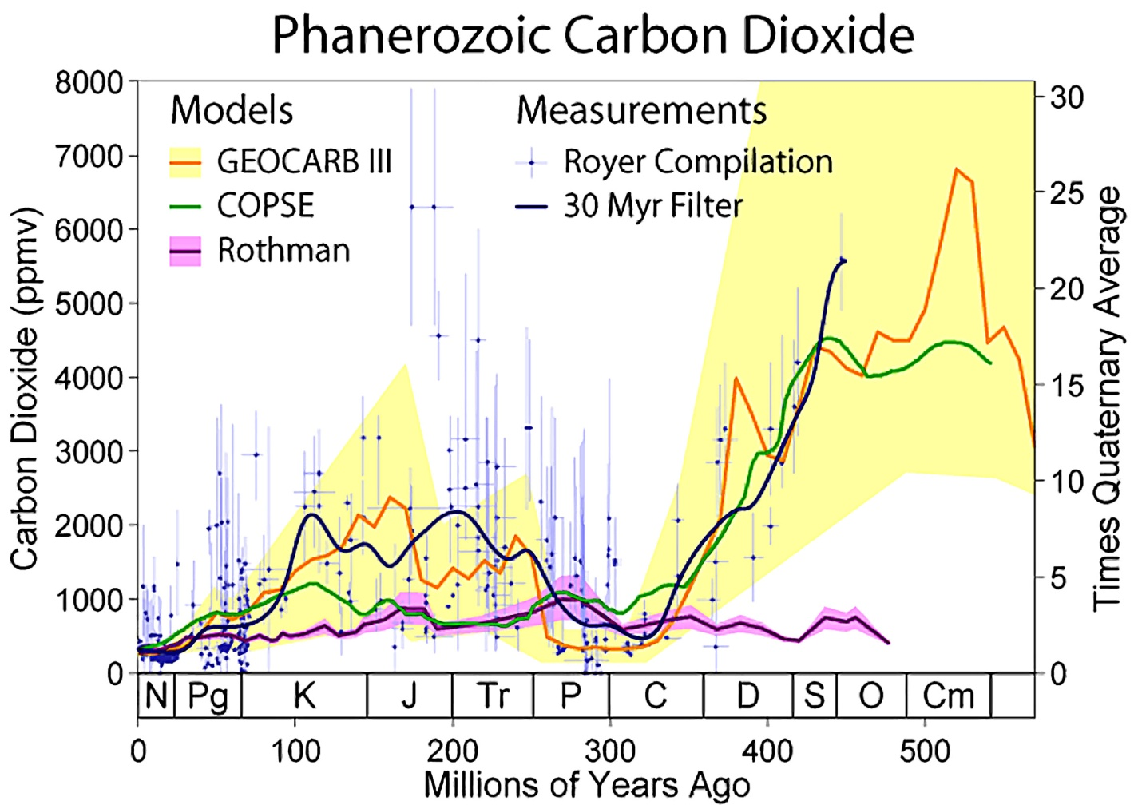
Source: Howard C.Hayden 2007. A Primer on CO2 and Climate. Second edition (Image created by Robert A. Rohde/Global Warming Art).
Also in accord with Figure 6.1. Of [IPCC 2007 p.441]
Notes:
(Top) Atmospheric CO₂ and continental glaciation 400 Ma to present. Vertical blue bars mark the timing and palaeolatitudinal extent of ice sheets (after Crowley, 1998). Plotted CO₂ records represent five-point running averages from each of the four major proxies (see Royer, 2006 for details of compilation). Also plotted are the plausible ranges of CO₂ from the geochemical carbon cycle model GEOCARB III (Berner and Kothavala, 2001). All data have been adjusted to the Gradstein et al. (2004) time scale. (Middle) Global compilation of deep-sea benthic foraminifera 18O isotope records from 40 Deep Sea Drilling Program and Ocean Drilling Program sites (Zachos et al., 2001) updated with high-resolution records for the Eocene through Miocene interval (Billups et al., 2002; Bohaty and Zachos, 2003; Lear et al., 2004). Most data were derived from analyses of two common and long-lived benthic taxa, Cibicidoides and Nuttallides. To correct for genus-specific isotope vital effects, the 18O values were adjusted by +0.64 and +0.4 (Shackleton et al., 1984), respectively. The ages are relative to the geomagnetic polarity time scale of Berggren et al. (1995). The raw data were smoothed using a five-point running mean, and curve-fitted with a locally weighted mean. The ¹⁸O temperature values assume an ice-free ocean (–1.0‰ Standard Mean Ocean Water), and thus only apply to the time preceding large-scale antarctic glaciation (~35 Ma). After the early Oligocene much of the variability (~70%) in the ¹⁸O record reflects changes in antarctic and Northern Hemisphere ice volume, which is represented by light blue horizontal bars (e.g., Hambrey et al., 1991; Wise et al., 1991; Ehrmann and Mackensen, 1992). Where the bars are dashed, they represent periods of ephemeral ice or ice sheets smaller than present, while the solid bars represent ice sheets of modern or greater size. The evolution and stability of the West Antarctic Ice Sheet (e.g., Lemasurier and Rocchi, 2005) remains an important area of uncertainty that could affect estimates of future sea level rise. (Bottom) Detailed record of CO₂ for the last 65 Myr. Individual records of CO₂ and associated errors are colour-coded by proxy method; when possible, records are based on replicate samples (see Royer, 2006 for details and data references). Dating errors are typically less than ±1 Myr. The range of error for each CO₂ proxy varies considerably, with estimates based on soil nodules yielding the greatest uncertainty. Also plotted are the plausible ranges of CO₂ from three geochemical carbon cycle models.

Slide 10
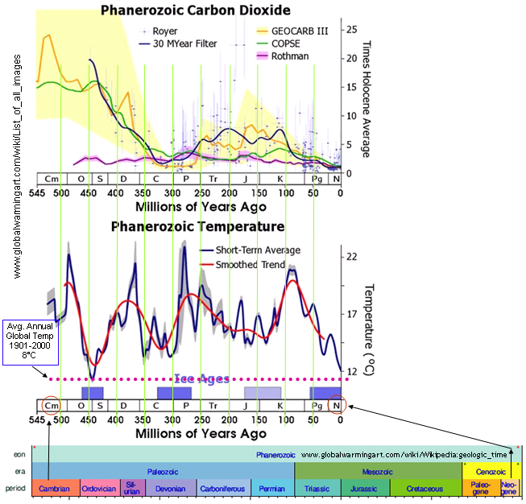
Notes:
(Top) Atmospheric CO₂ and continental glaciation 400 Ma to present. Vertical blue bars mark the timing and palaeolatitudinal extent of ice sheets (after Crowley, 1998). Plotted CO₂ records represent five-point running averages from each of the four major proxies (see Royer, 2006 for details of compilation). Also plotted are the plausible ranges of CO₂ from the geochemical carbon cycle model GEOCARB III (Berner and Kothavala, 2001). All data have been adjusted to the Gradstein et al. (2004) time scale. (Middle) Global compilation of deep-sea benthic foraminifera 18O isotope records from 40 Deep Sea Drilling Program and Ocean Drilling Program sites (Zachos et al., 2001) updated with high-resolution records for the Eocene through Miocene interval (Billups et al., 2002; Bohaty and Zachos, 2003; Lear et al., 2004). Most data were derived from analyses of two common and long-lived benthic taxa, Cibicidoides and Nuttallides. To correct for genus-specific isotope vital effects, the 18O values were adjusted by +0.64 and +0.4 (Shackleton et al., 1984), respectively. The ages are relative to the geomagnetic polarity time scale of Berggren et al. (1995). The raw data were smoothed using a five-point running mean, and curve-fitted with a locally weighted mean. The ¹⁸O temperature values assume an ice-free ocean (–1.0‰ Standard Mean Ocean Water), and thus only apply to the time preceding large-scale antarctic glaciation (~35 Ma). After the early Oligocene much of the variability (~70%) in the ¹⁸O record reflects changes in antarctic and Northern Hemisphere ice volume, which is represented by light blue horizontal bars (e.g., Hambrey et al., 1991; Wise et al., 1991; Ehrmann and Mackensen, 1992). Where the bars are dashed, they represent periods of ephemeral ice or ice sheets smaller than present, while the solid bars represent ice sheets of modern or greater size. The evolution and stability of the West Antarctic Ice Sheet (e.g., Lemasurier and Rocchi, 2005) remains an important area of uncertainty that could affect estimates of future sea level rise. (Bottom) Detailed record of CO₂ for the last 65 Myr. Individual records of CO₂ and associated errors are colour-coded by proxy method; when possible, records are based on replicate samples (see Royer, 2006 for details and data references). Dating errors are typically less than ±1 Myr. The range of error for each CO₂ proxy varies considerably, with estimates based on soil nodules yielding the greatest uncertainty. Also plotted are the plausible ranges of CO₂ from three geochemical carbon cycle models.

Slide 11
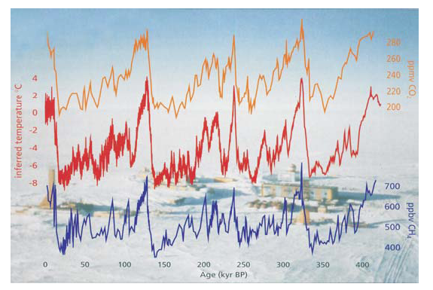
Source: R.M.Carter “The Myth of Dangerous Human-caused Climate Change,” The Australian Institute of Mining and Metallurgy New Leaders’ Conference. 2007.
See http://icecap.us/images/uploads/200705-03AusIMMcorrected.pdf

Slide 12
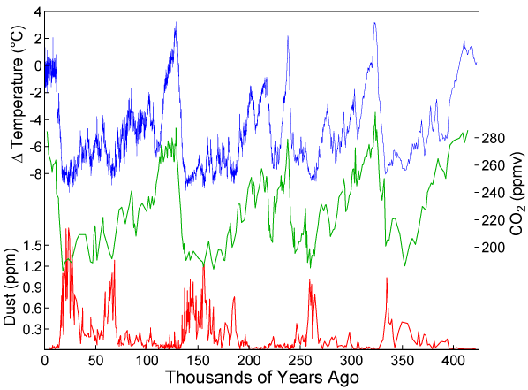
Vostok Ice Core Data
Will Happer. Amherst 2009

Slide 13
Will Happer. Amherst 2009

Slide 14
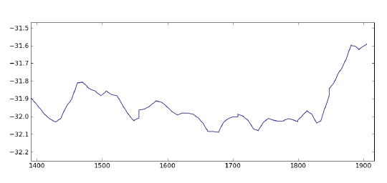
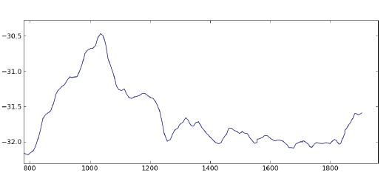
Global Temperature Records from 500 yr.BP (upper) and 1,200 yr.BP (lower)
Source: National Climatic Data Center, NOAA Paleoclimatology. See http://www.ncdc.noaa.gov/paleo/metadata/noaa-icecore-2475.html

Slide 15
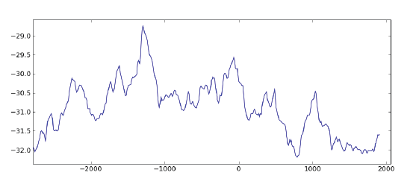
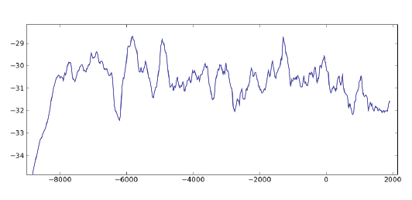
Global Temperature Records from 2,500 yr.BP (upper), and 9,000 yr.BP (lower)
Source: National Climatic Data Center, NOAA Paleoclimatology. See http://www.ncdc.noaa.gov/paleo/metadata/noaa-icecore-2475.html
Notes:
Source: National Climatic Data Center, NOAA Paleoclimatology. See http://www.ncdc.noaa.gov/paleo/metadata/noaa-icecore-2475.html

Slide 16
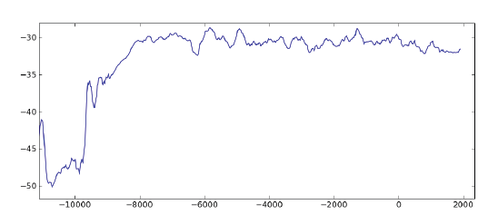
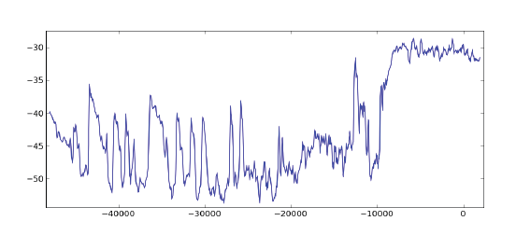
Global Temperature Records from 12,000yr. BP(upper) and 50,000 yr.BP(lower)
Source: National Climatic Data Center, NOAA Paleoclimatology. See http://www.ncdc.noaa.gov/paleo/metadata/noaa-icecore-2475.html

Slide 17
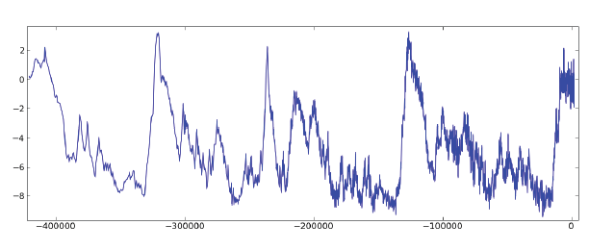
Global Temperature Record from 400,000yr BP
Source: National Climatic Data Center, NOAA Paleoclimatology. See http://www.ncdc.noaa.gov/paleo/metadata/noaa-icecore-2475.html

Slide 18
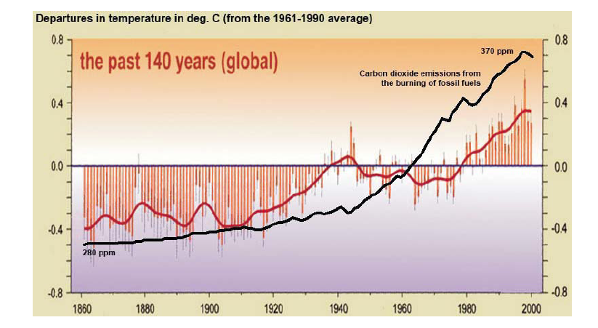
Source: R.M.Carter “The Myth of Dangerous Human-caused Climate Change,” The Australian Institute of Mining and Metallurgy New Leaders’ Conference. 2007.
See http://icecap.us/images/uploads/200705-03AusIMMcorrected.pdf

Slide 19
Will Happer. Amherst 2009

Slide 20
AGW EFFECTS

Slide 21
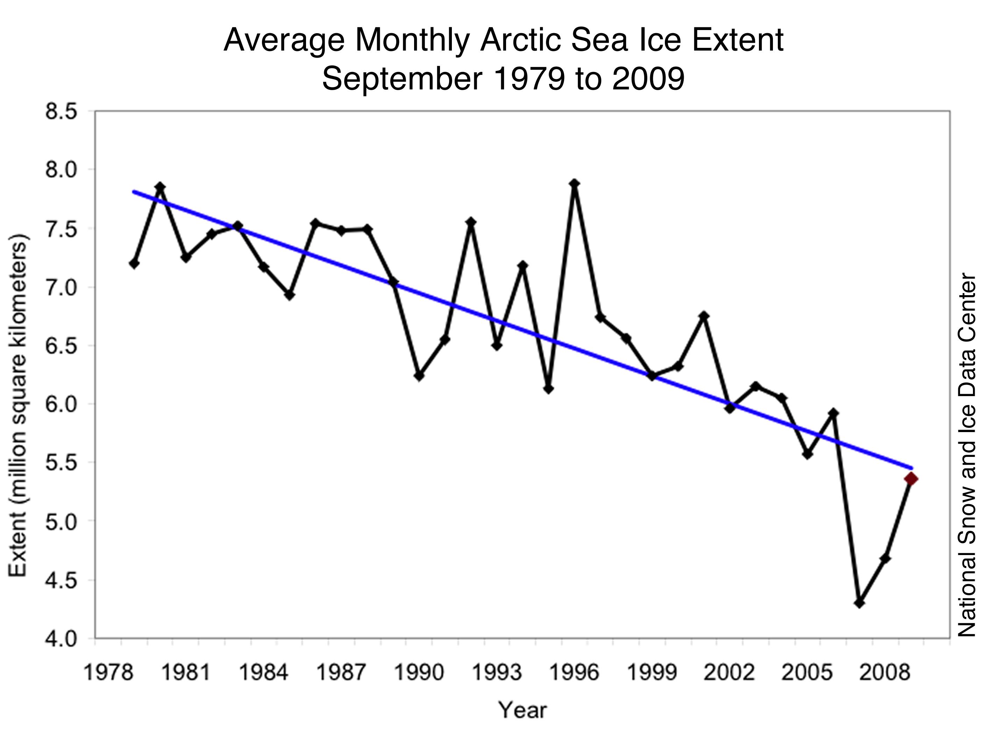
Source: National Snow and Ice Data Center, University of Colorado at Boulder.
Will Happer. Amherst 2009

Slide 22
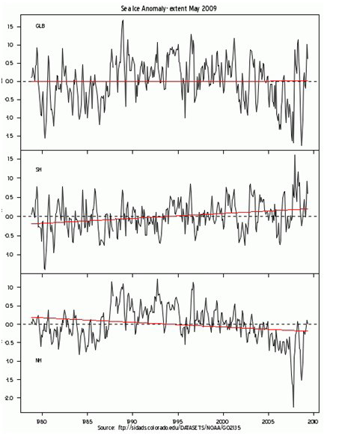
Sea Ice Anomalies: global (top); southern hemisphere (middle); northern hemisphere (bottom)
Source: National Snow and Ice data Center, University of Colorado @ Boulder

Slide 23
Source: National Snow and Ice data Center, University of Colorado @ Boulder

Slide 24
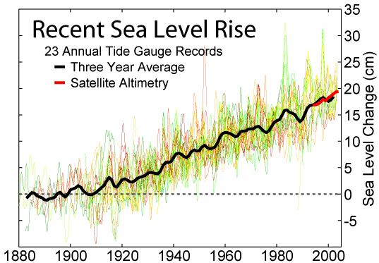
Will Happer. Amherst 2009

Slide 25
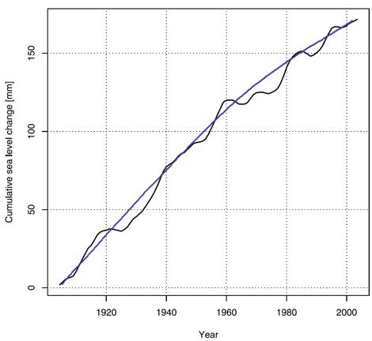
Cumulative Increase in mean global sea level (1904-2003) from 9 hi-quality tide gauges.
( Adapted from Holgate S.J. 2007 Geophysical Research Letters. 31)
Source: Climate Change Reconsidered.2009 Report of the Nongovernmental International Panel on Climate Change Heartland Institute.

Slide 26
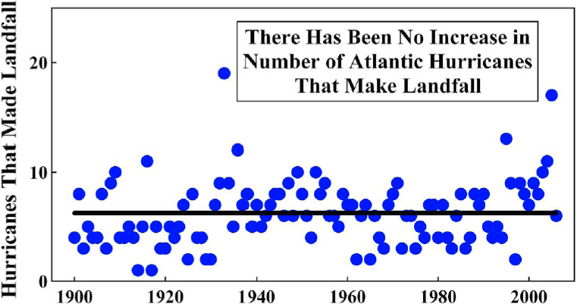
Will Happer. Amherst 2009

Slide 27
Will Happer. Amherst 2009

Slide 28
Arizona Precipitation Record Shows No Trend
In Periodic Droughts
Source: Climate Assessment For The Southwest
(University of Arizona) 2006
Will Happer. Amherst 2009

Slide 29
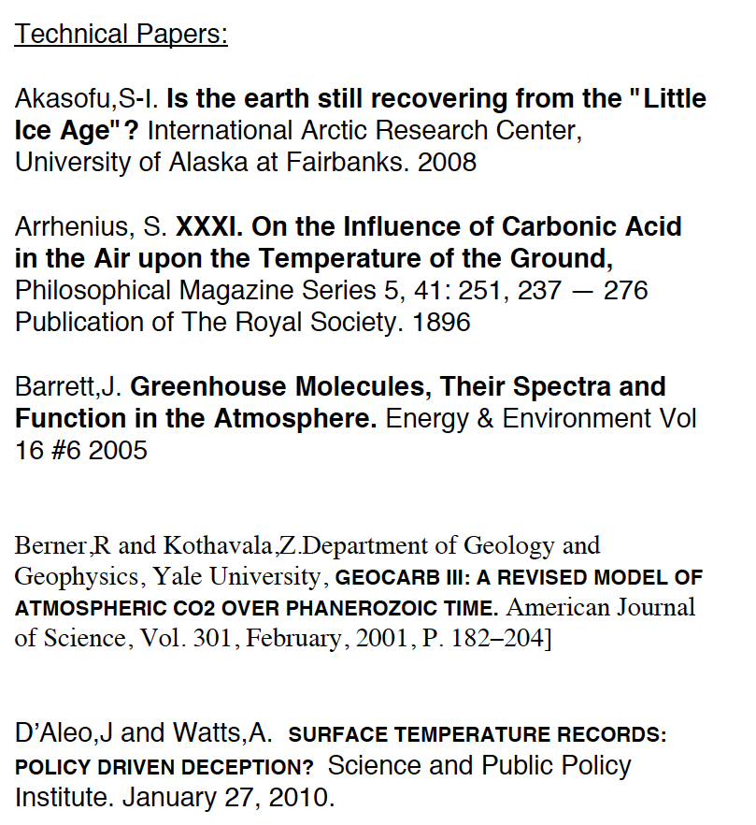
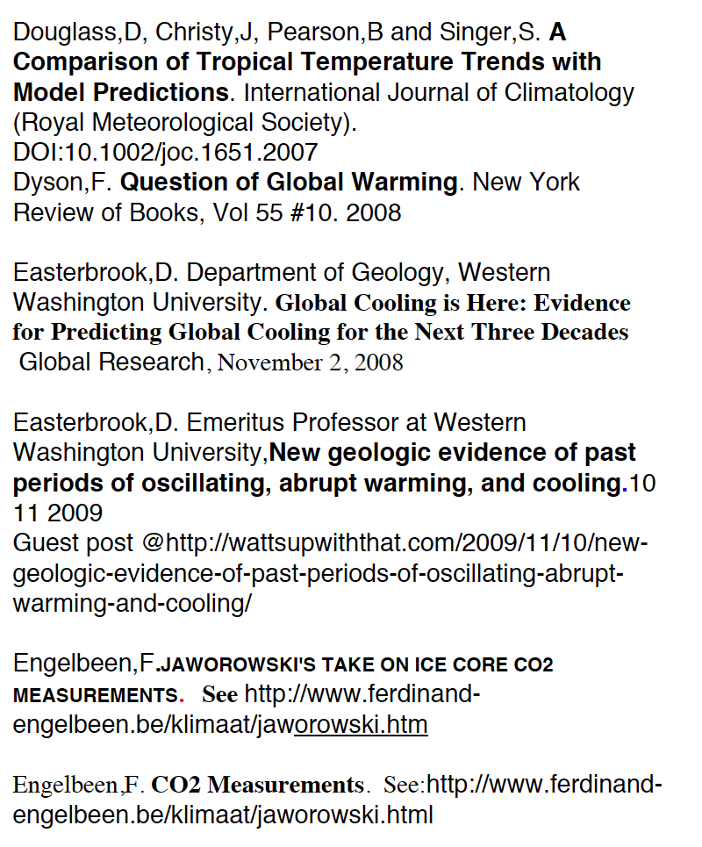
REFERENCES

Slide 30
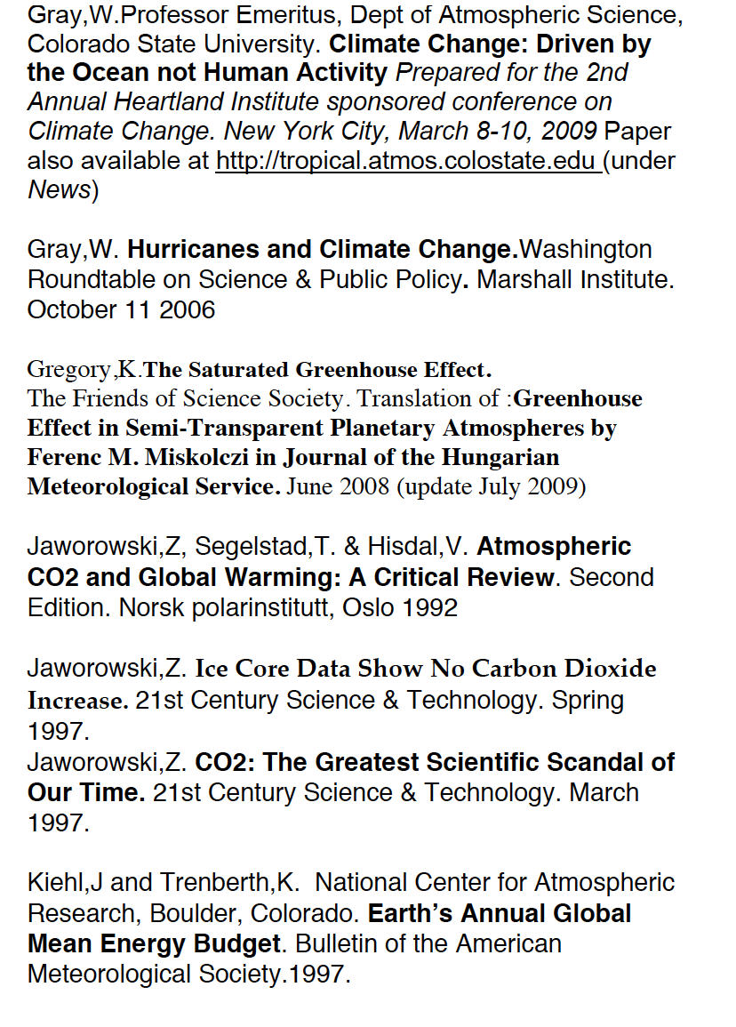
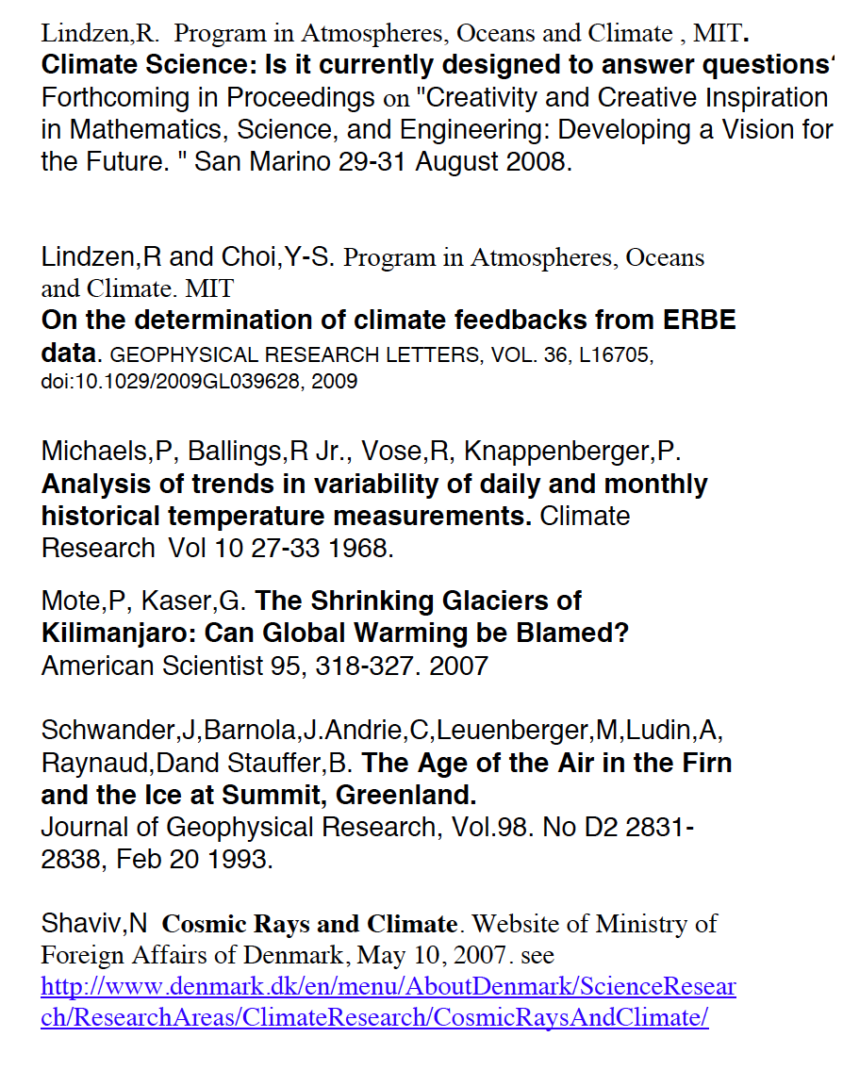
REFERENCES-2

Slide 31
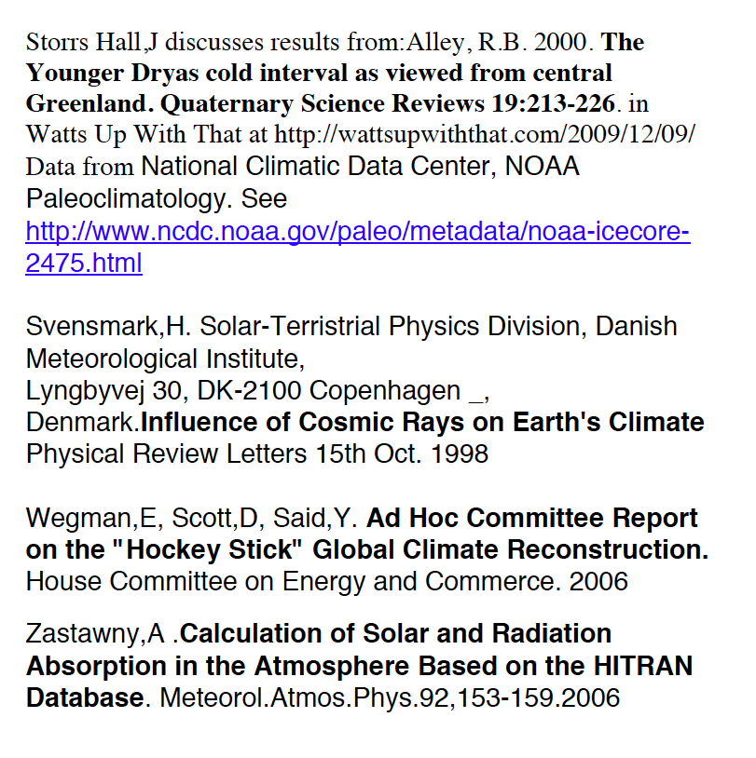
REFERENCES-3

Slide 32
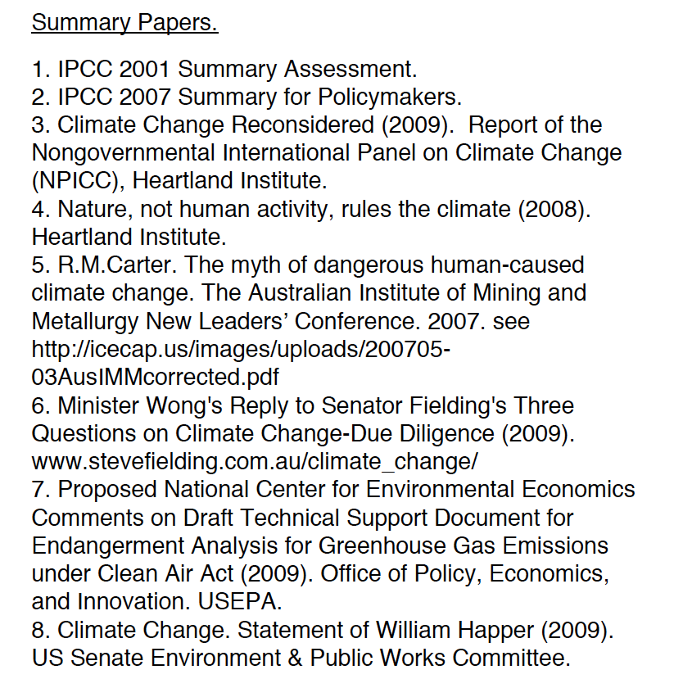
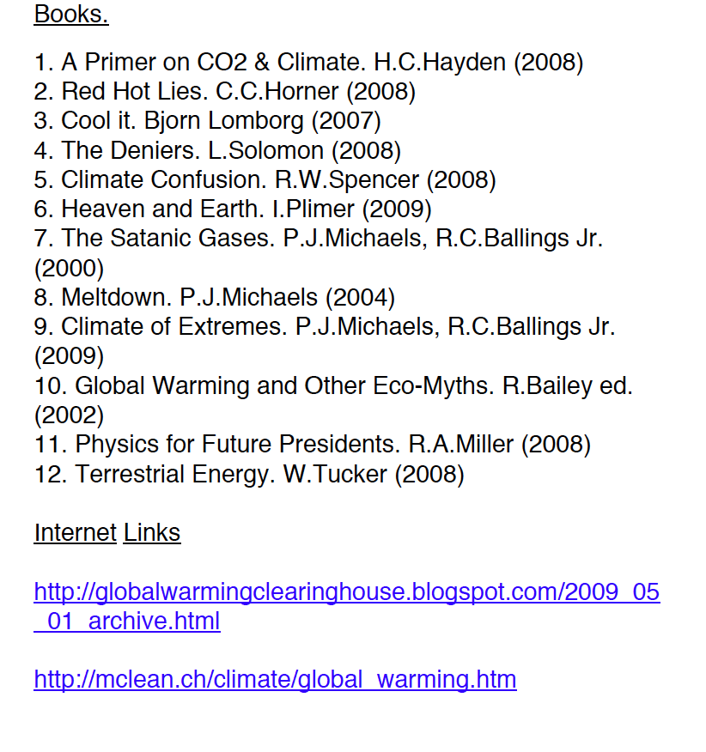

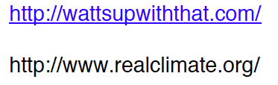
REFERENCES-4

