Slide 2
Alexandria was found by Alexander the great 332B.C, Alexandria is the second largest city of Egypt. It is a harbor city. Alexandria is a summer resort on the Mediterranean Sea..

Slide 3
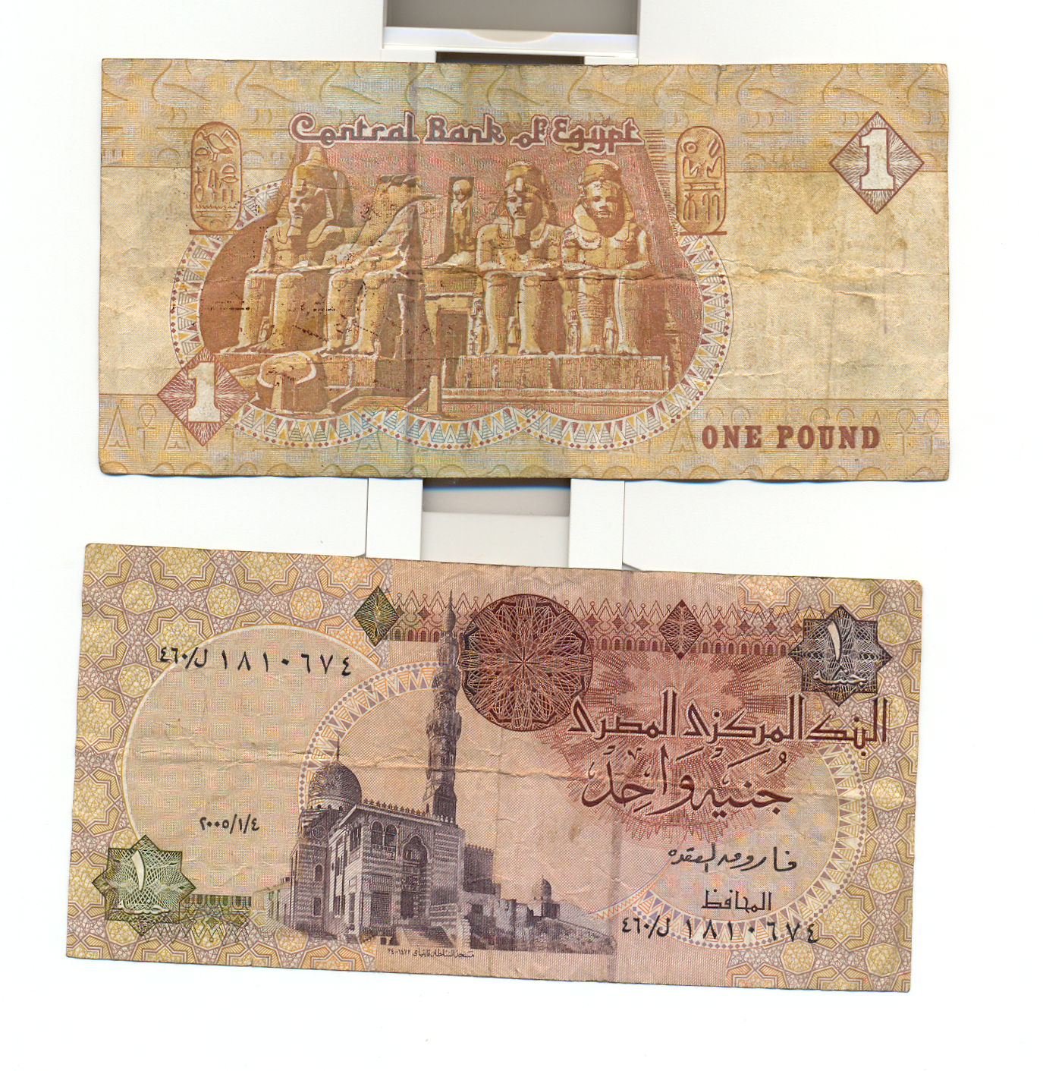
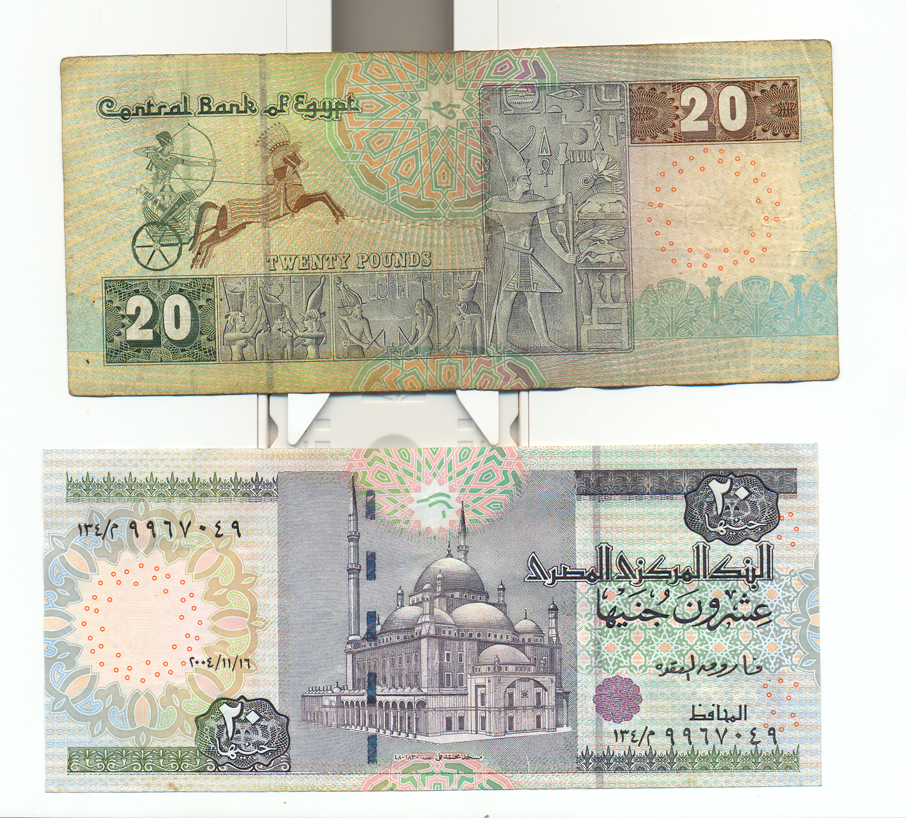

Slide 4
Egypt and Egyptians
welcome your visit soon
Thank you
so much
for your attention

