Slide 1
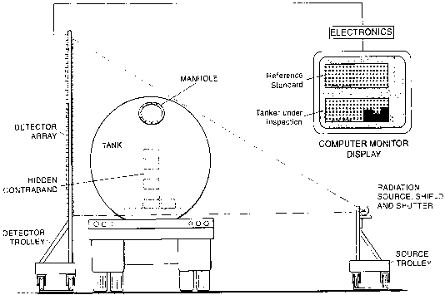
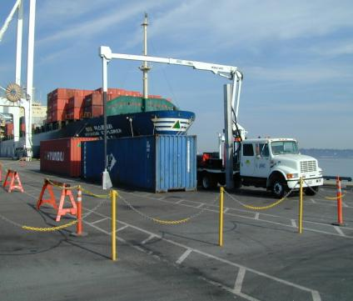
Bridging the Gap from an Idea to a Product: Lessons Learned from VACIS®
Presentation to Lyncean Group
Vic Orphan (SAIC) and Jim Winso (SLI)
November 16, 2011
Notes:
Welcome to the session “Bridging the Gap from an Idea to a Product”
Hope that the experiences of our 6 invited talks will provide insights into this important area—if we don’t figure out how to effectively bridge the gap then many good ideas for improving security, safety and contraband detection will fail to be commercialized
I’ll start with “Lessons Learned from VACIS (Vehicle and Cargo Inspection System)” developed and commercialized by SAIC.

Slide 2
AGENDA
Operating Principle of VACIS -- Vic Orphan
Overview of VACIS Products -- Vic Orphan
VACIS Production Enhancements -- Jim Winso
Next Generation VACIS -- Vic Orphan
Discussion of Lessons Learned -- Vic Orphan
Jim Winso

Slide 3
VACIS® an ~$1B Business resulted from an innovative solution developed by Dr. Victor Verbinski
US Customs Service (now Customs and Border Protection) in early 1990s faced a challenging requirement:
  How to more effectively inspect nearly-empty propane tanker trucks for drugs entering the US from Mexico
  Customs Service found 8000 pounds of cocaine hidden in a nearly-empty propane tanker by painstakingly opening the tanker (after transferring propane to another tanker truck)
  This manual inspection took more than 4 hours
Customs Service clearly needed a much faster, non-intrusive inspection method if they were to effectively inspect propane tankers
In response to a request by Customs Service to SAIC for non-intrusive inspection ideas, Dr. Victor Verbinski suggested a gamma-ray densitometer
In a proof-of-concept (POC) experiment using the seized propane tanker truck, Verbinski demonstrated the ability to detect small thicknesses (few inches) of simulated drugs using a gamma densitometer comprised of a ¹³⁷Cs gamma-ray source and several NaI detectors
VACIS started with a $50K contract in the early1990’s from Customs to show POC
Notes:
First—a little background on the idea that lead to VACIS and the motivation.
VACIS idea was motivated by an urgent Customs Service (now CBP) requirement in the early 1990’s—faster means of inspecting nearly empty tanker trucks.
Dr. Victor Verbinski suggested a “gamma densitometer” (gamma-ray transmission using isotopic source—Cs-137)
POC experiment showed good sensitivity to few inches of “drug simulant” using Cs-137 source and several NaI detectors.

Slide 4
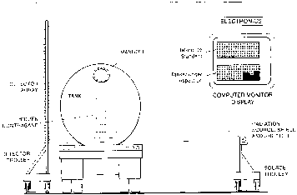
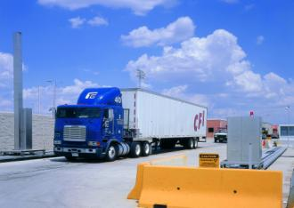
Verbinski VACIS® Notional Design in early 1990’s
Initial concept was a non-imaging gamma densitometer (a few NaI gamma-ray detectors monitoring the Cs-137 662 keV gamma-ray attenuation as the detectors and source scanned the tanker truck
To insure more complete coverage of the tanker truck, additional NaI detectors were added—resulting in a linear array of detectors
This early VACIS I produced a crude (~2 to 4 inch pixels) gamma radiographic image of the tanker truck
VACIS I was field evaluated at a Customs POE providing valuable feedback
Customs requested higher resolution images which resulted in the first VACIS product-VACIS II (Relocatable VACIS) with ~0.5inch resolution.
Notional VACIS® concept
VACIS II-First Product
Notes:
Initial concept was a non-imaging gamma densitometer—scanning tanker truck to detect anomalies (drugs)
To speed up the inspection we added additional NaI detectors (eventually producing a linear array—as illustrated)
A prototype (VACIS I) was assembled and field evaluated by Customs—provided valuable feedback which aided us in improving the design.
One Customs suggestion (demand) was that higher spatial resolution would enable more general use (in addition to Tanker Truck inspection)
Led to smaller NaI detectors and production of first VACIS product (VACIS II or Relocatable VACIS) with ~ 0.5 inch resolution (see photo)

Slide 5

Operating Principle of
VACIS® Gamma-Ray Imaging
Image Processing
Detector array
“Shadow” cast by vehicle on detectors
Gamma ray fan beam
Photon counting electronics
Source
Host Computer and
Control Console
User/Operator Control

Slide 6
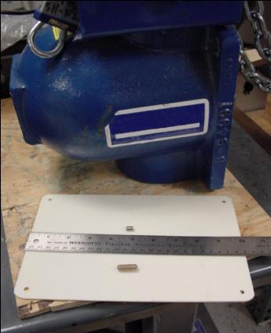
VACIS® Source Holder and
Relative Size of Radiation Capsule
A small pellet (a few millimeters in diameter) provides the source of gamma rays at 662 KeV (Cs-137) or 1.25 MeV (Co-60).
The pellet is installed in a steel and tungsten explosion-proof housing equipped with a tungsten shutter.
Source holder
Source Capsule
Multivitamin

Slide 7
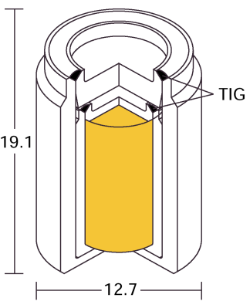
VACIS® Source Pellet Sealed in the Capsule
The aspirin-sized pellets weigh less than .05 grams.
The capsules are sealed using a very high-quality tungsten-in gas (TIG) welding method.
These capsules conform to the ISO and IAEA specs for sealed sources, and are in use in almost every country in the world.
Pellet
(dimensions are in mm)

Slide 8
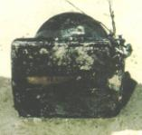
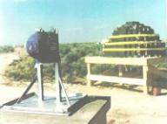
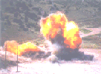
VACIS® Sources
Tested to Extreme Conditions
Registered device
Fail-safe shutter design
Source is safely sealed inside steel housing
Testing of source housing
Temperature tested: -29ºC to 60ºC
(-20ºF to +140ºF)
Drop-tested: From 2.7 meters (9 feet)
Fireproofed: Withstands 800ºC (1,472ºF)
Bomb-tested: With 3,400 kg (7,500 lbs.) of TNT-equiv. explosives

Slide 9
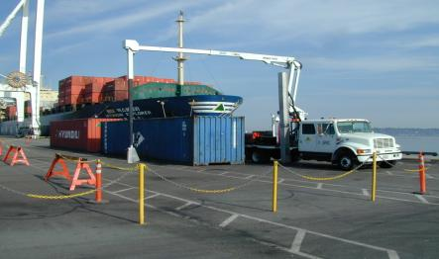
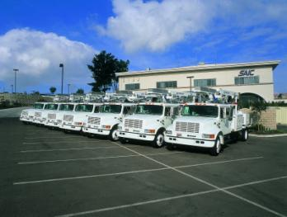
SAIC Developed Mobile VACIS® using company funding
Customs purchased and successfully deployed 30 VACIS II’s in 1998-2001 after extensive government performance test and evaluation
Although VACIS IIs proved quite effective (and are still in use), Customs (now CBP) determined that in many inspection locations a truck-mounted mobile system with higher resolution was desirable (greater inspection flexibility and reduced required CBP footprint at seaports)
In response to CBP’s requirement, SAIC developed a Mobile VACIS, using company funds, in less than 6 months and CBP purchased 10 initial Mobile VACIS (1999)
Over 200 Mobile VACIS have been deployed by CBP, foreign Customs, DoD, etc.
Port of Vancouver, Canada
Undergoing testing by Revenue Canada
Rancho Bernardo, CA September, 2000
Seven units delivered
Notes:
Customs purchased and deployed 30 VACIS IIs. Relocatable feature was rarely used. Plan to move from one POE or port to another changed.
Customs wanted a mobile system-SAIC proposed development program to the government but SAIC decided to fund development as government funding cycle was too long to satisfy Customs needs for a timely response
SAIC developed Mobile VACIS in ~6 months and was rewarded with an order from Customs for 11 systems in 2000. Mobile VACIS has proved to be the most popular VACIS model—over 200 have been sold to CBP, foreign customs, state governments and DoD.

Slide 10
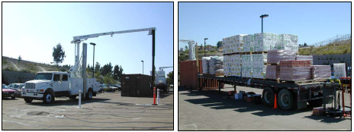
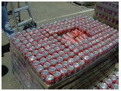
Mobile VACIS® Features and Performance
Dual mode operation—stationary and moving
Driver in-cab operation
Set-up time of 5 minutes
Scan speed of 0.5 to 2.0 mph
Resolution (at object mid-plane) of 0.37 in (9 mm)
Co-60 gamma-ray source providing penetration of 6.5 inches (165mm) steel
Image speed corrected in real-time
High operational availability (>95%)
Demonstration to prove Co-60 source provides
superior detection capability to Cs-137 source
Typical concealment of drugs in cargo
Notes:
Review Mobile VACIS performance capabilities—enhanced over VACIS II (slightly better spatial resolution and 6.5 inches steel penetration vs 4.5 for VACIS II with Cs-137
Convincing Customs that it was worthwhile to switch from Cs-137 to Co-60 (shorter lifetime) required company funded demonstration in 2002—side-by-side performance on real cargo into which simulated drugs were inserted.

Slide 11
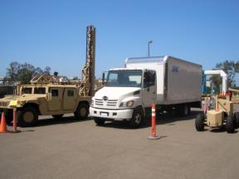
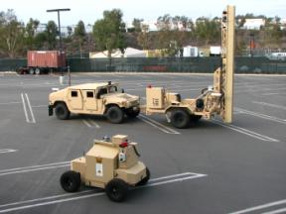
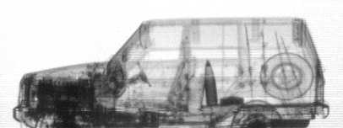
Military Mobile VACIS®
SAIC developed (with TSWG Funding) a militarized Mobile VACIS with the detector array mounted on a HMMWV and the source on a small robotic out-vehicle
Successful evaluation of the MMV prototype in Kosovo and Afghanistan resulted in Army orders of ~75 MMVs
Recently, SAIC developed a Trailer-mounted MMV which offers greater operational flexibility and a remotely operated HMMWV removing operators from harms way during scanning of suspect VB-IEDs
This effort was funded in 2002 from TSWG on an marketing effort started in 1997 to fund the base Mobile VACIS (funded by SAIC to meet the Market window)
Military Mobile VACIS
Trailer-Mounted Military Mobile VACIS
Notes:
In response to an urgent need (Force Protection) for a more rugged version of SAIC’s commercial MV, SAIC under government funding, developed MMV
In MMV the detector array was mounted on a HMMWV and the source was on a small “outvehicle” designed to automatically track the detector array as the HMMWV was driven past the target vehicle
The prototype MMV was successfully operated in Kosovo and later in Afghanistan—leading to an order for ~75 production MMV which SAIC is currently about to complete. Radiograph shows ability to detect threat objects (in this case, an artillery shell and a land mine)
For TSWG, SAIC recently developed a trailer-mounted MMV (see photo) which features remote operation and if used in a portal (stationary) mode does not tie up a HMMWV during scanning operations.

Slide 12
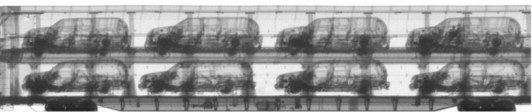
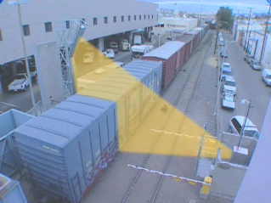
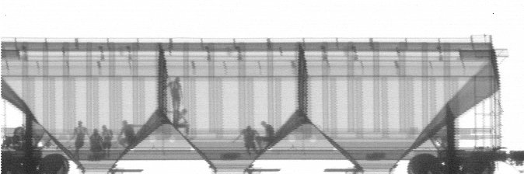
Railroad VACIS®
Railroad VACIS was developed to meet CBPs need to inspect railcars carrying freight into the US from Canada and Mexico with CBP Funding
CBP has deployed Railroad VACIS systems on all the major rail lines entering the US
Railroad VACIS scans at speeds up to 10 mph with a very low dose/scan (5 micro Rem)
people
people
600 lbs cocaine
Notes:
In response to CBPs need for a means of inspecting railcars entering the US from Mexico and Canada, SAIC performed several POC demos at a US-Mexico POE rail line. Used existing “Relocatable VACIS” equipment
Some of the initial images (shown) revealed that the railcars were being used more for smuggling people than for drugs. The smugglers offered their clients both “first class” (ride in SUVs being imported from Mexico) or “economy” in a hopper car
When word got out that CBP was using a means to “see people in the railcars”, the smuggled people started crouching down below window level—which, of course, did not impact their detectability with VACIS.
Railroad VACIS used a Co-60 source (~1 Ci) and a detector array designed to allow double stack railcars to be inspected.
All major rail lines entering the US now use Railroad VACIS to inspect trains at speeds up to 10 mph.

Slide 13
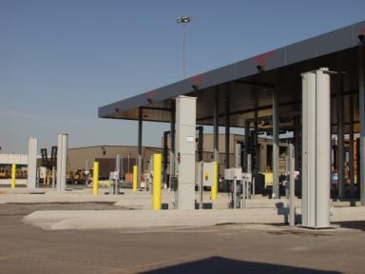
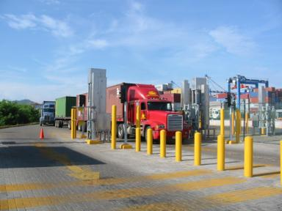
Portal VACIS®
Features
High-resolution, high-throughput system
Small footprint (uses dual Co-60 sources and detector arrays)
Supports drive-thru or stop-and-go operation
Deployed in conjunction with existing vehicle control points
Notes:
CBP and other Customs Agencies needed means of inspecting cargo trucks at land and sea POEs with the constraint that the inspection system fit within the footprint of a normal traffic lane.
Portal VACIS was designed with two pairs of source –detector array; one covering the top half of the cargo vehicle and the other the bottom half
Portal VACIS was designed to automatically sense the gap between the vehicle cab and the cargo trailer –and open the shutter and scan only the cargo. Portal VACIS can be used in conjunction with other vehicle control features—license and container ID readers and driver id kiosk

Slide 14
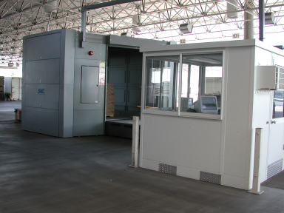
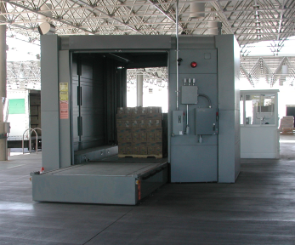
Pallet VACIS®
Features
Uses Cobalt-60 gamma-ray source
Highest penetrating pallet system commercially available, yet needs no special shielding
Inspection time is less than a minute with 3/8-inch resolution
Notes:
CBP had a need to inspect cargo pallets (approximately 4’ cubes) which were too dense to be penetrated by conventional x-ray pallet inspection systems so we developed a Co-60 based Pallet VACIS. To minimize the size of the system the detector array was horizontal and the source and detector array scan the pallet (which is transported to the inspection position by a belt) vertically
System requires no additional shielding and provides high resolution images (3/8” ). Initial design was for a standard VACIS detector array (3/4” resolution) but CBP noticed that smugglers were using smaller drug bricks (1 kg vs 10 kg) which required the higher resolution for detection.

Slide 15
SAIC Management demonstrated the safety of VACIS®
Demonstrating that we personally considered VACIS safe was critical for international sales in Latin America, Southeast Asia and the Middle East
Notes:
CBP had a need to inspect cargo pallets (approximately 4’ cubes) which were too dense to be penetrated by conventional x-ray pallet inspection systems so we developed a Co-60 based Pallet VACIS. To minimize the size of the system the detector array was horizontal and the source and detector array scan the pallet (which is transported to the inspection position by a belt) vertically
System requires no additional shielding and provides high resolution images (3/8” ). Initial design was for a standard VACIS detector array (3/4” resolution) but CBP noticed that smugglers were using smaller drug bricks (1 kg vs 10 kg) which required the higher resolution for detection.

Slide 16

VIDEO SHOWING VACIS FAMILY OF PRODUCTS
Notes:
3:45 Length

Slide 17
Market Strategy (1999) … start with what we know best
Entry through the rapidly-growing North American market
  Logical first step … principally U.S. Government customers
  Provides a “Gold-Standard” reference for international customers
Deliberate penetration of the international market will follow
  Beneficial strategic alliances will be formed to penetrate target markets
  Candidate strategic partners will be identified on a country-by-country basis
    Preference given to native firms
    Customer-initiated opportunities will be selectively pursued

Slide 18
Predicted North America Target Market in 1999… By Segment, by Year, in $M
TOTAL ANNUAL TARGET MARKET
$8M
$55M
$78M
$81M
$83M

Slide 19
PREDICTED TARGET MARKET (1999) Investment will result in opportunity for expansion beyond USCS potential

Slide 20
Product Development Model - Leverage Government Funded Product Development
Achieve Significant U.S. Market Share - Aggressive R&D Program
  SAIC Internal IR&D and Government Funded R&D
  Each ~ 5% - 8% of Revenue, Total about 10-15% of Revenue
While Leverage Outstanding Staff of Scientists and Engineers of SAIC to develop discriminators vis-à-vis our competitors
The Road to Production
Engineering Prototype
Production Engineering
Product Release
Government Funded
(if possible)
NRE - as part of first build
IR&D - Reduce Risk, Control Market

Slide 21
Investment in VACIS® demos – key to implementing marketing strategy
Partial list of VACIS demonstrations
    Port of Vancouver, directly led to first of numerous sales for Revenue Canada
    Force Protection Equipment Demonstration, Quantico, VA, led to sale of first 10 units to USCS and first 2 units to DoD (PM-PSE) operated by National Guard
    Ft Polk, LA, intended to lead to sale of Military Units to widespread use in USAEUR
    Dubai – should lead to first Middle Eastern sale
    Port of Oakland – USCS buy Mobile VACIS for port
          Vadm Riutta, USCG, Pacific Area Commander attended demo
    ONDCP Counter-drug Symposium (San Diego)
    HMC&E (UK) performance testing in San Diego
    PSDB (UK) performance testing in San Diego
    Washington DC Navy Yard – should lead to several DC area sales
      Federal Protective Service – GSA building protection
      US Capitol Police- planning on locating MV at Capitol
      USAF Air Combat Command (Langley, VA) – Force Protection
      DoD Counter-drug Technology Support Office
Near-term planned VACIS Demonstrations
    Florida State Legislature – sale of MV for use at highway checkpoints
    US Capitol –demo to key Congressional staff and Capitol Police

Slide 22
Product Line Production Flow …Minor assembly and integration labor required
Detectors
Circuit Boards
Cables
Power supplies
Assembly
& Test
Completed
Modules
Source &
Shutter
Install Shutter
Test
INTEGRATION
@ SAIC
VACIS
PRODUCT
Subcontracted
Hardware
Quality and
Configuration
Control
Computer
&
Boards
Software
Configuration
Control
Configure System
Load Software
Test

Slide 23
Product Components…Developing solid vendor relationships

Slide 24
Initiation of Mobile VACIS
1995 | VACIS initiated by a $50K USCS Concept Study to find a tool to Non-Intrusively inspect Propane Trucks declared to be “Empty”. A Laboratory set up was taken to Otay Mesa to determine if the performance of a Gamma NII System would indicate the feasibility of a Field System.
1997 | With ONDCP Funding a Field Prototype Track and Trolley System (VACIS I) was deployed to Santa Theresa, NM. The expectation was that the system would be able to complete 200 scans to demonstrate that a Field Capable Unit could be built. VACIS I exceeded the expectations and continued in operation until 2000 when replaced by a VACIS II. At that time it had registered over 60,000 Scans.
1998 | VACIS II was installed at Port Everglades and detected 600 pounds of illicit cargo the first day of operation.. USCS Purchased approximately 30 VACIS II units that are still in operation. SAIC recognized the need for a significant Field Service and Training capability and made investments to initiate this capability.
1999 | SAIC recognized the potential for dominating the marketplace if a Mobile VACIS was developed. SAIC Corporate funded the First Mobile VACIS Platform (~$2M) with a goal to demonstrate the capability at Force Protection Equipment Demo in May 1999.

Slide 25
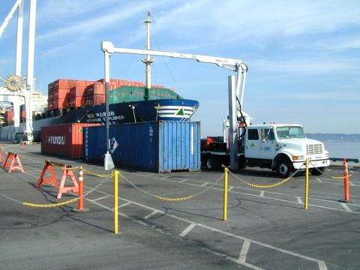
Mobile VACIS - Background
In 1998 it was becoming apparent that a Mobile NII System could be very useful to USCS and other US Government Agencies
At that time Mobile NII devices were large (60,000+ lb) multiple axle systems with limited mobility, reliability and cost issues
SAIC recognized that the VACIS technology could be a useful Mobile tool and invested in development of the Mobile VACIS
SAIC worked closely with USCS technical and operations staff and developed the basic requirements document in 1998
A few requirements were:
    Ability to maintain highway speeds (60 MPH)
    Single Fuel Type (some existing systems had multiple fuel requirements)
    Less than 26,000 pounds to enable driving without a Commercial Drivers License (CDL)
    Ability to obtain a Sealed Source Device Registry and DOT Certification to facilitate ease of transport
    Maximize use of COTS Components
    Minimize worse case exposure to the Operator to 50 Micro R/hr (actual < 30 Micro R/hr) by rigorous shielding of the cab
    Provide adequate lighting for Night Operation
    Operate in a temperature range of -30C to +50C
Prototype Mobile VACIS at Port of Vancouver 1999

Slide 26

Mobile VACIS – Background (cont)
SAIC worked with USCS and ALTEC (Americas largest Bucket Truck Supplier) to select a chassis which was Suitable for the requirements, load and driving demands
Over 90% (more than 4000) of ALTEC Bucket Trucks are on IH Platforms, leading SAIC to the selection of the IH4700 as the best vehicle in the 19,000 – 26,000 lb class (Permitting driving without a Commercial Drivers License (CDL)
A few trade offs leading to the IH 4700 selection were:
    IH is populated by a large dealer base in the United States
    A Dual Cab with capability to house an Operator Station was available
    A reputation for consistent production providing confidence in VACIS System Interfaces
    Being preferred by the key supplier ALTEC and our major prospective customer – USCS
The prototype production began in late 1998 and was available in 1999 for:
    Demonstration at Force Protection Equipment Demo at Quantico, VA in May
    Demonstration to Commission Ray Kelly at the Reagan Building in June
    Operation at the Port of Vancouver to gain Field Performance Data for 6 months
Based on this experience SAIC released the Mobile VACIS design for production in late 1999 with the first production lot shown at left produced in 2000. The first USCS MVACIS System was delivered to New Orleans.
²⁵

Slide 27
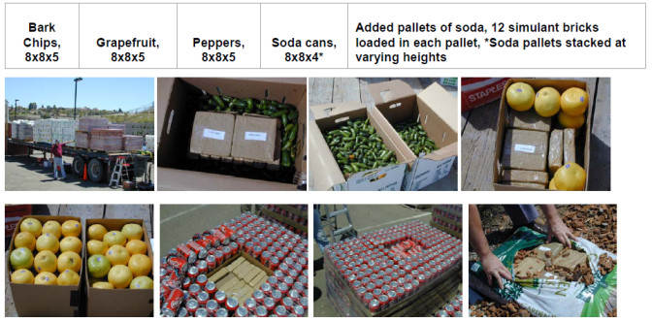
Mobile VACIS® Features and Performance
Convincing Customs to switch from Cs-137 to Co-60 (shorter lifetime) required a company funded demonstration in 2002
This switch was critical to avoid being held back by limited Cs-137 penetration
Hid drug simulants in typical cargo configurations and evaluated ability of Customs inspectors to detect “drugs” in a blind test using a Mobile VACIS with Co-60 and a Mobile VACIS with Cs-137
Notes:
Review Mobile VACIS performance capabilities—enhanced over VACIS II (slightly better spatial resolution and 6.5 inches steel penetration vs 4.5 for VACIS II with Cs-137
Convincing Customs that it was worthwhile to switch from Cs-137 to Co-60 (shorter lifetime) required company funded demonstration in 2002—side-by-side performance on real cargo into which simulated drugs were inserted.

Slide 28
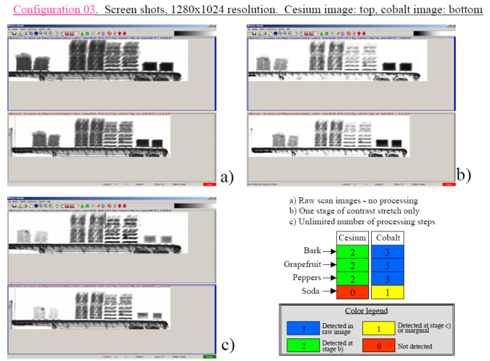
Typical results from the Co-60 vs Cs-137 Tests (Single Pallets)
Notes:
Review Mobile VACIS performance capabilities—enhanced over VACIS II (slightly better spatial resolution and 6.5 inches steel penetration vs 4.5 for VACIS II with Cs-137
Convincing Customs that it was worthwhile to switch from Cs-137 to Co-60 (shorter lifetime) required company funded demonstration in 2002—side-by-side performance on real cargo into which simulated drugs were inserted.

Slide 29
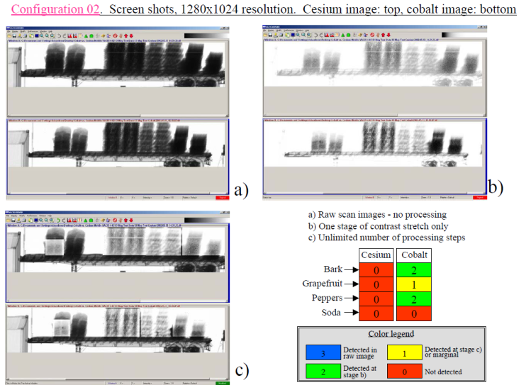
Typical results from the Co-60 vs Cs-137 Tests (Double Pallets)
Notes:
Review Mobile VACIS performance capabilities—enhanced over VACIS II (slightly better spatial resolution and 6.5 inches steel penetration vs 4.5 for VACIS II with Cs-137
Convincing Customs that it was worthwhile to switch from Cs-137 to Co-60 (shorter lifetime) required company funded demonstration in 2002—side-by-side performance on real cargo into which simulated drugs were inserted.

Slide 30
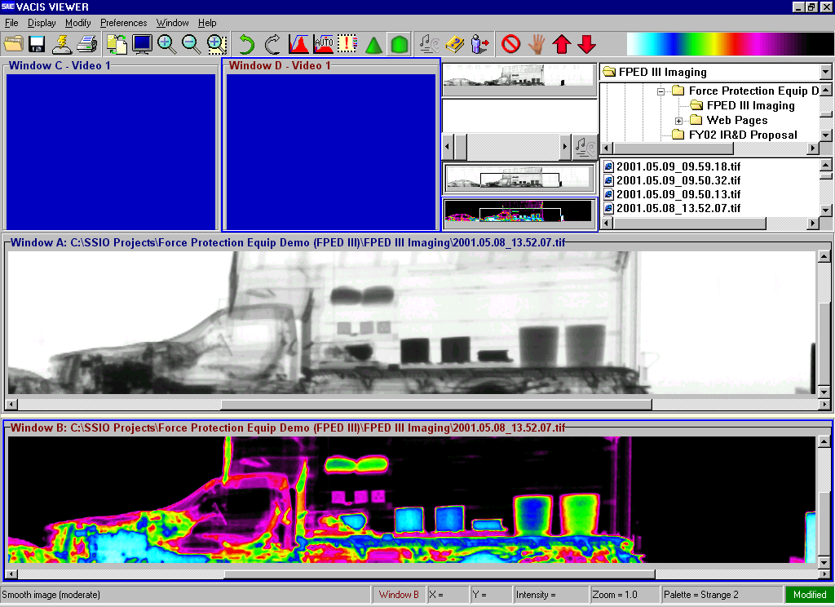
VACIS® Image Enhancement -Nonlinear Contrast Stretch
Image obtained during FPED III, May, 2001
Mobile VACIS with Co-60
Water
Ammonium Nitrate
Notes:
Using image enhancement techniques (like non-linear contrast stretch) we were able to detect small changes in radiographic density and when the dimensions of a target were known (like the barrels in this image) one can detect presence of an anomalous substance (ANFO instead of water)

Slide 31
Need for Integrated Systems Led to Developing the Integrated Container Inspection System (ICIS)
Radiation Portal Monitors (RPMs) used to detect nuclear weapons and radioactive materials by detecting gamma-rays and neutrons (Passive Detection)
High density shielding can prevent passive detection of nuclear weapon or radioactive material
Gamma or X-ray radiographic imaging can detect anomalous high density shielding –complements RPMs
Need capability to inspect 100% of containers without impacting the flow of commerce

Slide 32

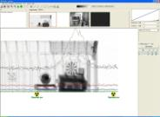
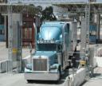
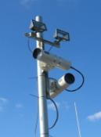
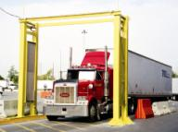
The ICIS System
VACIS®
gamma
imaging
ICIS Viewer
Cargo images
ICIS
Database
Integrated ICIS data
OCR identification
Integrated ICIS data
Customs
Agencies
Container IDs
Radiation profiles
Container data
Manifest data
Terminal
Operators
Carriers
Radiation Portal Monitor

Slide 33
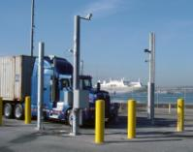
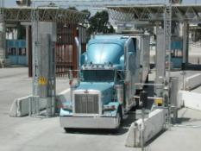
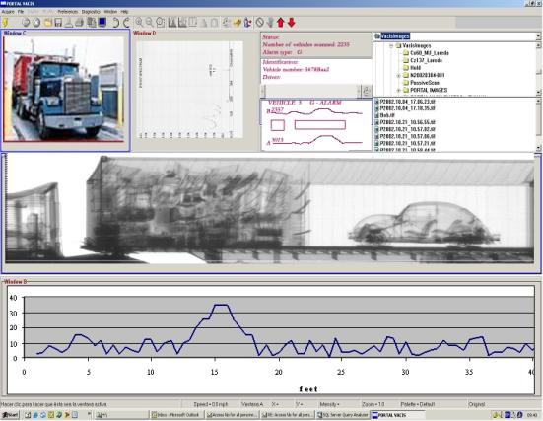

ICIS Viewer integrated data display
OCR identification
VACIS® gamma imaging
Container IDs
Cargo images
Radiation Portal Monitor
Radiation profiles

Slide 34
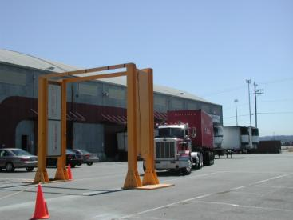
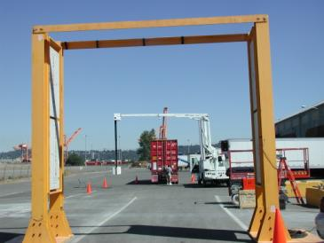
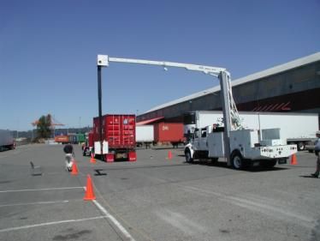
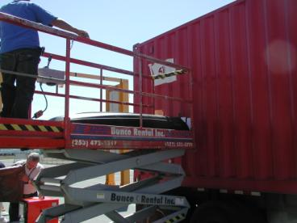
ICIS at Tacoma
Operation Safe Commerce (OSC) Experiment
July 23-24, 2004

Slide 35
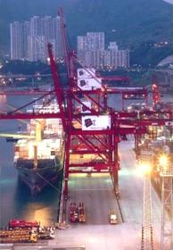
ICIS Demonstration
Concept of operation
  Install in terminal’s normal traffic patterns
  Collect and integrate imaging, radiation and OCR data
  Provide data to Customs and other approved parties
Hong Kong ICIS demonstration
  Install VACIS Portal, RPM and OCR at Modern
  Terminals and/or Hong Kong International Terminals
  Collect and integrate data in central repository
  Provide integrated data to Customs and CTOA for evaluation
  Began operation September 27, 2004; 6-months demonstration
  Demonstration for DHS (CBP, CG, S&T) and DOE representatives
Goal: Demonstrate the benefits of ICIS for Customs, terminal operators and shippers
  Increase supply chain security by screening cargo at port of origin
  Reduce security costs for terminals by minimizing impact on traffic
  Reduce costs for shippers by qualifying for expedited processing
  Enhance cargo security and management through data analysis
  Expedite recovery following an incident

Slide 36

Video of Hong Kong ICIS Demo

Slide 37
Rationale for VACIS Z and CAARS Development (6 & 9 MeV Dual Energy X-ray)
Addressed need for high speed screening of cargo for high-Z materials (DHS/HSARPA)
Dr. Rex Richardson invented an innovative Cherenkov detector array for VACIS Z with significant advantages over scintillation detectors
  Inherent threshold energy reduced scattered x-rays improving contrast sensitivity
  More affordable detector array
  Wider dynamic range
Successful demonstration of VACIS-Z led to DHS/DNDO funding development of CAARS, a gantry-based dual energy (6 and 9 MeV) x-ray system with ability to automatically detect shielded high-Z materials at high scanning speeds
Notes:
DHS/DNDO had a requirement for scanning cargo and detecting high-Z material (indicative of nuclear material) in cargo containers.
As part of a dual high energy radiography system development, Dr. rex Richardson developed an innovative Cherenkov detector array which provided significant advantages over conventional scintillator-based detector arrays (used on gamma-source based VACIS)
Successful demo of VACIS-Z POC system led to a contract to develop a 6 and 9 MeV x-ray system (gantry based system called CAARS) for DNDO

Slide 38
Development of Dual High Energy Radiography
System (VACIS Z)
High-Z detection using dual energy x-ray based on increase
in mass attenuation of high-Z elements between 6 and 9 MeV
Unique “Cherenkov” x-ray detector invented for VACIS-Z
Notes:
Shows principle of dual –energy VACIS-Z—note that as the x-ray energy increases from 6 to 9 MeV the attenuation increased for high-Z, remains relatively flat for medium z materials and decreases for low-Z materials. Analysis of 6 and 9 MeV radiographic images can automatically identify high-Z materials (and other materials of interest—for example low-Z materials which are indicative of drugs)
Also shows principle of Cherenkov detectors

Slide 39
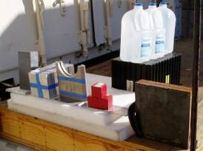
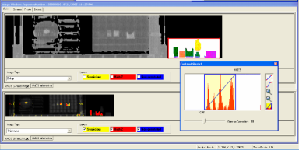
Material Separation Utilizing Dual Energy
SCAN
6/9 MeV
Radiograph
Target Setup Photo
VACIS-Z GUI with Z-Map
Low Z
Low Z
Abbreviations
Pb……. Lead
Al…….. Aluminum
W…….. Tungsten
DU…… Depleted uranium
High Z.. High atomic number
Al
Al
Fe/Cu
Fe/Cu
High Z
High Z
Inset Detail from Z-Map Image
Notes:
Early POC results from our VACIS-Z development showing ability to identify wide range of different Z materials ( from water to DU)

Slide 40
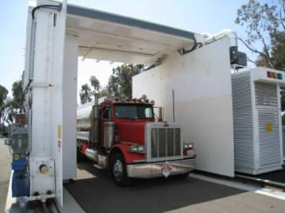
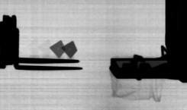
CAARS Performance
Dual-energy x-ray (6 and 9 MeV) allows automated detection of high-Z materials in a
cargo container
Scan speed of 33 inches/sec
Penetration greater than 16 inches of steel equivalent
Contrast sensitivity of 1%
Spatial resolution of 0.28 inches at cargo container centerline
Ability to image 0.010 inch thick steel foil in free air
Automated detection of 100 cc of high-Z material behind 10 inches of steel
0.010 “
CAARS image of steel kites
Notes:
CAARS (Gantry based dual energy system using a 6 and 9 MeV interlaced Linac) performance is shown
CAARS gantry photo –cargo truck or container is stationalry and gantry scans it.
Performance characteristics
Algorithms developed which allow high-Z material to be automatically detected—radiograph illustrates two high-Z targets that have been automatically flagged.
Wide dynamic range of CAARS illustrated in radiograph (right) which shows a thin steel “kite” (10mils thick) easily imaged—so with the same high energy system we can penetrate dense, thick material (up to 16 inches steel equivalent) and thin, low-density material (0.010 inches steel)

Slide 41
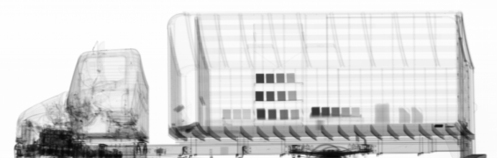
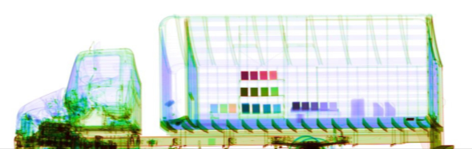



CAARS Performance (15 levels of Z discrimination)
Columns have same density/area
Pb
Sugar
Motor Oil
Fe
Al
HD Poly
U uranium
Pb lead
Cu copper
Fe iron
High-Z
U
Pb
Cu
Fe
Al
Low-Z
Handgun
Drug Simulant
SAIC CAARS 6 MeV / 9 MeV dual energy separation of materials by atomic number
(work funded by DHS DNDO)
Notes:
This radiograph illustrates CAARS ability to differentiate 15 levels of Z which will make the dual-energy technique useful for not only screening for nuclear (high-Z) materials but other contraband (drugs, weapons and explosives) which can be identified by their characteristic average-Z

Slide 42
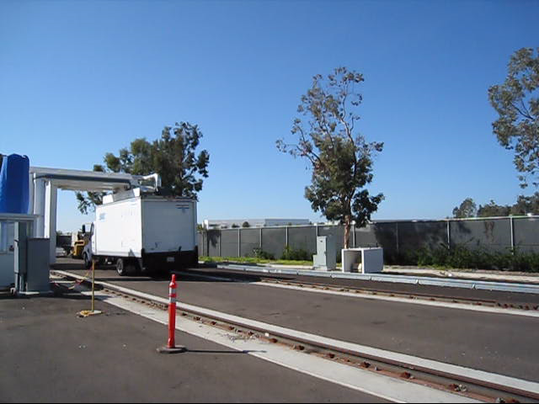
CAARS VIDEO

Slide 43
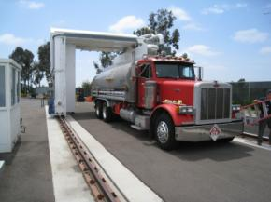
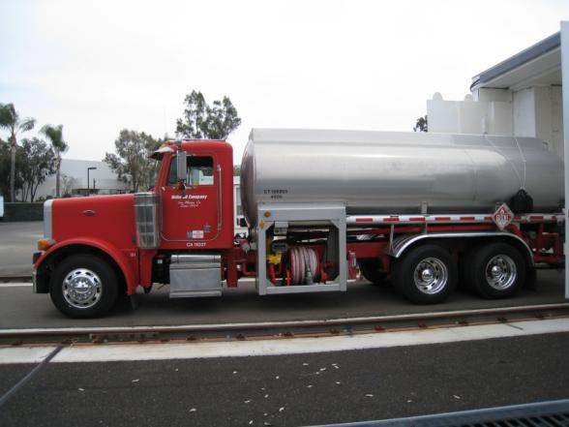
Loaded Fuel Tanker
Plastic land mine (inert)

Slide 44
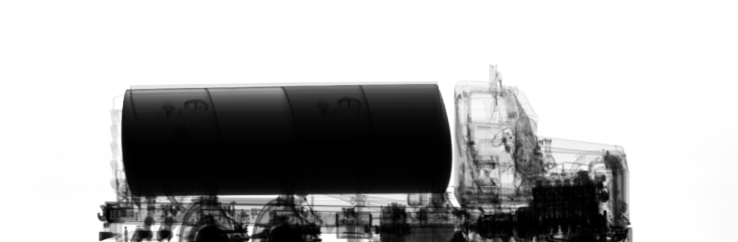

Loaded Fuel Tanker
Scan speed:
33 inches/sec
Plastic land mine (inert)

Slide 45

Why detecting explosive in loaded tanker truck is important

Slide 46

Mobile 6&9 MeV X-ray System Proposed for DHS CanScan Program

Slide 47
Lessons Learned from Development of Family of VACIS® Products
Develop product idea which addresses an important real-world requirement (detecting contraband in cargo entering the US)
Invest in understanding customer requirements and user CONOPS (especially constraints on CONOPS)
Strive to provide innovative product designs which offer significant performance advantages over “conventional” inspection approaches
When demonstrating performance strive to use performance metrics that the user can readily relate to (e.g. for VACIS: enhanced contraband detection capability)
Obtain feedback from users as early as possible in the development (demonstration of prototypes in the field provides valuable performance data in a realistic operating environment)
Work closely with user to adapt product for user’s needs (e.g., VACIS role expanded from tanker trucks to cargo containers, railcars, pallets)
Invest in developing infrastructure (manufacture, installation, maintenance and training) required to support commercialization of the product
Notes:
Summary of lessons learned from the development of VACIS in to a family of products over more than a 10 year period
User requirements –examples-CBP worried about 1 Ci Cs-137/Co-60 source at POE—radiation safety concerns addressed—for example, fast acting shutter automatically closes if railcar stops during scan on Railroad VACIS
Offer advantages over conventional inspection approaches—VACIS offered greater inherent system reliability over conventional x-ray system (99% availability for some systems and greater than 95% for all)
User-oriented Performance Metrics– example, experiment demonstrating superior imaging (and contraband detection of Co-60 vs Cs-137-used CBP inspectors to interpret images and draw conclusions on detectability.
Feedback early—VACIS I at POE (Laredo) provided many valuable suggestions for improving VACIS and led to VACIS II with improvements
Work with User to identify related applications—ex. Whole family of VACIS products inspecting trucks CCs, RR cars, pallets, etc.
Infrastructure: product support essential—even a good product will fail if it is not effectively supported.

Slide 48
Lessons Learned from Development of Family of VACIS® Products-continued
Identify additional applications of the product and invest in product modification required to address those applications (e.g., Military Mobile VACIS)
Pursue government research and development funding (but, be ready to invest private funds)
  Results of R&D can be leveraged into improved products (e.g., family of VACIS gamma-based systems, VACIS-Z and CAARS)
  Helps insure government customer “buy in” to the technical solution
  Seek company funding for product development when there is clear requirement and government R&D funding is not available in timely manner but ensure customer participation and “buy in” (e.g. SAIC development of Mobile VACIS)
  Private funding helps ensure Intellectual Property protection
Notes:
MMV is a good example of broadening applications by identifying a need with a new customer (DoD)—Force Protection instead of contraband detection for CBP
Finally, important to seek and obtain government funding but be prepared to invest private funding

