Slide 1
Agenda for 5/10/17 111th Meeting
Reminder: please turn off or mute cell phones
Announcements and Introductions
Website issues
Pete’s Lynx
Upcoming Scheduled Talks
“The Seven Summits”, Cindy Outlaw

Slide 2
Jim Lonergan
Jim passed away on April 31st, just 2 days after our last meeting
His wife, Cathy, is organizing a celebration of Jim’s life
Here at the Southwestern Yacht Club
Sunday, July 16th, 1:00 PM
We will also send out an email with the date, time, and place to inform Lyncean members who are not here today

Slide 3
Website
Thanks to all who contributed to defray our website costs!
Hacking continues to be a challenge but SiteLock scans and frequent monitoring by several of us seems to be adequate to keep things working and secure
Expenses
Our current website expenses are now ~$204 per year
We are paid up for the next year
How should we raise the money for this in the future?
If problems return, we could spend another $70/yr for an SSL certificate, which encrypts all user interactions with the site and makes it harder for a hacker to penetrate the site
Some search engines downgrade or ignore sites without SSL certificates
This would bring our annual website expense up to $274 per year

Slide 4
Website Costs
Item | Annual Cost | Status
Domain Name | $20.17 | Paid thru 2/18/22
Hosting Service | $96.00 | Paid thru 2/20/18
Daily Security Scans | $84.00 | Paid thru 2/26/18
Daily Backups | $24.00 | Paid thru 2/26/18
TOTAL ANNUAL COST | $224.17 | $204.00 thru 2/18/22
SSL certificate | $49.99 | Assuming 3-yr contract
TOTAL ANNUAL COST | $274.16 | $253.99 thru 2/18/22
Current
There could be additional expenses if someone successfully hacks the site:
Another one-time scan by security expert would cost $199.99
Security expert service costs $80/month to cover 3 issues/month
Suggest we raise at least $500/yr

Slide 5
How to Pay for This in the Future
Raise the meeting fee?
Raise money on an as-needed basis?
Other expenses may arise (e.g., dedicated laptop)
 |  | Annual Amount Raised
Average # Meetings/yr | 8
Average # Attendees/Mtg | 40
Increase in Meeting Fee | $1.00 | $320.00
Increase in Meeting Fee | $2.00 | $640.00
Increase in Meeting Fee | $3.00 | $960.00

Slide 6
Upcoming Talks
SUBJECT TO CHANGE
This information is also on the website under
“Upcoming Talks”
Date | Speaker | Topic
5/10/17 | Cindy Outlaw Former Group Controller, SAIC Board Chair, Plant With Purpose Mountain Climber | The Seven Summits
6/21/17 | Barbara Durrant Director and Henshaw Chair, Reproductive Sciences, Institute for Conservation Research, San Diego Zoo Global | San Diego Zoo’s Frozen Zoo®
8/2/17 | Patrick Lee Vice President, Infrastructure & Technology, Sempra Infrastructure and President, PXiSE Energy Solutions (a company owned by Sempra Energy) | Advanced Control Technology for the Electric Grid of the Future
9/13/17 | John Glass Professor, J. Craig Venter Institute | Synthetic Biology and CRISPR Technology

Slide 7
Upcoming Talks
SUBJECT TO CHANGE
This information is also on the website under
“Upcoming Talks”
Date | Speaker | Topic
10/25/17 | Ray Ashley Professor, J. Craig Venter Institute | Replicating the San Salvador, the ship in which Juan Cabrillo sailed to San Diego
12/6/17 | Andreas Bratt-Leal Director of Research & Development, Summit for Stem Cell Foundation | Patient-specific cell therapy for Parkinson’s disease
1/17/18 | Alex Cannara Engineering and Environmental Consultant | Ocean Acidification
2/28/18 | TBD
Thanks to Pete Lobner, we already have the first talk of 2018 booked!

Slide 8
Southwestern Yacht Club, San Diego
Pete’s nuclear powered submarine
We are here

Slide 10
Southwestern Yacht Club, San Diego
Pete’s nuclear powered submarine
We are here

Slide 11
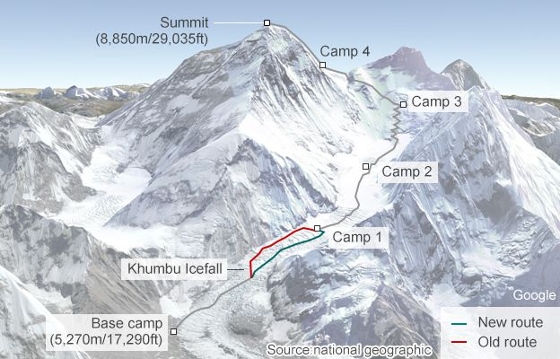
Plant Cindy’s Coin on Everest!
New Route
Old Route

Slide 12
Our Plan to Scamper Up This Big Boy
New Route
Old Route
Shortcut!

Slide 13
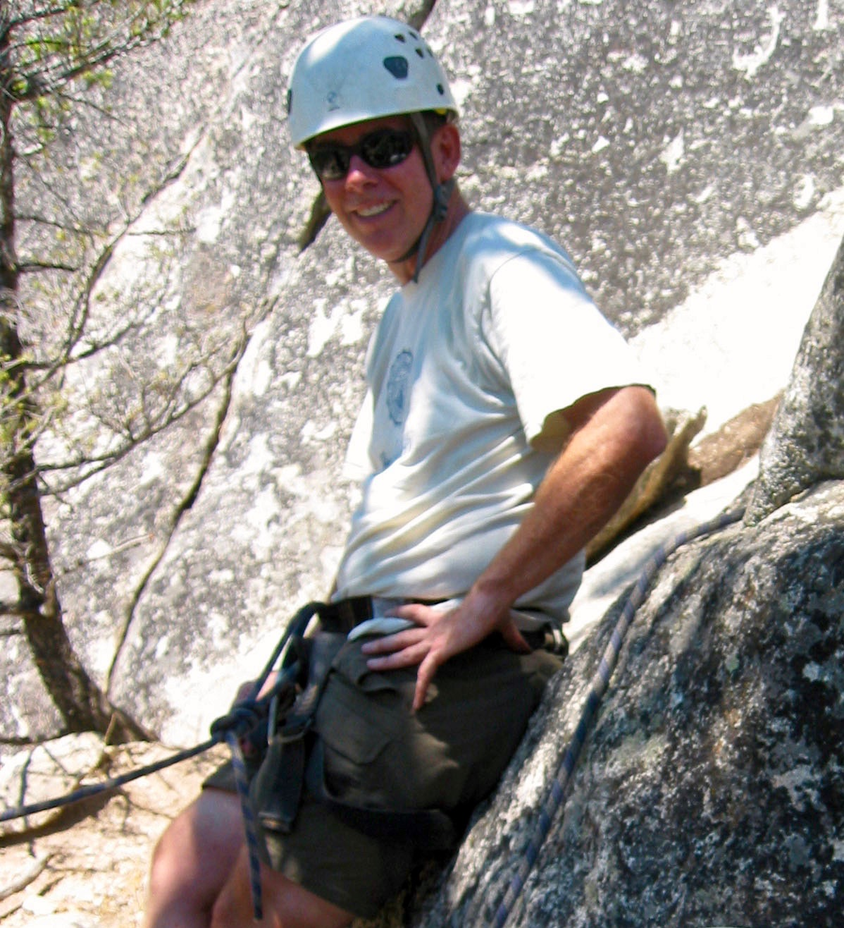
Morning, Starting Out at Base Camp
Photo Credit: Ed Murphy

Slide 14
Later That Day, At the Summit (sorry Ed muffed the picture)
Photo Credit: Ed Murphy

Slide 15
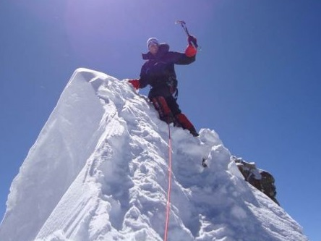
Burying the Coin on the Summit
Photo Credit: Ed Murphy

Slide 16
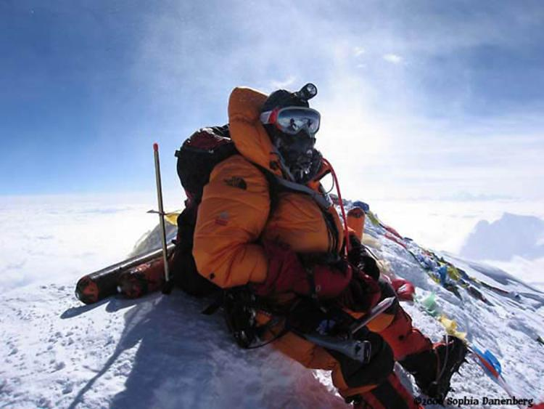
Climbing Partner & Photographer, Ed Murphy
Photo Credit: Bill Hagan

Slide 17
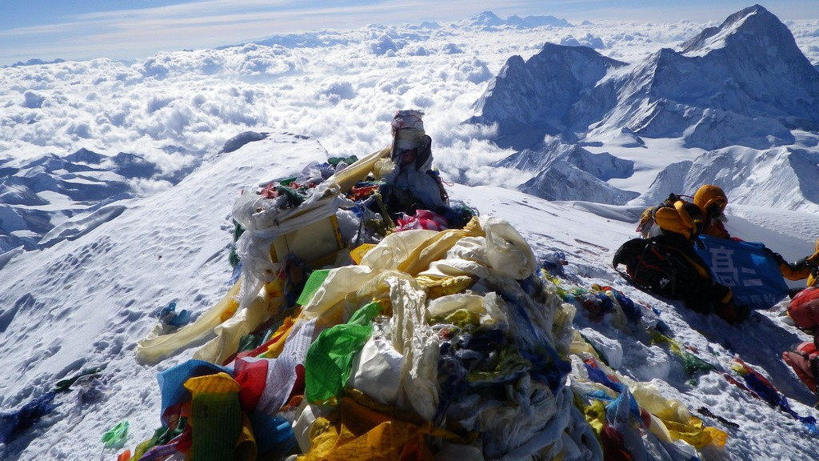
Cindy, It’s Right Under That Yellow Flag!
Lyncean Coin Location
Ed
Photo Credit: Tenzing Norgay II

