Slide 1
Agenda for 9/13/17 114th Meeting
Reminder: please turn off or mute cell phones
Announcements and Introductions
Upcoming Scheduled Talks
Interesting website statistics
“Engineering Life Using CRISPRs and Synthetic Biology”, Dr. John Glass

Slide 2
Upcoming Talks
SUBJECT TO CHANGE
This information is also on the website under
“Upcoming Talks”
Date | Speaker | Topic
9/13/17 | John Glass Professor and Group Leader, Synthetic Biology & Bioenergy Group, J. Craig Venter Institute | Engineering Life Using CRISPRs and Synthetic Biology
10/25/17 | Ray Ashley President and CEO, San Diego Maritime Museum | Replicating the San Salvador, the ship in which Juan Cabrillo sailed to San Diego
12/6/17 | Andreas Bratt-Leal Director of Research & Development, Summit for Stem Cell Foundation | Patient-specific cell therapy for Parkinson’s disease
1/17/18 | Alex Cannara Engineering and Environmental Consultant | Ocean Acidification
2/28/18 | TBD

Slide 3
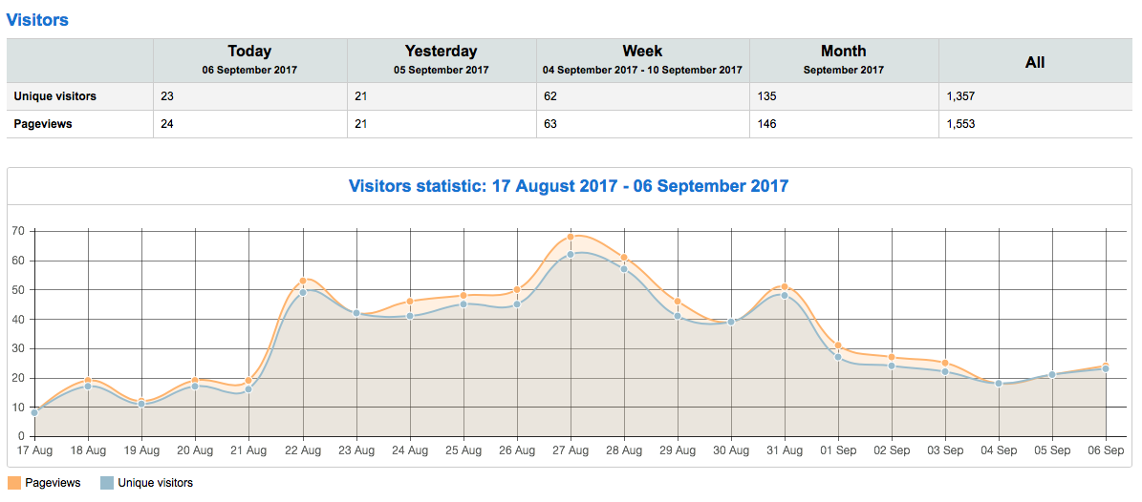
What Happened on Aug 22nd?

Slide 4
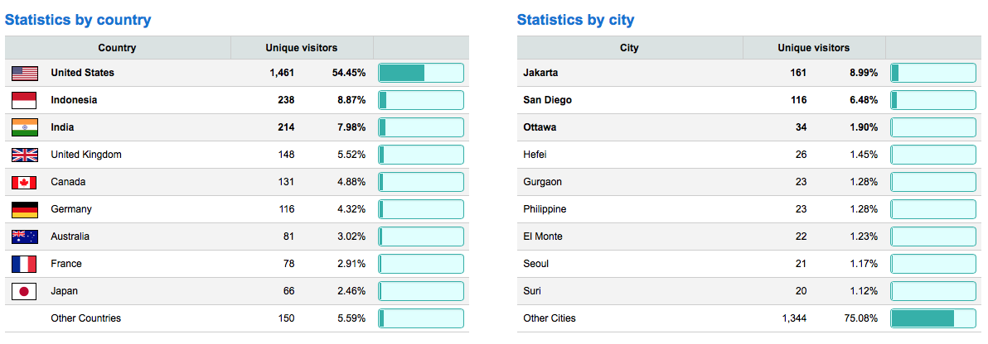
More Visitors from Jakarta Than San Diego?

Slide 5
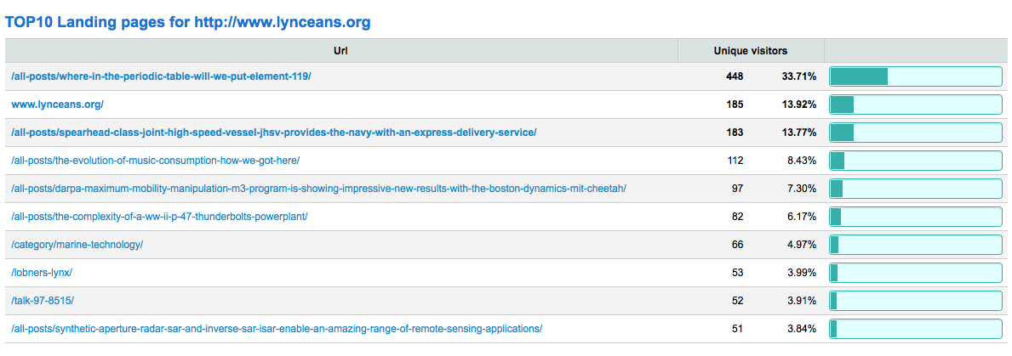
What is So Appealing About Putting Element 119* on the Periodic Table?
*Ununennium, also known as eka-francium or simply element 119, is the hypothetical chemical element with symbol Uue and atomic number 119. Ununennium and Uue are the temporary systematic IUPAC name and symbol, respectively, until a permanent name is decided upon. In the periodic table of the elements, it is expected to be an s-block element, an alkali metal, and the first element in the eighth period.

Slide 6
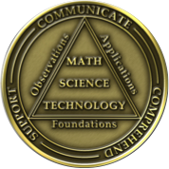
Southwestern Yacht Club, San Diego
Pete’s nuclear powered submarine
We are here

Slide 7
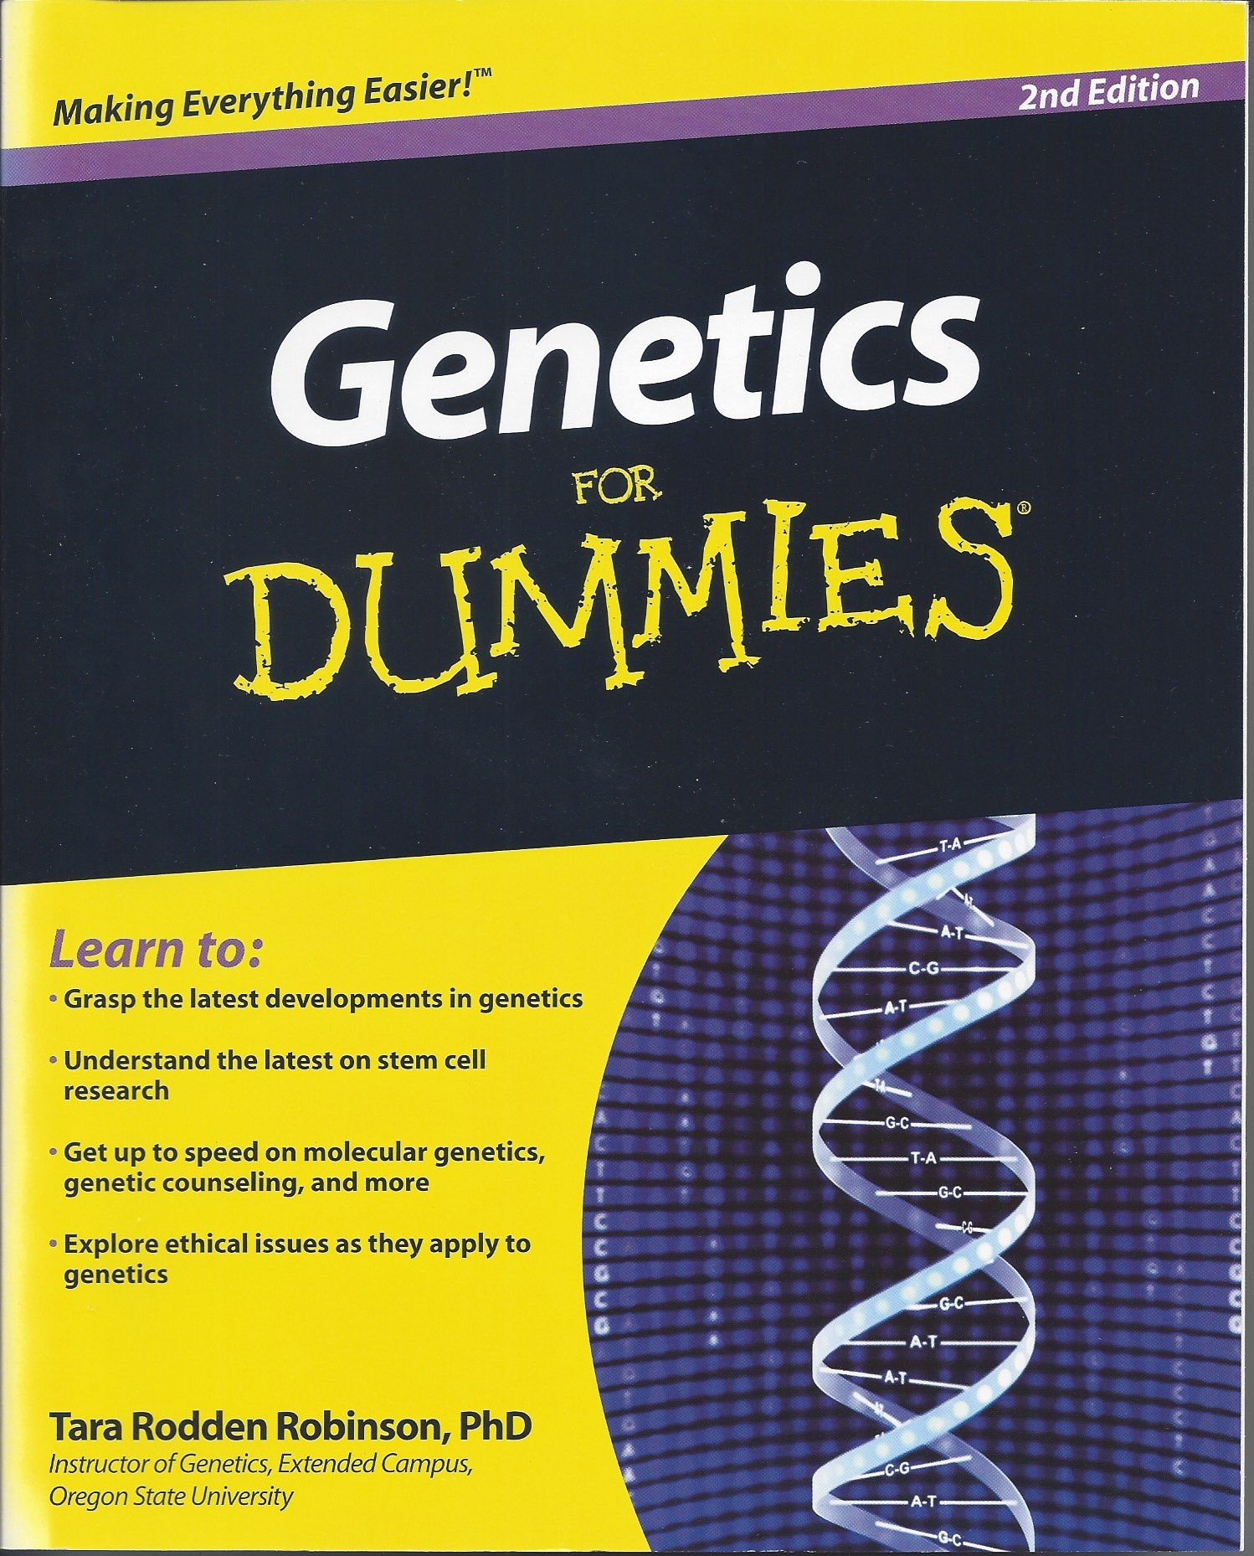
Turn Lemons Into Lyncean Coins (ie, Citrus limonium -> Citrus lyncean)
Experiment Objective: Use CRISPR to modify DNA of lemon seed
Create tree that produces Lyncean coins instead of lemons
Accelerate growth rate of tree by 100X
Experiment Plan:
Raid Lyncean cash fund to buy supplies
Figure out how to use CRISPR
Modify lemon seed
Plant modified seed and grow tree
Harvest coins for future speakers
Make delicious beverage out of juice from coins
CRISPR
$8.92
✔
✔
✔
✔
✔
✗

Slide 8
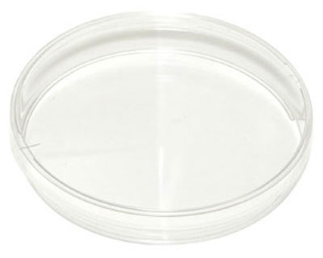
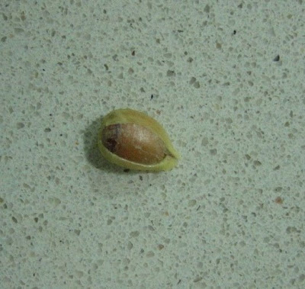
Incubation of Modified Seed – 1st Try
Growth
Time
0 Days
1 Day

Slide 9
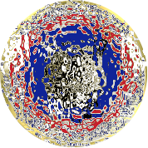
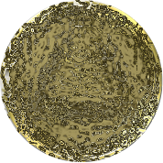
Incubation of Modified Seed – 1st Try
Hmmm…
Front
Back
Growth
Time
2 Days
4 Days
8 Days

Slide 10
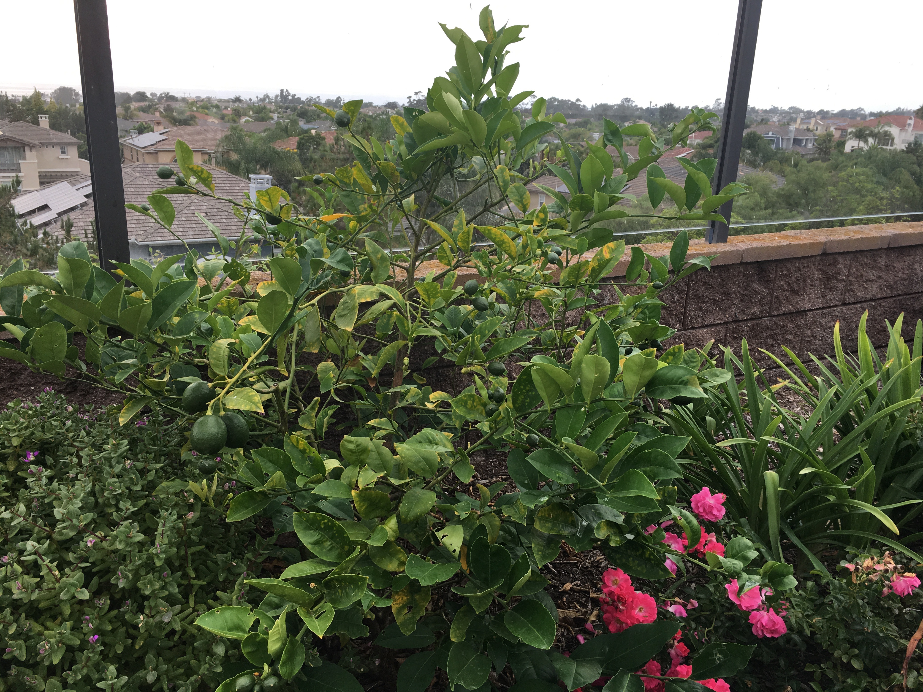
1st Try

Slide 11
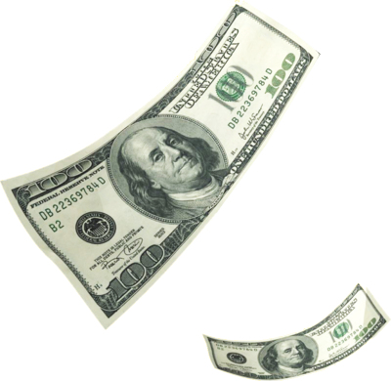
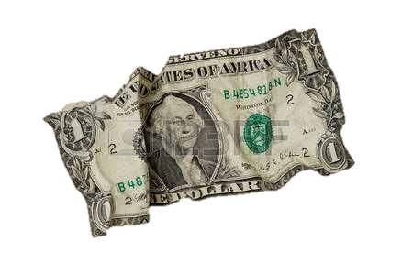
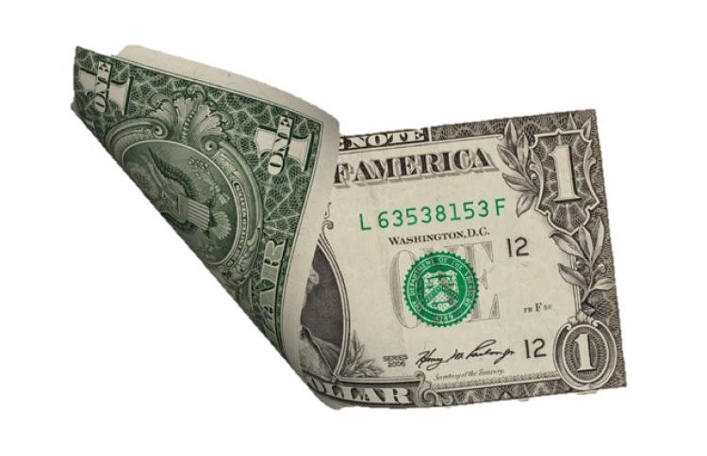
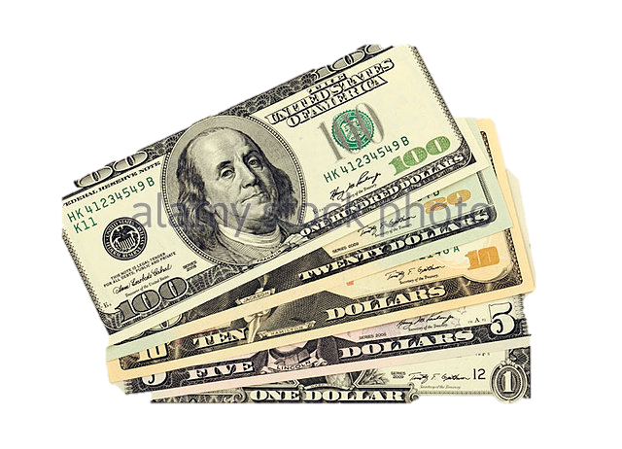
1st Try

Slide 12
1st Try

Slide 13
Incubation of Modified Seed – 2nd Try
Growth
Time
0 Days
1 Day

Slide 14
Incubation of Modified Seed – 2nd Try
SUCCESS?
Front
Back
Growth
Time
2 Days
4 Days
8 Days

Slide 15
2nd Try

Slide 16
2nd Try

Slide 17
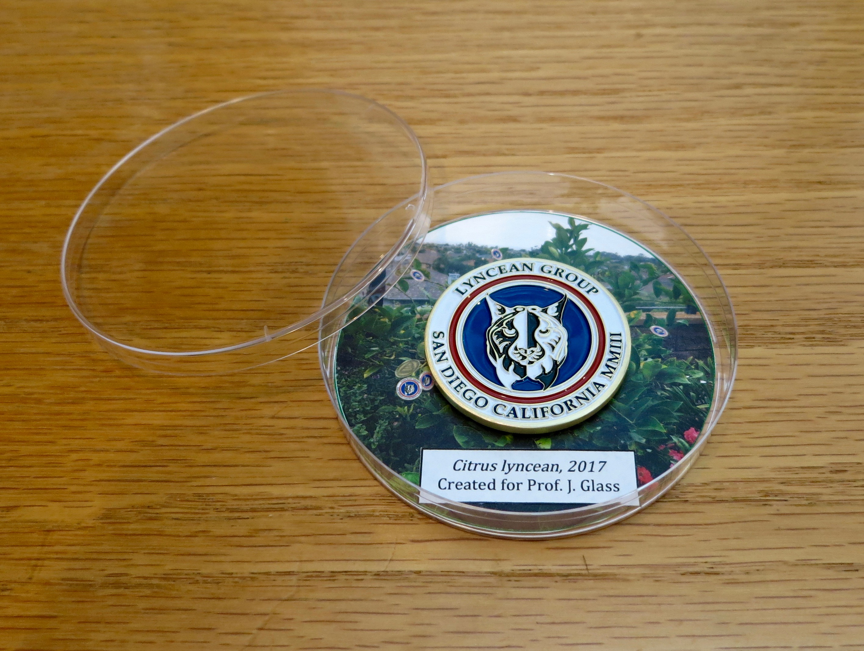
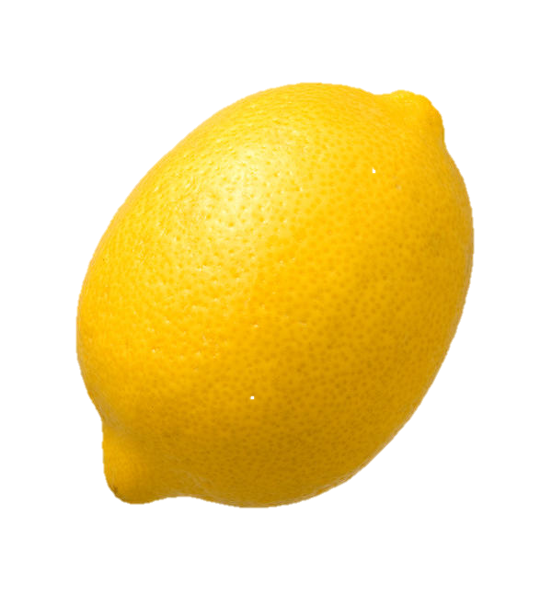
Harvested 9/13/17 for Prof. John Glass
✔

Slide 18
Southwestern Yacht Club, San Diego
Pete’s nuclear powered submarine
We are here

