Slide 1
Agenda for 5/23/18 120th Meeting
Reminder: please turn off or mute cell phones
Announcements, Introductions, Issues, or Ideas
Page for recommended reading on the website
Upcoming Scheduled Talks
Without Warning author signing opportunity Nov 14: Thomas Sanger
Another author signing opportunity on August 22: David Brin
Pete’s Lynx
Website Stuff
“The Zwicky Transient Facility at Palomar Observatory”, Matthew Graham & Roger Smith

Slide 2
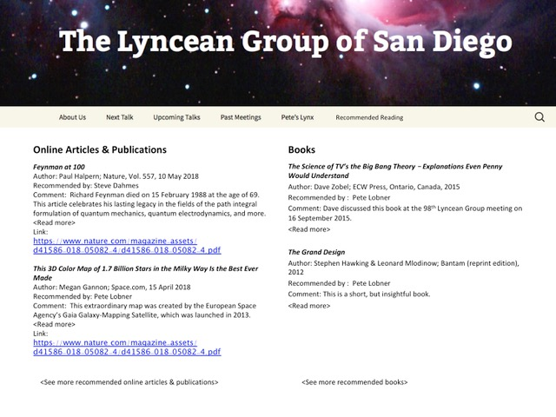
Recommended Reading Page on the Website

Slide 3
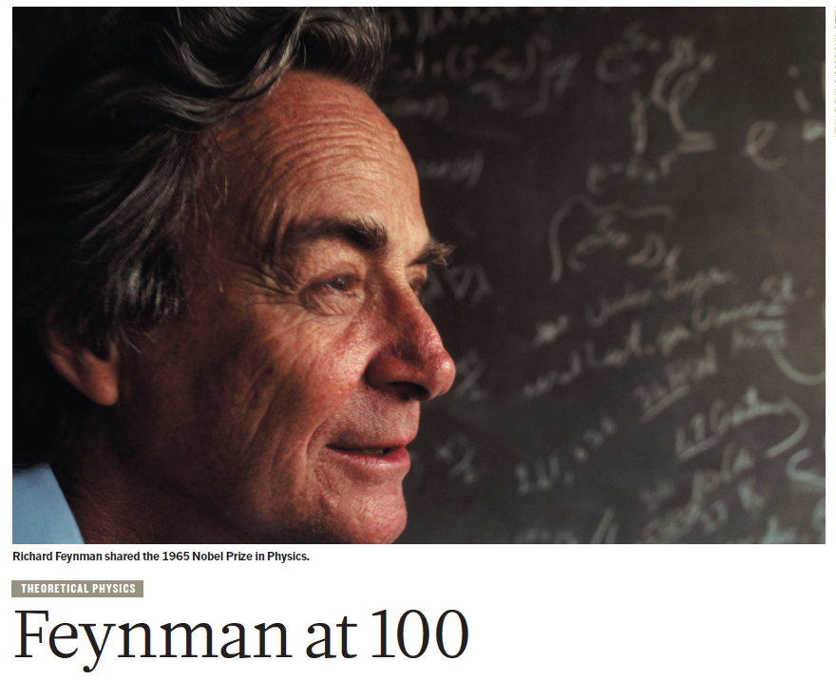
May 2018: Feynman’s 100th Birthday

Slide 4
Upcoming Talks
SUBJECT TO CHANGE
This information is also on the website under
“Upcoming Talks”
Date | Speaker | Topic/Title
5/23/18 | Matthew Graham Senior Computational Scientist, Center for Advanced Computing Research, Caltech Roger Smith Principal Electronics Engineer, Palomar Observatory | The New Zwicky Transient Facility (ZTF) at Palomar Observatory
7/11/18 | John Whiteman Harmonica Collector | The Harmonica, It’s Evolution, Variety, and Beauty - For Players, Collectors, and the Curious
8/22/18 | David Brin Scientist, Author*, Technology Consultant, Speaker (http://davidbrin.com) *eg, The Postman | Singularities, AI-takeover, the Fermi Paradox, and other reasons everyone should stay calm and let science drive the future

Slide 5
Upcoming Talks
SUBJECT TO CHANGE
This information is also on the website under
“Upcoming Talks”
Date | Speaker | Topic/Title
10/3/18 | Tim Barton Maritime Chief Engineer Maritime, Integration, and Mission Systems Operation Vice President, Solution Architect, and Technical Fellow Leidos | The Anti-submarine warfare (ASW) Continuous Trail Unmanned Vessel (ACTUV)
11/14/18 | Thomas Sanger Journalist, Documentarian, and Author of Without Warning, a novel based on the sinking of the Athenia | Athenia – A Forgotten Tragedy of World War II
1/9/19 | TBD

Slide 6
Pete’s Lynx

Slide 7
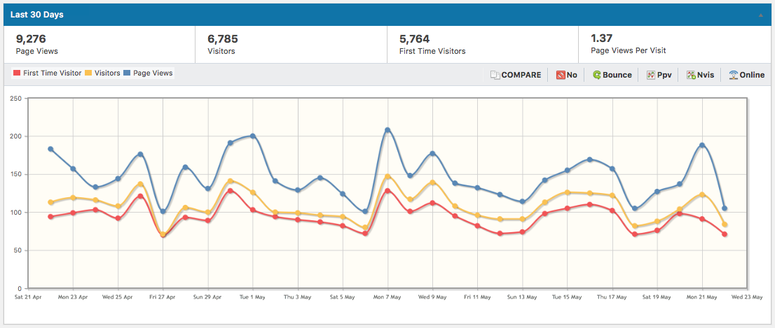
Website Stats Apr 22 – May 22 (2 PM)
16,121 since Feb 3 (109 days). That is approximately 148
visitors per day or 4,400 per month or 53,000 per year.

Slide 8
Top 10 “hits” for Yesterday at 2 PM
“Element 119 and the Periodic Table”
has been displaced!

Slide 9
The Zwicky Transient Facility at Palomar Observatory Matthew Graham and Roger Smith

Slide 10
Lyncean Coin Presentation
Pete’s nuclear powered submarine
We are here

Slide 11
Lyncean Coin Presentation
Southwestern Yacht Club, San Diego
or
An Exercise in Hubris
Pete’s nuclear powered submarine
We are here

Slide 12
Preface…
I got off to a bad start in planning this coin presentation a few weeks ago because I did not bother to read about the ZTF. So I didn’t really know what I was talking about, but I thought I did
In looking back, I think this oversight was the result of:
The arrogance of having an advanced degree (from so long ago that I no longer understand my own dissertation), and
The experience of having worked in the federal government for 4 years (oddly, and falsely, empowering)
In other words – HUBRIS (defined as “excessive pride or self-confidence”)
I didn’t need to read about the ZTF because I just KNEW its purpose was to look for exoplanets orbiting other suns by measuring their transit times and the dip in light from the star during the transit
Hence the name Zwicky Transit Facility!

Slide 13
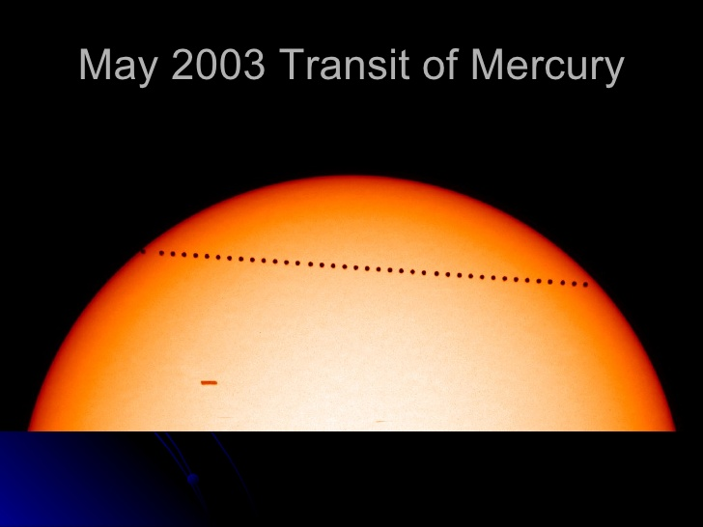
Planet Moving Between Star and Observer…

Slide 14
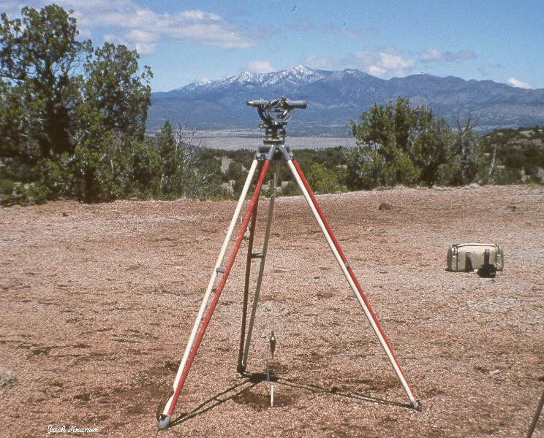
Lyncean Coin Transits a Transit

Slide 15
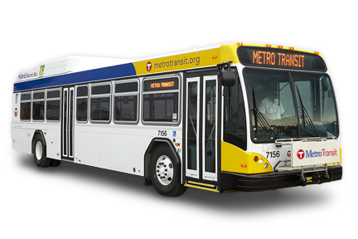
Lyncean Coin Transits (Metro) Transit

Slide 16
HOWEVER…
It is NOT the
Zwicky Transit Facility
It is the
Zwicky Transient Facility

Slide 17
But I STILL didn’t bother to read about the science that is planned for the ZTF
Hubris strikes again!

Slide 18
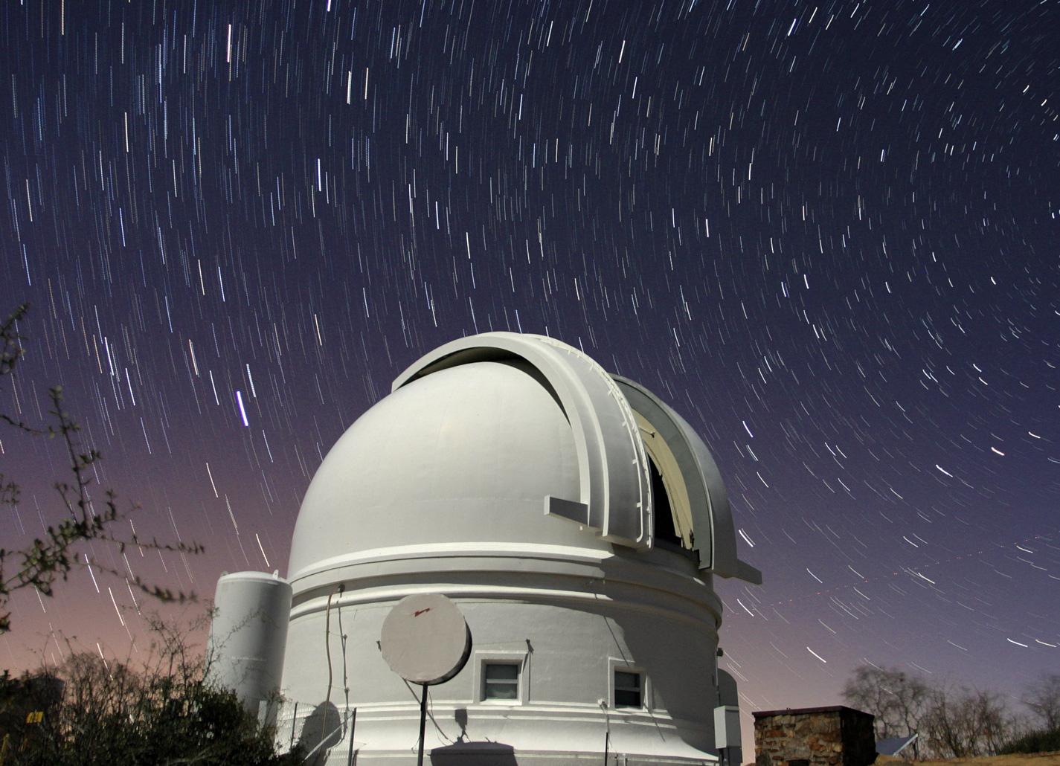
Lyncean Coin Transits the Transient Facility

Slide 19
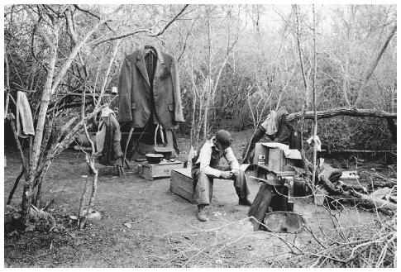
Lyncean Coin Transits a Transient

Slide 20
I was so full of hubris that I wondered why they had named the facility so oddly. “Scientists are not very good communicators,” I told myself.
“Especially astronomers. ” But it nagged at me!
FINALLY, while biking just a few days ago, I had the epiphany to go to the ZTF website and read about it.
The words “transit” and “exoplanet” do not appear ANYWHERE on the website.
To quote Roseanne Roseannadanna,
“Nevermind”

Slide 21
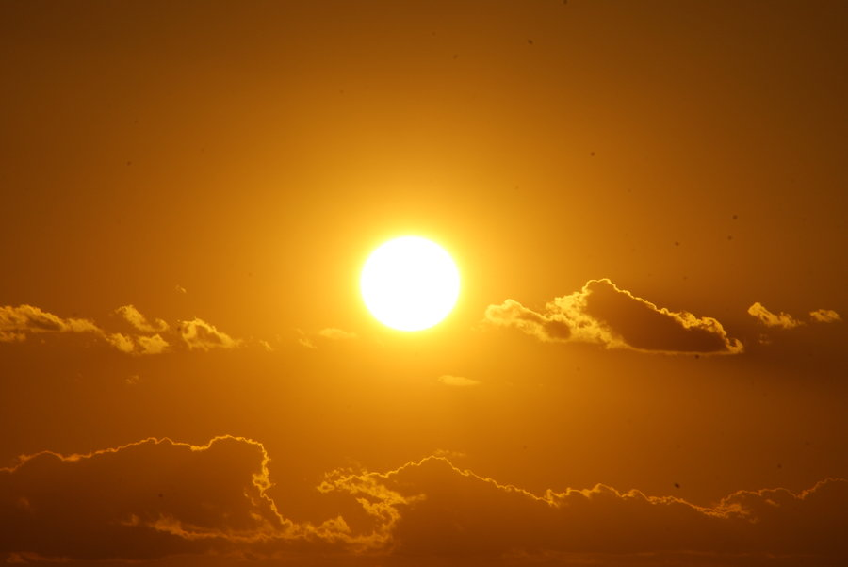
Lyncean Coin Transits Distant Star

Slide 22
Then Returns to Eclipse It

Slide 23
Thank You!
Lyncean Coins Presented to
Roger Smith and Matthew Graham
of the
Zwicky Transient Facility
May 23, 2018

Slide 24
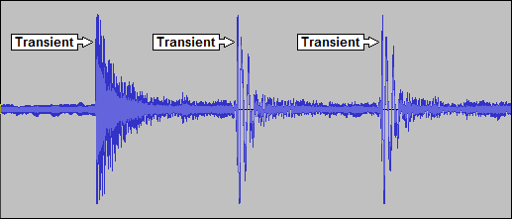
Lyncean Coin Transits Transients

Slide 25
Thank You! (“Nevermind” Version)
Lyncean Coins Presented to
Roger Smith and Matthew Graham
Good for
Free Ride on
SD Transit
Bus
of the
Zwicky Transit Facility
May 23, 2018

Slide 26
Meeting Adjourned
Southwestern Yacht Club, San Diego
Pete’s nuclear powered submarine
We are here

