Slide 1
Agenda for 7/11/18
121st Meeting
Reminder: please turn off or mute cell phones
Announcements, Introductions, Issues, or Ideas
  David Groce update on Lena Murchikova
  Recommended Reading has been added to the website
  2001: A Space Odyssey is 50 years old!
Upcoming Scheduled Talks
  Added two more new ones – now scheduled up through February 2019!
  Without Warning book signing Nov 14: Thomas Sanger
  Another book signing opportunity on August 22: David Brin
  And another book signing opportunity on Feb 20, 2019: Brian Keating
Website Statistics
“The Harmonica: It’s Evolution, Variety, and Beauty”, Dr. John Whiteman
Coin Presentation

Slide 2
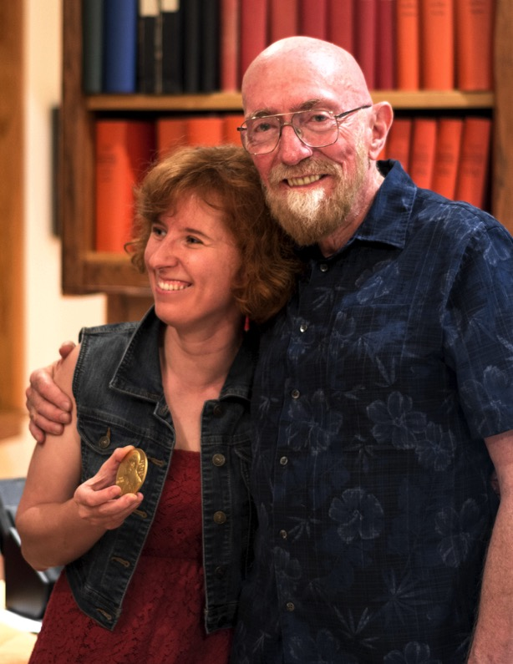

Lena Murchikova and Kip Thorne Celebrate Having Both Been Awarded Lyncean Coins

Slide 3
Lena Murchikova and Kip Thorne Celebrate Having Both Been Awarded Lyncean Coins
Professor Thorne’s Nobel Prize

Slide 4
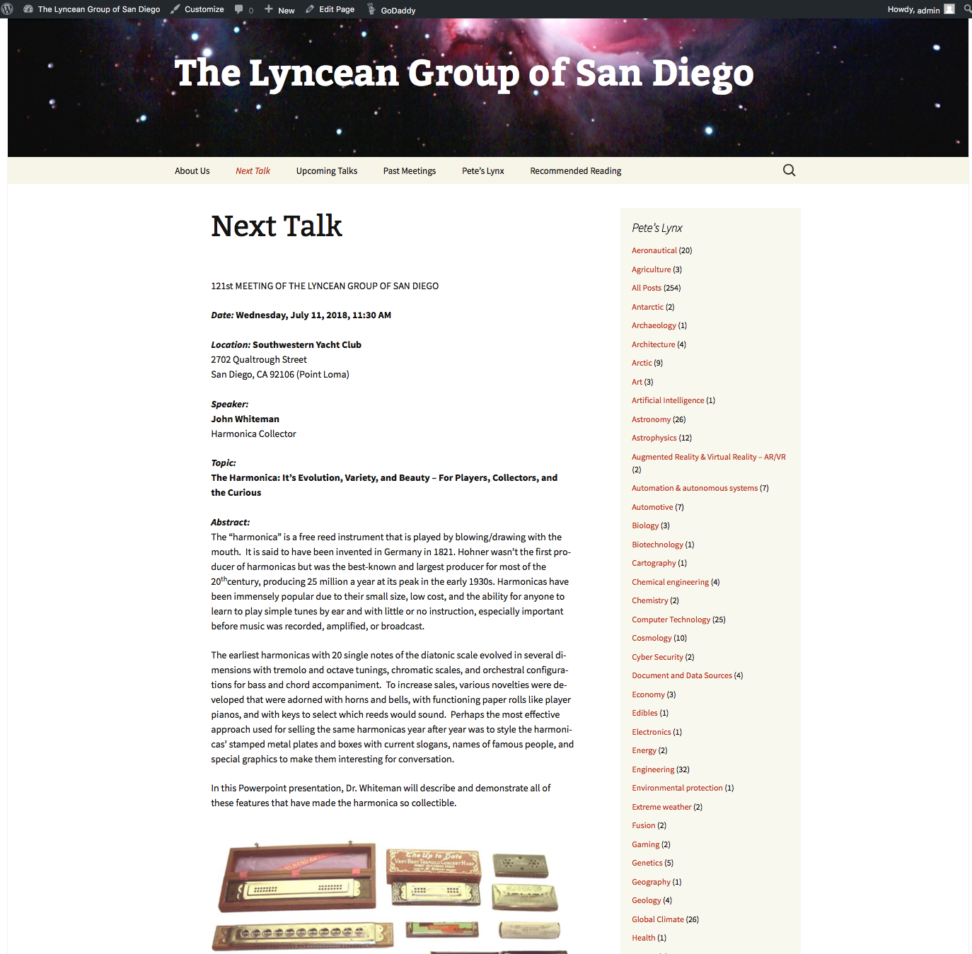
Recommended Reading Page

Slide 5
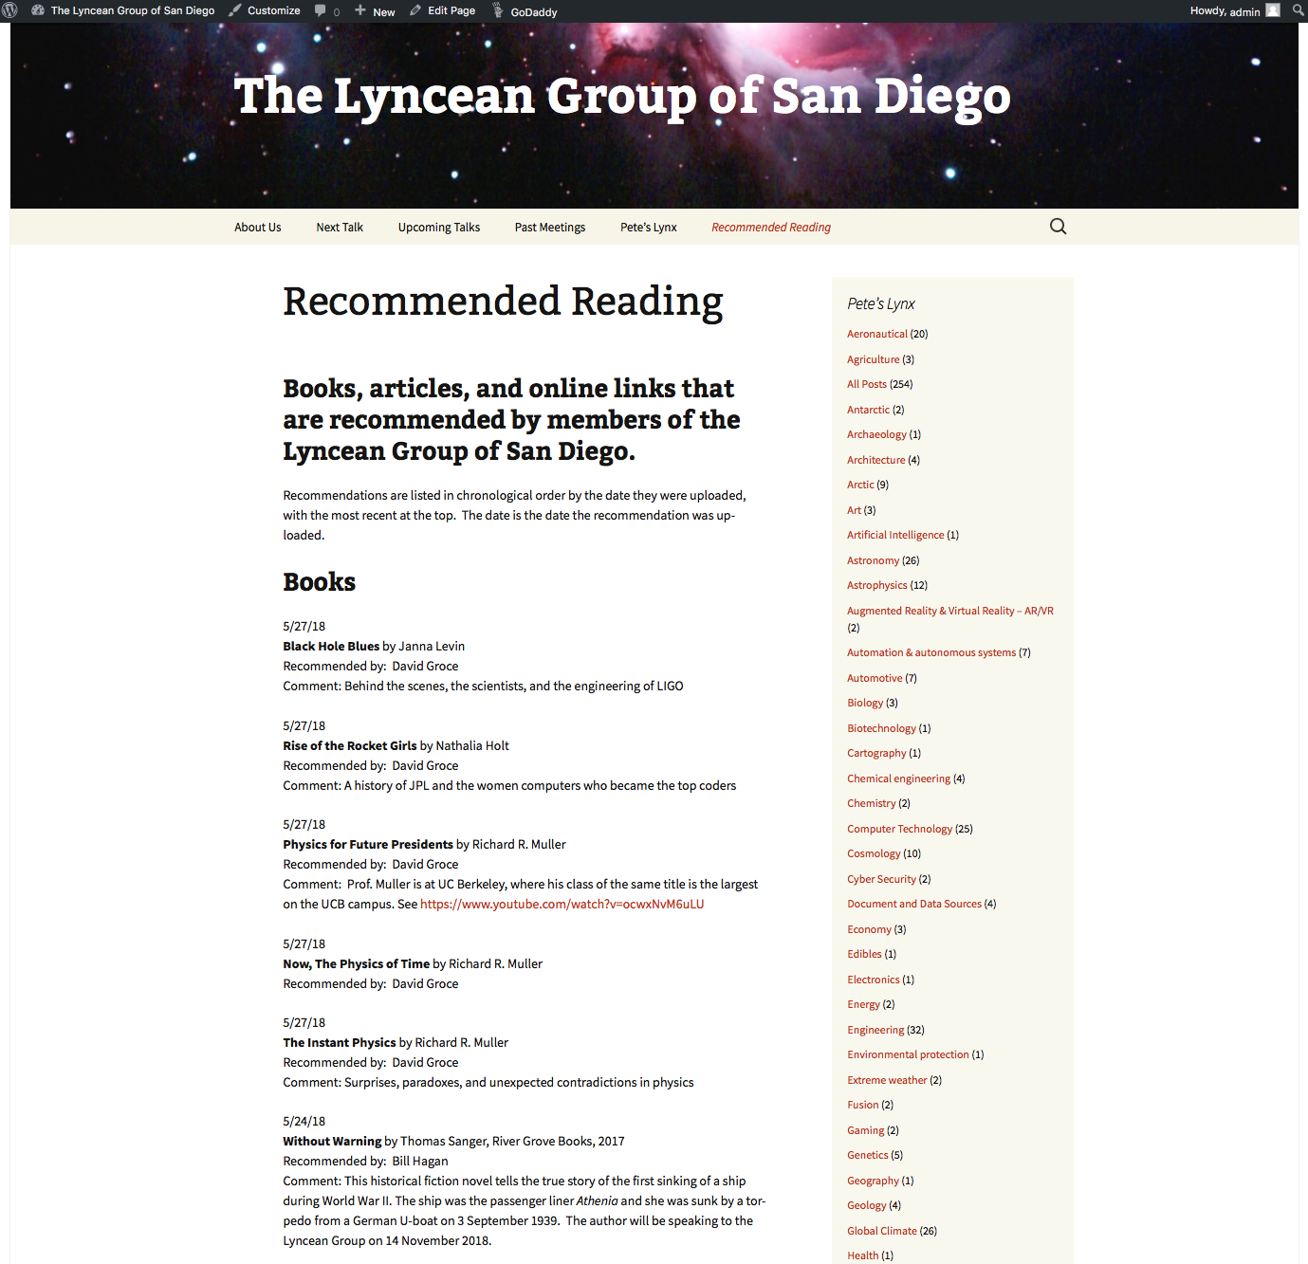
Looks Like This (for now)

Slide 6
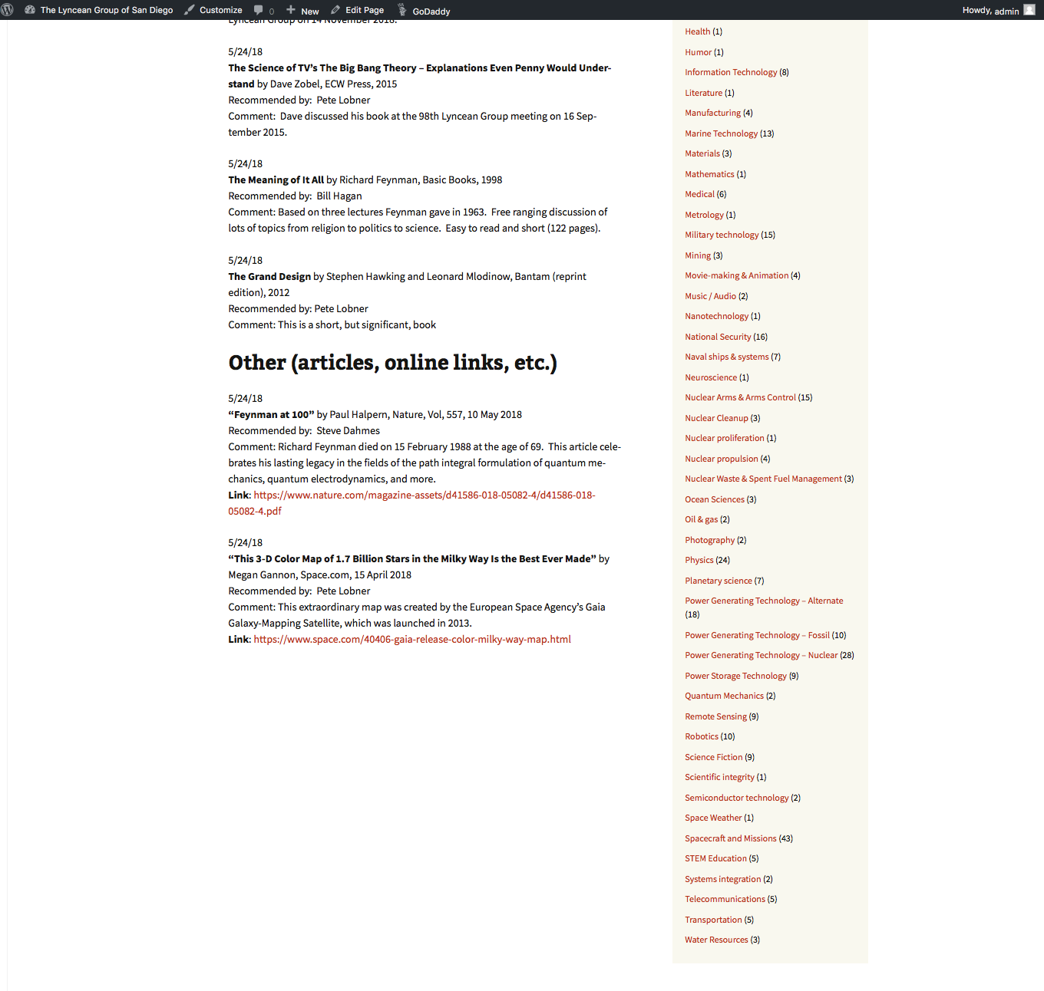
Looks Like This (for now)

Slide 7
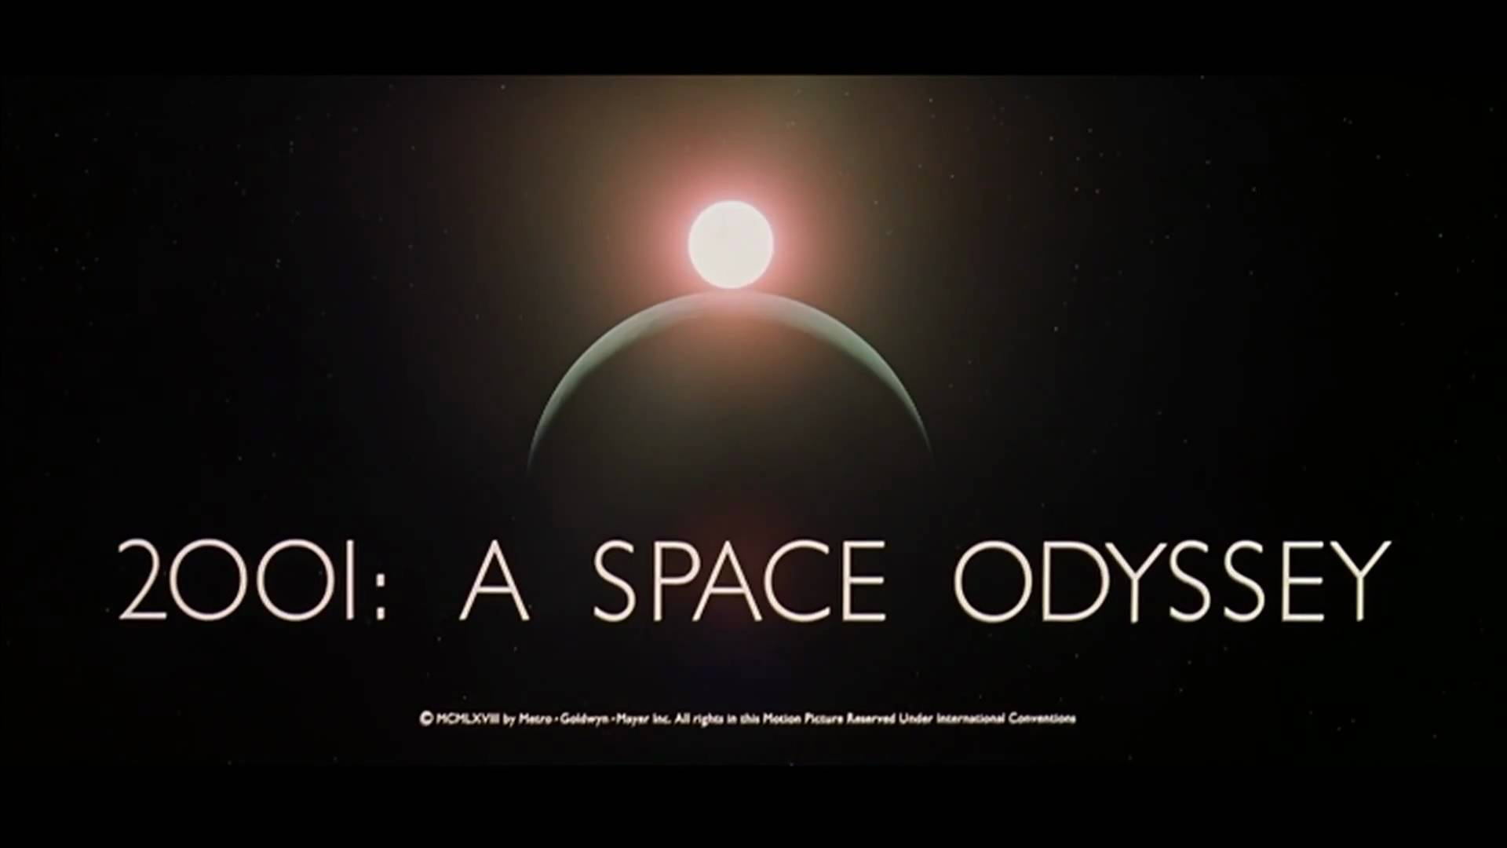
2018: A Groundbreaking Movie is 50

Slide 8
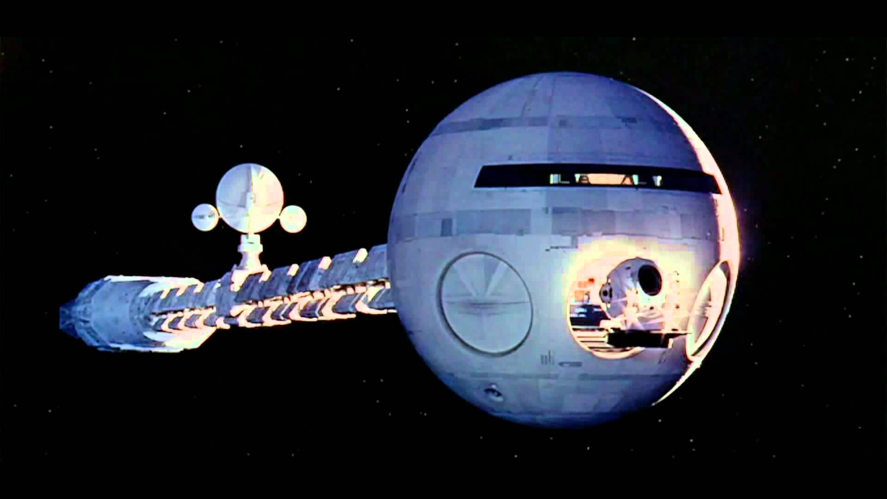
2001: A Space Odyssey Is 50

Slide 9
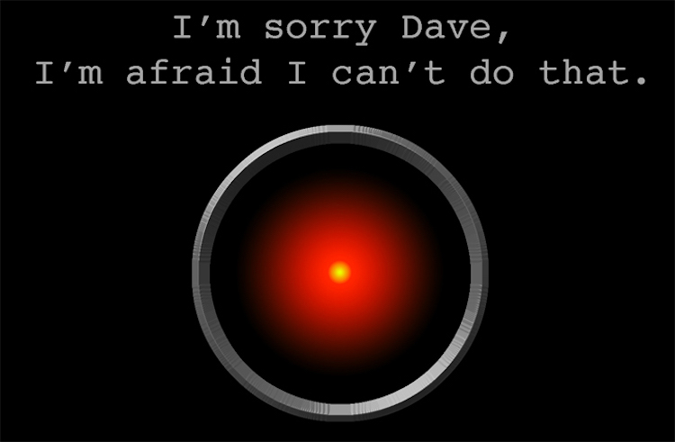
2001: A Space Odyssey Is 50

Slide 10
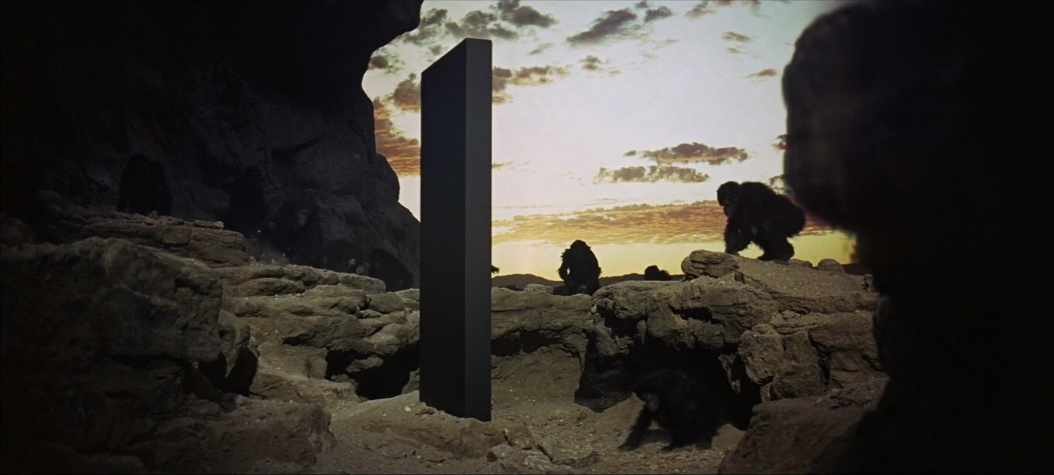
2001: A Space Odyssey Is 50

Slide 11
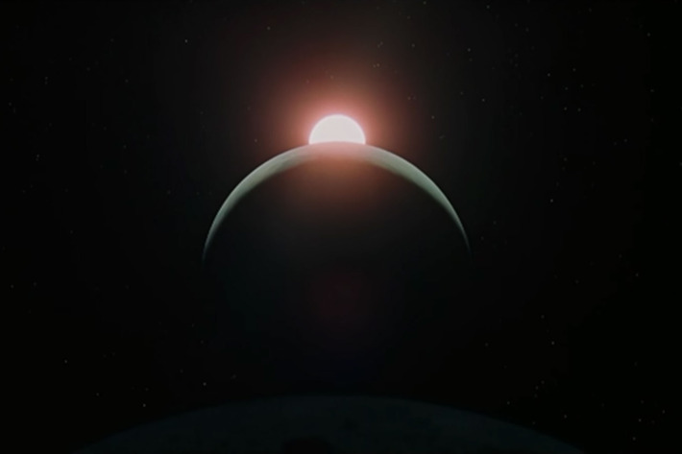
2001: A Space Odyssey Is 50
THE ICONIC IMAGE

Slide 12
Upcoming Talks
SUBJECT TO CHANGE
This information is also on the website under
“Upcoming Talks”
Date | Speaker | Topic/Title
7/11/18 | John Whiteman Harmonica Collector | The Harmonica, It’s Evolution, Variety, and Beauty - For Players, Collectors, and the Curious
8/22/18 | David Brin Scientist, Author*, Technology Consultant, Speaker (http://davidbrin.com) *eg, The Postman | Singularities, AI-takeover, the Fermi Paradox, and other reasons everyone should stay calm and let science drive the future
10/3/18 | Tim Barton Maritime Chief Engineer Maritime, Integration, and Mission Systems Operation Vice President, Solution Architect, and Technical Fellow Leidos | The Anti-submarine warfare (ASW) Continuous Trail Unmanned Vessel (ACTUV)

Slide 13
Upcoming Talks
SUBJECT TO CHANGE
This information is also on the website under
“Upcoming Talks”
Date | Speaker | Topic/Title
11/14/18 | Thomas Sanger Journalist, Documentarian, and Author of Without Warning, a novel based on the sinking of the Athenia | Athenia – A Forgotten Tragedy of World War II
1/9/19 | Nai-Chang Yeh Professor of Physics Fletcher Jones Foundation Co-Director Kavil Nanoscience Institute Caltech | The Rise of Graphene: From Laboratory Curiosity to a Wonder Material for Science and Technology
2/20/19 | Brian Keating Professor of Physics Center for Astrophysics & Space Sciences University of California San Diego | Losing the Nobel Prize: A Cosmic Mystery Story

Slide 14
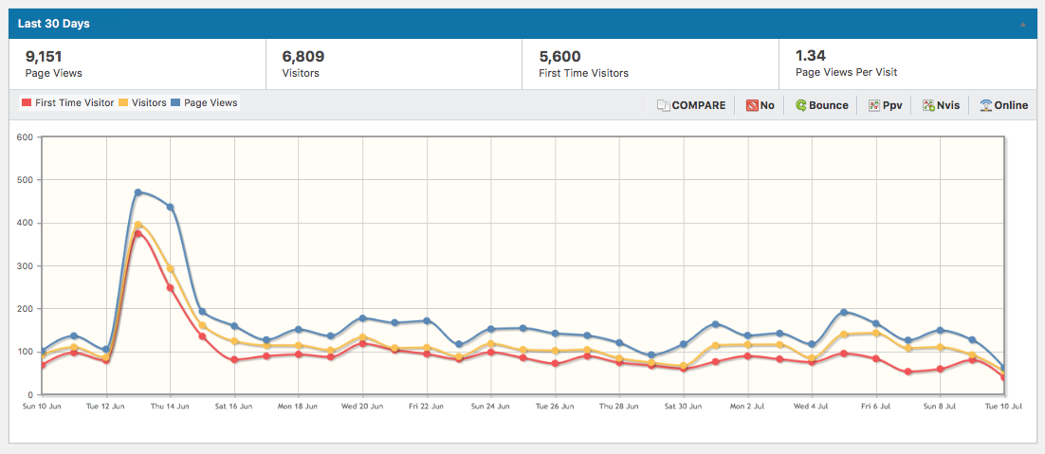
Website Stats Jun 10 – Jul 10

Slide 15
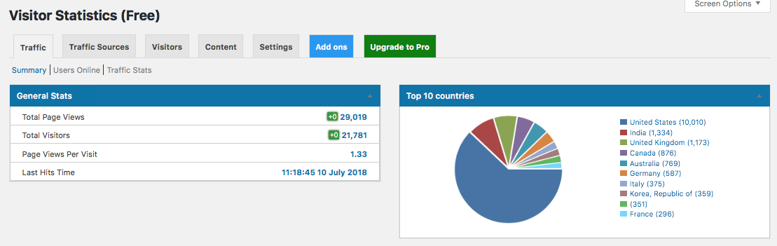
Visitors Feb 3 – Jul 10

Slide 16
Cumulative Visits Feb 3 – Jul 10
(5+ months)

Slide 17
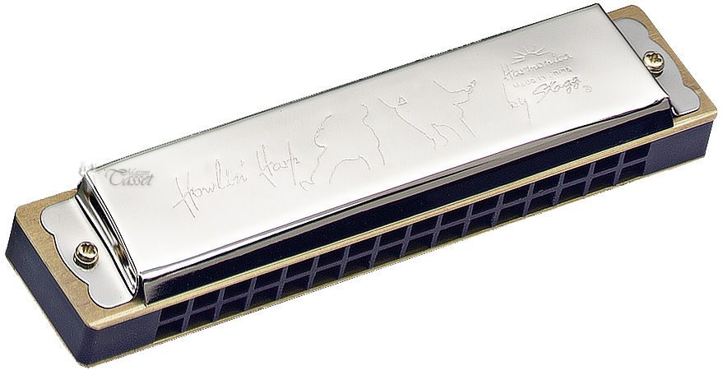
The Harmonica:
It’s Evolution, Variety, and Beauty
Dr. John Whiteman

Slide 18

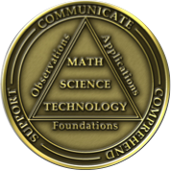
Lyncean Coin Presentation
Pete’s nuclear powered submarine
We are here

Slide 19


Slide 20
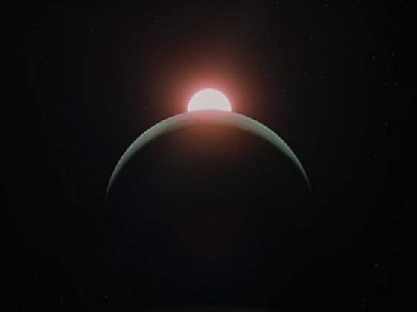
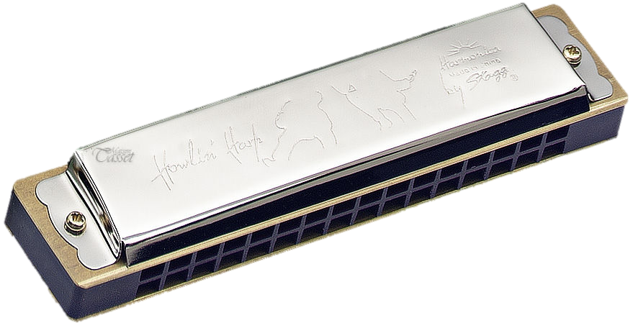


Slide 21

And now something just for John…

Slide 22


Meeting Adjourned

