Slide 1

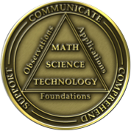
Welcome to the 123rd meeting of the Lyncean Group
3 October 2018

Slide 2
Agenda for 10/3/18
123rd Meeting
Reminder: please turn off or mute cell phones
Announcements, Introductions, Issues, or Ideas
  Summiting Cho Oyu (Nepal) today!
  Nobel Prize in Physics yesterday
Website
  Recommended Reading
  Statistics
Today’s talk: “SEA HUNTER and Maritime Autonomous Behaviors”, Dr. Tim Barton
Upcoming Scheduled Talks
  Without Warning book signing Nov 14: Thomas Sanger
  Losing the Nobel Prize book signing Feb 20, 2019: Brian Keating
Speaker Appreciation

Slide 3
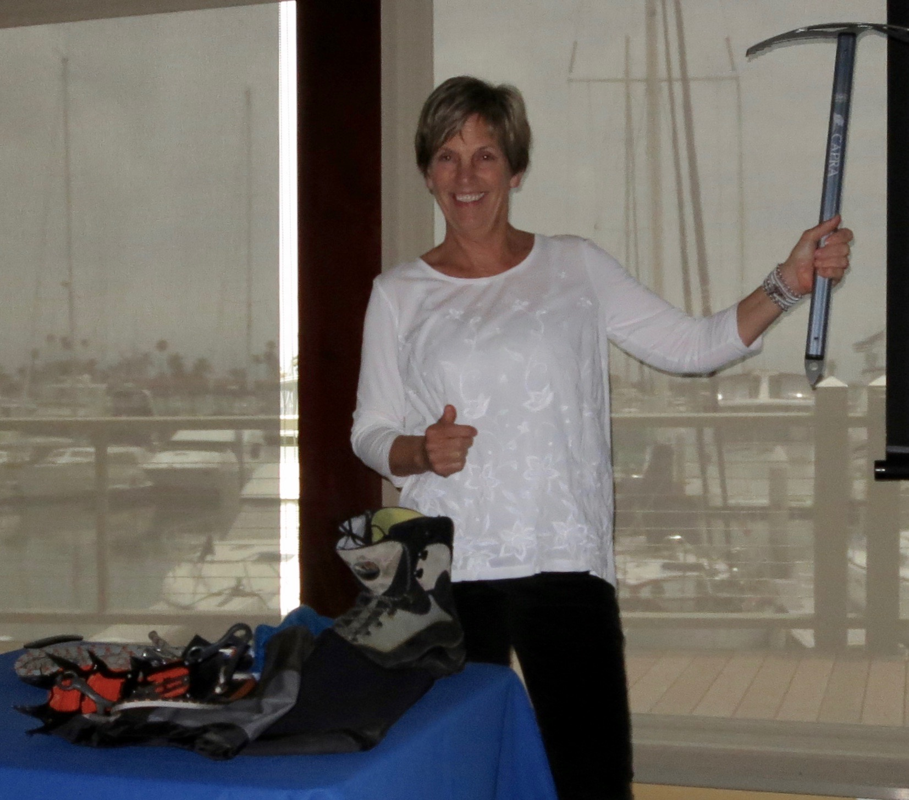
Cindy Outlaw’s Schedule for
Climbing Cho Oyu in Nepal
Cindy was our speaker at the 111th
Meeting of the Lyncean Group, on
10 May 2017: “The Seven Summits.”
See her presentation on the Past
Meetings Tab on the Lyncean website.

Slide 4
2018 Nobel Prize in Physics
Arthur Ashkin (US) shares the 2018 Nobel Prize in Physics with Gérard Mourou (France) and Donna Strickland (Canada) for their “groundbreaking inventions in the field of laser physics.”
Arthur Ashkin’s award was “for the optical tweezers and their application to biological systems.”
  This is a technique developed by Ashkin in the late 1960s, and first published in 1970, using laser beam(s) to create a force trap that can be used to physically hold and move microscopic objects (from atoms and molecules to living cells). The technique now is widely used in studying a variety of biological systems, with applications such as cell sorting, and bio-molecular assay.
The award to Mourou and Strickland was “for their method of generating high-intensity, ultra-short optical pulses.”
  They developed a technique called “chirped pulse amplification” (CPA) that is used for producing very short duration laser pulses of very high intensity. CPA is applied today in laser micromachining, surgery, medicine, and in fundamental science studies.
Donna Strickland is the first female Physics laureate in 55 years. The preceding female Physics laureates were:
  In 1963, Maria Goeppert-Mayer was recognized for her work on the structure of atomic nuclei (shared with J. Hans D. Jensen and Eugene Wigner).
  In 1903, Marie Curie won the physics prize for her work on atomic radiation phemomena (shared with Pierre Curie and Henri Becquerel).

Slide 5
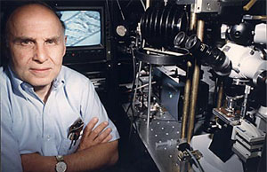
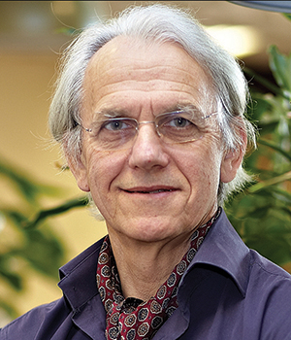
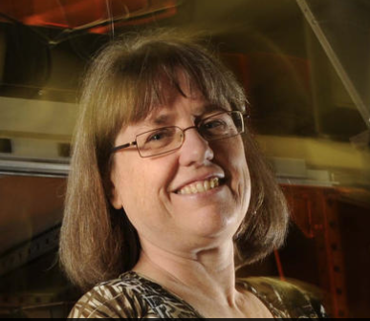
2018 Nobel Prize in Physics
Arthur Ashkin is a researcher at Bell Laboratories in New Jersey.
  At 96, he the oldest person to be awarded the Nobel Prize.
Gérard Mourou is the director of the Laboratoire d'Optique Appliquee at the ENSTA ParisTech (École nationale supérieure de techniques avancées).
  He was Donna Strickland’s PhD advisor.
Donna Strickland is an associate professor in the Physics and Astronomy Department of the University of Waterloo, Canada (about 90 km west of Toronto).

Slide 6
2018 Nobel Prize in Physics
You can read the press release from the Royal Swedish Academy of Sciences here:
https://www.nobelprize.org/uploads/2018/10/press-physics2018.pdf
You’ll find more background information in the post, 2018 Nobel Prize in Physics, which you’ll find on Pete’s Lynx here:
https://lynceans.org/lobners-lynx/

Slide 7
Recommended Reading Page https://lynceans.org
Number of recommendations from members other than David, Bill and myself:
2
(both from Steve Dahms)

Slide 8
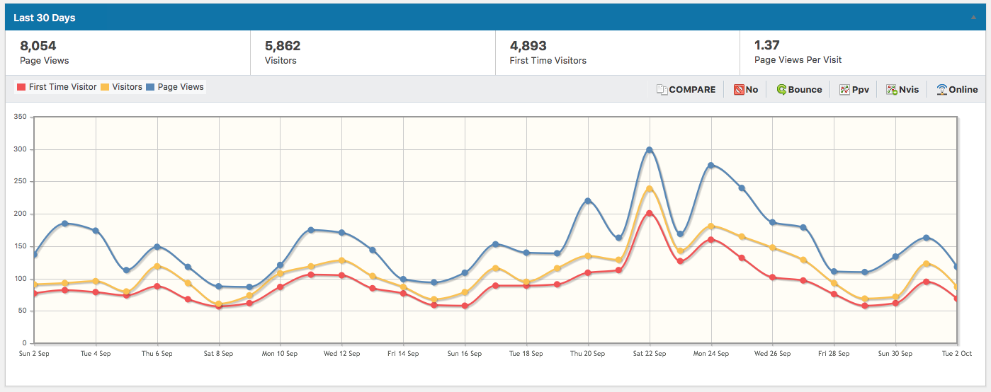
Our website: visitors in the last 30 days https://lynceans.org

Slide 9
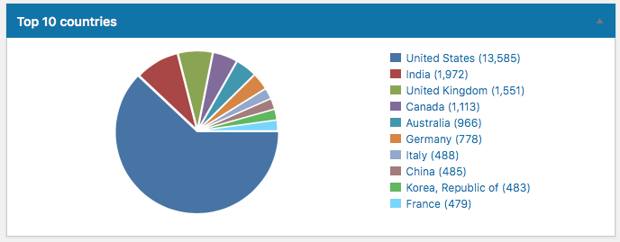
Our website: visitors Feb 3-Oct 3, 2018 https://lynceans.org

Slide 10
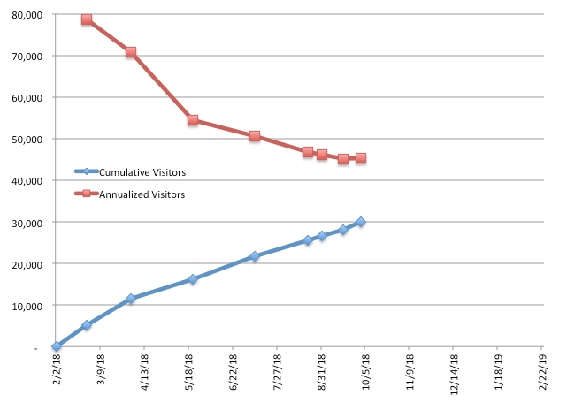
Our website: visitors Feb 3-Oct 3, 2018 https://lynceans.org

Slide 11
SEA HUNTER and Maritime Autonomous Behaviors
Dr. Timothy A. Barton
Leidos Vice President, Technical Fellow, and Solutions Architect and
Maritime Chief Engineer of the Leidos Mission Systems Integration Operation

Slide 12

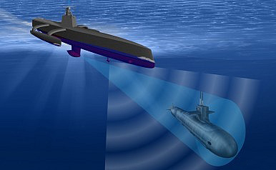
Tim Barton’s nightmare in the open ocean

Slide 13
Speaker Appreciation
Pete’s nuclear powered submarine
We are here

Slide 14
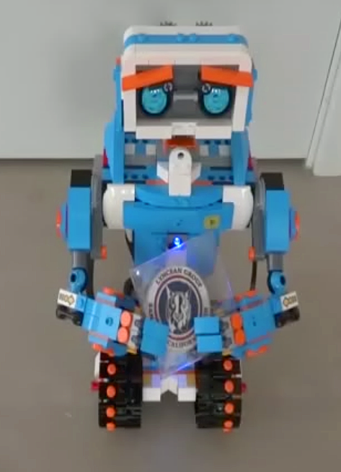
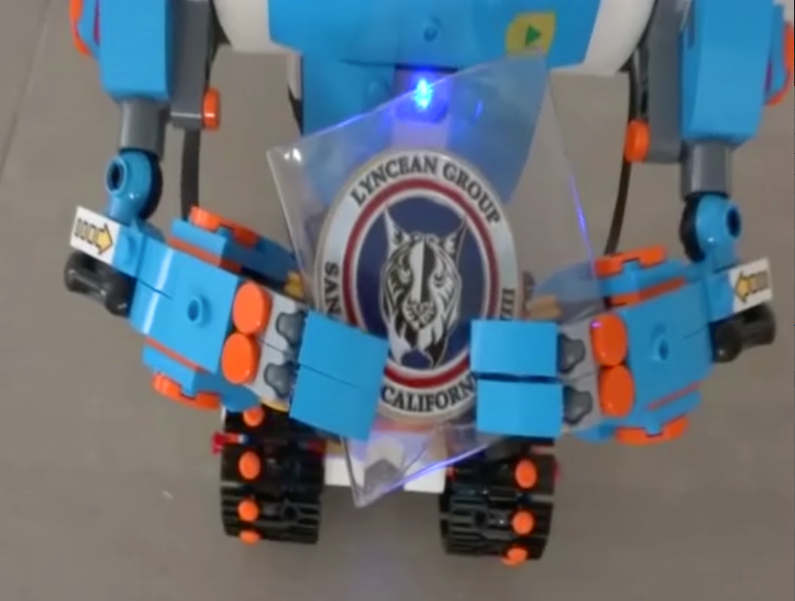
Vernie, the Lyncean
Autonomous Coin Delivery Robot
Pete’s nuclear powered submarine
We are here

Slide 15
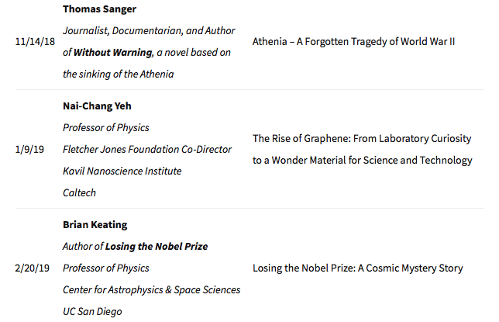
Upcoming Talks
SUBJECT TO CHANGE
This information is also on the website under “Upcoming Talks”

Slide 16

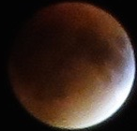
Lyncean
Meeting #123 is Adjourned

