Slide 1
NOTICE
This meeting will be filmed as part of a documentary about the sinking of the Athenia. As a result, it is possible that images of members of the audience may appear in the film. There is a sign outside the meeting room disclosing this fact and stating that attendees agree that their image may be used in the documentary. Please plan your attendance accordingly.

Slide 2
Agenda for 11/14/18
124th Meeting
(Last Meeting of 2018)
Reminder: please turn off or mute cell phones
Announcements, Introductions, Issues, or Ideas
  This meeting will be filmed
  New badges
  Members who make these meetings possible…
Upcoming Scheduled Talks with book signing opportunities:
  Without Warning, Nov 14: Thomas Sanger
  Losing the Nobel Prize, Feb 20, 2019: Brian Keating
Website
  Recommended Reading
  Statistics
“Athenia – A Forgotten Tragedy of World War II”, Tom Sanger
Speaker Appreciation

Slide 3
Badges
Because we have added many new members in the last year or two, there was a suggestion to create badges
  Our membership list now has >200 entries!
Use is optional
If you cannot find your badge (I may have missed your name) or you have a guest who is not on the membership list, there are blanks on which you can write your name
Detach the badge from the lanyard and place in baskets after the meeting
Please do not take the badges home

Slide 4
For the Benefit of Our New (and old) Members:
These are the Volunteers Who Do the Work
Lynne Eddy & Jack Thorpe – SWYC liaisons
David Groce – finds more speakers than anyone
Pete Lobner – Technical Blog Writer (Pete’s Lynx) and meeting leader
Lew Linson – Treasurer and holder of “the bag”
Dennis Buckley – Secretary and maintainer of the membership list
Bill Hagan – Program Chair, website guy, and meeting leader

Slide 5
Upcoming Talks
SUBJECT TO CHANGE
This information is also on the website under “Upcoming Talks”
Date | Speaker | Topic/Title
11/14/18 | Thomas Sanger Journalist, Documentarian, and Author of Without Warning, a novel based on the sinking of the Athenia | Athenia – A Forgotten Tragedy of World War II
1/9/19 | Nai-Chang Yeh Professor of Physics Fletcher Jones Foundation Co-Director Kavil Nanoscience Institute Caltech | The Rise of Graphene: From Laboratory Curiosity to a Wonder Material for Science and Technology
2/20/19 | Brian Keating Professor of Physics Center for Astrophysics & Space Sciences University of California San Diego | Losing the Nobel Prize: A Cosmic Mystery Story
4/3/19 | Pamela Cosman Professor Dept. of Electrical and Computer Engineering University of California San Diego | TBD

Slide 6
Recommended Reading Page
Number of recommendations since the last meeting:
0

Slide 7
Cumulative Visits Feb 3-Nov 13 https://lynceans.org

Slide 8
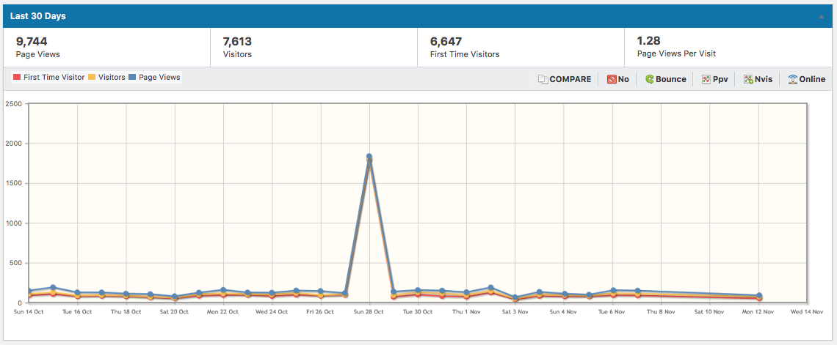
What Happened on Sunday, October 28th?
And why no data on Nov 8-11?

Slide 9
“Athenia – A Forgotten Tragedy of World War II”
Thomas C. Sanger

Slide 10


Speaker Appreciation
Pete’s nuclear powered submarine
We are here

Slide 11
Literary Prizes
Nobel Prize: awarded to an author who has produced “in the field of literature the most outstanding work in an ideal direction.”
Man Booker International Prize: awarded to an author who demonstrated “continued creativity, development and overall contribution to fiction on the world stage.”
National Book Award for fiction, poetry, non-fiction, and young people’s literature
Pulitzer Prize for history, fiction, poetry, drama, and general on-fiction
Many more
Turns out, there is a Lyncean Prize for Literature…

Slide 12
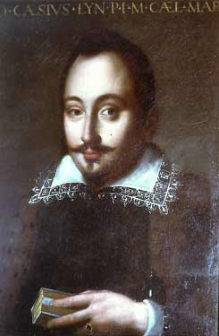
Lyncean Prize for Literature
The Lyncean Prize for Literature was created in 1603 at the inaugural meeting of the Academia del Lincei at the Palazzo Corsini in Rome*
The Academia founder, Federico Cesi, described the requirements for the Prize, which were quite restrictive
*Historical note: the cost of lunch in 1603 was $20. It has not increased in 415 years.

Slide 13
The Lyncean Prize for Literature: Requirements (1603)
“For a literary work of historical fiction…
  that is based on the sinking of a passenger ship
  in the Atlantic ocean
  during a time of war
  on which a relative of the author was a passenger
  and the author must collect baseball caps that are only 1) fitted, and 2) purchased in the ballpark where the team plays.”

Slide 14
Lyncean Prize for Literature
It is the last requirement that is so remarkable, since it was described in 1603 and baseball was not invented until the formation of the New York Knickerbocker Baseball Club in September 1845
  The first official game of baseball was played in 1846
Hence, the Prize was not possible to award until almost 250 years after it was first announced
Taken altogether, the requirements are so restrictive that the Lyncean Prize for Literature has actually never been awarded
Until today!

Slide 15
The Lyncean Prize for Literature: Requirements As Applied to Without Warning:
“For a literary work of historical fiction…
  that is based on the sinking of a passenger ship
  in the Atlantic ocean
  during a time of war
  on which a relative of the author was a passenger
  and the author must collect baseball caps that are only 1) fitted, and 2) purchased in the ballpark where the team plays.”
✔
✔
✔
✔
✔

Slide 16

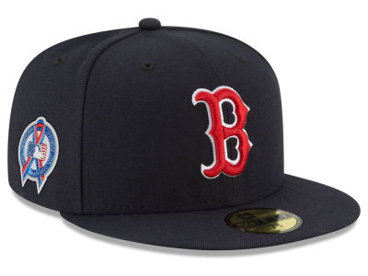



The 2018 Lyncean Prize for Literature is Awarded to…
Thomas C. Sanger
for his novel
Without Warning

Slide 17
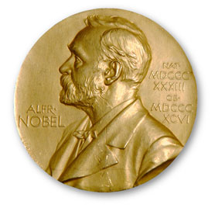
2018 Lyncean Prize for Literature
Like the Nobel Prize, the Lyncean Prize for Literature includes three components:
  Cash award of $1,000,000 (check is in the mail)
  Gold medallion
    Looks like the Nobel medallion, but it’s bigger!
  Diploma with lots of colorful art and calligraphy

Slide 18
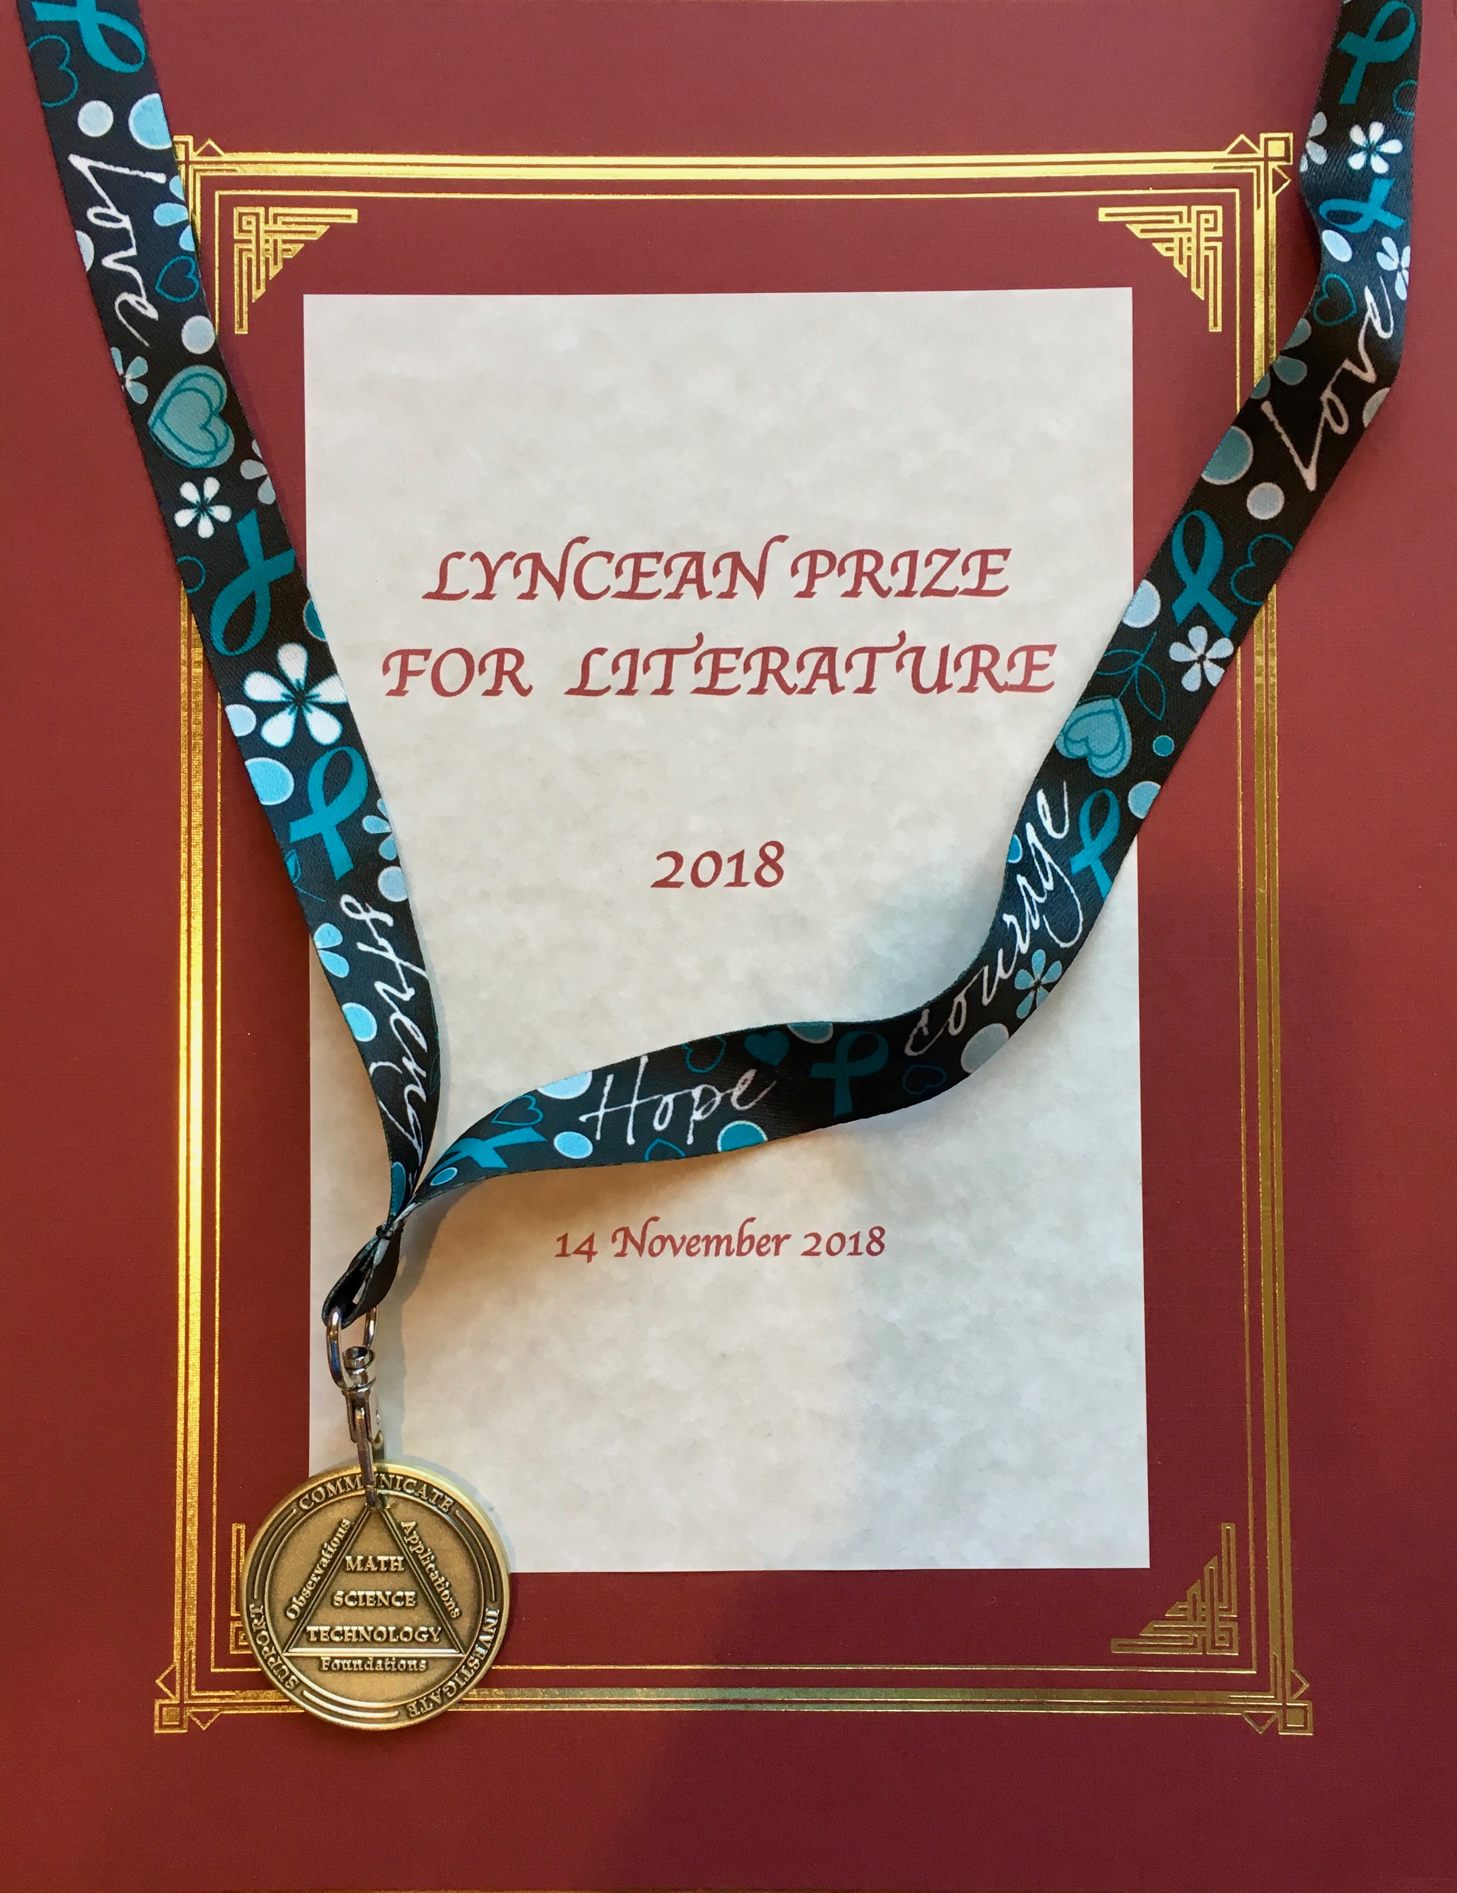

Slide 19
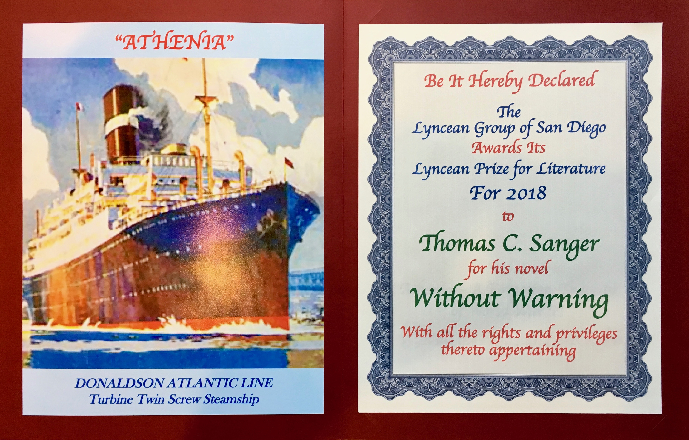
Colorful Art
Colorful Calligraphy
(of which there are none)

Slide 20


Lyncea
Meeting #124 is Adjourned

