Slide 1
Agenda for 1/9/19
125th Meeting
Reminder: please turn off or mute cell phones
Announcements, Introductions, Issues, or Ideas
Next meeting - book signing opportunity:
  Losing the Nobel Prize, Feb 20, 2019: Brian Keating (just selected as one of Amazon’s Twenty Best Science Books of the Year)
Other upcoming (and new) talks
Pete’s Lynx
Website
“The Rise of Graphene: From Laboratory Curiosity to a Wonder Material for Science and Technology”, Nai-Chang Yeh
Speaker Appreciation

Slide 2
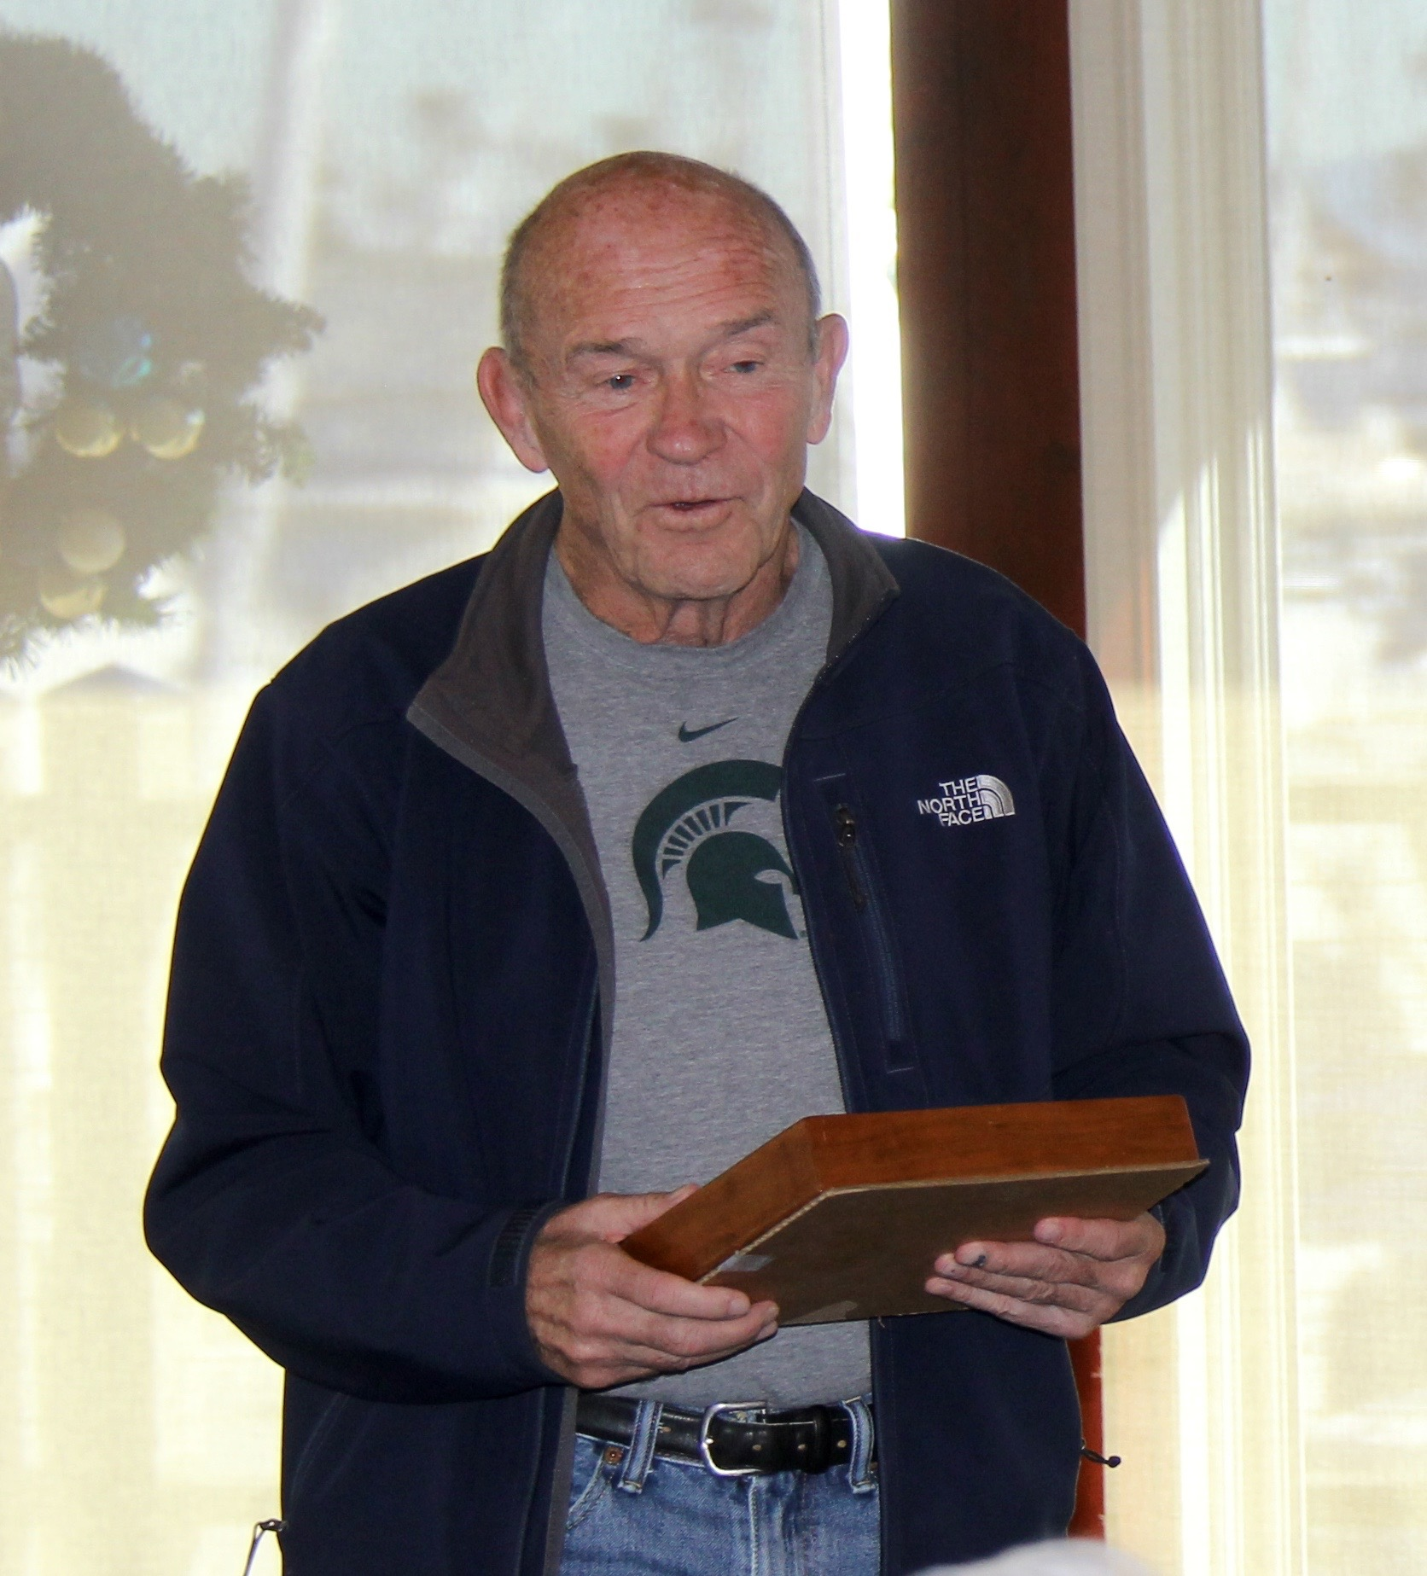
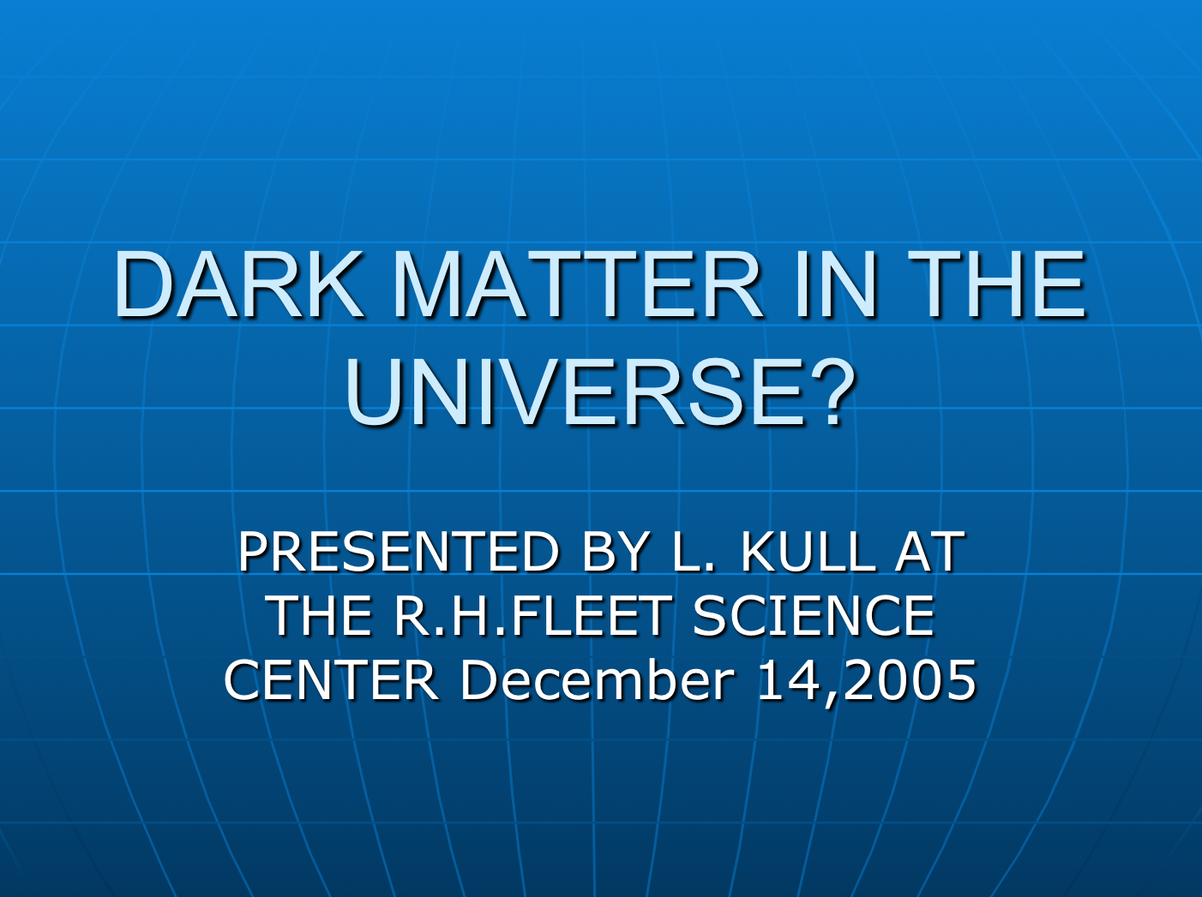
Larry Kull
Larry Kull died on December 6, 2018 after recent medical complications. He was 80.
Larry gave a talk about dark matter on December 14, 2005. He discussed Einstein’s field equations, MACHOs, neutrino mass, baryon energy density, and dark matter detection.
The Lyncean Group started with a meeting at Larry’s house on November 25, 2002.
The first talks were in 2003 and the speakers were Clyde Richards, Bob Ginaven, Bill Scott, Tom Olson, and Barry Butler.
At the 100th Meeting in December 2015

Slide 3
Larry Kull
Larry was many different things:
Lyncean founder
Scientist
President of SAIC (Larry loved SAIC)
Sailor
Pilot
Father
Husband
Mentor
Problem solver
There will be a celebration of Larry’s life on Sunday, February 10, 2019, 1PM-5PM here at the Southwestern Yacht Club.
But to everyone who knew him, Larry Kull was a friend and a good man
At the 100th Meeting in December 2015

Slide 4
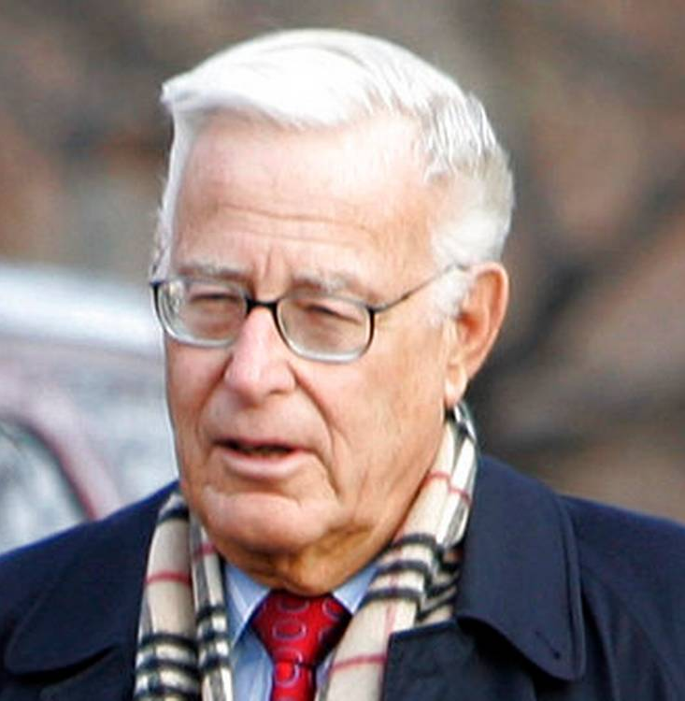
Harold Brown
Harold Brown died on January 4, 2019 at his home in Rancho Santa Fe of pancreatic cancer. He was 91.
Before leaving office, Jimmy Carter awarded Harold the Presidential Medal of Freedom.
A friend to SAIC, after leaving government he conducted special meetings for Bob Beyster called “Brown Panels”.
Recognized as a genius from childhood, he graduated from high school at 15 and received his PhD in physics at age 21 from Columbia*. His advisor was I. I. Rabi.
In his farewell address as Sec of Defense, he said, “Most satisfying of all is that for four years, our nation remained at peace despite the world tensions and turmoil that constantly pose challenges to our interest and peace.”
A bit of an underachiever:
(age 33!)
60-61: LLNL Dir
61-65: DDR&E (34)
65-69: Sec of Air Force (38)
69-77: Caltech President (42)
77-81: Sec of Defense (50)
Outside the White House in 2006
*Beta-Spectra of Gaseous Argon-41 and Oxygen-15,
Harold Brown, Columbia University, 1951.

Slide 5

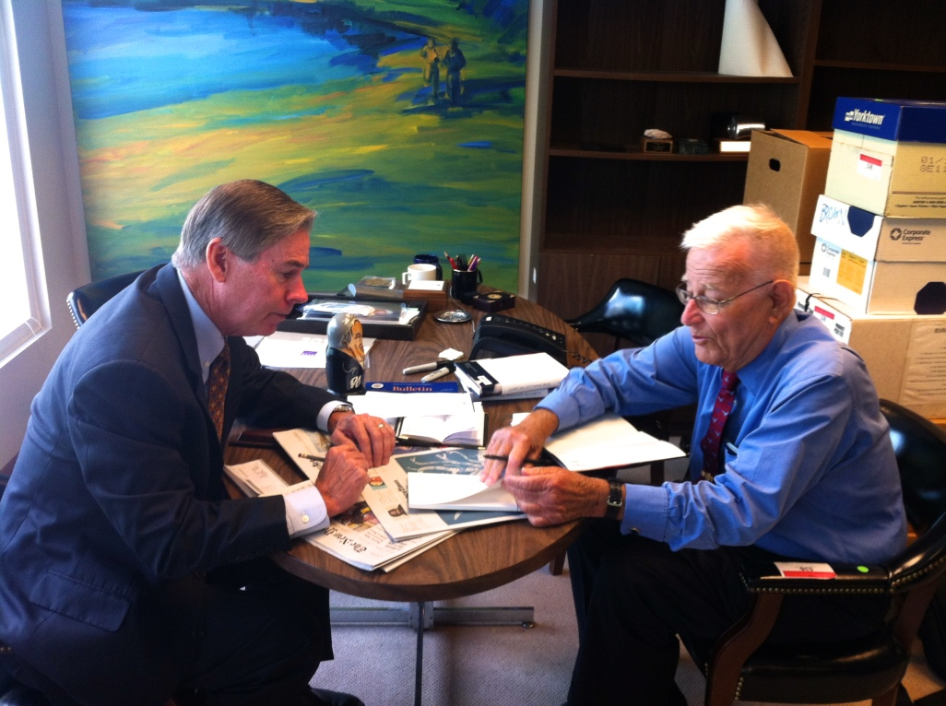
Harold Brown
Harold Brown signing copies of “Star Spangled Security” in his office at the Center for Strategic and International Studies (9/17/13)

Slide 6
Upcoming Talks
SUBJECT TO CHANGE
This information is also on the website under “Upcoming Talks”
Date | Speaker | Topic/Title
2/20/19 | Brian Keating Professor of Physics Center for Astrophysics & Space Sciences UC San Diego | Losing the Nobel Prize: A Cosmic Mystery Story
4/3/19 | Vadim Parfenov Professor State Electrotechnical University St. Petersburg, Russia | TBD
5/15/19 | Pamela Cosman Professor of Electrical and Computer Engineering Jacobs School of Engineering UC San Diego | TBD
6/26/19 | Jeff Severinghaus Professor Geosciences Research Division Scripps Institution of Oceanography UC San Diego | TBD

Slide 7
Upcoming Talks
SUBJECT TO CHANGE
This information is also on the website under “Upcoming Talks”
Date | Speaker | Topic/Title
8/7/19 | William Tong Professor of Chemistry & Biochemistry San Diego State University | TBD
9/18/19 | Mark Merrifield Director, Center for Climate Change Impacts and Adaptation Scripps Institution of Oceanography UC San Diego | TBD
10/30/19 | Richard Norris Professor of Paleobiology Geosciences Research Division Scripps Institution of Oceanography UC San Diego | TBD
12/11/19 | TBD | TBD

Slide 8
Pete’s Lynx

Slide 9
Cumulative Visits: 2/3/18 - 1/8/19 www.lynceans.org

Slide 10
“The Rise of Graphene:
From Laboratory Curiosity to a Wonder Material for Science and Technology”
Nai-Chang Yeh

Slide 11


Speaker Appreciation
Pete’s nuclear powered submarine
We are here

Slide 12

nano-coin
Pete’s nuclear powered submarine
nano-coin
.
.
Lyncean nano-factory
(enlarged 1,000,000X)

Slide 13
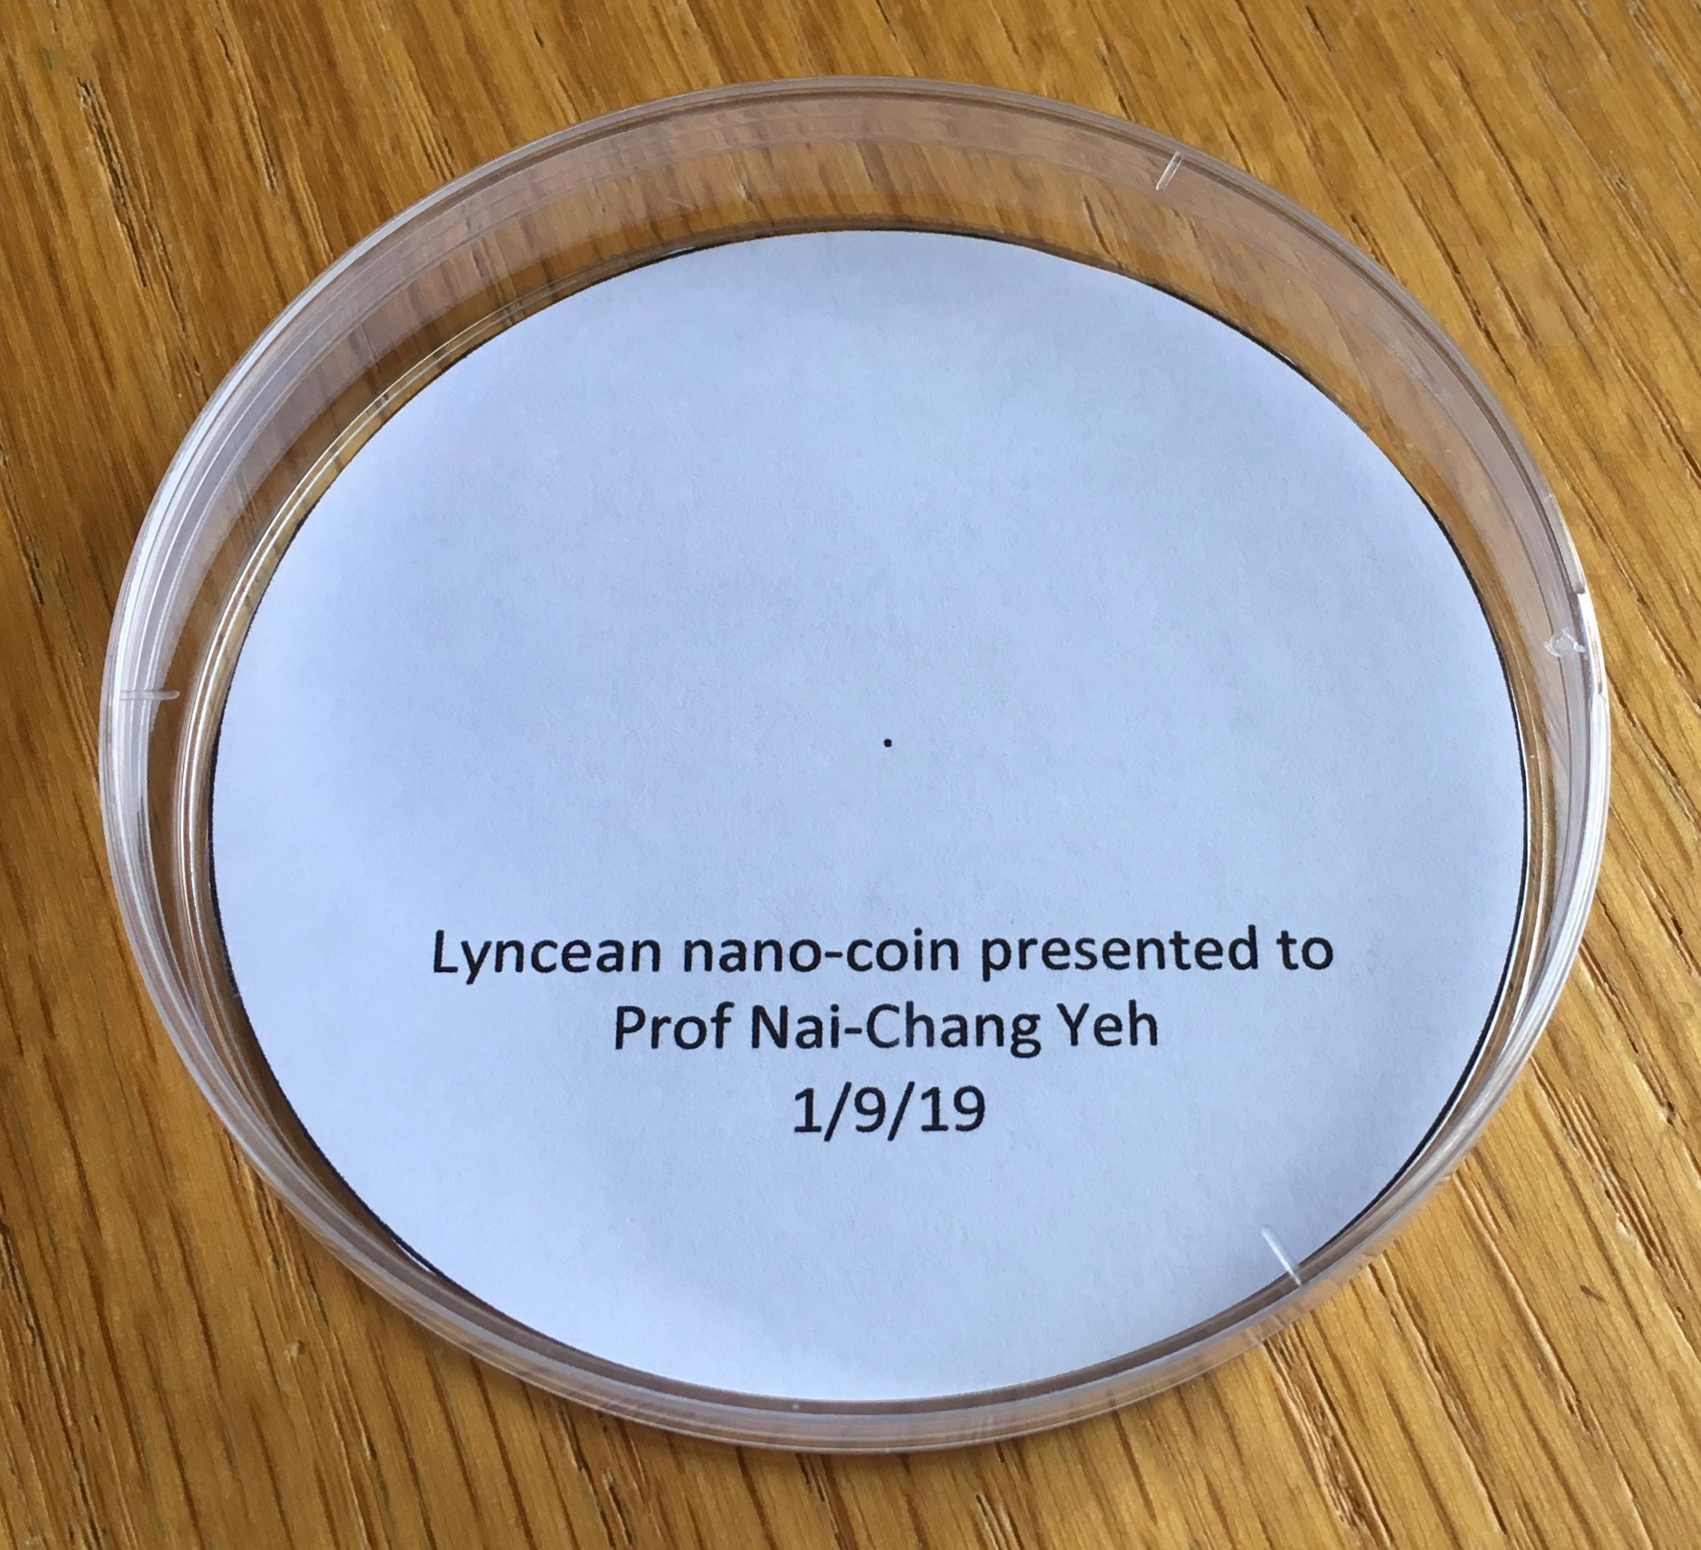
1.0 nm
(= 1 X 10⁻⁹ meter)

Slide 14

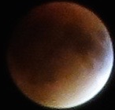
Lyncea
Meeting #125 is Adjourned

