Slide 1
Ships of the San Diego Maritime Museum on Parade in the San Diego Harbor 2018
Photographs by
Pete Lobner

Slide 2
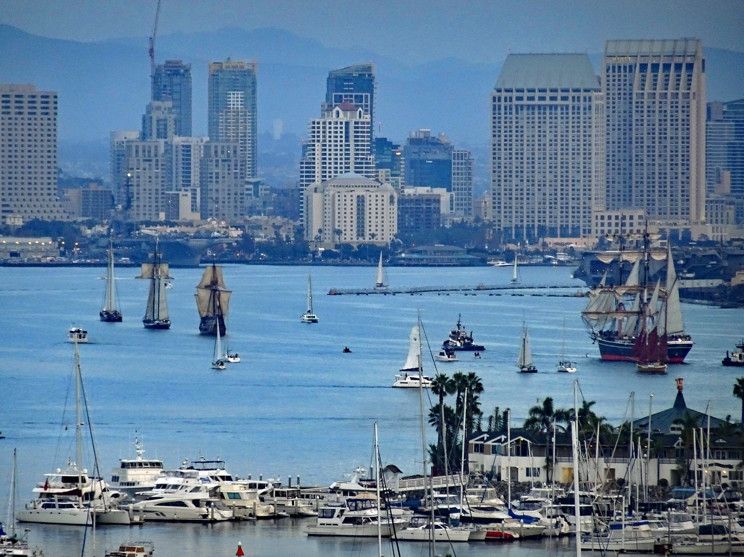
America (leading), Californian, San Salvador, Star of India

Slide 3
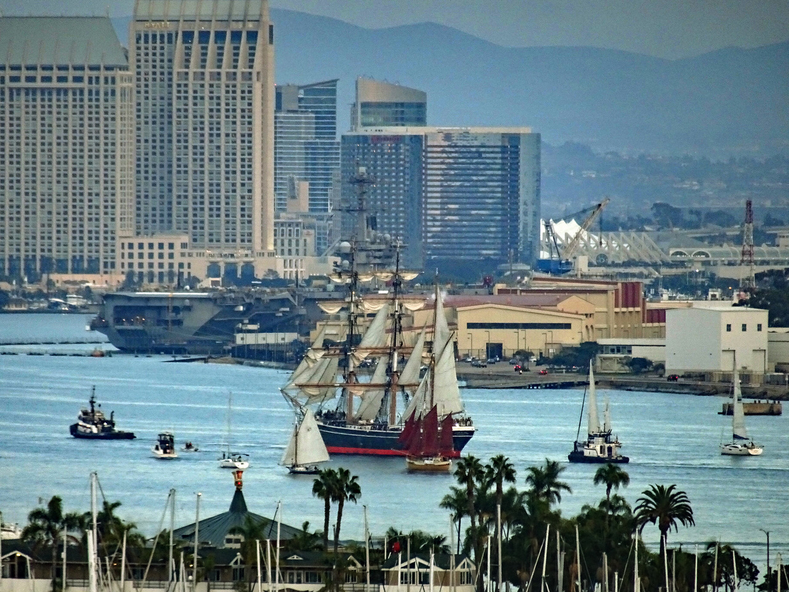
Star of India

Slide 4
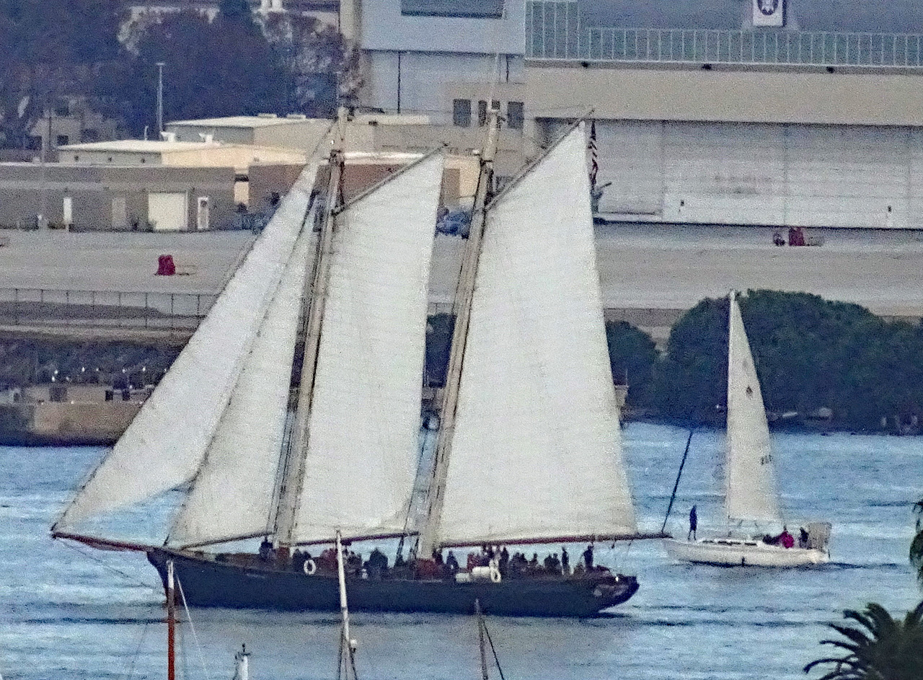
America

Slide 5
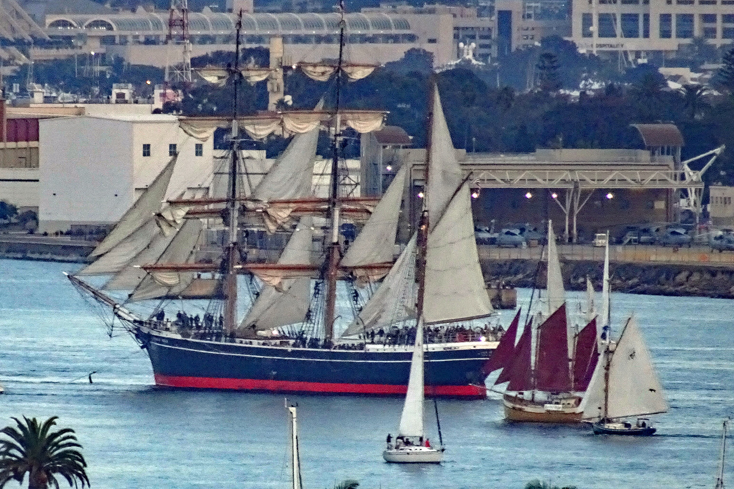
Star of India

Slide 6
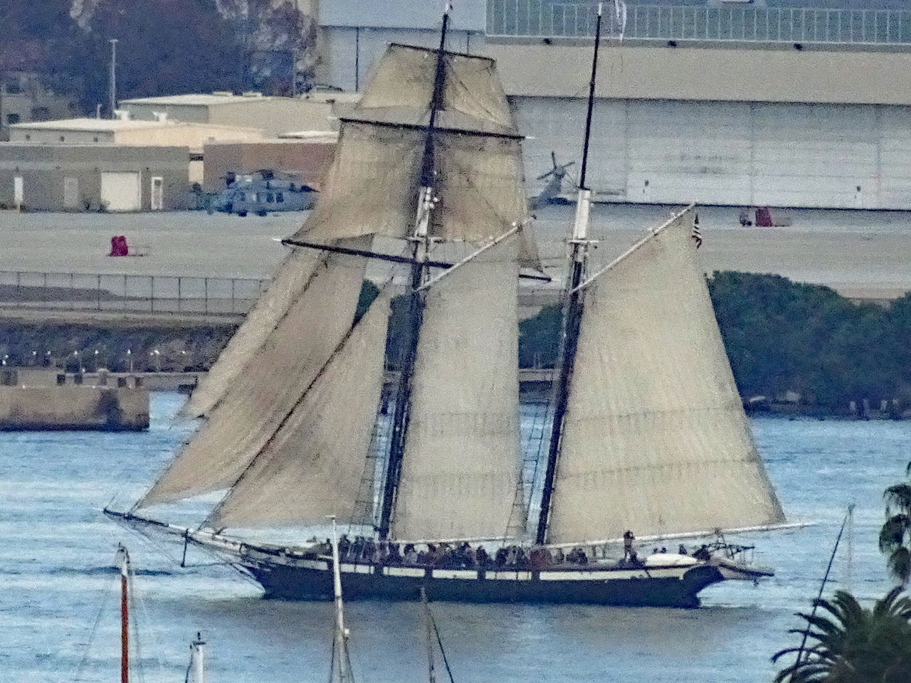
Californian

Slide 7
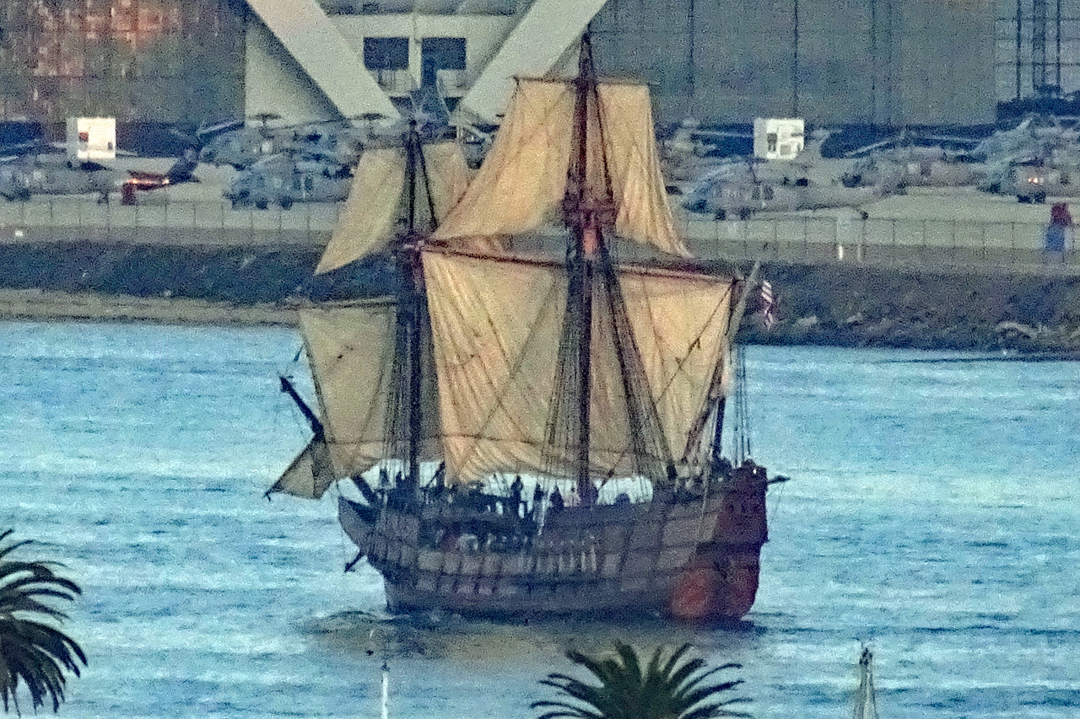
San Salvador

Slide 8
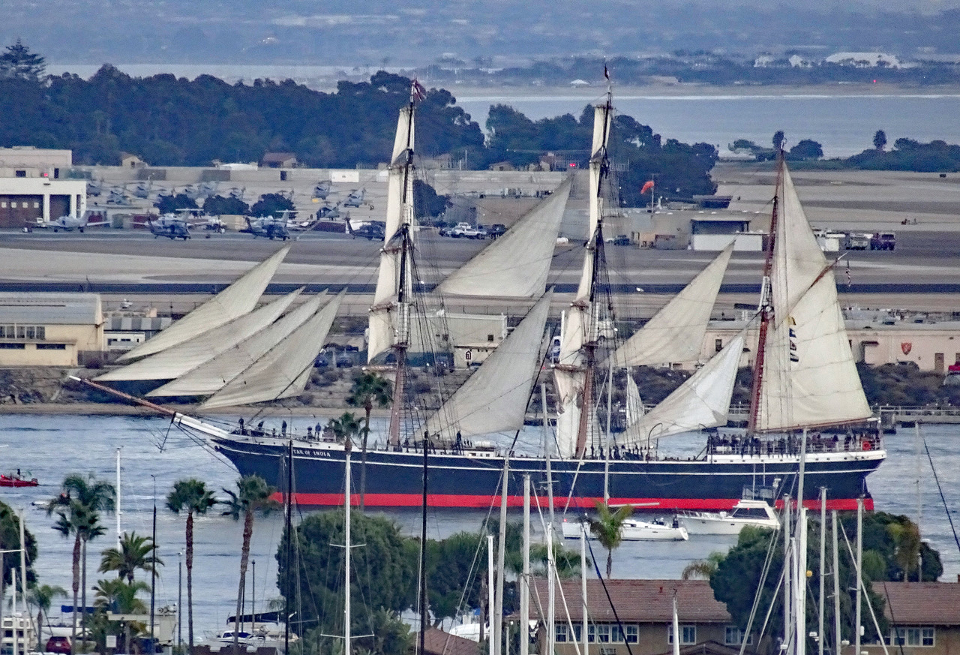
Star of India

Slide 9
America (leading), Californian, San Salvador

