Slide 1


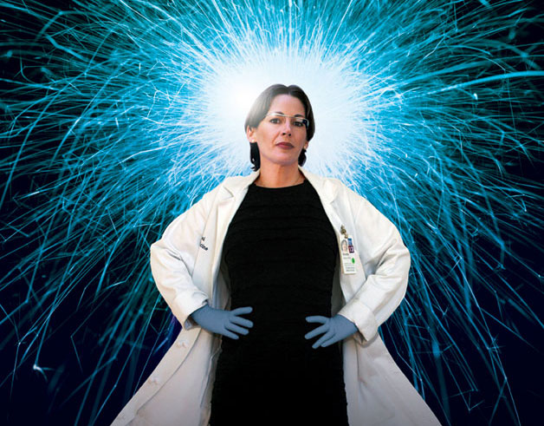



An Engineer’s Data-Driven Perspective on Gender in STEM
April 3, 2019
Pamela Cosman
Professor, Department of Electrical & Computer Engineering
Co-Director, Center for Research on Gender in STEMM
UC San Diego

Slide 2
Who I am
Education in Electrical Engineering
  B.S. from Caltech
  M.S., Ph.D. from Stanford
  Postdocs at Stanford & Univ. of Minnesota
  Since 1995: Prof. of Electrical & Comp. Engineering at UC San Diego
UC San Diego – past administrative roles
  Director of Center for Wireless Communications (2006-2008)
  Associate Dean for Students (2013-2016)
UC San Diego – current administrative roles (about 20% time)
  Faculty Equity Adviser, Jacobs School of Engineering (2012 – )
  Co-Director, Center for Research on Gender in STEMM (2014 - )

Slide 3


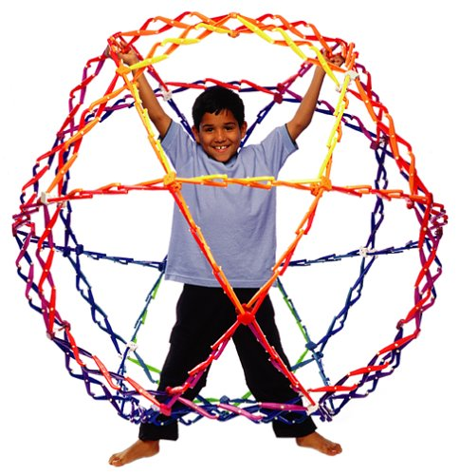

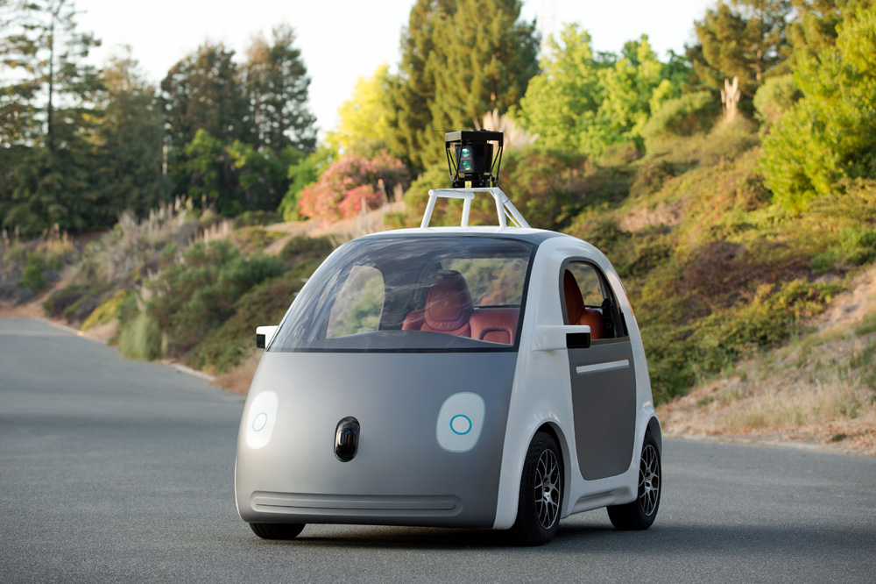
Outline
Trends in participation of women in science/engineering
  Across time
  Across different countries
  Across the U.S.
Two of my projects
  Presentations in academic interviews
  Book project
Suggestions for what individuals can do

Slide 4
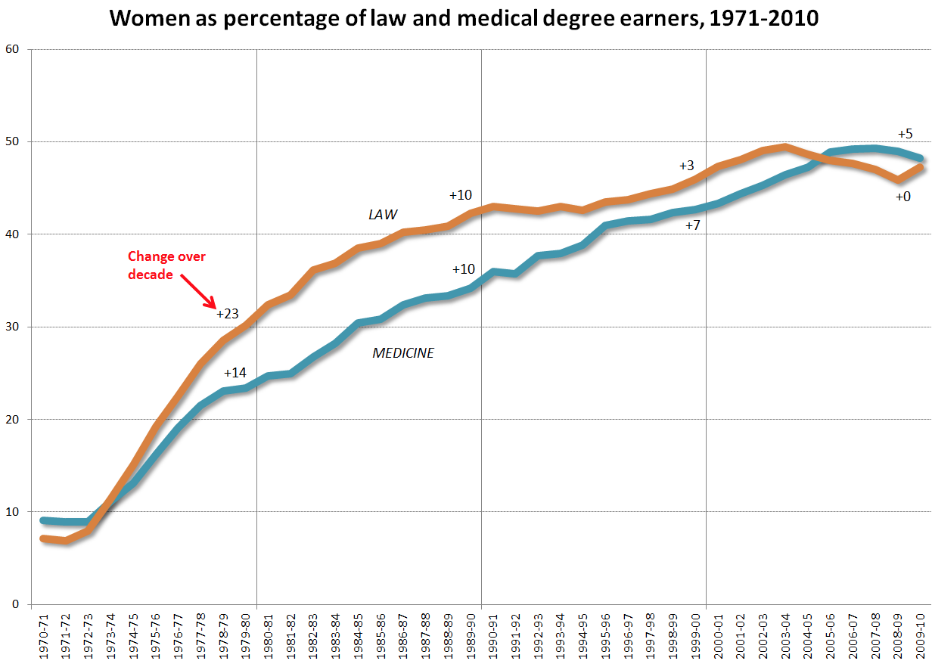
Law & Medical degrees: % women, 1971-2010
50%

Slide 5
Science fields - % bachelors degrees to women
1966
2010
Biology
50%
Chemistry
Math
Earth/Ocean
Astro
Physics
CompSci
Data from http://www.nsf.gov/statistics/seind14/

Slide 6
Engineering fields - % bachelors degrees to women
40%
What happened?
Data from http://www.nsf.gov/statistics/seind14/

Slide 7
Science Education in the Past
After American Revolution
  Geography was school science (physics, biology, astronomy, geology)
  Subject for boys (exploration was for men)
Dawn of 19th century
  Classics = highest status
  University admission
  Natural theology
  Girls were cheap labor for data collection & lab work
End of 19th century
  More girls than boys taking advanced science classes
Colleges open to women
  Shift to classics
World War I
  National security
  Less nature study
Great Depression & WWII
  Backlash against women in workforce
  Science careers reached all-time lows
Dawn of computers
  Considered clerical
  Performed more by women

Slide 8
Science Education in Other Countries
There are more than 20 countries where women earn the majority of the bachelor’s degrees in STEM fields
  Which ones?

Slide 9
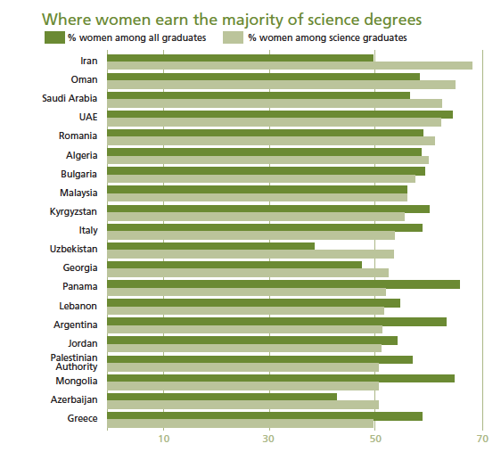
Iran
Oman
Saudi Arabia
UAE
Romania
Algeria
Bulgaria
Malaysia
Kyrgyzstan
Italy
Uzbekistan
Georgia
Panama
Lebanon
Argentina...
Maria Charles, “What Gender is Science?
50%

Slide 10
Why do wealthy countries have fewer women in STEM?
Less need to earn a living:
  Can study subjects that don’t lead to secure or high-paying jobs.
College viewed as identity construction and self-realization:
  Expressing your essential male/female selves, rather than career preparation, economic betterment
More high school choices:
  Art, drama, many languages… Girls can opt out of STEM
More college choices created for girls:
  Home economics, early childhood education, gender studies

Slide 11

Consumerism:
  Sell more toys if boys/girls play with different stuff

Slide 12
Why do wealthy countries have fewer women in STEM?
“Follow your passion”
  Many 18-year-olds don’t know their passion
  What does society expect me to be passionate about?
  Becomes a stereotypical gendered choice
Self-reinforcing:
  Fewer opportunities to socialize with other girls in STEM clubs
  Believing in difference can produce difference (e.g., stereotype threat)

Slide 13
Why do many conservative Muslim/Arab countries have more women in STEM?
Single-sex education:
  More girls enjoy STEM when no pressure to appear feminine
  No need to “dumb down”
Military, religious, political jobs:
  Only for men in some countries, leaving more STEM jobs for women
Safe spaces for women:
  Chemistry lab vs. courtroom

Slide 14
What about in the U.S. ??
In the U.S., boys on the average outperform girls in math, and girls outperform boys in English/language arts (ELA).
  Which of the following do you think is true about math? Boys outperform girls by a larger amount in:
  poor school districts
  wealthy school districts

Slide 15
Math/ELA gender gaps among children
Stanford Center for Education Policy Analysis, CEPA Working Paper No. 18-13 (Reardon, Fahle, Kalogrides, Podolsky, Zarate)
  Scores on 260 million standardized tests
  Roughly 10,000 U.S. school districts
  Grades 3-8
  2008-09 through 2014-15 school years
  Composite measure of average socioeconomic status (SES)
  Local adult gender disparities

Slide 16
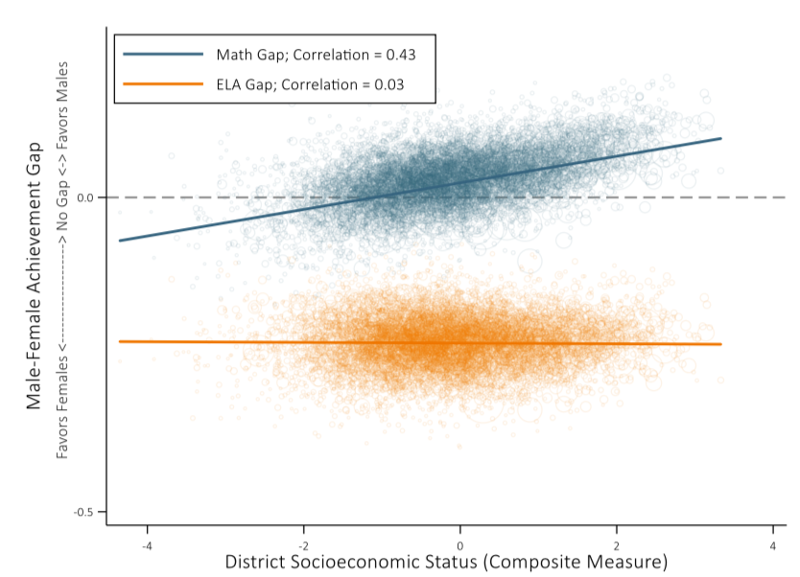
Stanford Center for Education Policy Analysis, CEPA Working Paper No. 18-13 (Reardon, Fahle, Kalogrides, Podolsky, Zarate)

Slide 17
Why? Hypothesis 1. Parents invest time/money resources in their children in gendered ways
Broad social norms
  Lead children to develop
Gendered interests
to which
Parents respond & reinforce
Parents have gender stereotypes
  Leading children to develop
Gendered interests
  Either way, greater investments from affluent families can lead to greater gender differences in children’s interests, identities, and skills

Slide 18
Why? Hypothesis 2. Different returns on educational investments
Wealthy families: Men earn more than women
  Leading to
Higher expected return on education for boys
Lower SES conditions (especially single-mom families)
Higher expected return on education for girls
  Sons of high-status fathers tend to achieve higher educational attainment than daughters
  Among low SES families, boys have lower academic & economic outcomes than girls

Slide 19
Why are Women Under-represented in STEM?
BIOLOGICAL FACTORS
Strength
Height
Aptitudes
Psychological factors
Preferences
Reproductive needs…
Job
Choice
SOCIAL FACTORS
Parental
Influence
Advertisements
Discrimination
Societal
Expectations
Role models…

Slide 20
Outline
Women in science/engineering
  Trends across time
  Trends across different countries
  Trends across the the U.S.
Two of my projects
  Presentations in academic interviews
  Book project
Suggestions for what to do

Slide 21
My roles & projects
Faculty Equity Advisor, Jacobs School of Engineering
  Search committee training
  Chair of faculty search committees
  Meet with faculty candidates
  Give talks to student groups
Co-Director, Center for Research on Gender in STEMM
  http://crg-stemm.ucsd.edu
  Research on engineering job talks
  Research on career assessment tools

Slide 22
Gender Gap in ECE Faculty: Many Causes
Hiring:
Lack of role models
Biases in ref letters
Biases in teaching evals
Self-citation patterns
Shifting criteria, etc.
Retention:
Hostile climate concerns
Two-body problems
Lack of mentoring
Exclusion from useful networks, etc.
Not much studied: The Interview Day

Slide 23
The Interview Day
1-hour research seminar open to faculty, students
Meet Department Chair
Individual meetings with faculty
Lunch, dinner
Other stuff…
Job Talk
Questions & Interruptions during Job Talks
Preliminary work: Analyses of Introductions

Slide 24
Research on Interruptions in Conversation
  Many contexts studied:
    Corporations
    Press briefings
    Parent-child
    Fictional TV
    Doctor-patient
    Supreme Court
  Groups with different:
    Gender composition
    Knowledge level
    Status
    Size
    Setting
    Topics of discussion
Interruptions indicate power & dominance
Gender and status effects
Many complex effects

Slide 25

How would you define an Interruption?
Simultaneous speech more than two syllables before the end of someone’s sentence
Interrupting in midst of incomplete grammatical unit
  It’s raining outside so I am going to leave.
  It’s raining outside …
  It’s…
Didn’t raise your hand; didn’t get acknowledged by the speaker

Slide 26

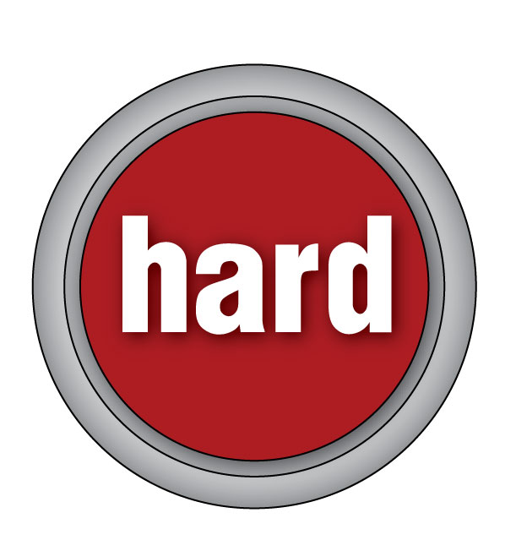
Definitions of Interruptions
Presenter is Presenting:
Presenter is Answering a Question:
Raise your hand, get acknowledged
  ACKNOWLEDGED QUESTION
Otherwise
  INTERRUPTION
Wait until the presenter has finished their answer, then ask another question without raising hand
  FOLLOW-UP QUESTION
Otherwise (ask another question without letting presenter finish, speech overlap)
  INTERRUPTION

Slide 27
First Data Set: Video recordings of job talks
140 videos
91 men, 49 women
Range of seniority:
  PhD students: 44
  1-2 years out: 26
  3-6 years out: 40
  7-21 years out: 30
2 large public R1 schools
Multiple departments
  EE, CS, ME, BioEng
Data analysis from pre-Q&A portion
Female, PhD+4 | Duration
Presenting | 10:03
Question (Acknowledged) | 00:07
Answer | 00:12
Presenting | 03:53
Question (Interruption) | 00:03
Answer | 00:06

Slide 28
Number of Questions vs. Length of Talk

Slide 29
Results
 | Men | Women
Interruptions | 3.31 | 4.20
Ack. Questions | 4.81 | 4.55
Follow-ups | 4.21 | 5.57
Total Questions | 12.3 | 14.3
Gender effect:
  Women get 3 more questions, on average
  Women experience more talks with zero questions
  Conditioned on getting any questions, women get 6 more questions than men, on average
Seniority effect
Department effect

Slide 30
Is it Bad to get More Questions?
Could be a sign of audience interest
No outcome information (offers, hires)
More questions correlated with speaker rushing:
  “There’s not much time left; I will rush through this”
  “I’m going to skip to the end”

Slide 31
Preliminary research: Analyses of Introductions
85 Introductions transcribed
Count positive comments in intro:
  Awards, Number of citations, Media attention, etc.
Positive introduction: >1 positive comment
  Men are four times as likely as women to have a positive introduction
Research Awards:
 | Listed in CV | Mentioned in Intro
Men | 78% | 52%
Women | 73% | 27%

Slide 32
Irrelevant or Inappropriate
Counting irrelevant statements in introduction:
  Things that wouldn’t be found in the CV
  Women: 40.9 %
  Men: 14.5 %

Slide 33

Suggestions for Engineering Departments
Standardize strongly positive introductions for all candidates
If questions get out of hand, ask audience to hold remaining questions for the end
  Most natural for introducer to say this
  But any faculty member in audience can step in
Engineering should have a more friendly, less aggressive culture!

Slide 34

My Book Project
Fictional story for kids (ages 9-11) that teaches a little about Electrical Engineering (error correction coding)
Originally had both lead characters as girls
Delancey ➔ Daniel

Slide 35
Some Assorted Recommendations
Do not say “Follow your passion”
  Instead say “Nurture an interest”
Women: Never say “I hated math… I could never understand it”
  Even if it’s true, don’t say it
  Believing in difference can actually produce difference
  Find something else to be self-deprecatory about
Message about equal capability
Encourage children to:
  Draw
  Work with their hands
  Play games that involve fitting things into places
  Play with construction toys

Slide 36
More Assorted Recommendations
Teach children that intellectual skills can be acquired
  Praise children for effort not innate brilliance
  Talented and gifted programs should send the message that they value growth and learning
Portray challenges, effort and mistakes as highly valued
  Marva Collins: If you can’t make a mistake, you can’t make anything
Expose girls to successful role models
Encourage girls to join robotics clubs, Girls Who Code, Math Clubs, etc.
Watch out for media portrayals of women scientists

Slide 37
Last Thoughts
The “Gender of Science” is a cultural construct…
  changes over time
  changes across different countries
  changes across different SES levels
When talking to scientists and engineers about sociology, data is important
U.S. needs more scientists and engineers!
Many things individuals can do to help

