Slide 1
Agenda for 4/3/19 127th Meeting
Reminder: please turn off or mute cell phones
Announcements, Introductions, Issues, or Ideas
Upcoming Talks
“An Engineer’s Data-Driven Perspective on Gender in STEM”, Pamela Cosman
Speaker Appreciation

Slide 2
Past Lyncean Speaker Lena Murchikova at the Atacama Large Millimeter Array in Chile (17,000 ft)

Slide 3
Upcoming Talks
SUBJECT TO CHANGE
This information is also on the website under “Upcoming Talks”
Date | Speaker | Topic/Title
4/3/19 | Pamela Cosman Professor of Electrical and Computer Engineering Jacobs School of Engineering UC San Diego | An Engineer’s Data-Driven Perspective on Gender in STEM
5/15/19 | Andrea Decker Adult Programs Manager Fleet Science Center +++++ Eric Robinson Strategic Outreach Manager Green Launch | Two Scientists Walk Into a Bar +++++ Space Cannons
6/26/19 | Jeff Severinghaus Professor Geosciences Research Division Scripps Institution of Oceanography UC San Diego | TBD

Slide 4
Upcoming Talks
SUBJECT TO CHANGE
This information is also on the website under “Upcoming Talks”
Date | Speaker | Topic/Title
8/7/19 | William Tong Professor of Chemistry & Biochemistry San Diego State University | TBD
9/18/19 | Mark Merrifield Director, Center for Climate Change Impacts and Adaptation Scripps Institution of Oceanography UC San Diego | TBD
10/30/19 | Richard Norris Professor of Paleobiology Geosciences Research Division Scripps Institution of Oceanography UC San Diego | TBD
12/11/19 | TBD | TBD
1/22/20 | TBD | TBD

Slide 5
“An Engineer’s Data-Driven Perspective on Gender in STEM” Pamela Cosman

Slide 6
Speaker Appreciation
REMINDER: Professor Cosman has agreed to sign copies of her book, The Secret Code Menace, after we are done with the presentations. She also has a limited number of copies for purchase ($10, cash only).
We are here

Slide 7
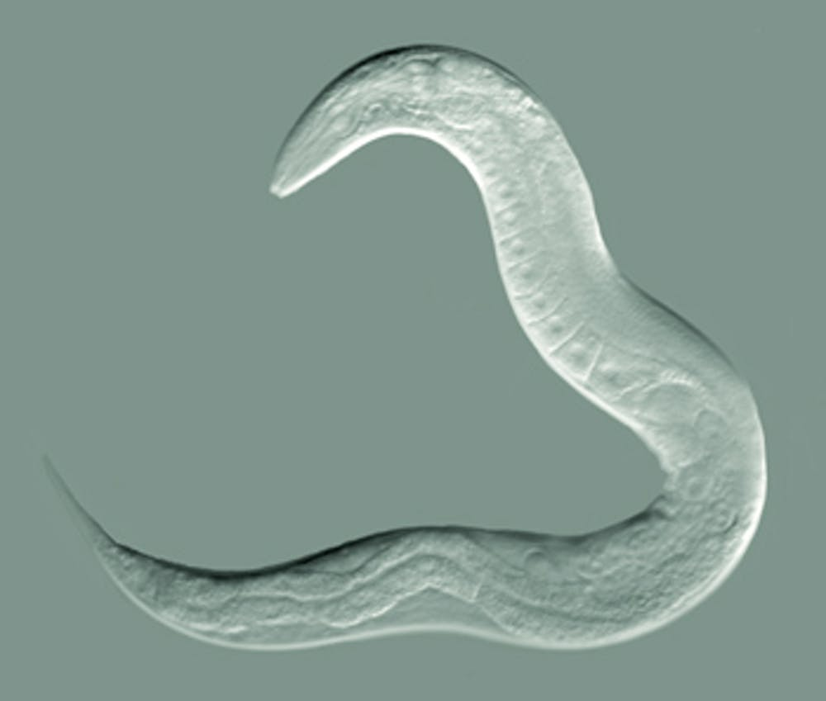
“Machine vision applied to automatic tracking and classification of mutant nematodes”
For those of you who may not know what a nematode is, here is a picture of a C. elegans worm or nematode:
Adorable, huh?
Can you imagine what a mutant version of this would look like?

Slide 8
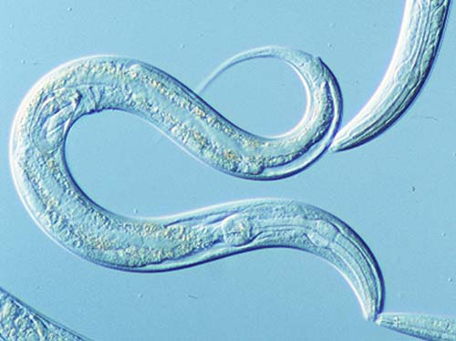
Examples of Research Papers
“Image Feature Extraction and Natural Clustering of Worm Body Shapes and Motion Characteristics”, IASTED International Conference on Signal and Image Processing, 2003.
“Automated Worm Tracking and Classification”, Proceedings 37th Asilomar Conference on Signals, Systems, and Computers, 2003.
“Detecting attached worm eggs using deformable template matching”, Proceedings IASTED International Symposium on Computers, Graphics, and Imaging, 2004.

Slide 9
Tracking Mutant Nematodes

Slide 10
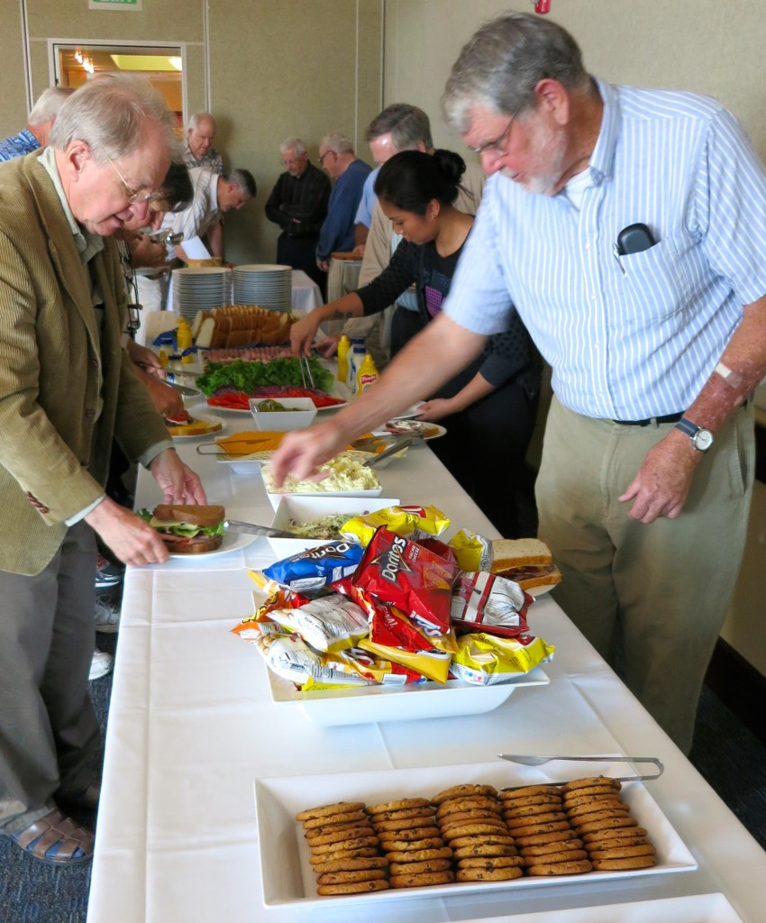
Speaker Appreciation – What To Do?
I was more interested in using the concept of classifying mutant worms than tracking them
*
*I’m not very good at tracking mutant nematodes. I was doing a tracking experiment with a couple dozen before lunch and several got away. They may have gotten into the cole slaw.

Slide 11
Speaker Appreciation – What To Do?
I was more interested in using the concept of classifying mutant worms than tracking them
How could I incorporate the fact that our speaker is also the author of a children’s book?

Slide 12
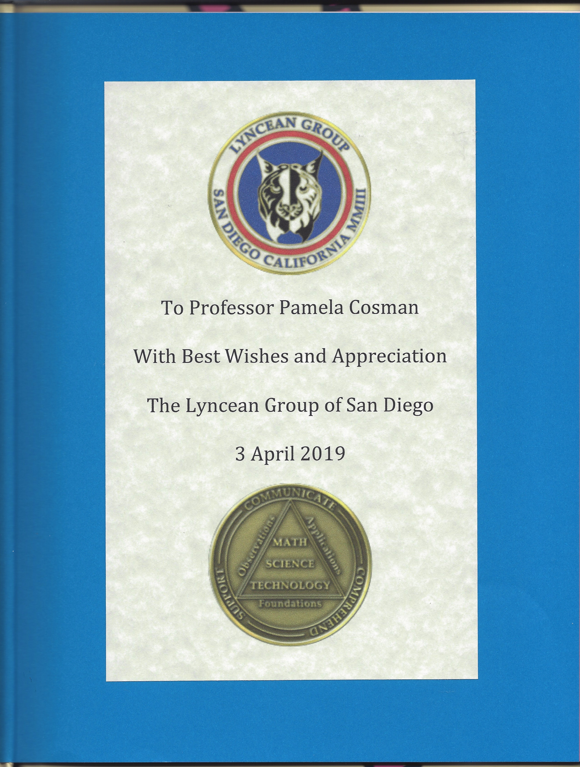
A Big Yellow Token of Appreciation
Cover
Front Page

Slide 13
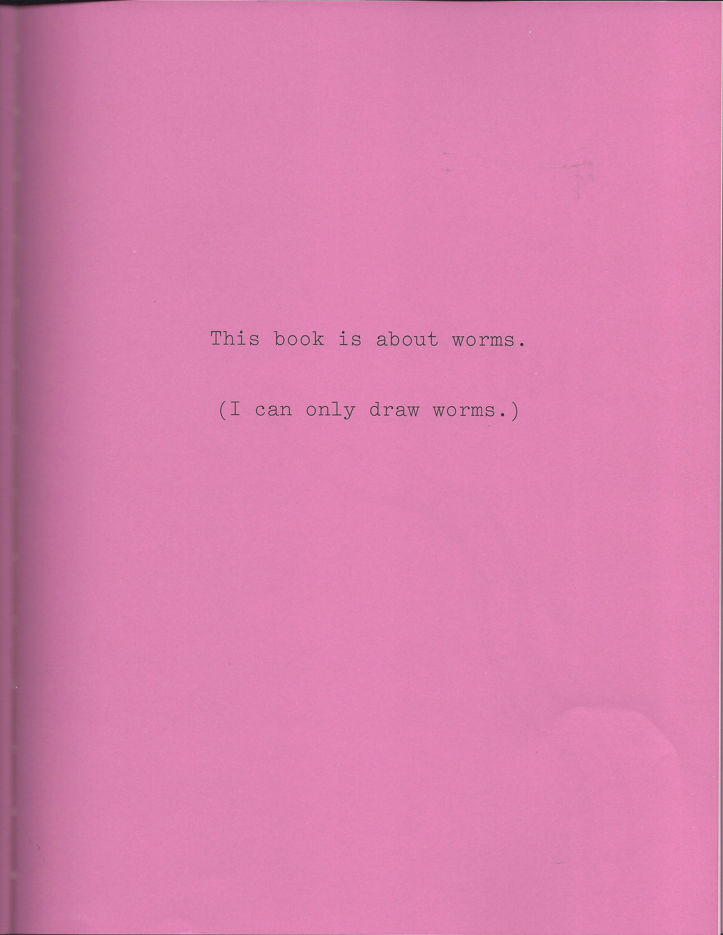
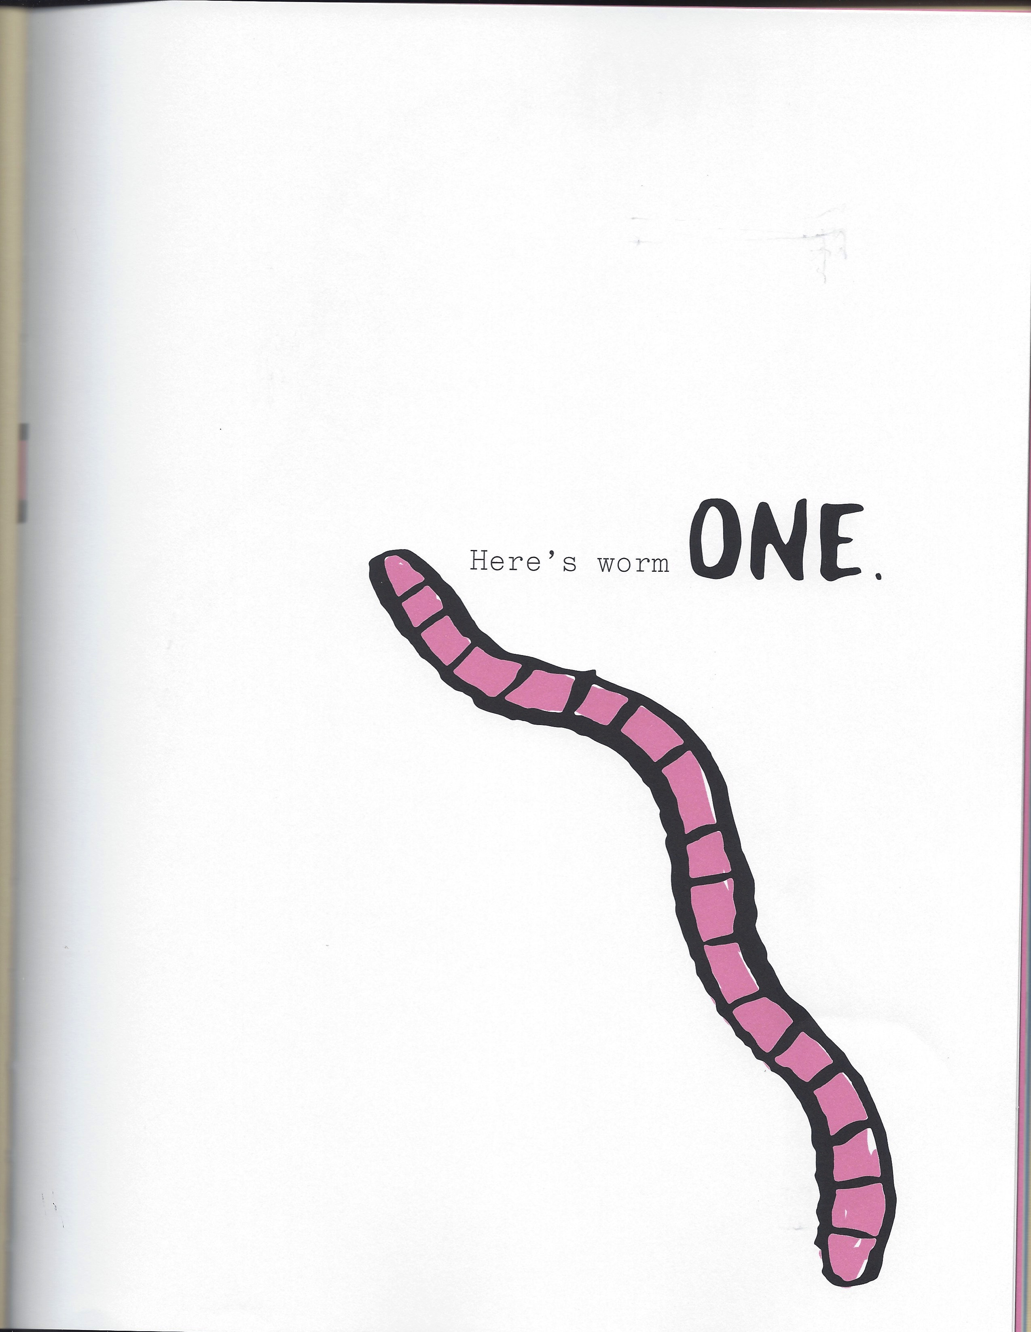
I Can Only Draw Worms
Page 1
Page 2

Slide 14
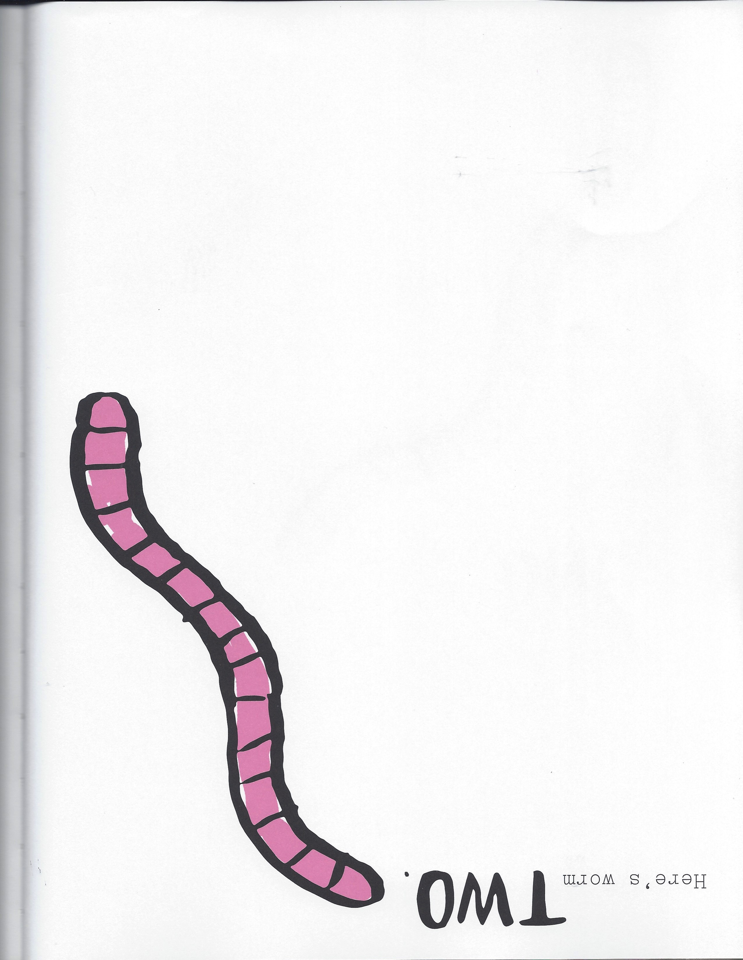
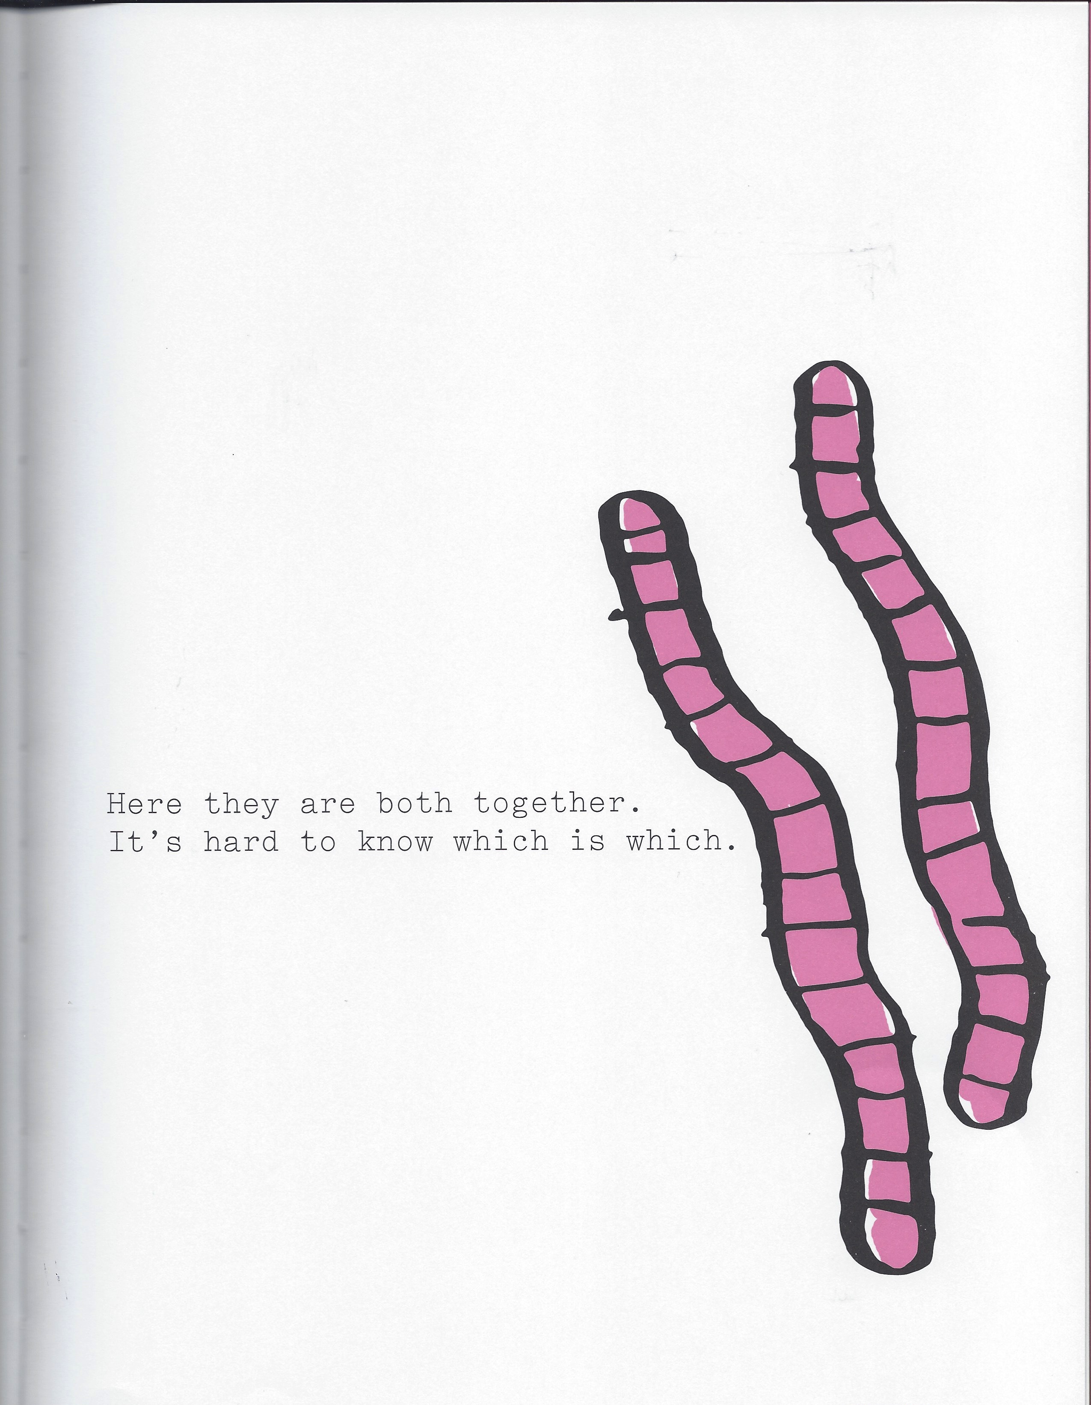
I Can Only Draw Worms
Page 3
Page 4
“Here they are both together. It’s hard to know which is which.”

Slide 15
IMAGE FEATURE EXTRACTION AND NATURAL CLUSTERING OF WORM BODY SHAPES AND MOTION CHARACTERISTICS*
Abstract:
Genetic analysis of nervous system function relies on the rigorous description of animal behaviors. However, standard methods for classifying the behavioral patterns of mutant Caenorhabditis elegans (a microscopic worm) rely on human observation and are therefore subjective and imprecise. Here we describe the application of machine learning and image feature extraction techniques to quantitatively define and classify the behavioral patterns of C. elegans nervous system mutants. We have used an automated tracking and image processing system to obtain measurements of a wide range of morphological and behavioral features from videos of representative mutant types. By performing principal component analysis using a selected subset of features, we represented the behavioral patterns of eight mutant types as data clouds distributed in multidimensional feature space. Cluster analysis using the k-means algorithm made it possible to quantitatively assess the relative similarities between worm types and to identify natural clusters among the data. The patterns of similarity identified in this study closely paralleled the functional similarities of the mutant gene products, suggesting that the quantitative image features are an effective diagnostic of the mutants’ underlying molecular defects.
*Geng, Cosman, Back, Berry, and Schafer, August 2003.
“It’s hard to tell which is which”

Slide 16
Speaker Appreciation
REMINDER: Professor Cosman has agreed to sign copies of her book, The Secret Code Menace, after we are done with the presentations. She also has a limited number of copies for purchase ($10, cash only).
We are here

Slide 17
Lyncea
Don’t forget to drop off your badges when you leave!

