Slide 1
Green Launch, a Hydrogen Cannon as the FedEx of Space
May 15 2019
Presentation by Green Launch LLC for THE
LynceAN Group
Dr. John Hunter and Eric Robinson

Slide 2
Motivation
Goal to be the FedEx of Space with just-in-time delivery of satellites and vital items to the ISS
Deliver propellant at $100/lb to space depots to support space / refueling missions
Zero hydrocarbon launch emissions for large scale space exploration

Slide 3
Hydrogen Cannons will deliver payload to orbit affordably!
Jules Verne had the right idea, but wrong propellant. We use hydrogen, not gunpowder to obtain much higher velocity
Umax=2*Co/(Gamma-1)
Where Co=sqrt(Gamma*R*T/Molec))
P=P0*(1-U/Umax)^{2*Gamma/(Gamma-1)}
Where Umax is the maximum speed of the gas expanding in vacuum
C0 is the speed of sound in the gas just before the launch, Po is the initial pressure.
Gamma is the ratio of specific heats of the gas, i.e. Gamma=C_{p}/C_{v}
This says that when U=Umax, pressure at the projectile is zero. As a practical matter it turns out the best you can achieve is about:
Vpractical=C0/(Gamma-1)

Slide 5
On Orbital Green Launchers Cannon boost minimizes the rocket stage

Slide 7
Green Launch demonstrator phases
Phase 1 is in process: Launch to the Karman Line
Demonstrates the first use of a hydrogen cannon to access space (suborbital)
Allows affordable delivery of science payloads to space
Demonstrates multiple launches/day
Phase 2: Launch to 200 km / Break altitude record
Delivers sensor packages and atmospheric samplers to help diagnose climate change. Affordable and Quick!!!
Provides 1 month turnaround on sounding experiments
Phase 3: Deliver 1 lb to Low Earth Orbit $5M
Allows cubesat delivery to orbit
Pioneers affordable delivery of payloads to orbit!
Will be scaled up for larger 100 lb to 1,000 lb payloads

Slide 8
Yuma Proving Grounds supplied a 55 ft cannon which we modified for light gasses

Slide 9
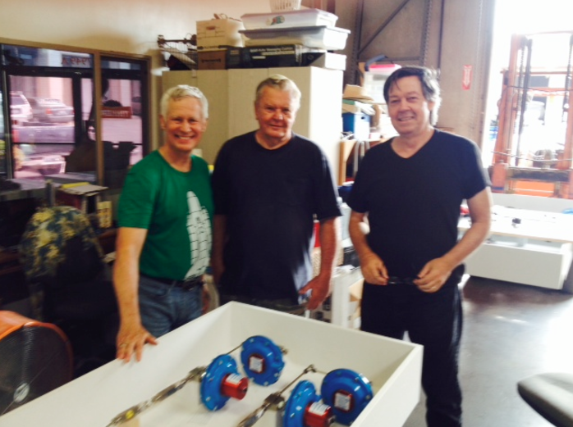
At the shop in Santee
building the gas manifold
At the Yuma Proving Grounds near the launch location

Slide 10
Mini Mart Vehicle with Sabot and Payloads
The Mini Mart launch vehicle is 4 inches in diameter and contains 3 payloads (4 inch long white cylinders)
Payloads can sample the atmosphere, record atmospheric gas properties and transmit information to a ground station

Slide 11
Modern electronics can take 30,000 Gs with minor mods

Slide 12
The KOFA Range at Yuma Proving Ground has unrestricted air space

Slide 13
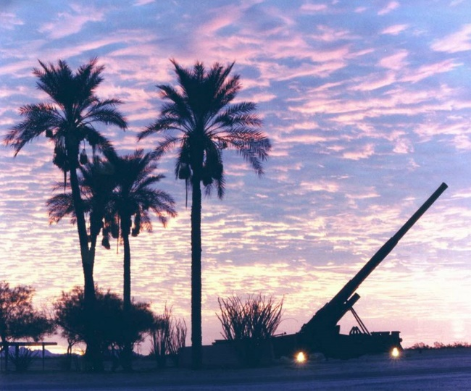
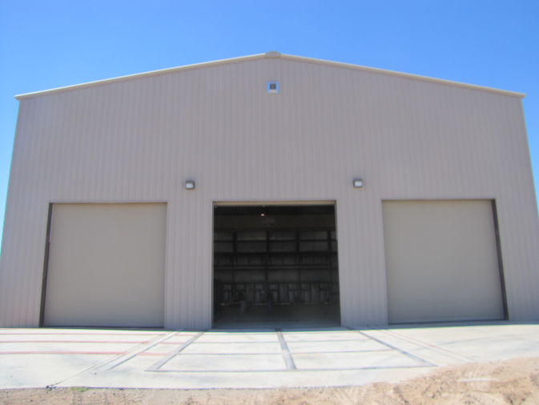
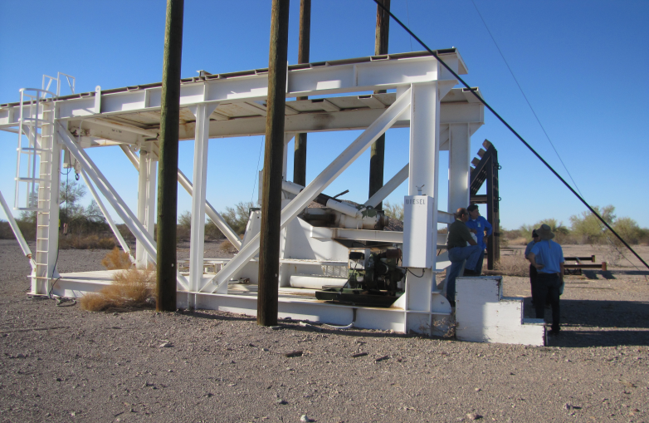
Yuma Proving Ground is affordable and convenient

Slide 14
Phase 1: Launch to the Karman Line.
Vehicle is launched at 2 km/s by Hydrogen Cannon within the KOFA test range
Sabot separates from vehicle and petals land nearby. Vehicle ascends at 85 degrees. The Sonic boom is minimal and brief.
Radar acquires vehicle and tracks it past Karman Line at 100 km
Vehicle turns around at apogee and reenters atmosphere. Vehicle impacts 40 km downrange.
Subsequent launches will have active payloads which eject at apogee and take data

Slide 15
Phase 2: 200 km altitude record
Same as Phase 1 except:
Vehicle with sensor payload is launched at 3.0 km/s
Vehicle exceeds 200 km, ejects payload
Payload parachutes to ground while vehicle impacts downrange
Launches have active payloads which eject at apogee and take data as well as sample atmospheric gasses

Slide 16
Phase 3: Cubesat orbital delivery
Vehicle is launched at 6 km/s by a hydrogen cannon. Hydrogen is captured and stored for next shot
Sabot separates and petals land nearby. Vehicle ascends at 30 degrees. The Sonic boom is downrange.
The aeroshell nose ablates several inches. Aeroshell is discarded at 100 km.
The rocket motor burns for 100 sec. Vehicle delivers Cubesat to 300 km altitude earth orbit

Slide 17
The Green Launch back story: Steps which have been accomplished
Build a 400 ft Hydrogen Cannon: SHARP was built and operated 1992-1998 by Hunter and the SHARP team at Lawrence Livermore National Laboratory.
G-hardening the GN&C electronics: Completed in 1998 for DARPA using commercial parts
G-Hardened rocket for orbital insertion: Completed by CAES in 1998 for DTRA for “Star Wars”
Horizontal Shots at YPG this year: Series of 16 shots completed with different parameters up to 2 Km/sec

Slide 18
1. SHARP Launched 10 lbs at Mach 9 at LLNL in 1998

Slide 19
2. Satellite from COTS parts tested to 3,200 Gs for DARPA

Slide 20
3. Rocket Sustained 15,000 G Launch

Slide 21
4. Active Green Launch testing at YPG

Slide 22
Green Launch cannon (modified for light gas shots at YPG in 2018)

Slide 23
Gun Mounting on Carriage

Slide 24
Gun mounted with support

Slide 25
Connection to Gas Supply

Slide 26
Current horizontal testing for Phase 1
The 55-foot cannon is successfully modified for light gasses
Gas manifold and controls are working well
Two shots per day using YPG personnel and our team
Shots 14, 15 and 16 in saw speeds up to 2 km/s
Next horizontal test series in May and June will assure performance of vertical test series to Karman Line
Contact or follow us at: https://greenlaunch.org/

Slide 27
Potential Orbital Launch Sites
Adak Island
Kwajalein (Reagan test range)
South Texas
Florida (Cape Canaveral)
Hawaii (Kuaui)

Slide 28
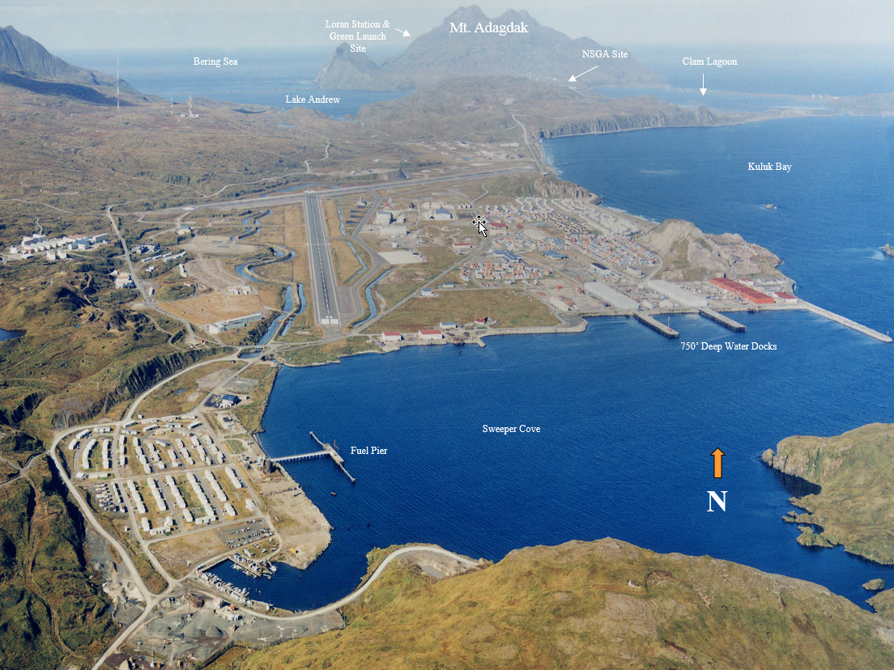

Slide 29
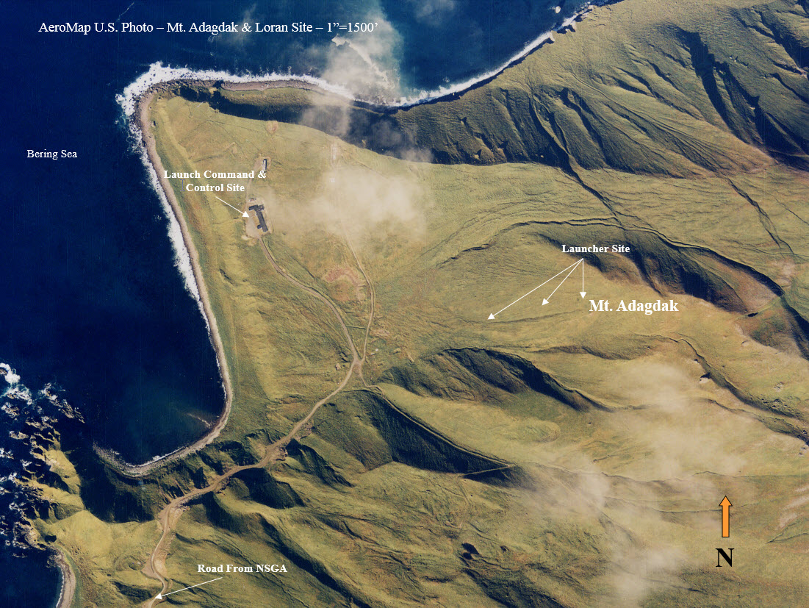

Slide 30
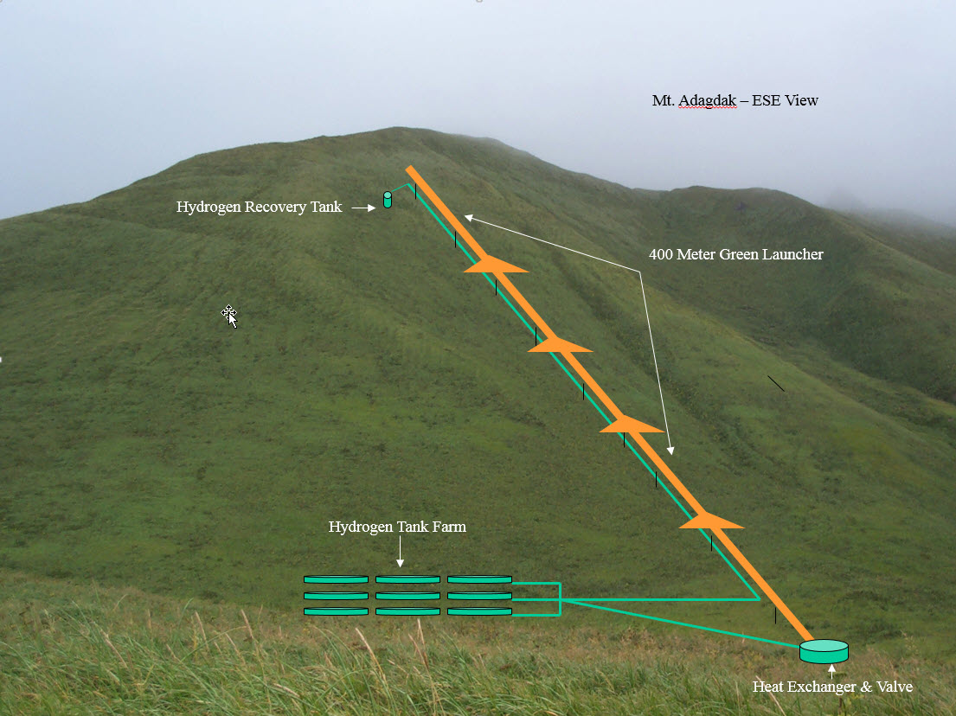

Slide 31
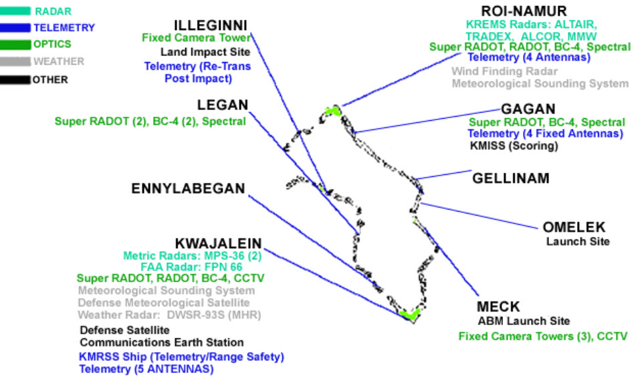
Kwajalein (Reagan Test range)

Slide 32
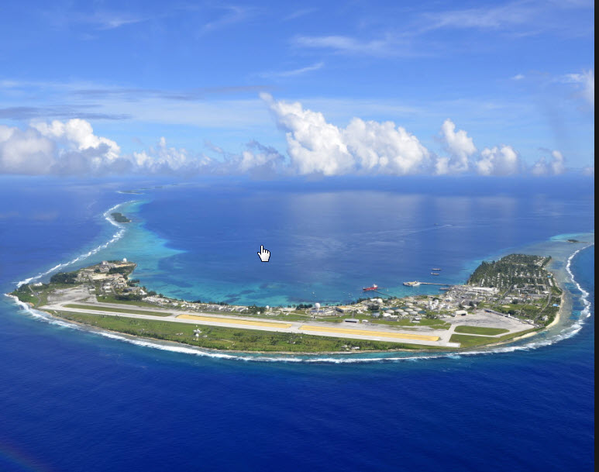

Slide 33
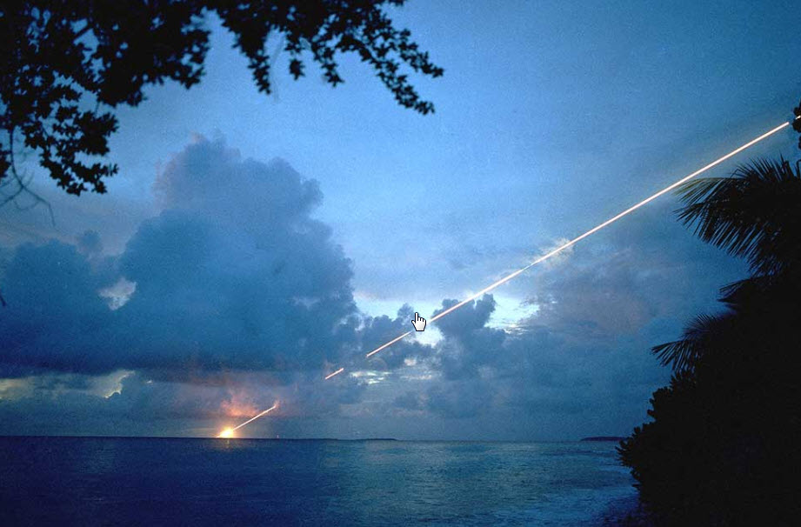

Slide 34
Thanks to
Jules Verne
The Green Launch team
Yuma Proving Ground (YPG) Test Directorate

