Slide 1


Welcome to the 131st meeting of the Lyncean Group
25 September 2019

Slide 2
Agenda for 9/25/19
131st Meeting
Reminder: please turn off or mute cell phones
Announcements, Introductions, Issues, or Ideas
Lyncean website / What’s new on Pete’s Lynx
Upcoming talks
“Sea-level Rise: Global and Local Perspectives”
  Dr. Mark Merrifield
Speaker Appreciation

Slide 3
Housekeeping
It has proven difficult to read some people’s handwriting on the sign-in sheet, so…
If you want to have your email address added to our list so you will receive meeting announcements, please send an email to Dennis Buckley at lynceandwb@gmail.com
If you are already on our list and want to change your address or have it deleted, please a note requesting such to the same address: lynceandwb@gmail.com
I don’t want to put Dennis’s address on the website, so I printed it on some little cards for each table. Feel free to take one if it will help you remember the address: lynceandwb@gmail.com

Slide 4
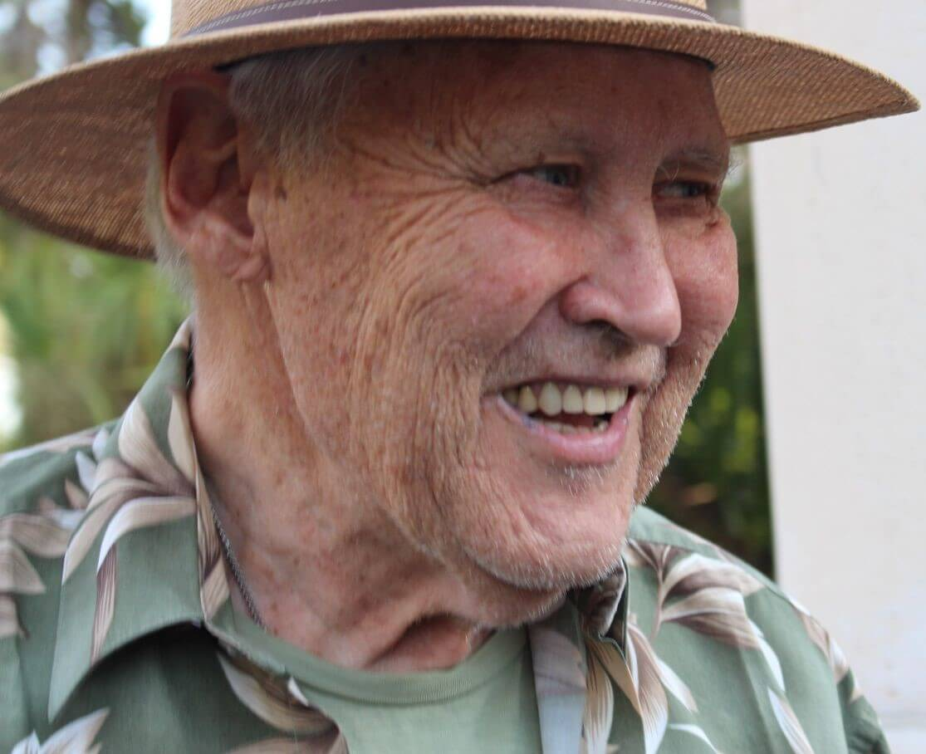
Announcements
Vince Cook passed away on 3 August 2019 after a long battle with cancer
He served in the US Air Force and then worked at the NSA, IBM, and SAIC
At SAIC, he was the Vice Chairman of International Operations
He also served on the:
  Defense Science Board
  National Security Telecommunications Advisory Council
  US Drug Enforcement Agency Technology Council

Slide 5

Announcements
Giancarlo Borgonovi, a founding member of the Lynceans and very early SAIC employee, has written a book, Quantum Decameron
It is a collection of short fiction stories that “… have in common some implausible connection with the world of physics, more quantum than classical, and some attempt at racy humor…”
Available on Amazon in Kindle form for $1.99
I recall Dr. Beyster once referring to Giancarlo as SAIC’s Physics Department so you can trust that the physics in this book is pretty good
The stories are short and well-written, but I am not sure I would call them “racy” in this day and age

Slide 6
Lyncean Website: www.lynceans.org
Annual Visitor Rate is Increasing
As of 9/24/19

Slide 7
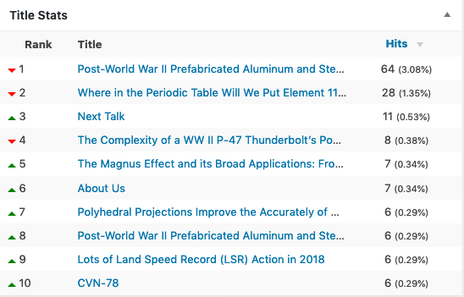
Lyncean Website: www.lynceans.org
Topics/Pages as of 9/24/19

Slide 8
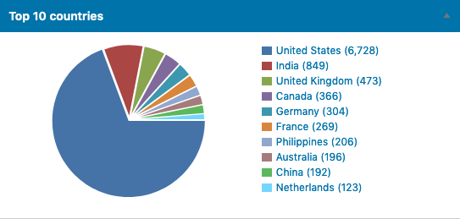
Lyncean Website: www.lynceans.org
Visitors as of 9/24/19

Slide 9
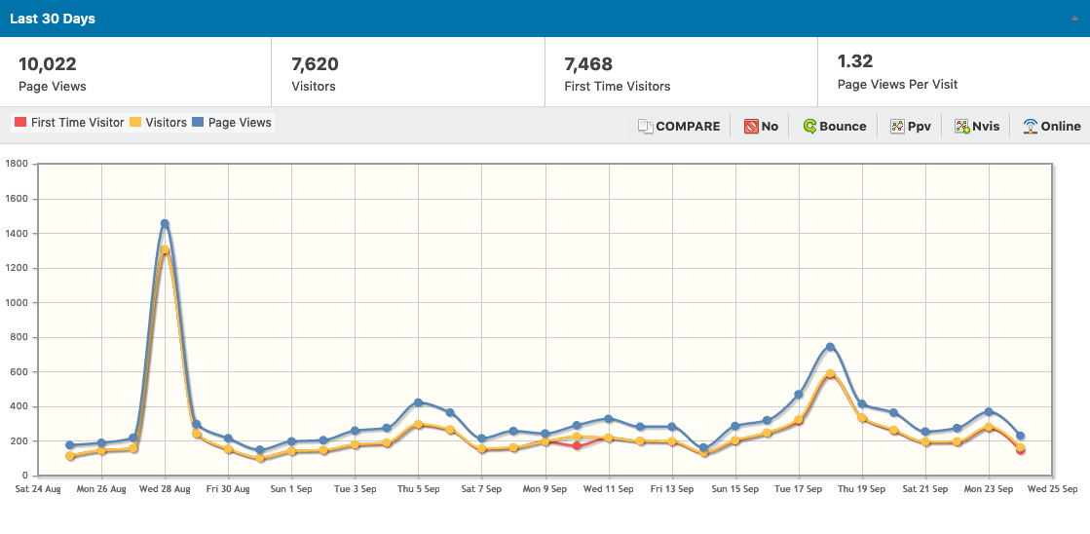
Lyncean Website: www.lynceans.org
Visitors for last 30 days as of 9/24/19

Slide 10
New on Pete’s Lynx
The Science Behind ATOMIK Vodka
Modern Airships – Part 1
  22 linked articles on historic and modern airships
  complete update & expansion of original August 2016 post
Modern Airships – Part 2
  25 more linked articles
Modern Airships – Part 3
  32 more linked articles
Third Source of Gravitational Waves Detected
  New source: Black hole – neutron star collision
  Previously: Black hole pair mergers & neutron star pair mergers

Slide 11

Upcoming Talks
SUBJECT TO CHANGE
This information is also on the website under “Upcoming Talks”
Date | Speaker | Topic/Title
9/25/19 | Mark Merrifield Director, Center for Climate Change Impacts and Adaptation, Scripps Institution of Oceanography, UC San Diego | Climate Change: Sea-level Rise – Global and Local Perspectives
10/30/19 | Richard Norris Professor of Paleobiology, Geosciences Research Division, Scripps Institution of Oceanography, UC San Diego | Climate Change: Modern climate impacts and what we can expect of the future
12/11/19 | Shelley Wright Associate Professor of Physics, Center for Astrophysics & Space Sciences, UC San Diego | New Ways to Search for Extraterrestrial Intelligence
1/22/20 | TBD | TBD
3/4/20 | Daniel Whiteson Professor of Physics & Astronomy UC Irvine | We Have No Idea: Big, Unanswered Questions about the Universe and Its Particles
Published 2017, available on Amazon

Slide 12
  Sea-level Rise: Global and
  Local Perspectives
Dr. Mark Merrifield
  Director, Center for Climate Change Impacts and Adaptations (CCCIA)
  Scripps Institution of Oceanography
  UC San Diego

Slide 13
Speaker Appreciation
We are here

Slide 14
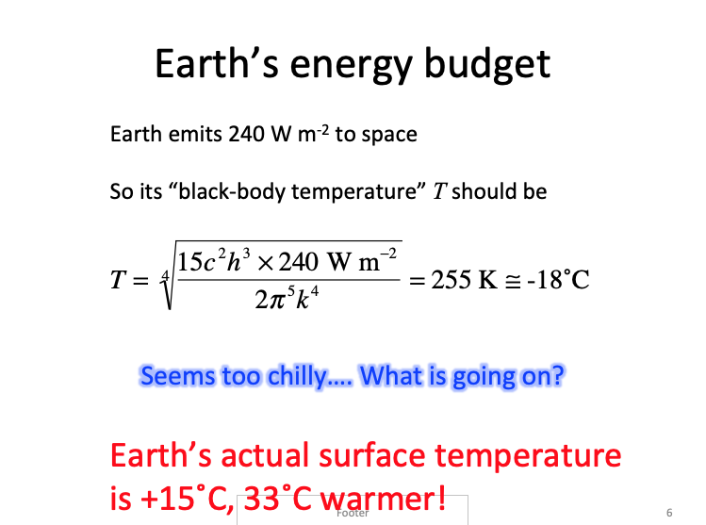
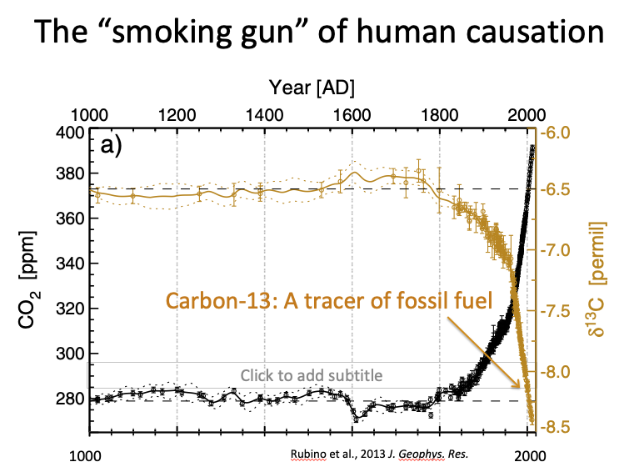
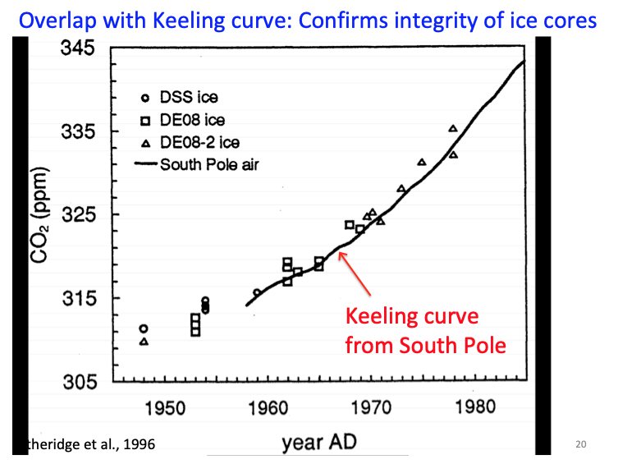
In his Lyncean talk on 6/26/19, Prof. Severinghaus made the case for human activity, especially the burning of fossil fuels, as the source of atmospheric CO₂ that causes global warming
He used ice cores and:
But could there be another explanation?
Equations
¹³C Data
Keeling Curve

Slide 15
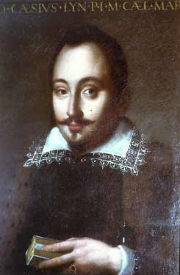
New Theory for the Increase in Atmospheric CO₂
We have used standard economic and statistical analysis instead of physics to understand the rise in atmospheric CO₂
The correlation is so exact that the only possible conclusion is that the the increase in atmospheric CO₂ is caused by the increase in meeting attendance NOT the burning of fossil fuels
Note:
  Economics is also known as “the dismal science”
  Statistics can be used to prove anything
  Work was sponsored by the Coal Mine Owners Association, proud makers of Clean Coal©
We have discovered a remarkable correlation between Lyncean meeting size and the amount of CO₂ in the atmosphere between 2003 and 2019
Federico Cesi
Academia del Lincei
Rome, 1603

Slide 17
Raw Data on Lyncean Meeting Size
Raw data is that in 2003, there were ~20 meeting attendees and by 2019 the number of meeting attendees is ~60
This data is fit by the equation S=20*(1+0.071)^{(Y-2003)} where:
  S=meeting size (number of attendees)
  Y=year, starting in 2003
  In other words, meeting size has grown by 7.1% per year since 2003

Slide 18
Standard Economics Theory* Requires
Some Adjustments to the Data
Annual change rates (ie, the 7.1%) must be adjusted to take into account inflation and annual changes in:
  Bond yields
  Price of tea in China
  Average weight of American men
Absolute values must scaled by:
  Ratio of the atomic weight of money to pollution
  Conversion factor from knots to miles per hour (or “economic velocity”)
*”How to Justify Anything,” Annals of Dismal Science (ADS), Alfred E. Neuman,
B.S., pp. 13-26, January 20, 2017.

Slide 19
Adjustments to Lyncean Meeting Size
Therefore, in accordance with accepted economics theory, the previous equation becomes
S=(A_{Au}/A_{C})*K*20*[1+(0.071-i-b-t-w)]^{(Y-2003)} where:
  i=inflation rate (1.80%)
  b=annual change in average bond yield, 2003-2019 (2.10%)
  t=annual change of price of tea in China, 2003-2019 (2.23%)
  w=annual change of average weight of men, 2003-2019 (0.40%)
  A_{Au}=atomic weight of gold (197), i.e., money
  A_{C}=atomic weight of carbon (12), i.e., pollution
  K=mph/knots conversion factor (1.141)

Slide 24
The Keeling/Lyncean Curve

Slide 25


Conclusion
The increase in atmospheric CO₂ is caused by the increase in Lyncean meeting attendance NOT the burning of fossil fuels
  Working explanation: large quantities of greenhouse gases are emitted during our meetings in proportion to the number of attendees
We plan to submit a paper to the Annals of Dismal Science
  Tentative title: “Fossil Fuels are Fine – Science Says So”
Instead of this pretty much worthless coin, I have been authorized (almost forced, really) to ask you to be lead author on the ADS paper and offer you a major (and I mean REALLY BIG) stipend from:
“Fossil Fuels are Fine – Scripps Scientist Says So”
The Coal Mine Owners Association
PROUD MAKERS OF CLEAN COAL©

Slide 26
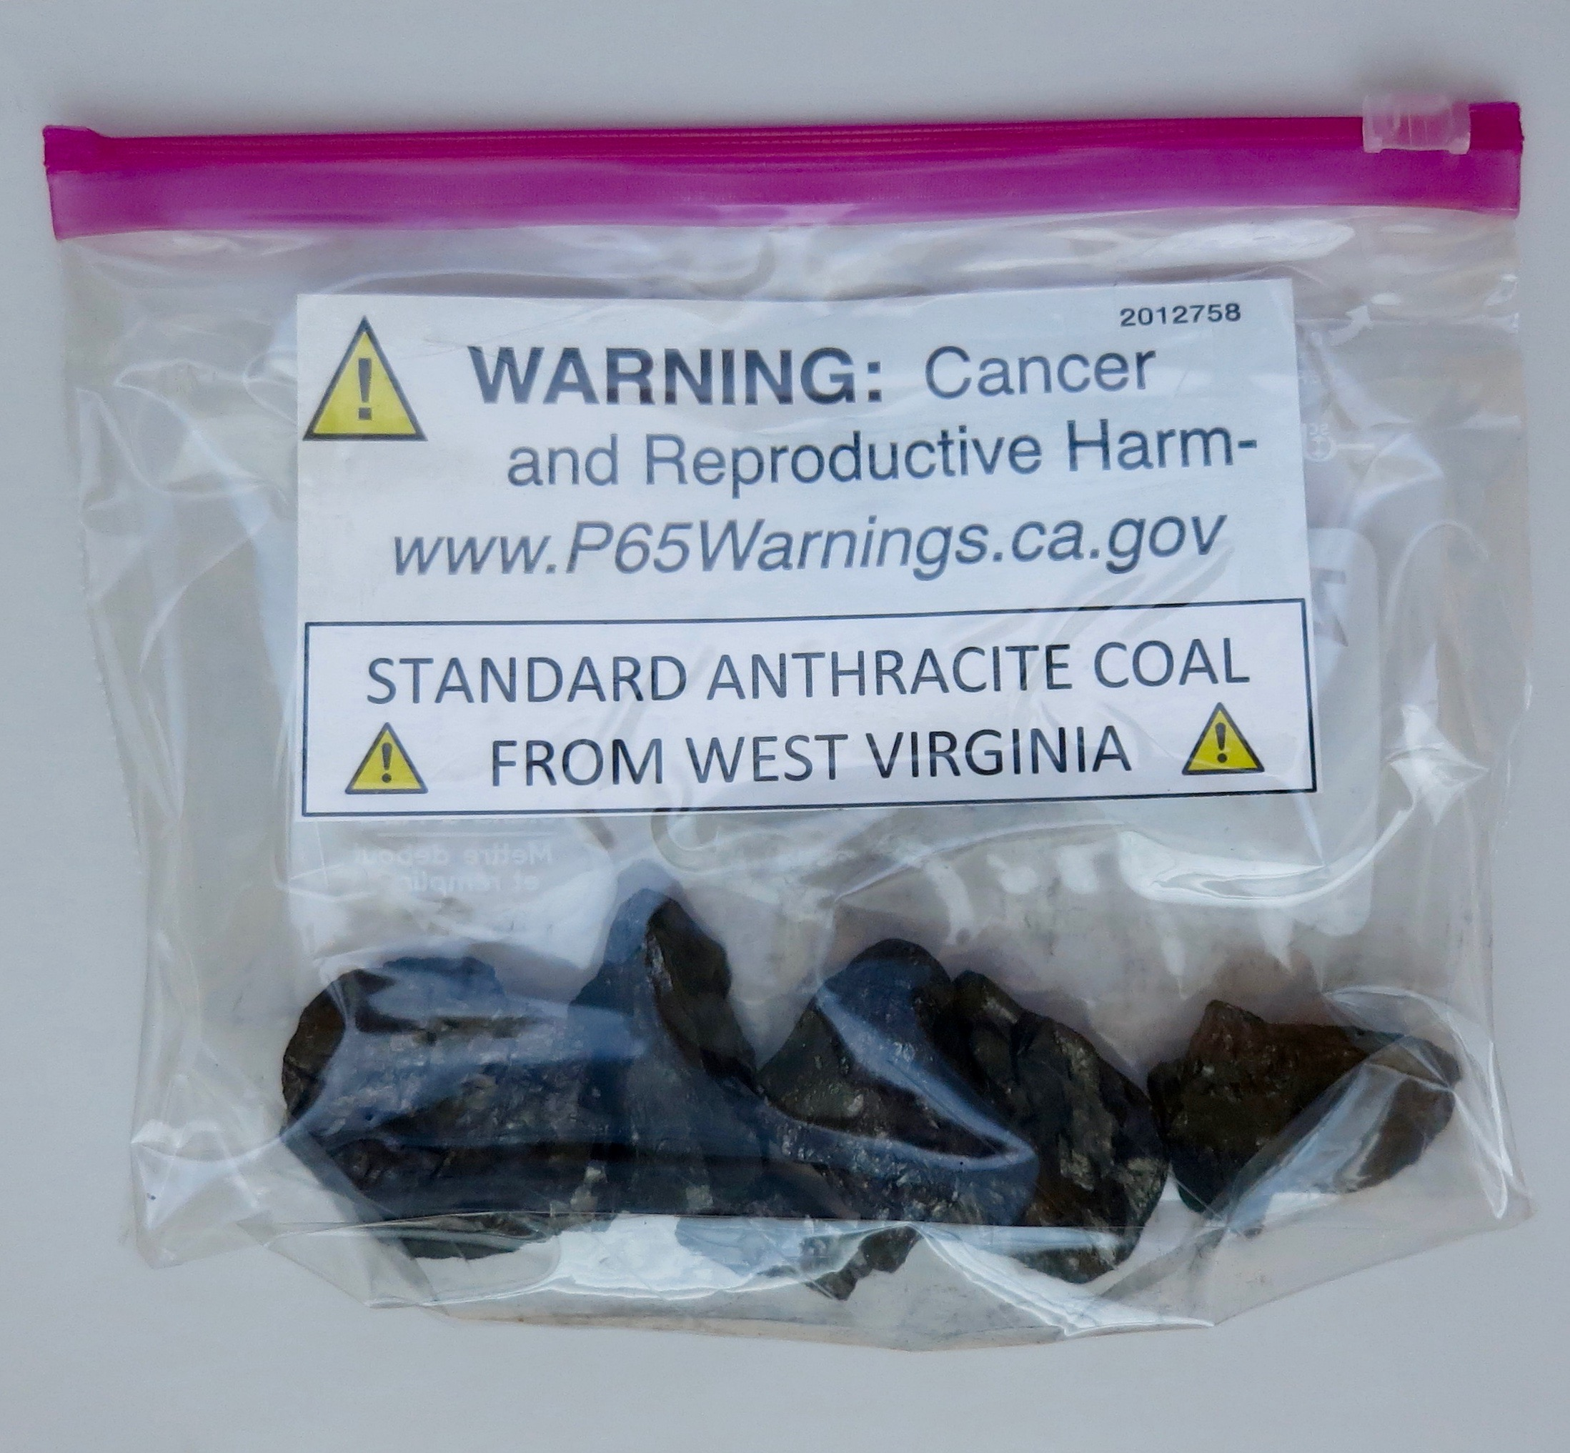
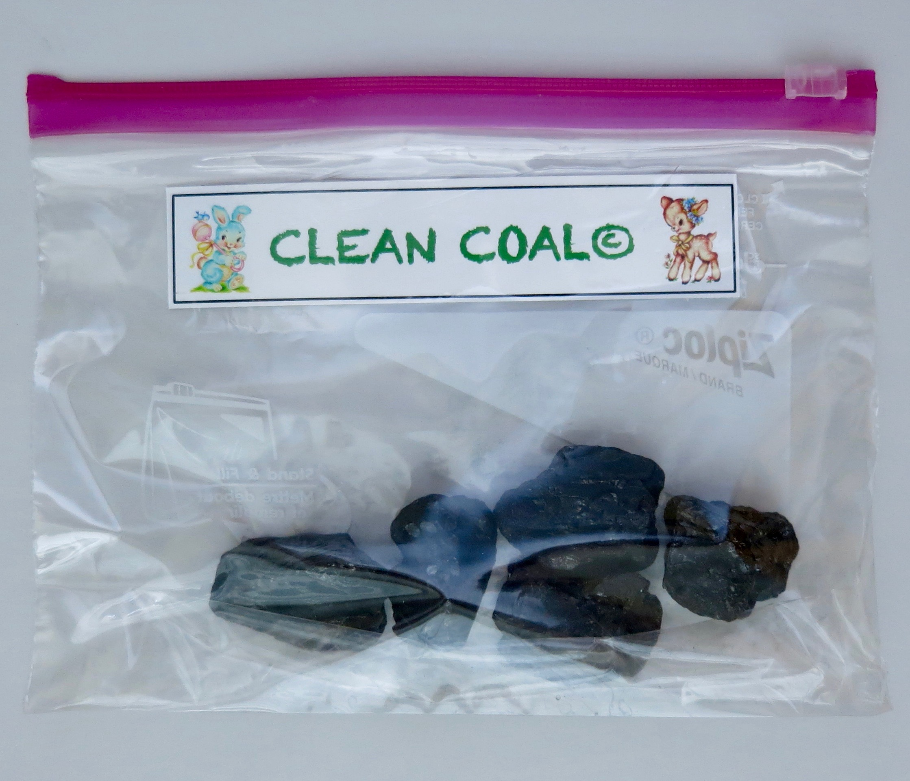
Regardless of your decision, please accept these complimentary samples from
The Coal Mine Owners Association

Slide 27

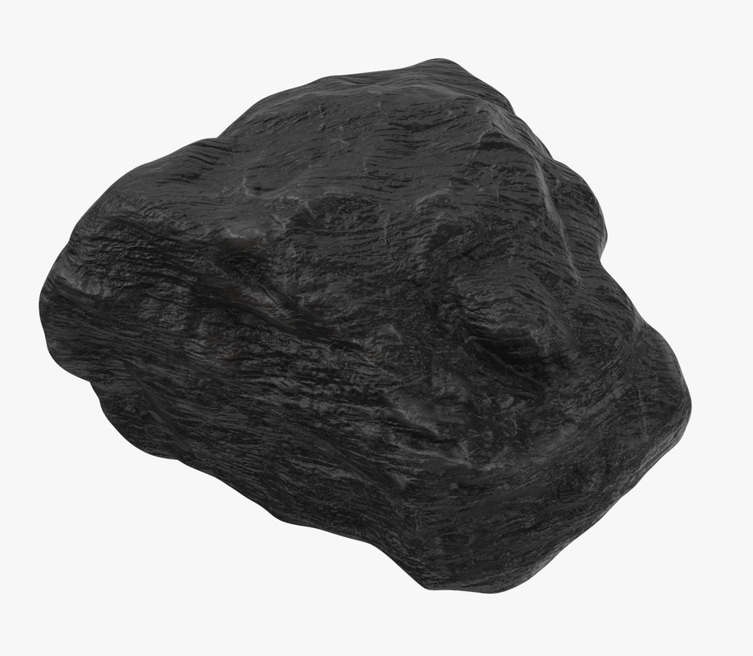
Conclusion
The increase in atmospheric CO₂ is caused by the increase in Lyncean meeting attendance NOT the burning of fossil fuels
  Theory: large quantities of greenhouse gases are emitted during our meetings in proportion to the number of attendees
We plan to submit a paper to the Annals of Dismal Science
  Tentative title: “Fossil Fuels are Fine – Science Says So”
Instead of this pretty much worthless coin, I have been authorized (almost forced, really) to ask you to be lead author on the ADS paper and offer you a major (and I mean REALLY BIG) stipend from:
It’s your choice: the coin or the coal cash?
“Fossil Fuels are Fine – Scripps Scientist Says So”
bribe
The Coal Mine Owners Association
PROUD MAKERS OF CLEAN COAL©

Slide 28

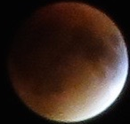
Lynxea
Don’t forget to drop off your badges when you leave!

