Slide 1
Welcome to the 132nd meeting of the Lyncean Group
30 October 2019

Slide 2
Agenda for 30 October 2019 132nd Meeting
Reminder: please turn off or mute cell phones
Announcements & upcoming talks
Pete’s Lynx update
The Larry Kull Endowed Student Award in Engineering and Entrepreneurship
Randy Vosti
Today’s Talk - Russia’s plans for Arctic development depend on marine nuclear power
Pete Lobner
Speaker Appreciation

Slide 3
Upcoming Talks
SUBJECT TO CHANGE
This information is also on the website under “Upcoming Talks”
Date | Speaker | Topic/Title
10/30/19 | Pete Lobner Chief Technical Blogger, Lyncean Group SAIC/DS&S (retired) Former US Navy nuclear submariner | Russia’s Plans for Arctic Development Depend on Marine Nuclear Power
12/11/19 | Shelley Wright Associate Professor of Physics, Center for Astrophysics & Space Sciences, UC San Diego | New Ways to Search for Extraterrestrial Intelligence
1/22/20 | Richard Norris Professor of Paleobiology, Geosciences Research Division, Scripps Institution of Oceanography, UC San Diego | Climate Change: Modern climate impacts and what we can expect of the future
3/4/20 | Daniel Whiteson Professor of Physics & Astronomy, UC Irvine | We Have No Idea: Big, Unanswered Questions about the Universe and Its Particles

Slide 4
Lyncean website
Pete Lobner

Slide 5
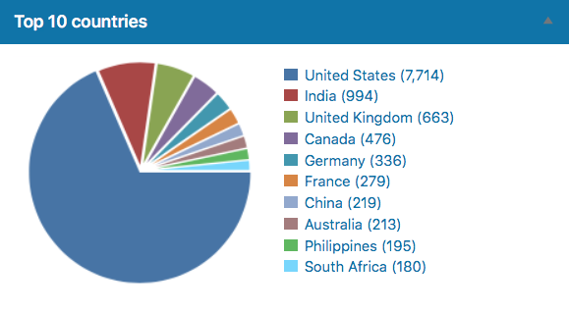
Lyncean website visitors

Slide 6
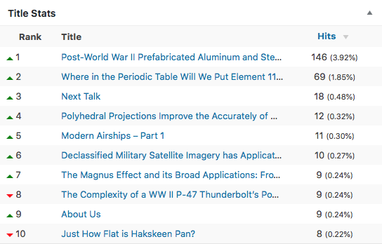
Popular on the Lyncean website 29 October 2019

Slide 7
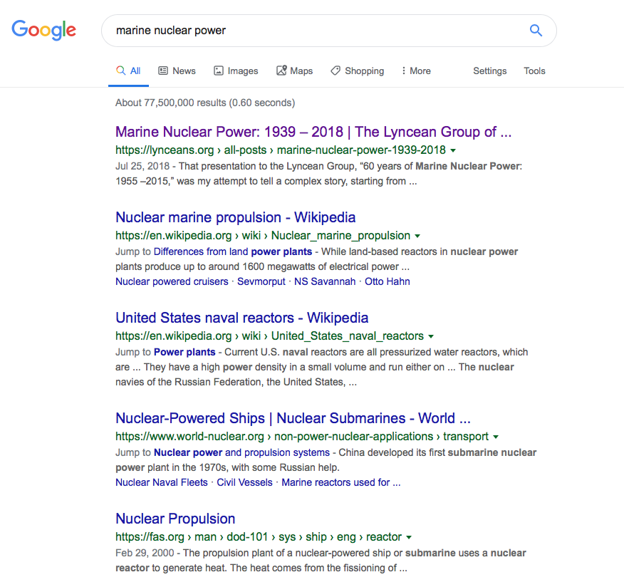
Popular on Google

Slide 8
The Larry Kull Endowed Student Award in Engineering and Entrepreneurship
Randy Vosti

Slide 9
Russia’s Plans for Arctic Development Depend on Marine Nuclear Power
Pete Lobner
Chief Technical Blogger, Lyncean Group
SAIC/DS&S (retired)
Former US Navy nuclear submariner

Slide 10
Speaker Appreciation
We are here

Slide 11
Lynxea
Don’t forget to drop off your badges when you leave!

