Slide 1
Welcome to the 133rd meeting of the Lyncean Group
11 December 2019

Slide 2
Agenda for 133rd Meeting 11 December 2019
Reminder: please turn off or mute cell phones
Announcements & upcoming talks
Pete’s Lynx update
Today’s Talk: New ways to search for extraterrestrial intelligence
Shelley Wright
Speaker Appreciation

Slide 3
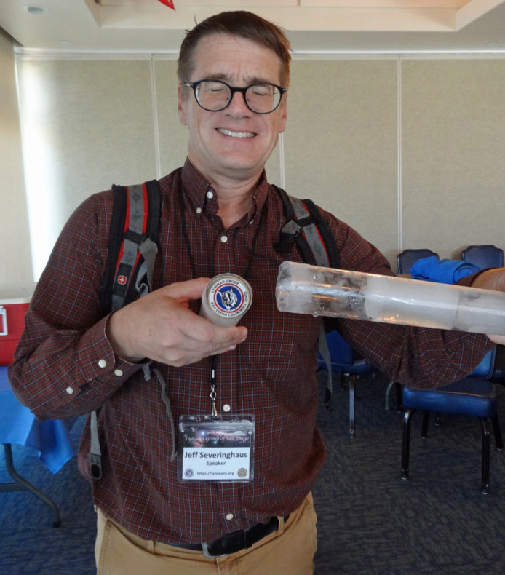
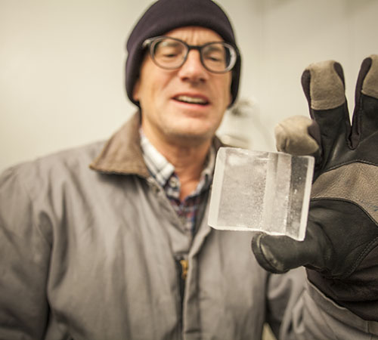
Announcements
UC San Diego professor and Lyncean speaker Jeff Severinghaus will be in Antarctica for the “summer,” searching for world’s oldest ice.
His expedition made front-page news on the San Diego Union-Tribune on 26 November 2019. Read it here:https://enewspaper.sandiegouniontribune.com/infinity/article_share.aspx?guid=b69020da-486c-45d4-bfba-98a6f6fa32ea
For more information see Scripps Institute of Oceanography news, here: https://scripps.ucsd.edu/news/scripps-scientists-friendly-race-among-nations-find-worlds-oldest-ice-record-time
You’ll find a copy of Dr. Severinghaus’ 26 June 2019 presentation to the Lyncean Group (Meeting # 129), “Climate Change: What have we learned about our future from studying ice-core climate records?” here: https://lynceans.org/talk-129-6-26-19/

Slide 4
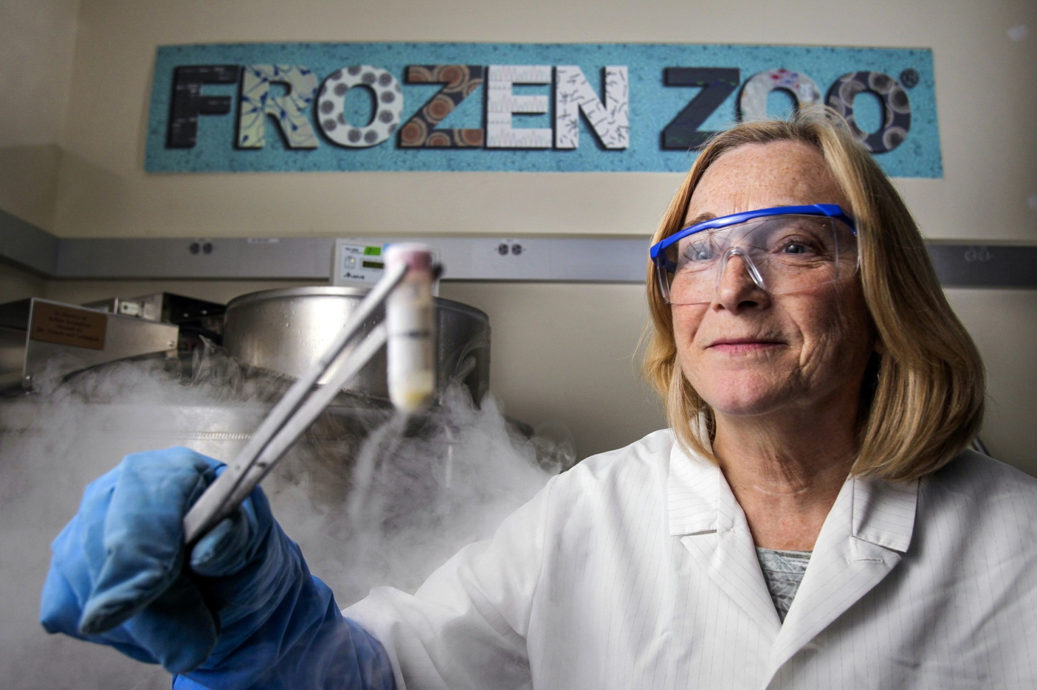
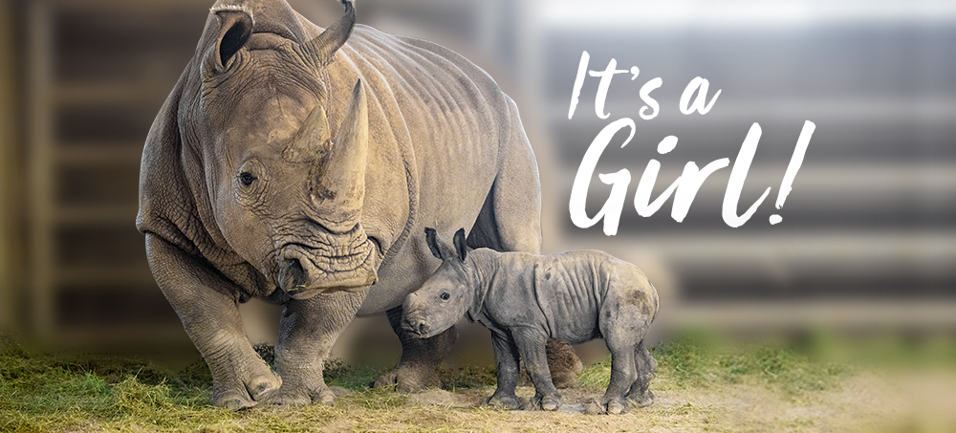
Announcements
Congratulations to San Diego Zoo Global’s Rhino Rescue Center and Dr. Barbara Durrant for the second successful birth of a southern white rhino resulting from artificial insemination.
The southern white rhino mother, Amani, gave birth to a girl on 21 Nov 2019. Read about it here: https://www.endextinction.org/amani
This is another promising step toward eventually being able to use a southern white rhino as a surrogate mother for a northern white rhino. There are only two northern white rhinos left in the world today.
You’ll find a copy of Dr. Barbara Durrant’s 21 June 2017 presentation to the Lyncean Group (Meeting # 112), “Endangered Species Rescue: How far should we go?” here: https://lynceans.org/112-62117/
Above: Dr. Barbara Durrant
Below: Amani and daughter

Slide 5
Announcements
Union-Tribune’s bio-tech reporter and Lyncean speaker Bradley Fikes died on 20 November 2019.
You’ll find the 21 November U-T article on Bradley Fikes here: https://www.sandiegouniontribune.com/news/science/story/2019-11-21/beloved-union-tribune-biotech-writer-bradley-j-fikes-dies-at-62
You’ll find a text copy of his 20 April 2016 presentation to the Lyncean Group (Meeting # 103), “Stem Cells: From the Lab to Patients” here: https://lynceans.org/talk-103-4192016/

Slide 6
Upcoming Talks
SUBJECT TO CHANGE
This information is also on the website under “Upcoming Talks”
Date | Speaker | Topic/Title
1/22/20 | Richard Norris Professor of Paleobiology, Geosciences Research Division, Scripps Institution of Oceanography, UC San Diego | Climate Change: Modern climate impacts and what we can expect of the future
3/3/20 Note that this talk is on Tuesday | Daniel Whiteson Professor of Physics & Astronomy, UC Irvine | We Have No Idea: Big, Unanswered Questions about the Universe and Its Particles
4/15/20 | Dr. Gresham Bayne Former Critical Care Consultant to STRATOS, Former medical consultant to Bird Aerospace Industries, Former CMO & Chair of the Technical Advisory Committee for NantHealth | What really happened during the STRATOS stratospheric parachute jump and what we still don’t know

Slide 7
Lyncean website www.lynceans.org
Pete Lobner

Slide 8
New on Pete’s Lynx
Later today: U.S. tritium production for the nuclear weapons stockpile – not like the old days of the Cold War
27 Nov 2019: Land Speed Record Lows and Highs in 2019
18 Nov 2019: A Visit to the Berlin Wall, 30 Years After it Started Coming Down
6 Nov 2019: Top 15 Largest U.S. Companies by Revenue (1954-2018)

Slide 9
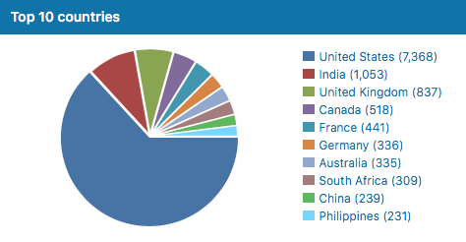
Lyncean website visitors 10 December 2019

Slide 10
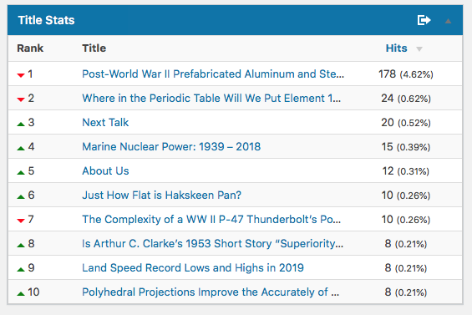
Popular on the Lyncean website 10 December 2019

Slide 11
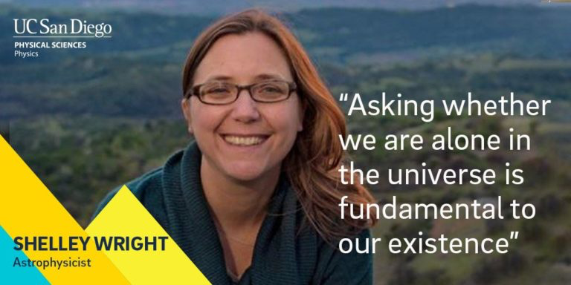
New ways to search for extraterrestrial intelligence
Shelley Wright
Associate Professor of Physics
Center for Astrophysics & Space Sciences
UC San Diego
https://saw.physics.ucsd.edu

Slide 12
Speaker Appreciation
We are here

Slide 13
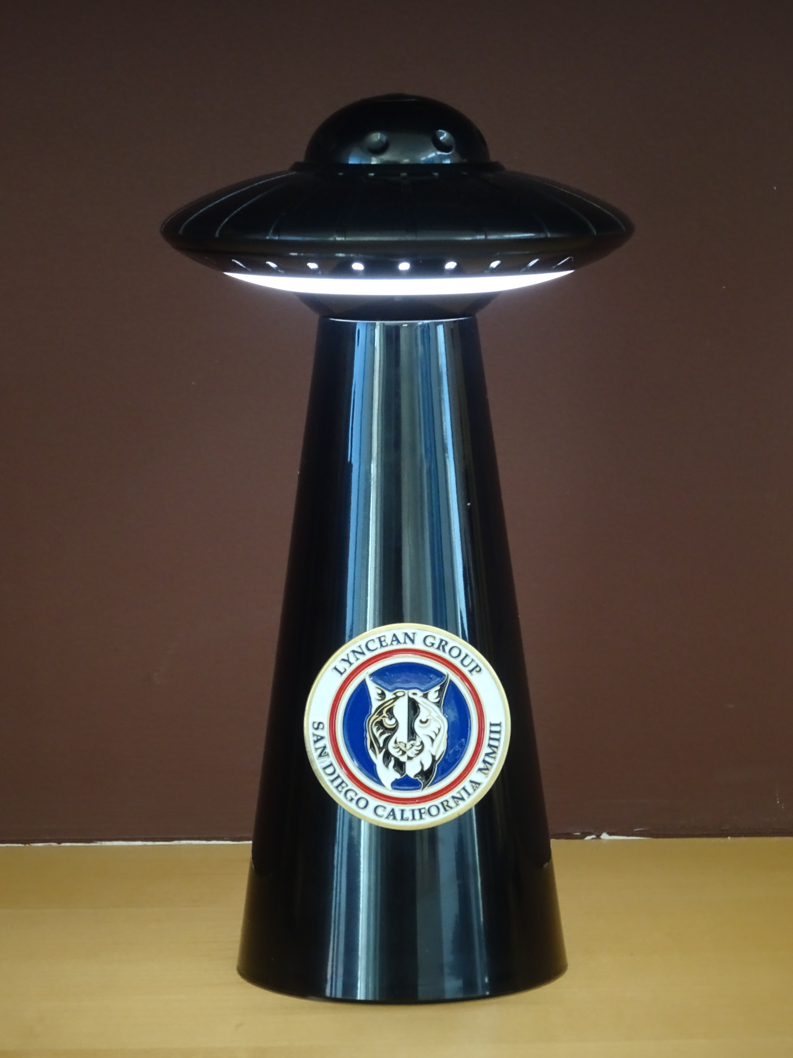
We are here

Slide 14
Lynxea
Don’t forget to drop off your badges when you leave!

