Slide 1
Future California If you know what’s coming, you can change it…
Richard D. Norris
Scripps Institution of Oceanography
Notes:
This talk is predicated on the idea that if you know what the future could be,, you can change it. You can change where you live, retire, invest and how you vote if you don't like that future.

Slide 2
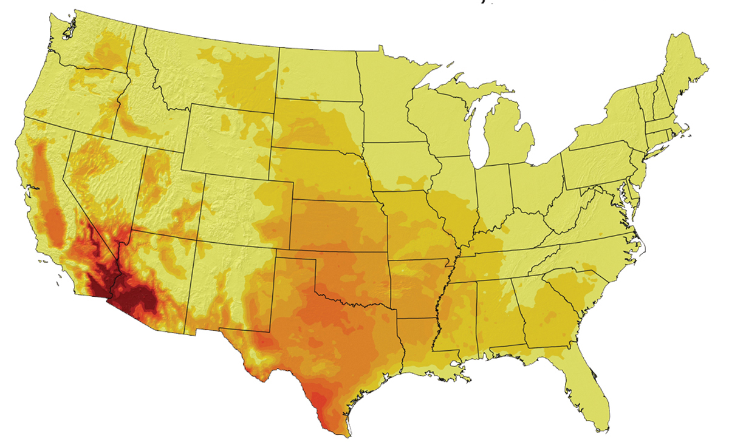
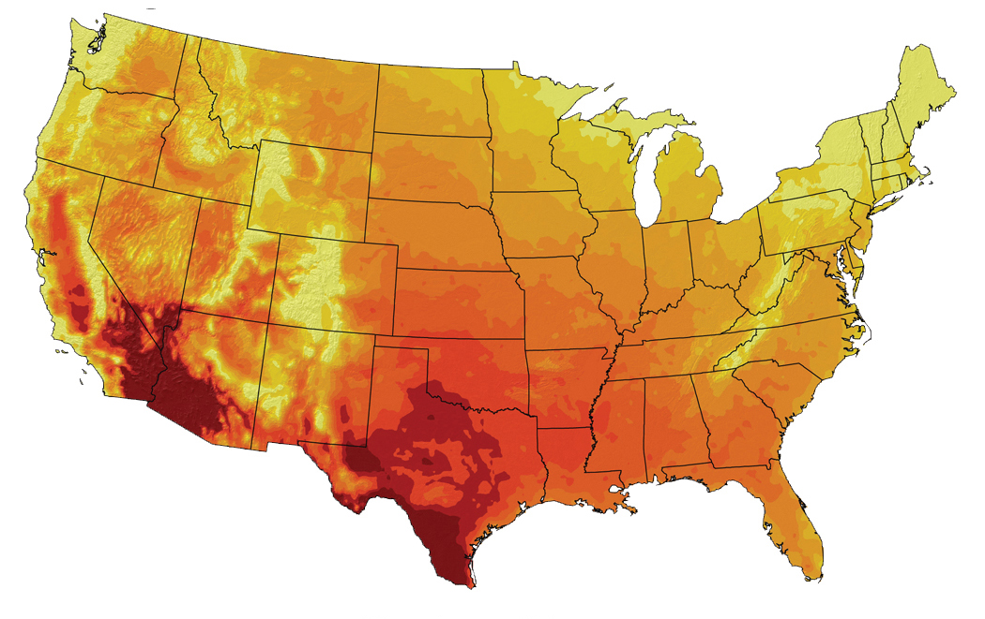
Retire to Tucson? Humm… Forecast Days Over 100°F
B1 Scenario
Average 2080-2099
Global Climate Change Impacts in the United States, Thomas R. Karl, Jerry M. Melillo, and Thomas C. Peterson, (eds.). Cambridge University Press, 2009. p. 90. Online: www.globalchange.gov
Average 1961-1979
A2 Scenario
Average 2080-2099
Notes:
My wife has been pestering me about retirement. We both liked living in Tucson, Az when I was a Master's Student...but future projections suggest more than 4 months with temps >100 F...no thank you! Investing in propertuy is not a good idea...

Slide 3
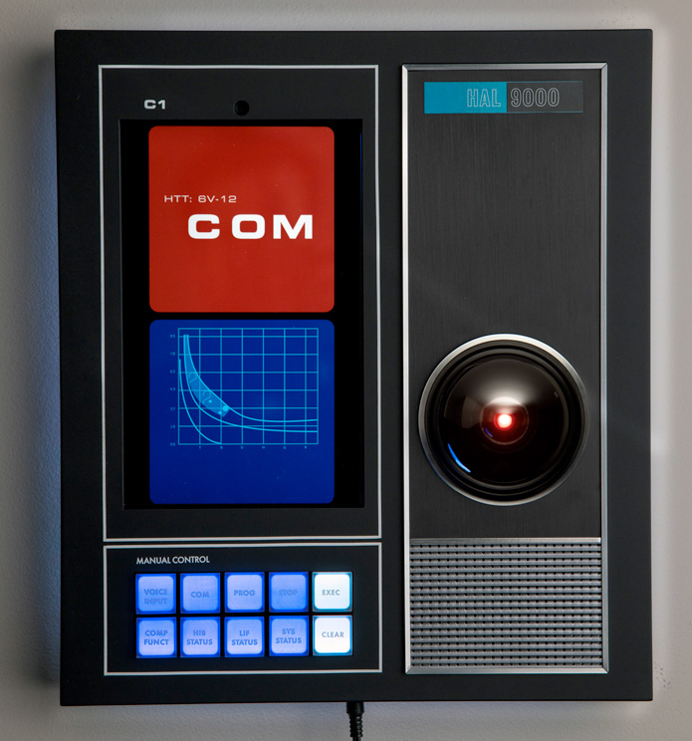
Predicting The Future…. Crystal Balls Basic Physics Computer Models
Methane warms Atmosphere
+
Warm air holds moisture
so:
Warm climate = more rain
MasBros-LensBall-Crystal-Photography-Accessory
https://www.slashfilm.com/cool-stuff-hal-9000
Notes:
We can project future climate by guessing like gazing at a crystal ball I(often not so good), or from our knowledge of basic physics (actually, not bad), or from more sophisticated computer analysis (also good). We do pretty well with climate projections, but demography, economics and politics are hard to predict.

Slide 4
Two Big Challenges in Forecasting the Future: Climate Change Growing Population (easy to model) (hard to model)
Sierra Club, Jan 2007
“What, me worry?” Alfred E. Newman, Mad Magazine
Notes:
Climate projections are often based on physics we know pretty well, so the direction of change is easy to estimate even if particulars are uncertain. But demographic change is very hard to get right since it depends on politics, economics, warfare and many other human social traits that are hard to estimate.

Slide 5
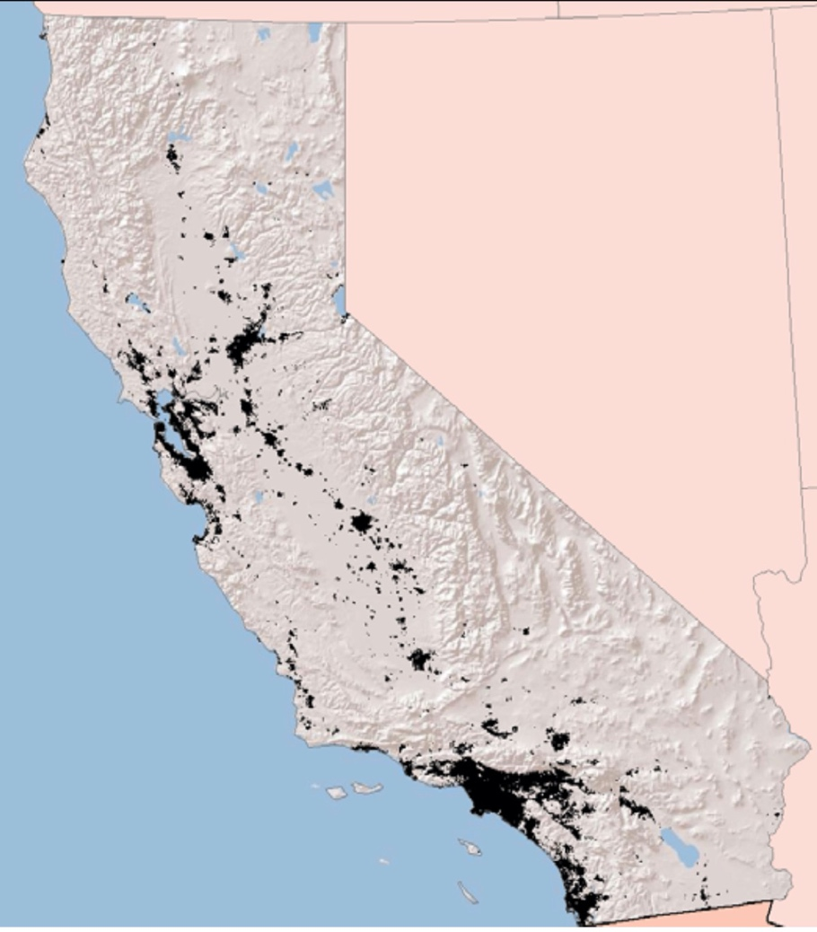
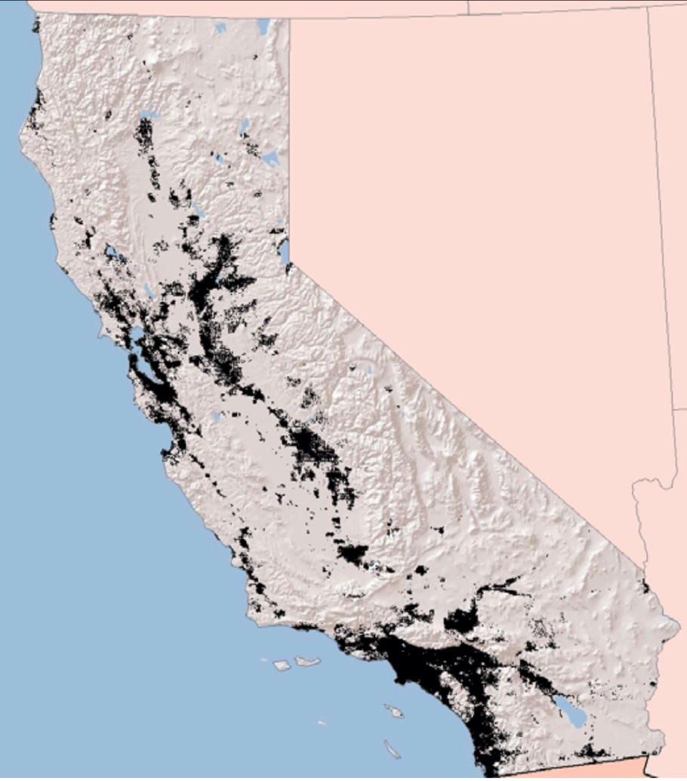
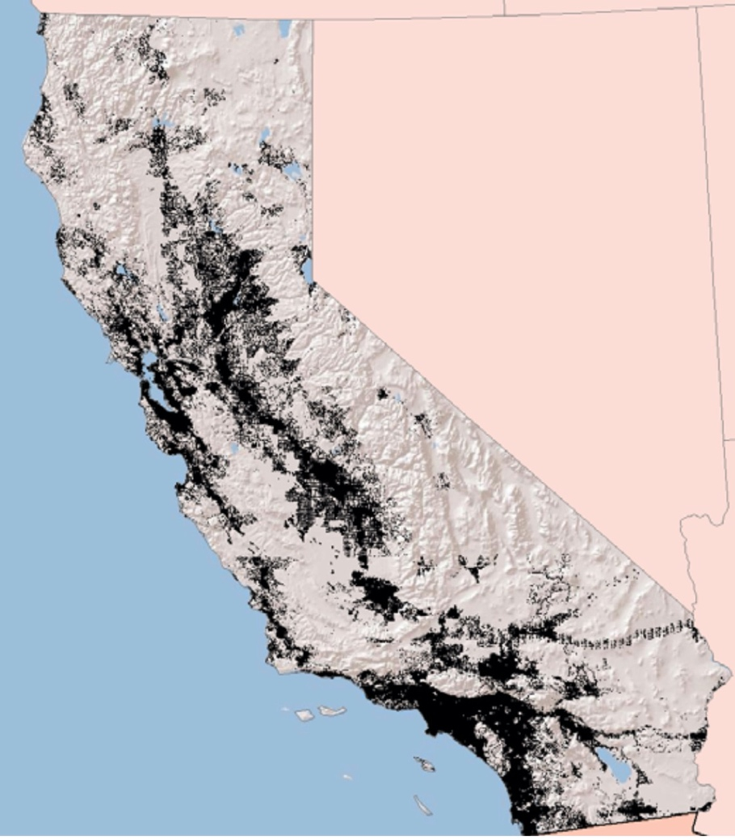
Trajectory #1: California’s Population
Urban Footprint from Stanstad et al. 2009 California Energy Commission CEC-500-2009-013-D
n.b. a 2013 estimate has California’s 2050 population at 50 million
2007
36.9 million
2050
59-69 million
2100
85-147 million
Urbanizing Valleys, Foothills and Deserts
Notes:
Still, here is a projection of urbanization. More recent projections suggest their 2050 projection is 10-20 million too high. Still the trajectory is probably right. Development occurs along transportation corridors and sprawls into the Sierra foothills. Just last month, the Riverside Board of Supervisors voted down a plan to build a new massive development between Palm Springs and Blythe in the middle of the desert. Development pressures are real even if the specifics are exaggerated

Slide 6
Urbanization Of San Diego
John D. Landis and Michael Reilly How We Will Grow: Baseline Projections of the Growth of California’s Urban Footprint through the Year 2100 Department of City and Regional Planning Working Paper 2003-04 Institute of Urban and Regional Development University of California, Berkeley
Notes:
We can already see the development pressure in our region, where 4S Ranch, San Marcos, Winchester, and Temecula are filling in with massive housing developments...

Slide 7
Carbon Footprint For US Households--Suburbia Matters
C. M. Jones & D.l M. Kammen, Spatial Distribution of U.S. Household Carbon Footprints Reveals Suburbanization Undermines Greenhouse Gas Benefits of Urban Population Density. Environ. Sci. Technol., 2013, dx.doi.org/10.1021/es4034364
https://coolclimate.org/maps
Mostly reflects suburban transportation, large homes and electricity from coal
Notes:
Suburban sprawl is not benign but massively increases GHG emissions--because suburban families are usually wealthy, have big homes, and drive a lot....

Slide 8
Trajectory # 2: Temperatures Slightly Warmer Winters And Much Warmer Summers
Winter
Temperatures
Cayan et al. 2006. Climate scenarios for California, White Paper: California Climate Change Center CEC-500-2005-203-SF
Summer
Temperatures
Notes:
Trends are toward hotter winters (by 2-3degrees C) but much warmer summers (by 3-8 degrees C)

Slide 9
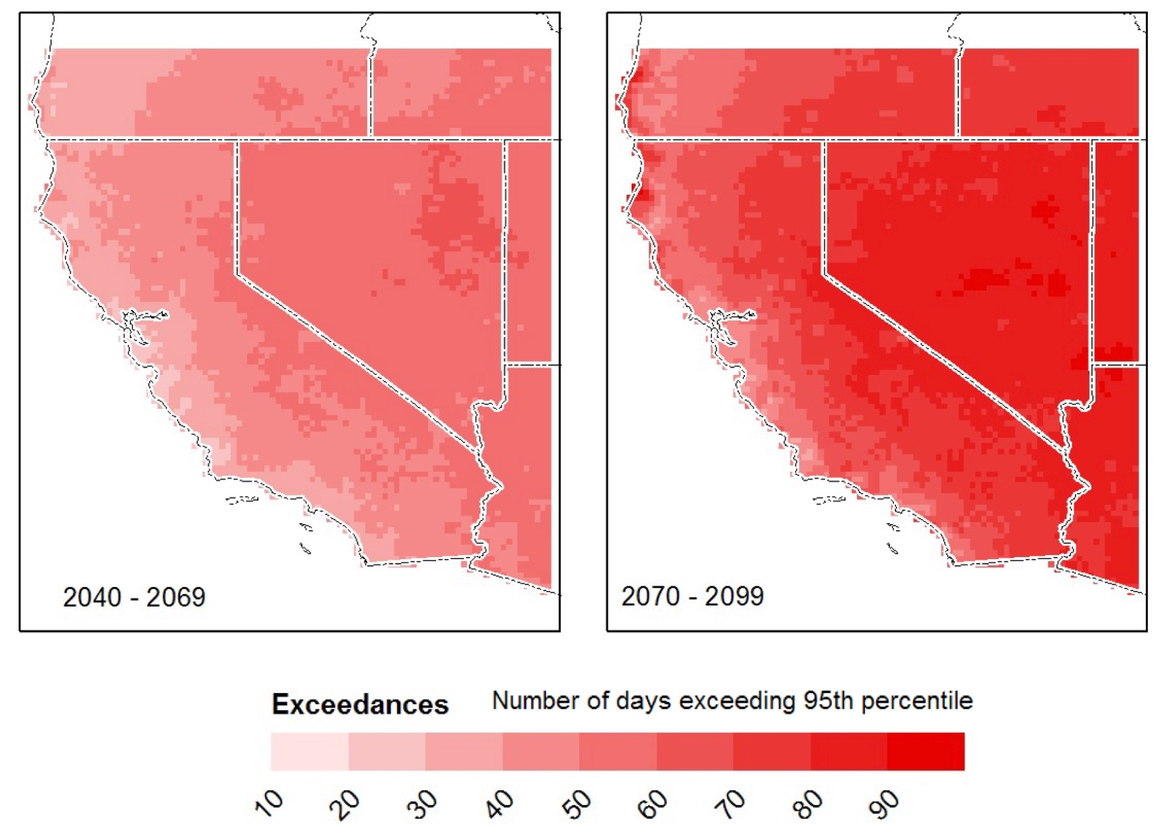
Increase of 50-70 days of extreme heat by 2100
Cooley et al. 2012 California Energy Commission
CEC-500-2012-013
Notes:
We also get many more days of excessive heat--by 1-3 months depending upon how far out we look

Slide 10
Heat Stress Reduces Outdoor Labor
https://www.epa.gov/cira/climate-action-benefits-labor
Notes:
Excessive heat gradually reduces outdoor labor with reductions up to ~7% of hours worked. This has large impacts on the building trade...

Slide 11
Trajectory # 3: Precipitation
The mountains…
but not much in
S. California,
(where rain supplies
5% of our needs)
see: To Quench a Thirst A brief history of water
in the San Diego County Region
Ivan Golakoff and collaborators, San Diego Co
Water Authority , 2003, 2005
Notes:
Today, most rain is over the mountains in Northern California; these wet areas export water to the dryer southern part of the state through the State water system.

Slide 12
Projections Of Future Yearly Rainfall Northern California
Six different models: Mike Dettinger, 2005 San Fran. Estuary and Watershed Science
Notes:
Multiple models suggest little change in overall precipitation amounts for California, but the devil is in the details....

Slide 13
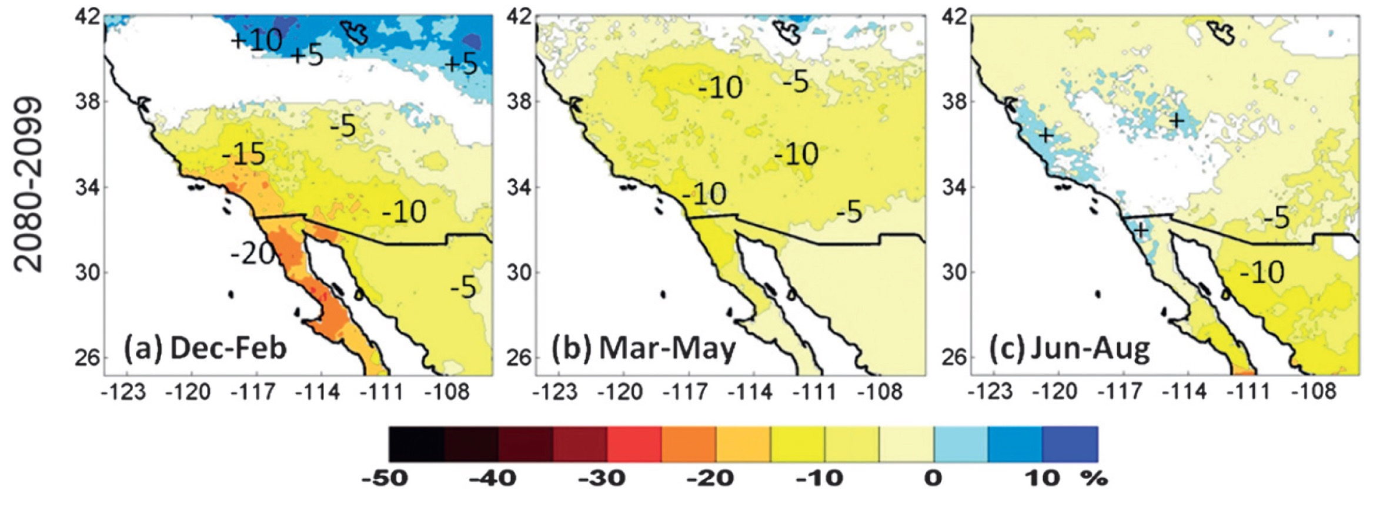
Dryer winters prolong the fire season but…
A little more Summer Rainfall in Southern CA and Central CA
Cavzos et al. 2012 J. Climate 25: 5904
Notes:
Precipitation continues to be uneven across the state, with falling Winter rainfall in Southern California and Baja California, and a modest increase in summer rains

Slide 14
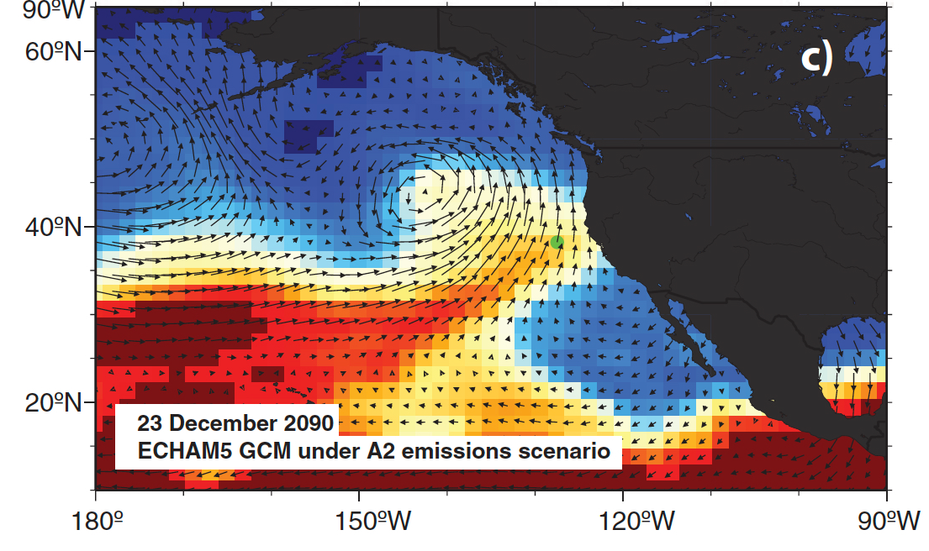
Increase in intensity, water content & seasonal duration of “atmospheric rivers” = more floods
Dettinger e tl
Dettinger 2011. J. American Water Resources 47: 514 47: 514
Notes:
ARs are projected to increase, with more focused water delivery

Slide 15
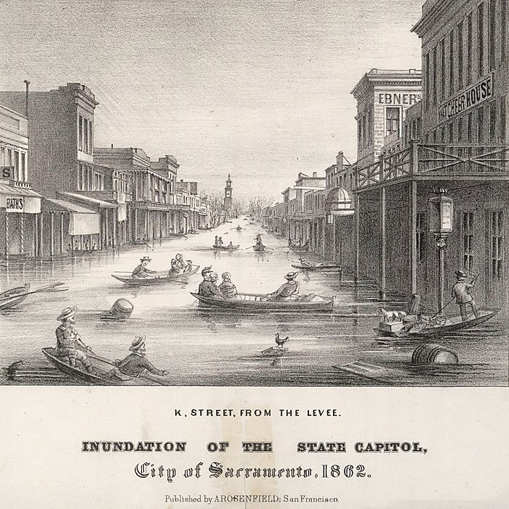
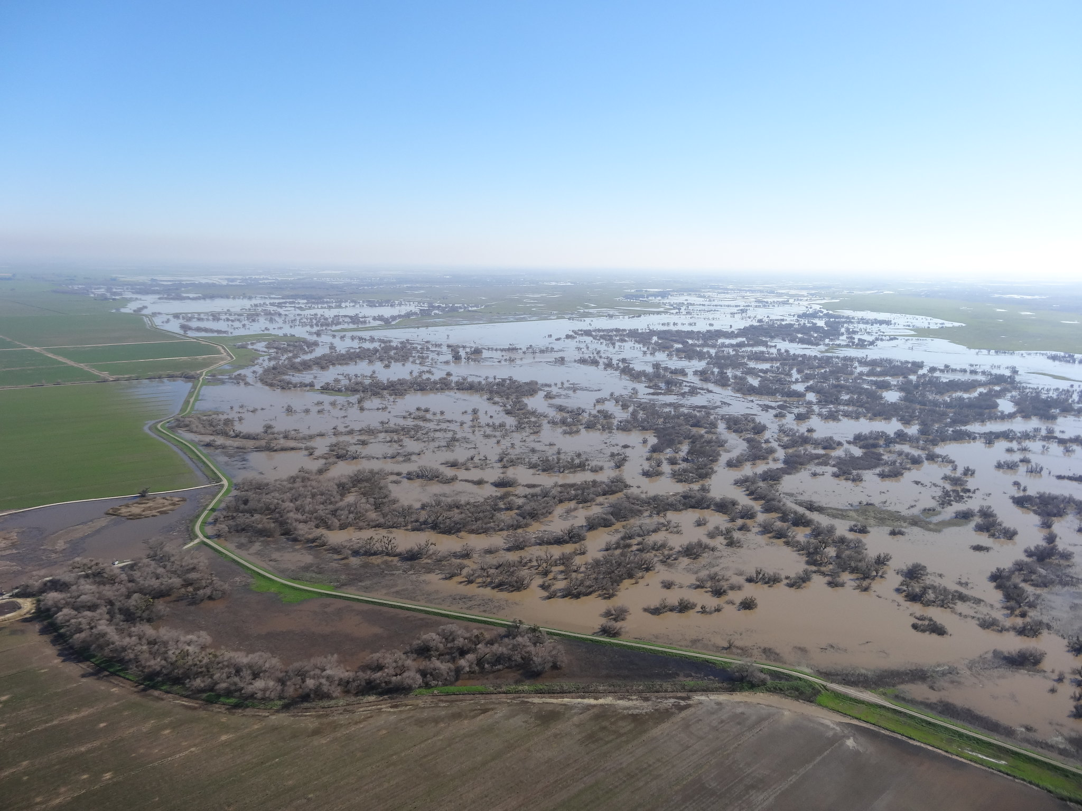
Floods: Then, Now and in the Future…
Flood waters are temporarily "stored" along the San Joaquin River. Photo by River Partners
http://content.cdlib.org/ark:/13030/tf2b69p086/?layout=metadata
Notes:
But projections suggest precipitation. will be far less predictable in any given year...from droughts to floods. For instance the 1862 flood that turned Sacramento into a lake (along with Oregon and the California deserts) was caused by an "Atmospheric River"

Slide 16
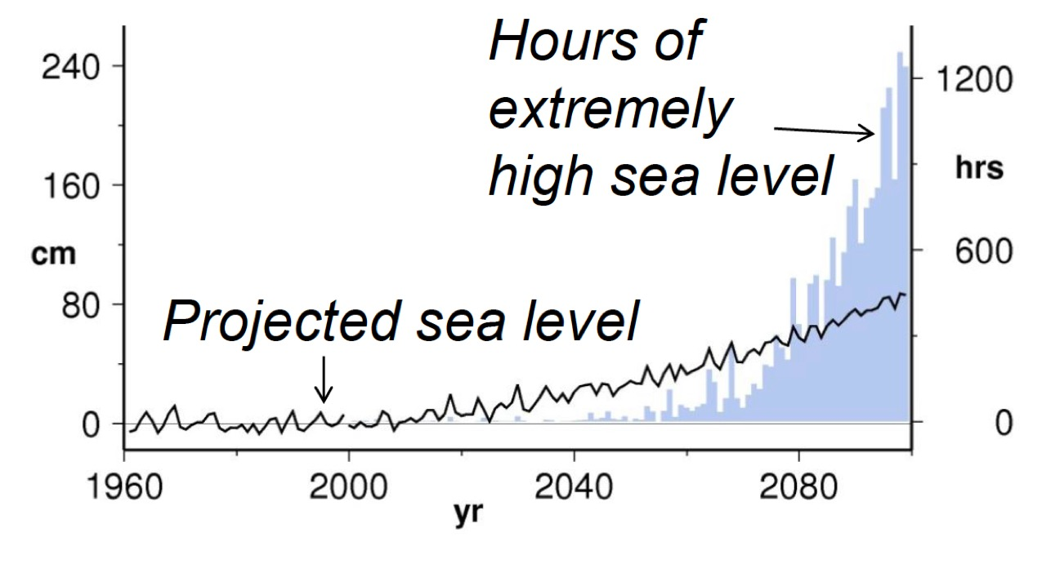
Trajectory # 4: Sea level & Storm surge
San Francisco Bay
Dalrymple et al. 2012 National Academies Slide Deck
“Sea-level rise for the coasts of California, Oregon and Washington”

Slide 17
National Research Council. 2012. Sea-Level Rise for the Coasts of California, Oregon, and Washington: Past, Present, and Future. Washington, DC: The National Academies Press. https://doi.org/10.17226/13389.
(max 55-320 m!)

Slide 18
Mission Bay is in bad shape with 4 ft of sea level rise
and 7 ft of “King Tide”
https://ss2.climatecentral.org/index.html#14/32.7806/-117.2290?show=satellite&projections=0-K14_RCP85-SLR&level=5&unit=feet&pois=hide

Slide 19
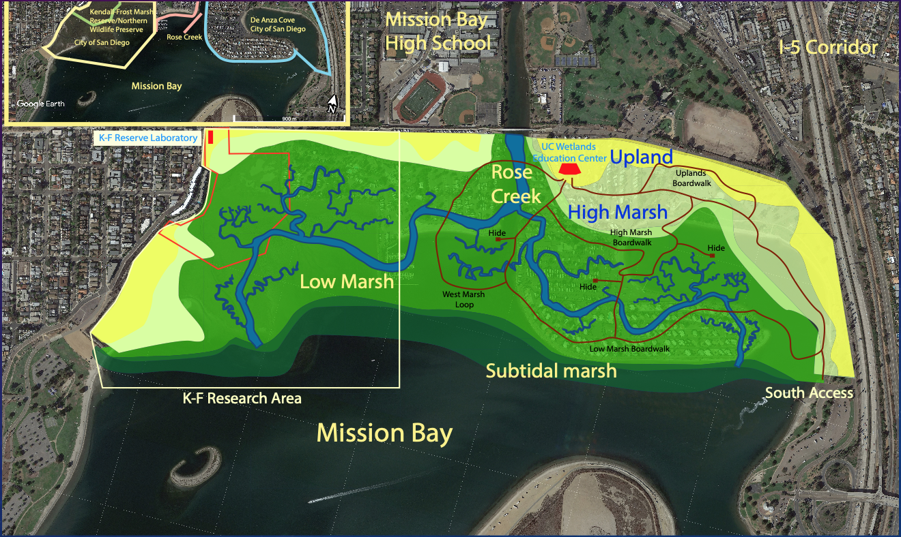
My Solution: build more marsh and maintain it
as a “Living Shoreline”

Slide 20
Trajectory #5: Snowpack. Forget The Sunshine And Beaches…In California, Snow Makes Us Rich!

Slide 21
Threats to A Big Fish: Just Gotta Have Salmon
Also fans of high & cold water
Notes:
Salmon, for instance, need flood water to have successful spawning so more drought will be bad for them. This is also the case for other endangered species--Sturgeon and the tiny "Delta Smelt" for instance, setting up conflicts between conservationists and everyone wanting water.

Slide 22
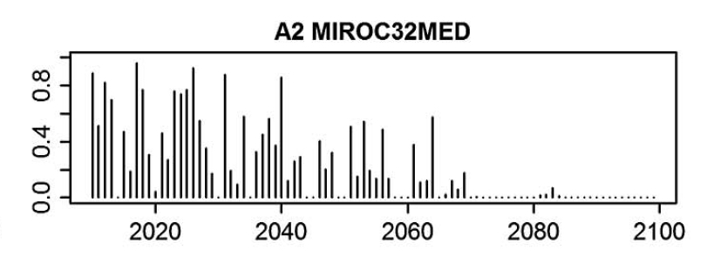
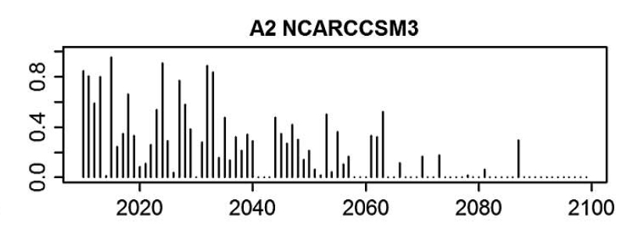
Salmon Have It Bad…. Thanks to high water temperature Proportion (relative to now) of Adult salmon in Butte Creek in 3 models
Thompson et al. 2012 J. Water Resour.
Plann. Manage. 2012.138:465-478.
Notes:
Salmon (trout too) both get nailed another way--as water temperatures increase in their stream habitats...increasing temperatures wipe out many spawning grounds by ~2050 since more than 3 years of failed spawning is enough to do in the population for sea-returning salmon.

Slide 23
Another problem: In 100 Years: Snowpack Goes Away.. Particularly In N. California
California Climate Change Center, 2006, Our changing Climate: assessing
the risks to California see: www.climatechange.ca.gov
Notes:
Water temps also rise because snow melt falls as glaciers and snow pack disappear. Projections are scary here--snow pack is nearly extinct by ~2080 in the "business as usual" GHG scenario

Slide 24
Storage Will Plummet—need (Gasp!) More Dams?
Notes:
If there is no snowpack, water comes down the streams as rain-runoff and flows to the sea. While the rain can be stored, there is now slowly-melting snow to resupply the water to dams when water deliveries are made to agriculture or urban centers. So overall storage falls.

Slide 25
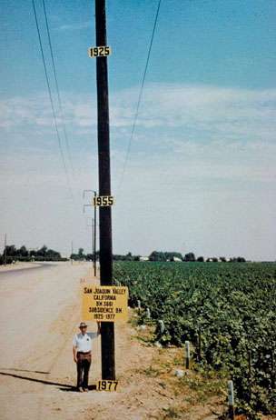
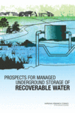
Don’t Want More Dams?
Need to look at ground water storage…
A “Water Bank”
No evaporation loss
No unsightly dams
But, needs management
Notes:
One solution is to 'bank' the runoff in the groundwater system. Only trouble is that we have abused the groundwater storage for years by massive over pumping.

Slide 26
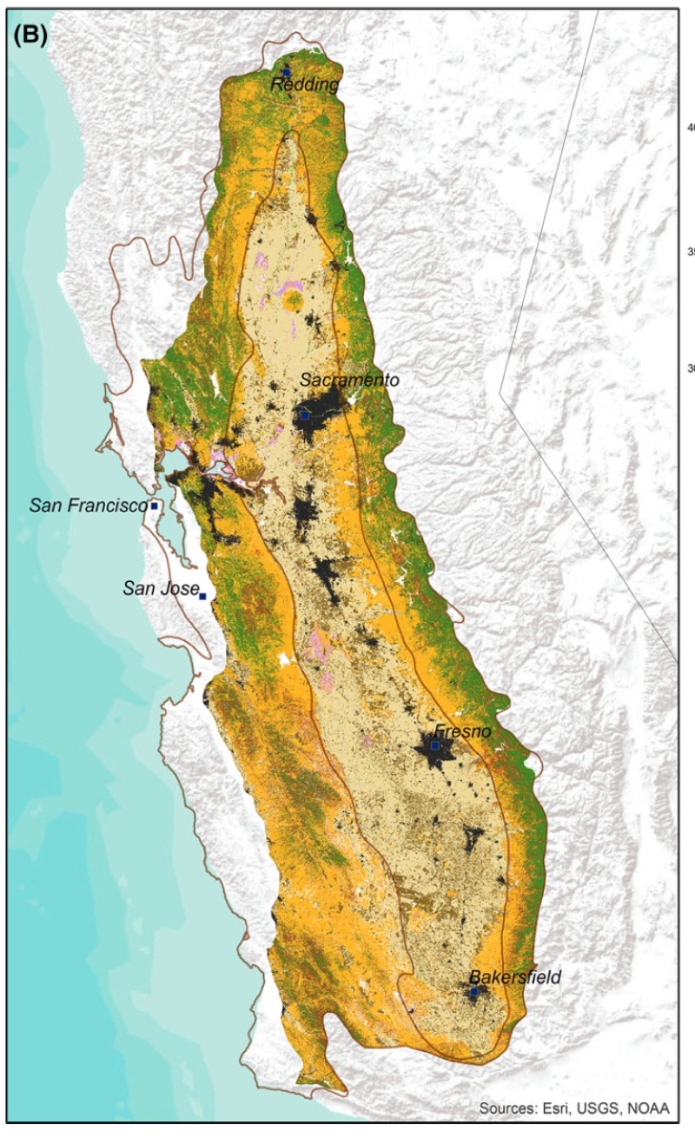
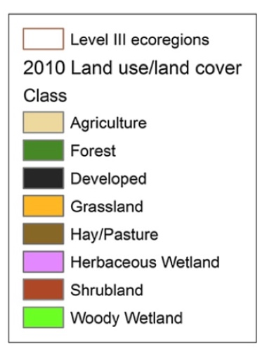
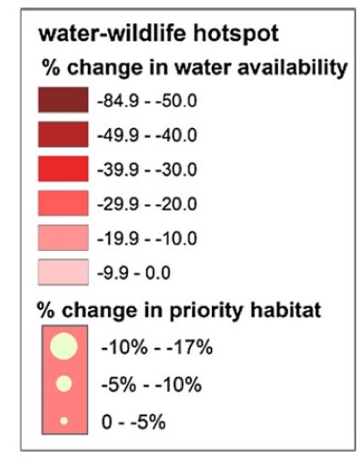
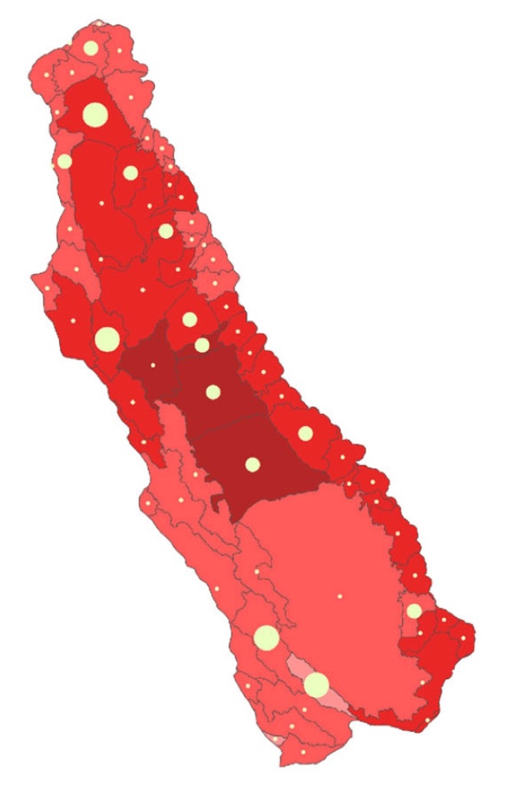
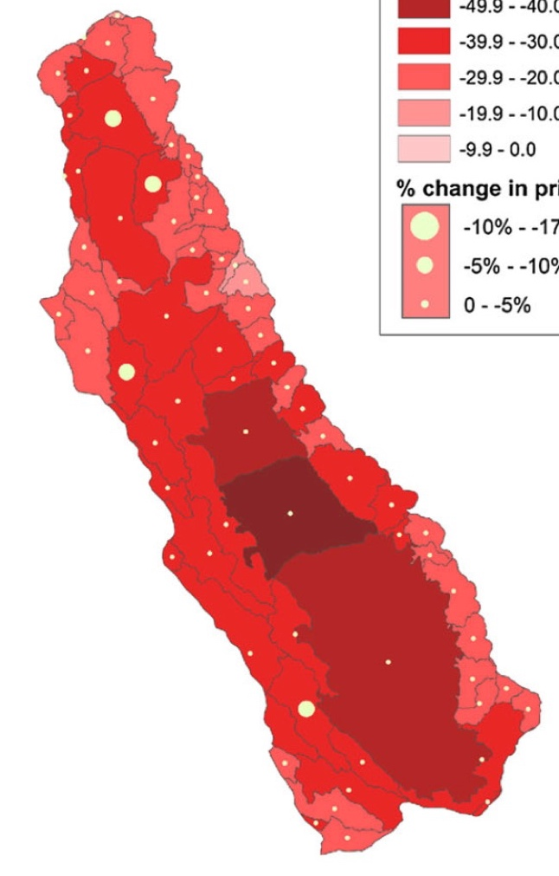
Trajectory # 6: Agriculture
Bryd et al. 2015 Landscape Ecologuy 30: 729
B1
“Increase
In
efficiency”
A2
“Business
as Usual”
Notes:
Hotter, dryer conditions dry out soils and convert grasslands to desert. The Central valley breadbasket of California is in trouble with 30-40% decreases in soil moisture by 2100. That water deficit will increase agricultural water demand just when expanding urban centers demand more water too....

Slide 27
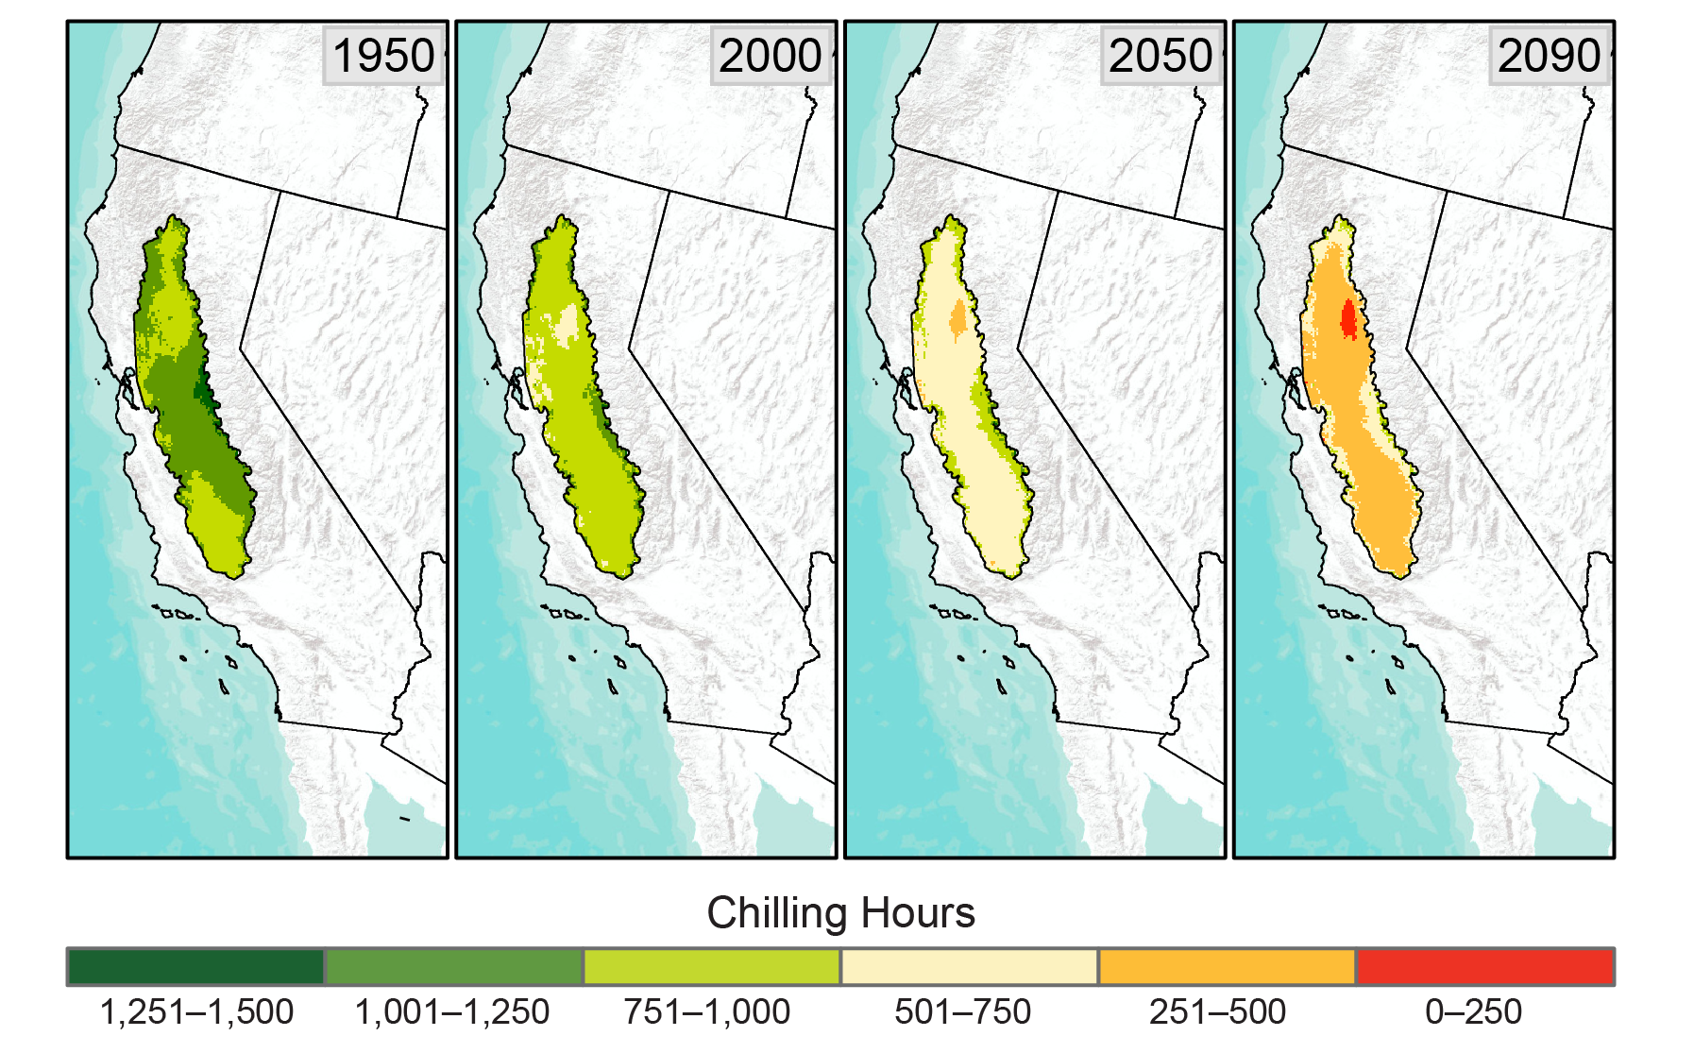
Stone Fruits, nuts and grapes do poorly in California’s Future
Luedeling, E., M. Zhang, & E. H. Girvetz, 2009: PLoS ONE, 4, e6166, doi:10.1371/journal.pone.0006166.
https://nca2014.globalchange.gov/report/sectors/agriculture#tab2-images
Notes:
Warming climate also decreases winter 'chill hours'--cold conditions needed to set the fruit for plums, nut trees and grapes.... Spells trouble for traditional California cash crops like almonds and stone fruit.

Slide 28
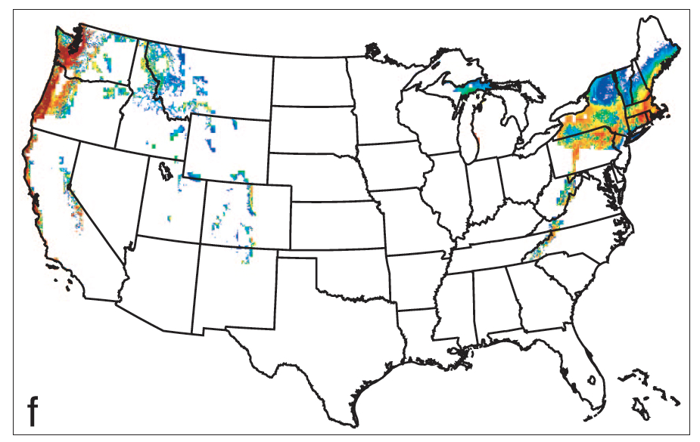
Wine Growing Declines By 81%
14 Hot Days
Message: CA Wine Growers,
move to Massachusetts!
Future
Today
7 Hot Days
White et al. 2006. PNAS v. 103, p.11217
doi10.1073pnas.0603230103
Notes:
Grapes for premium wines are in trouble in California but new growing area will appear in Mass. and Oregon-Washington. The big limitation is when hot days exceed 35°C ad when there is more than a week or two of such temperatures. . Less-than-premium-wines can be grown at these temps suggesting that California will return to making "wine in the box" with added sugar....

Slide 29
Trajectory # 7: Wildfire …it isn’t all about getting burned
Cedar Fire, 2003
https://www.kcet.org/climate-change-la/wildfire
Notes:
Hotter, drier conditions are ripe for wild fire; this is not just about fires on the landscape, but about smoke too...

Slide 30
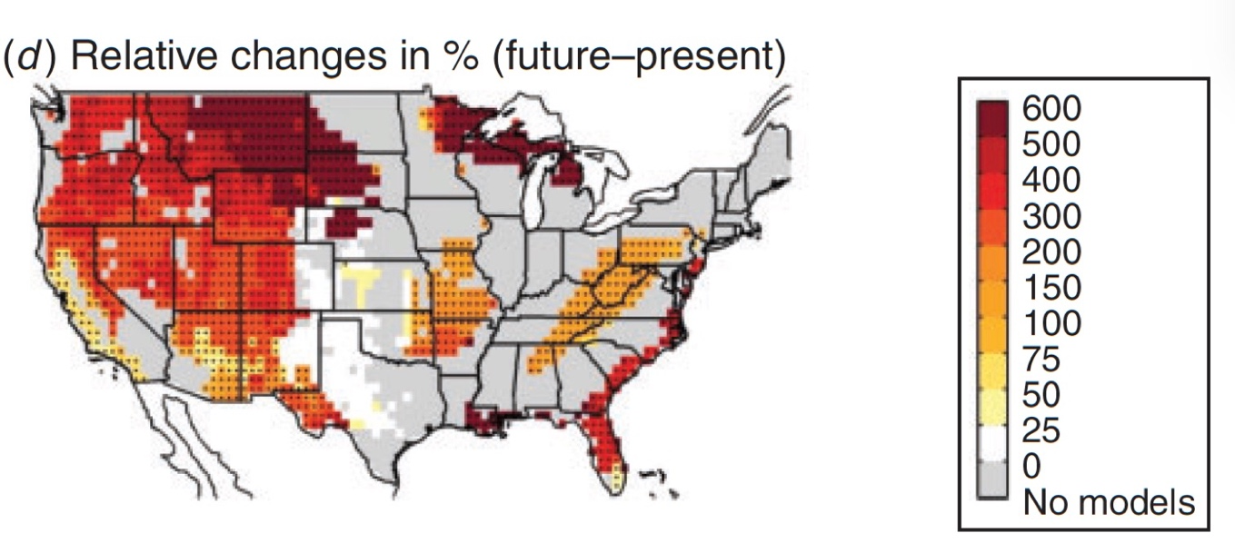
Very Large Fires (VLF) Increase 75-300% By 2070
Barbero et al. 2015 Int. J. of Wildland Fire 24:892
Notes:
Very large fires become 75-300% more prevalent compared to the past, particularly in the West, Great Lakes and Southeast.

Slide 31
Future Burned Area Accounting For Urban Sprawl in 2085
NCAR PCM1
CNRM CM3
GFDL CM2.1
All based on A2
Emissions Scenario
(Like Today)
( 400% of Today)
Westerling et al. 2011. Climatic Change (2011) 109 (Suppl 1):S445–S463
Notes:
Most models show massive increases in Sierra and North Coast fire mostly owing to climate change, but also urban sprawl. Urbanization increases fire loss and also increases fire frequency (owing to more ignitions) up to a point. But at higher human density, there is more effort to suppress fires and more relatively hard-to-burn structure to get in the way of freely spreading blazes.

Slide 32
Smoke Impacts Getting burned is not the half of it
Woolsey Fire encroaching on Malibu on November 9, 2018 Photo: Cyclonebiskit Creative Commons
Notes:
Smoke is an emerging problem since it can be very dense, can travel very far and has significant negative health effects. Smoke may also lower real-estate value if persistent.

Slide 33
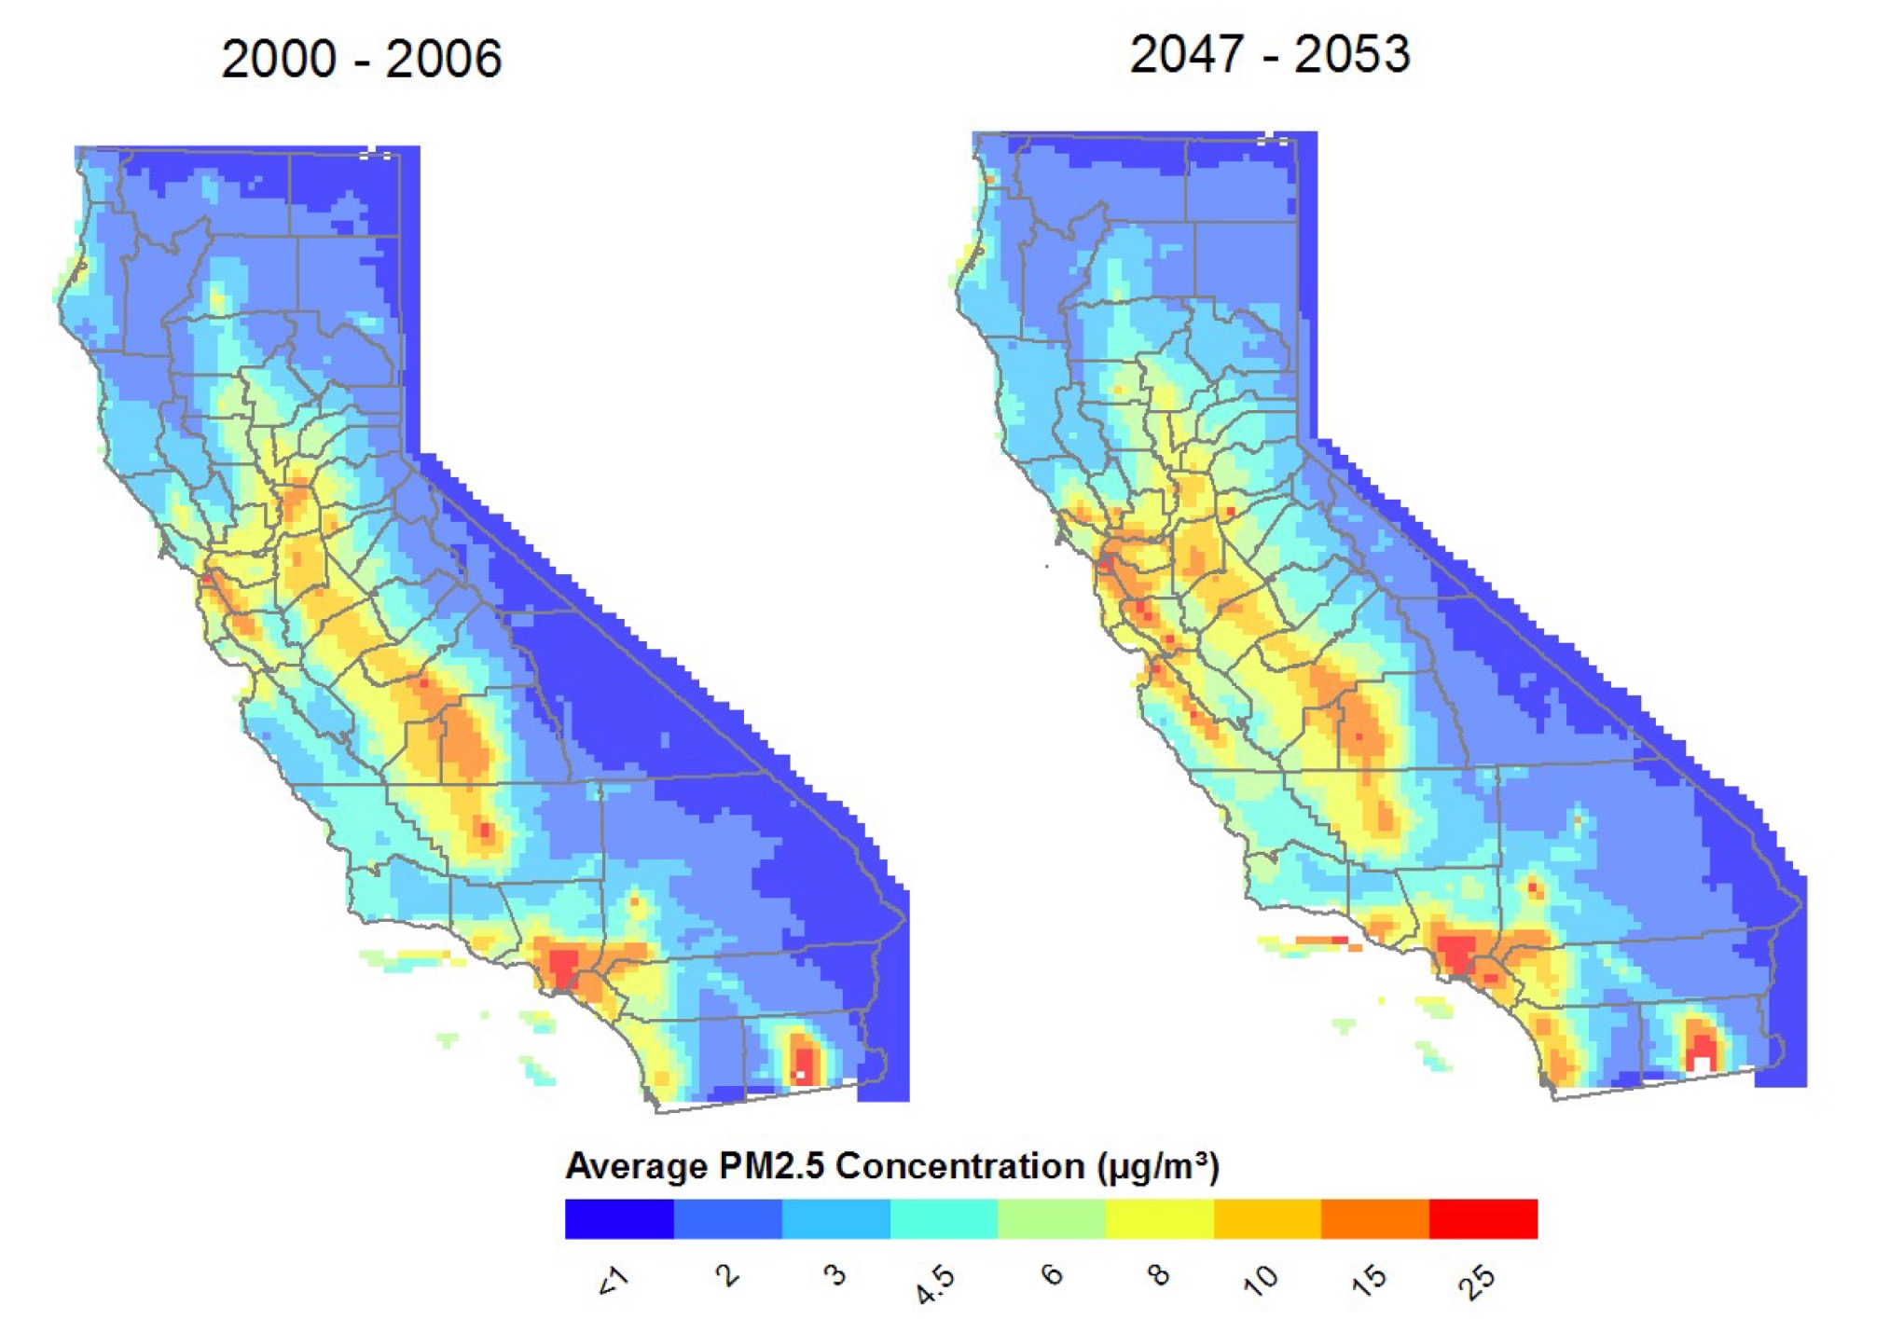
Air pollution expands in the urbanized valleys over the next 30 years
(Even without population change)
Cooley et al. 2012 California Energy Commission
CEC-500-2012-013
Notes:
Even without population change, warming and more inversions will increase ground-level air pollution in the ubanized SoCal and interior Bay area.

Slide 34
Future Climate Increases Ozone. Emissions Reductions Help, but Asian Pollution Offsets These Gains
Climatology + Emission
reductions + Asian Pollution
Climatology Only
Steinter et al. 2006 J. Geophys. Res., 111,
D18303, doi:10.1029/2005JD006935
Notes:
Ozone rises into the future, particularly in cities as they warm, but we can do something about this by controlling emissions. Unfortunately, Asian emissions will make it all the way across the Pacific to lower our air quality.

Slide 35
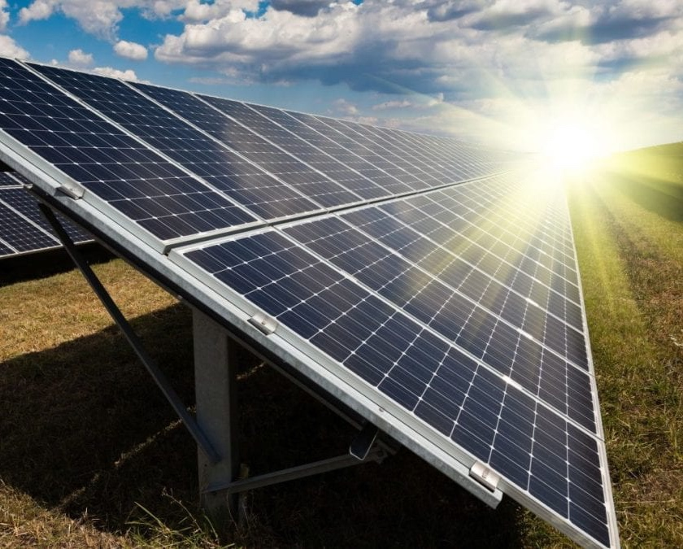
Trajectory # 8: Making Power
https://www.iaasiaonline.com/testing-the-insulation-resistance-of-photovoltaic-panels/
“Brightsource” Ivanpah Molten Sodium Power Station
Photovoltaic Power System
Notes:
One solution to global change is more renewables, but climate affects them too.

Slide 36
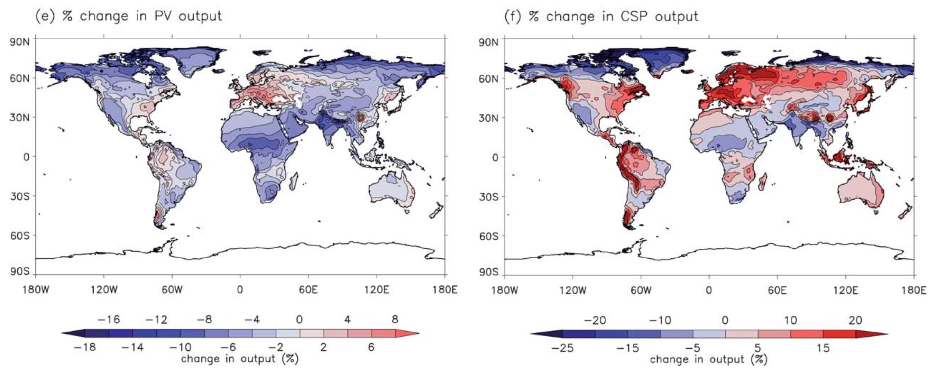
Rising heat & Lower insolation bad for Photovoltaics and good for Concentrated Solar Plants
Difference in power output between now and 2080
Crook et al. 2011, Energy & Environmental Science 4:3101
Notes:
B y 2080, photovoltaic energy production falls off by 4-6% because of more insolation O(due to more water vapor in the atmosphere) and hotter days that reduce efficiecy of PV power production. Concentrated solar plans also suffer a little from reduced insolation, but they. do better than PV

Slide 37
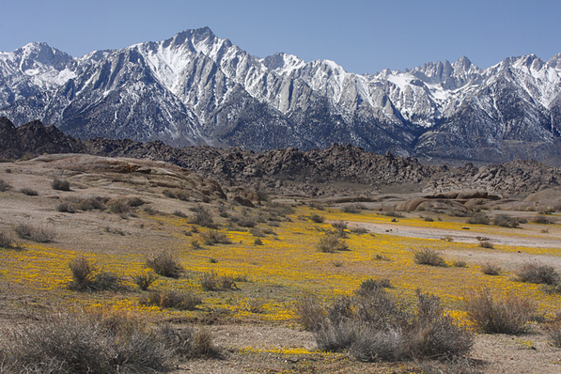
Trajectory # 9: California’s Ecosystems
Mount Whitney in Inyo County | Creative Commons photo by Alan Vernon

Slide 38
Current Vegetation (A) And Two Models For 2060 (B & C)
Stralberg et al. 2009. PLoS ONE 4(9): e6825. doi:10.1371/journal.pone.0006825
Grassland
Hardwood
Blue Oaks
Ponderosa
Desert Scrub
Redwood
Pinyon Juniper
Lodgepole
Chaparral
Sagebrush
Douglas fir
Fir

Slide 39
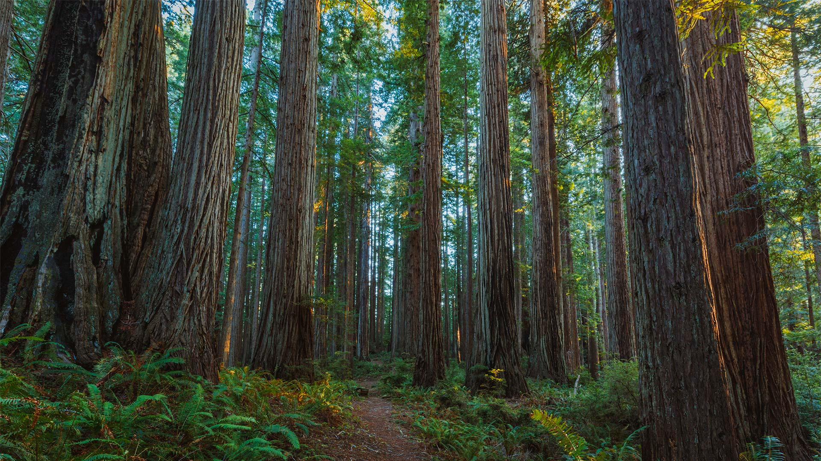
Shrinking habitat for Coast Redwoods
https://en.wikipedia.org/wiki/Prairie_Creek_Redwoods_State_Park
Fernandez et al. 2015 Global Change Biology
doi: 10.1111/gcb.13027

Slide 40
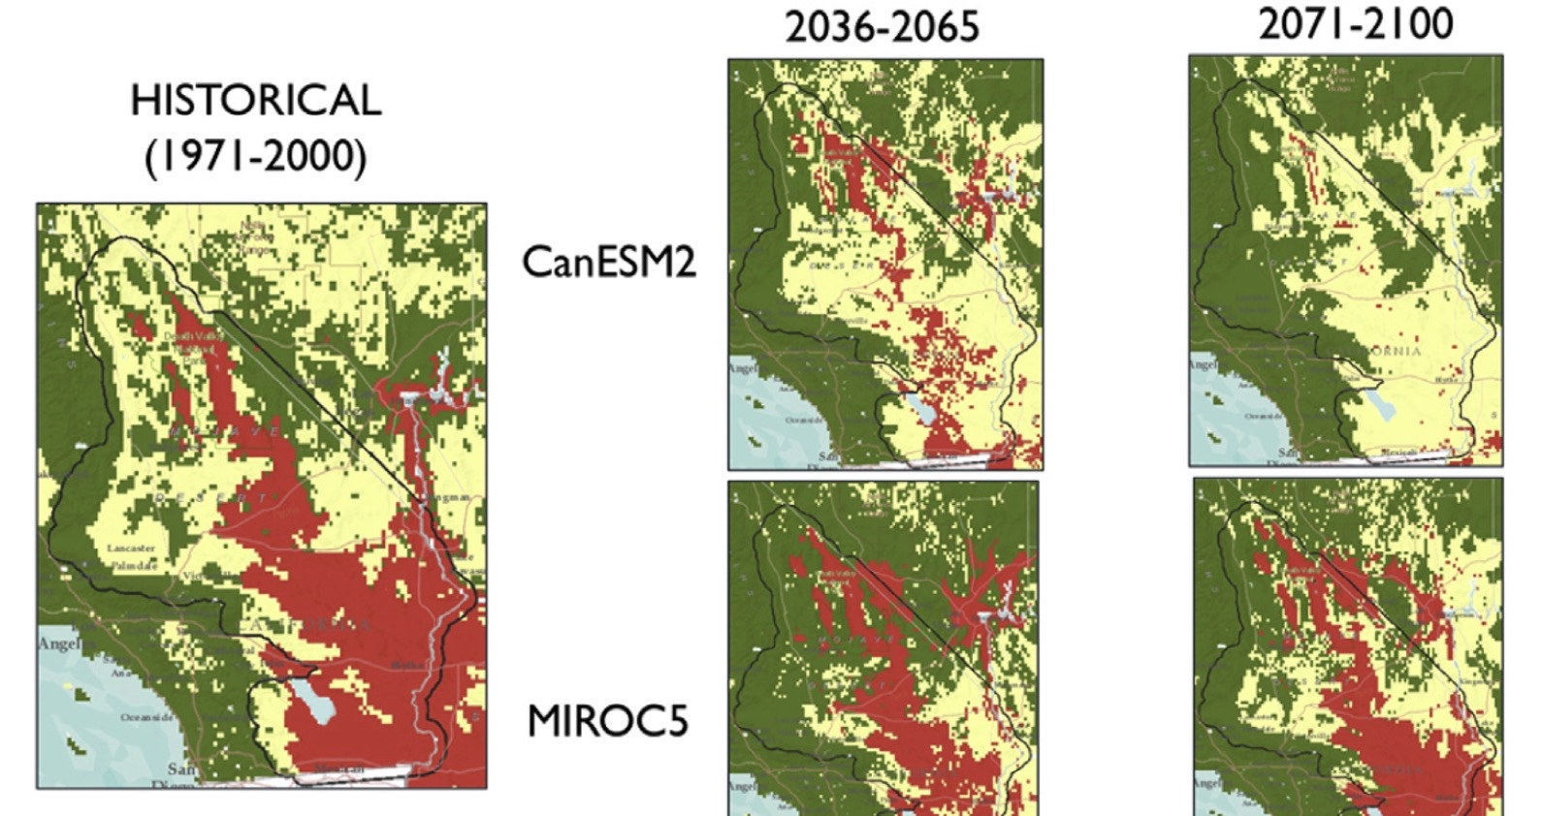
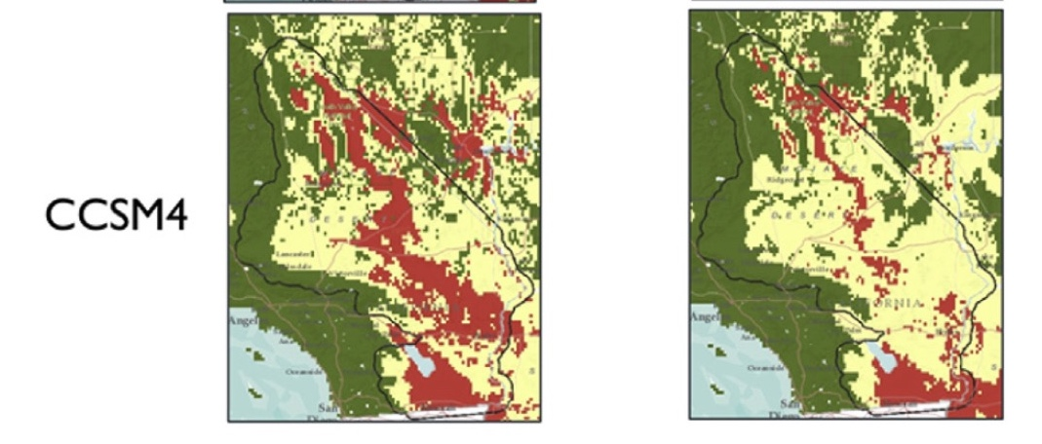
Wetter, grassy
Deserts in our
future
By 2100, warmer
climates but wetter
with more summer rain
Bachelete et al. 2015
J. Arid Environments 127: 17-29

Slide 41
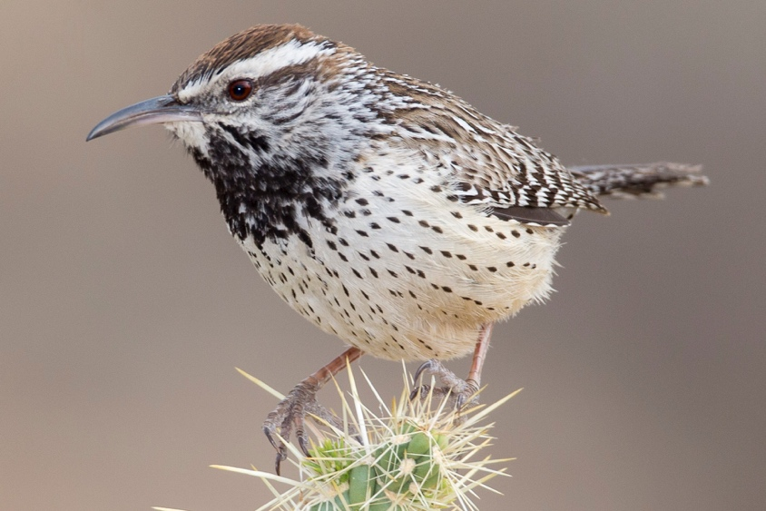
Range Shifts Cactus Wrens are expanding their range
https://www.audubon.org/climate/survivalbydegrees/state/us/ca

Slide 42
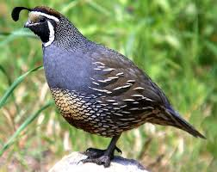
Range Shifts California Quail are heading for Oregon
https://www.audubon.org/climate/survivalbydegrees/state/us/ca

Slide 43
https://www.hollywoodreporter.com/news/why-jane-fonda-keeps-wearing-red-coat-getting-arrested-1252315
Trajectory # 10: Activism….but don’t exaggerate

Slide 44
Conclusions—Some Big Trends
A lot more people and energy-intensive suburbia
More heat stress, particularly in the interior
“Flashy” Future with more floods owing to:
heavier rainfall, more “Atmospheric River” storms
more rain relative to snow
Sea level (+ storms) increase coastal retreat
Can partly fix this with “living shorelines”

Slide 45
More Trends
Warming wipes out California trout and salmon
Warming also does in snowpack
requires new thinking about storage
Agricultural lands become dryer and thirstier
Sell off those California Wineries!
Fire and Smoke impacts grow, particularly in N. California
Deserts expand, particularly arid grasslands
Plants and animals are on the move
Including iconic ones like redwoods and California quail

Slide 46
Hazards Of Life: Risks of Earthquake, Tornado, Flood, Hurricane, Hail
https://static01.nyt.com/packages/pdf/weekinreview/05012011-natural-disaster-risk-map.pdf

Slide 47
Besides Storm flooding, droughts increase too…
Drought Frequency
Dettinger et al. 2016 San Francisco Estuary and Watershed Science https://escholarship.org/uc/item/2r71j15r
Notes:
But along with abundance is drought--projected to increase particularly after 2050 owing to having mode precipitation delivered by relatively infrequent ARs

Slide 48
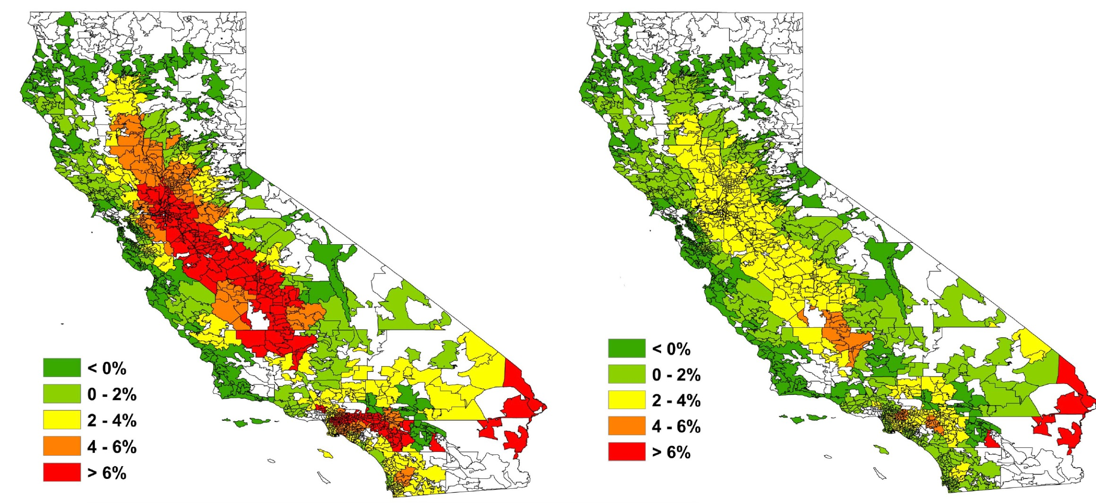
Future Electricity Demand in 2080-2099
(Constant population, relative to 1961-1990)
Affhammer & Aroonruengsawat 2011 Climate Change 109 (S1)
IPCC A2 (“Business as usual”)
IPCC B2 Scenario
Notes:
In most climate scenarios, electricity demand spikes, mostly due to increased heating, more extreme hot days, and less cooling at night. Electricity demand will go up a lot more iff demgrapohic change is taken into account.

Slide 49
Large Wildfire Risks Increase by 2080 AD Particularly In N. California (2 models)
Westerling & Bryant 2008. Climatic Change (2008) 87
(Suppl 1):S231–S249 DOI 10.1007/s10584-007-9363-z

Slide 50
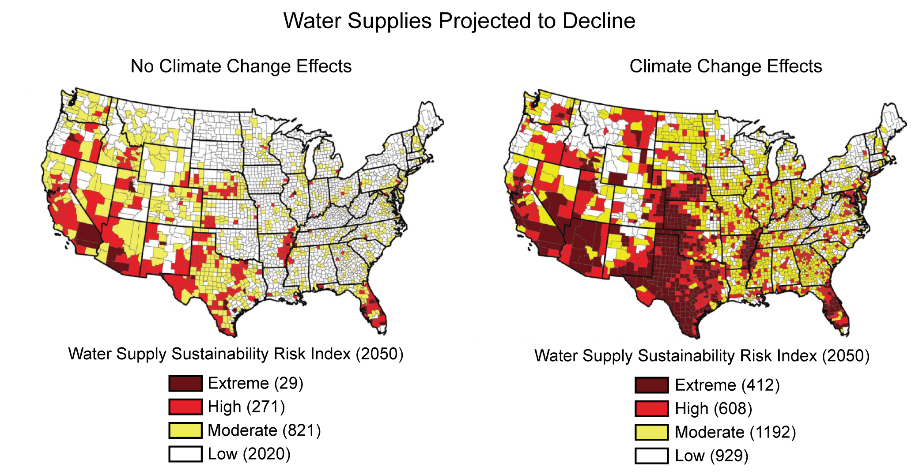
Water supplies in 2050 threatened by
overdrafts (left) and climate change (right)
Roy, S. B., L. Chen, E. H. Girvetz, E. P. Maurer, W. B. Mills, and T. M. Grieb, 2012: Projecting water withdrawal and supply for future decades in the U.S. under climate change scenarios. Environmental Science & Technology, 46, 2545−2556, doi:10.1021/es2030774.
https://nca2014.globalchange.gov/report/sectors/ecosystems

Slide 51
Bird Community Changes By ~2060 AD In Four Models—Most change (red) in Deserts and Sierra foothills
Stralberg et al. 2009. PLoS ONE 4(9): e6825. doi:10.1371/journal.pone.0006825

Slide 52
Atmospheric Rivers Shift South (over SoCal)
Wind speeds in meters/sec for RCP8.5-historical climatology
Shields & Kiehl 2016. Geophys. Res. Lett.,
43, 8775–8782,
doi:10.1002/2016GL070470.
Notes:
ARs are also projected to head south I(toward S. Cal) more frequently, soaking our region.

Slide 53
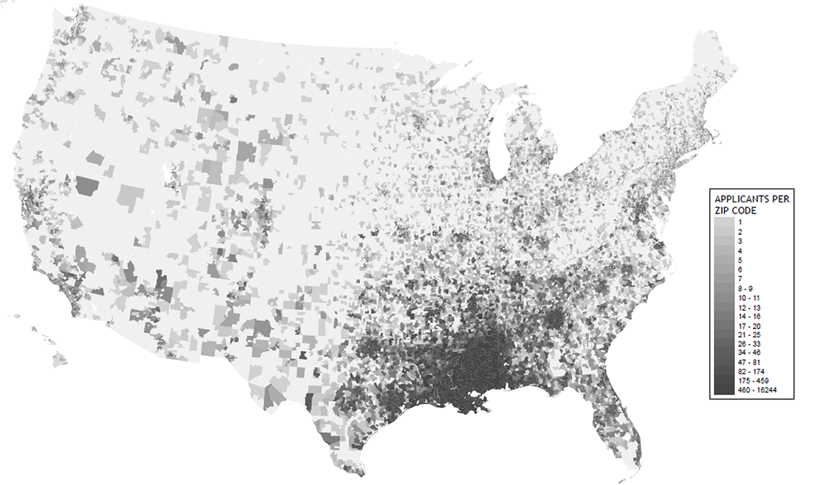
Climate Refugees
where did the Katrina Evacuees go?
Kent, J. D., 2006: Louisiana Hurricane Impact Atlas. 39 pp., Louisiana Geographic Information Center, Baton Rouge, LA
https://nca2014.globalchange.gov/report/sectors/human-health

Slide 54
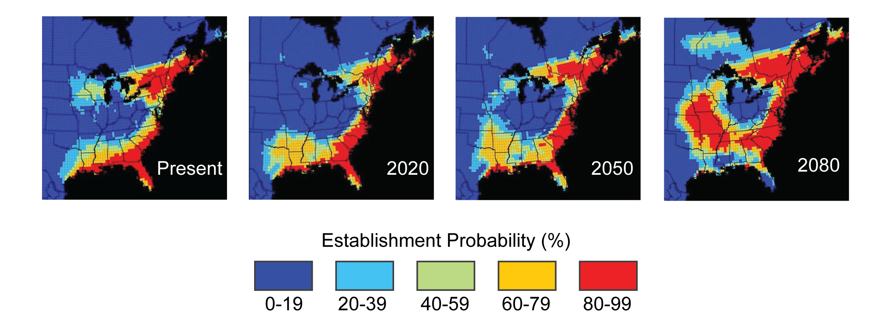
Ticks (as a vector of Lyme disease) spread up
the Mississippi Valley and into Canada
Brownstein, J. S., T. R. Holford, and D. Fish, 2005: Effect of climate change on Lyme disease risk in North America. EcoHealth, 2, 38-46, doi:10.1007/s10393-004-0139-x. |
https://nca2014.globalchange.gov/report/sectors/human-health

Slide 55
Household Carbon Footprint
Greenhouse gas emissions due to source of energy,
Housing, transport and material goods
Fool and services.
Note that total emissions (panel G) are
Concentrated in suburban areas in the
Midwest where coal-fired Electricity, long
distance driving and large homes
Increase carbon intensity
Christopher M. Jones and Daniel M. Kammen, Spatial Distribution of U.S. Household Carbon Footprints Reveals Suburbanization Undermines Greenhouse Gas Benefits of Urban Population Density. Environ. Sci. Technol., 2013, dx.doi.org/10.1021/es4034364

Slide 56
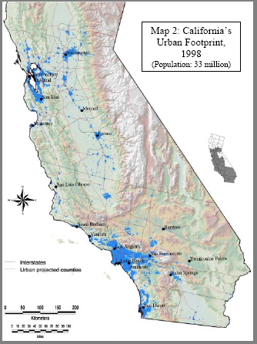
Another Guess At California’s Future Population (n.b. Their 2020 forecast was 5 million too high)
John D. Landis and Michael Reilly How We Will Grow: Baseline Projections of the Growth of California’s Urban Footprint through the Year 2100 Department of City and Regional Planning Working Paper 2003-04 Institute of Urban and Regional Development University of California, Berkeley
Notes:
This 2003 estimate was also a little high, but the development pattern is the same....

Slide 57
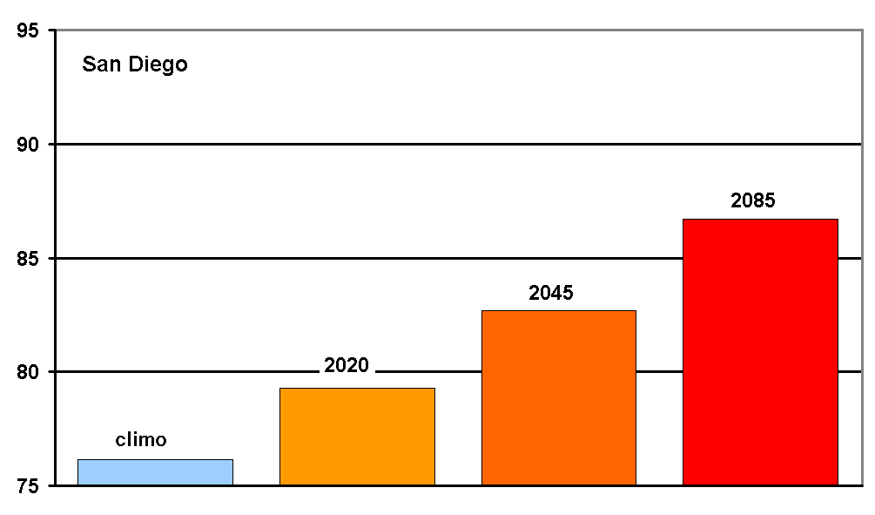
A Hot Future In San Diego?
Average July daily maximum temperature, based on San Diego and La Mesa
historical average (blue) and model projected warming (orange-red)
GFDL model, A2 GHG Emission scenario

Slide 58
A Warmer Future By 2-5°C ( up to 100.4-123.8°F) for 2060AD (Probability of Hitting a Given Extreme Temperature or Lower)
Historic
Historic
Historic
Future (2060)
Future (2060)
Future (2060)
Pierce et al. 2013, Climate Dynamics 40:839-856
Notes:
Similar results for other parts of the state; the interior of CA is always projected to have greater extreme temps (by 4-5°C) than the coast (typically 2°C). Note that the figure shows the cumulative probability, which means that a probability of 0.99 means that that extreme temperature has about a 1% chance of being reached while a temperature extreme at the 0.75 probability has about a 25% chance of being reached

Slide 59
Next 100 Years: Slightly More Winter Rain (Maybe)
Cayan et al. 2006. Climate scenarios for California, White Paper:
California Climate Change Center CEC-500-2005-203-SF

Slide 60
Regional Projections Of Future Climate More Extreme Heat
Difference maps between the periods 1961-1985 and 2071-2095
Days with higher than average temps/year, (b) number of days with
extreme temps
Diffenbaugh et al. 2005. PNAS 102 (44) 15774-15778

Slide 61
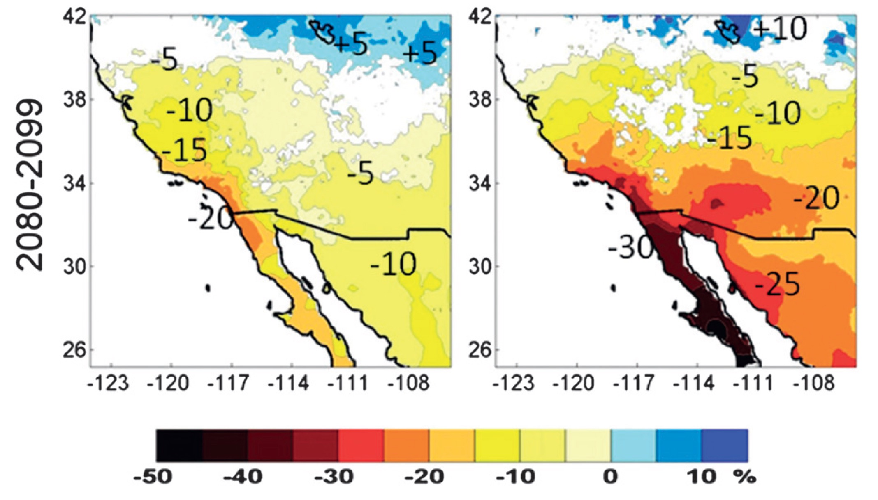
Two Climate Scenarios: Dryer Southern California
and much dryer Baja California in 2100
Cavzos et al. 2012. Journal of Climate
B1
A2

Slide 62
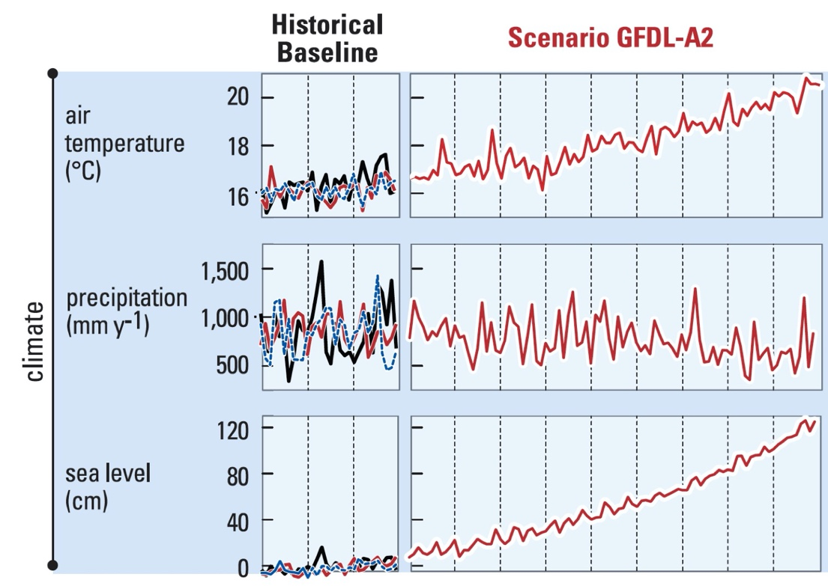
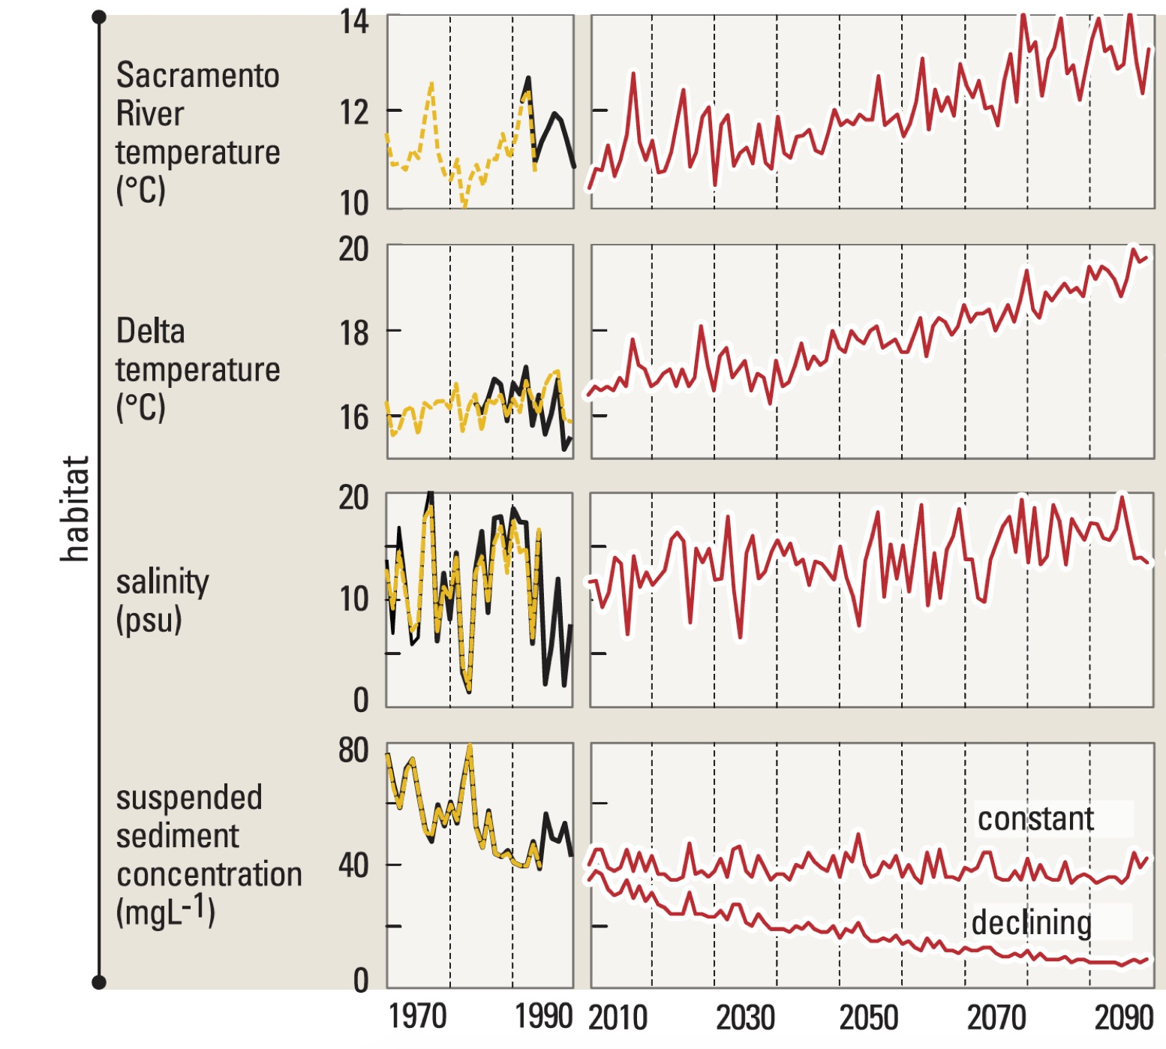
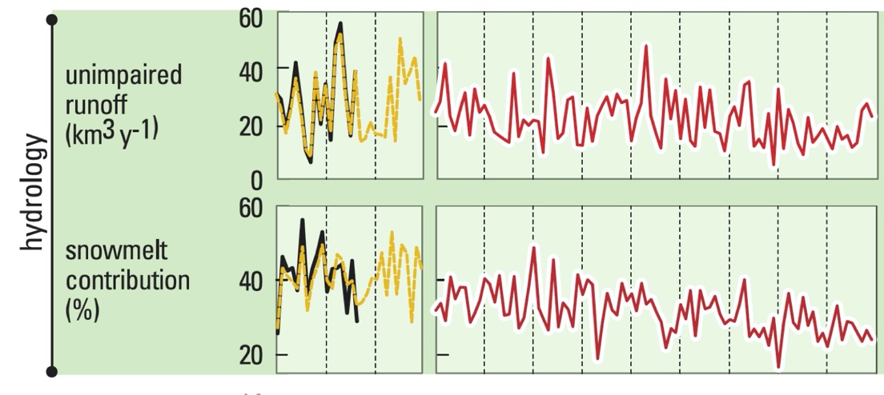
Trends in SF Bay: Hotter, Flooded, Fewer fish and prone to Algal blooms
Cloern et al. 2011 Plos One 6(90 e24465

Slide 63
Threats From A Dinky Fish: The Delta Smelt
These little guys love high water flows

