Slide 1


Welcome to the 134th meeting of the Lyncean Group
22 January 2020

Slide 2
Agenda for 134th Meeting
22 January 2020
Reminder: please turn off or mute cell phones
Announcements & upcoming talks
Website & Pete’s Lynx
Pre-introduction & a little Lyncean history
Today’s Talk: Future California: if you know what’s coming, you can change it
  Richard Norris, Professor, Geosciences Research Division, Scripps Institution of Oceanography, UC San Diego
Speaker Appreciation

Slide 3
Our Email Address List
It has proven difficult to read some people’s handwriting on the sign-in sheet, so…
If you want to have your email address added to our list so you will receive meeting announcements, please send an email to Dennis Buckley at lynceandwb@gmail.com
If you are already on our list and want to change your address or have it deleted, please add a note requesting such to the same address: lynceandwb@gmail.com
I don’t want to put Dennis’s address on the website, so I printed it on some little cards. Feel free to take one if it will help you remember the address: lynceandwb@gmail.com

Slide 4
Upcoming Talks
SUBJECT TO CHANGE
This information is also on the website under “Upcoming Talks”
Date | Speaker | Topic/Title
3/3/20 Note that this talk is on a Tuesday | Daniel Whiteson Professor of Physics & Astronomy, UC Irvine | We Have No Idea: Big, Unanswered Questions about the Universe and Its Particles
4/15/20 | Gresham Bayne Former Critical Care Consultant to STRATOS, Former medical consultant to Bird Aerospace Industries, Former CMO & Chair of the Technical Advisory Committee for NantHealth | What really happened during the STRATOS stratospheric parachute jump and what we still don’t know
5/27/20 | Ryan Kastner Professor of Computer Science and Engineering UC San Diego | Engineers for Exploration
7/8/20 | TBD | TBD
NEW

Slide 5
Upcoming Talks
SUBJECT TO CHANGE
This information is also on the website under “Upcoming Talks”
Date | Speaker | Topic/Title
8/19/20 | Joe Valenzuela Director of Business Development for Tactical Systems & Deputy CTO KRATOS Defense & Security Solutions | Autonomous air vehicle evolution and applications
9/23/20 | Katherine de Kleer Assistant Professor Division of Geological and Planetary Sciences Caltech | Dynamic Processes in the Solar System (tentative title)
11/18/20 | TBD | TBD
1/6/21 | TBD | TBD
NEW
NEW

Slide 6
Lyncean Website Total Visitors
22 January 2020

Slide 7
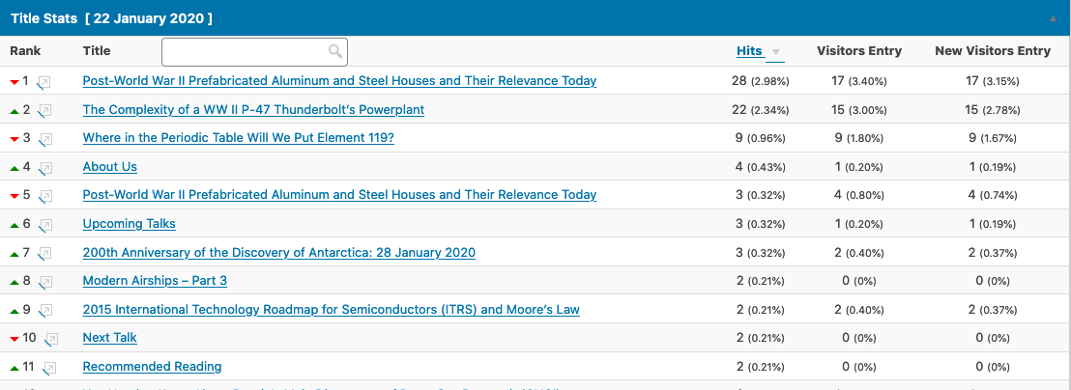
Popular on the Lyncean Website
22 January 2020

Slide 8
New on Pete’s Lynx
U.S. Tritium Production Timelines
U.S. Tritium Production for the Nuclear Weapons Stockpile – Not Like the Old Days of the Cold War (300th post)
60th Anniversary of the First Visit by Humans to the Deepest Point in the Ocean – the Challenger Deep
Antarctica – What’s Under All That Ice?
200th Anniversary of the Discovery of Antarctica: 28 January 2020
Celebrate Isaac Asimov’s Centennial by Reading Some of His Fabulous Books (Again)

Slide 9
Updates on Pete’s Lynx
A Visit to the Berlin Wall, 30 Years After it Started Coming Down – 19 November 2019
  DDR Museum
JASON and NRAC Contracts Were Cancelled by the Pentagon in Early 2019 – JASON Has Survived but NRAC Has Not – 12 April 2019
  New contract
The Navy’s Troubled Littoral Combat Ship (LCS) Program is Delivering a Costly, Unreliable, Marginal Weapons System – 18 December 2016
  Congress limits funding & number of ships
Kurzgesagt Explains the Fermi Paradox: Where are all the aliens? – 24 May 2015
  New video links

Slide 10
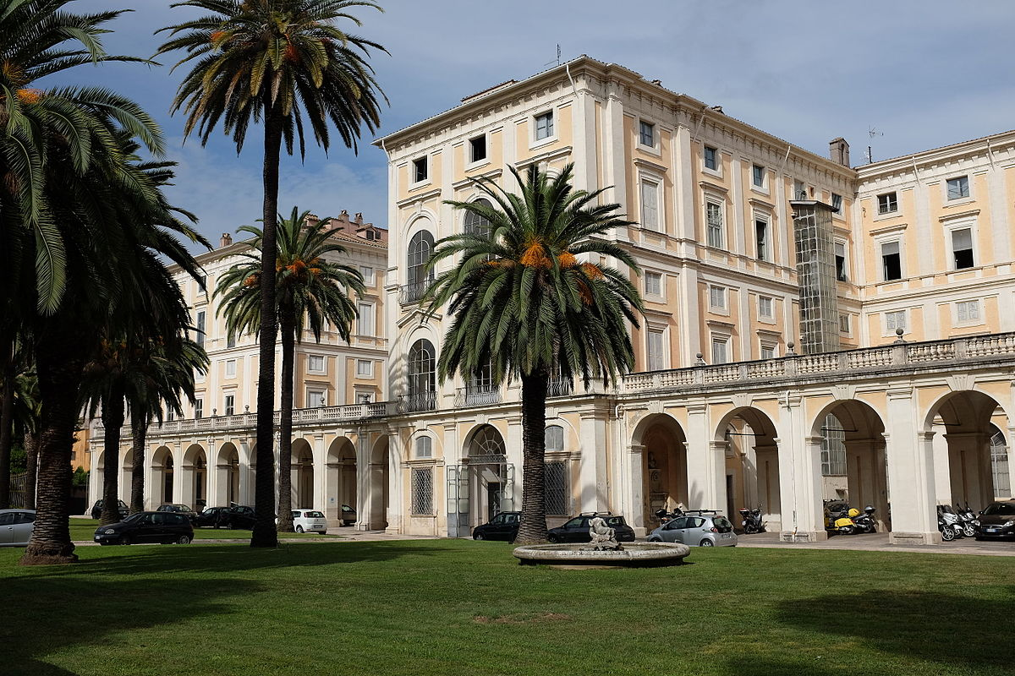
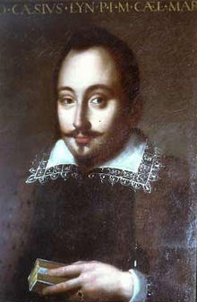
A Pre-Introduction
A little history: our Lyncean Group is loosely based on the Academia Lincei, which was founded in 1603 by Federico Cesi at the Palazzo Corsini in Rome
Thanks to Steve Dahms, who searched on the term “Lynceans” in Google Books and pointed me to some very interesting references, I learned several surprising things about the Academia Lincei
As you will see, the first Lynceans were quite good at recognizing scientific talent and quite prescient with regard to their founding principles

Slide 11

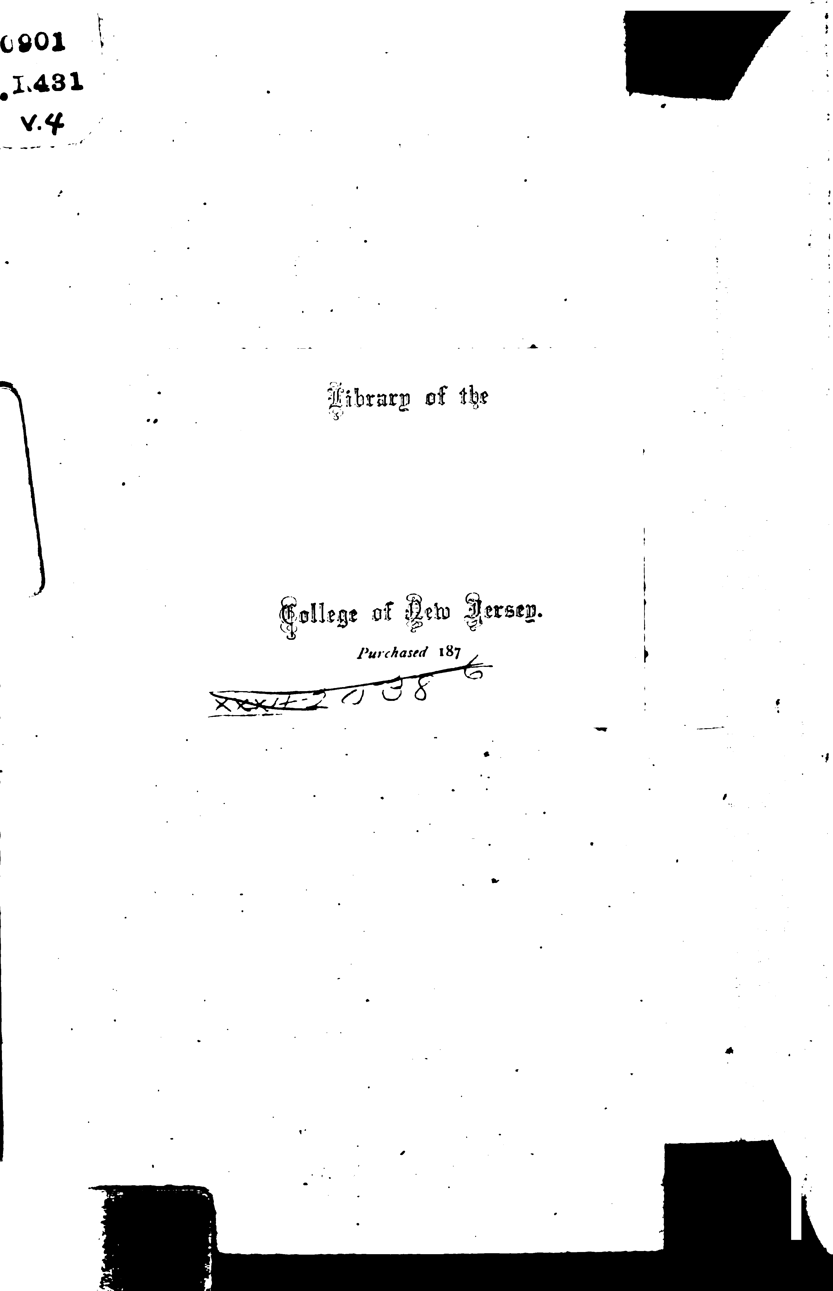

Slide 12
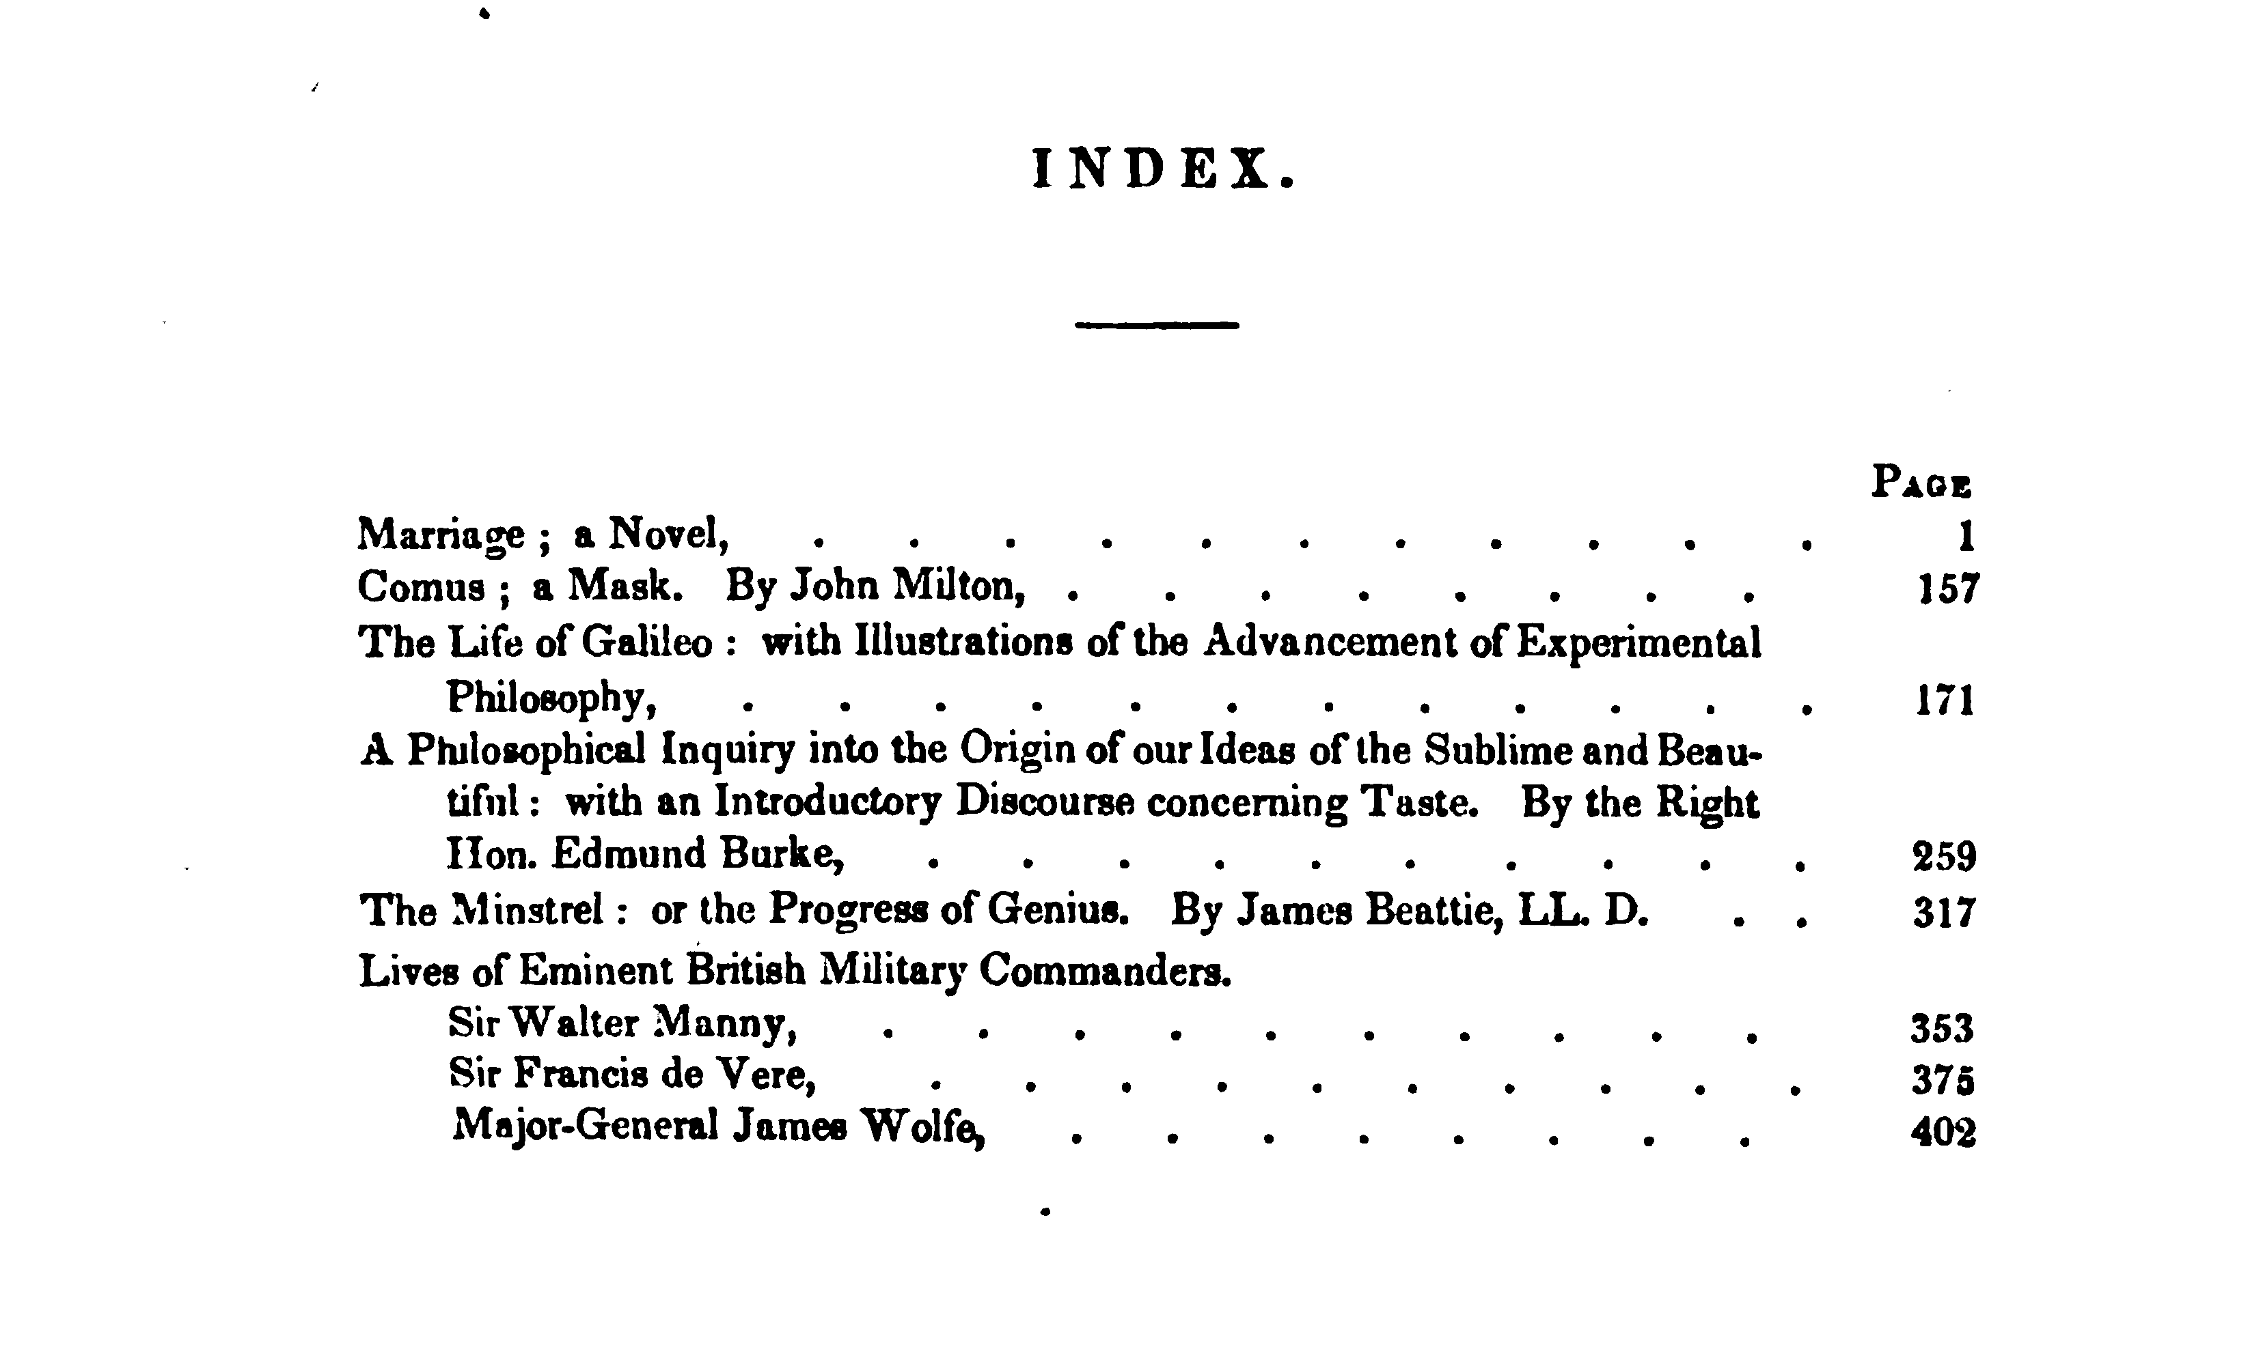

Slide 13

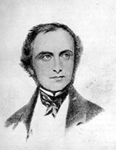
John Elliot Drinkwater Bethune
Published Life of Galileo in 1830

Slide 14
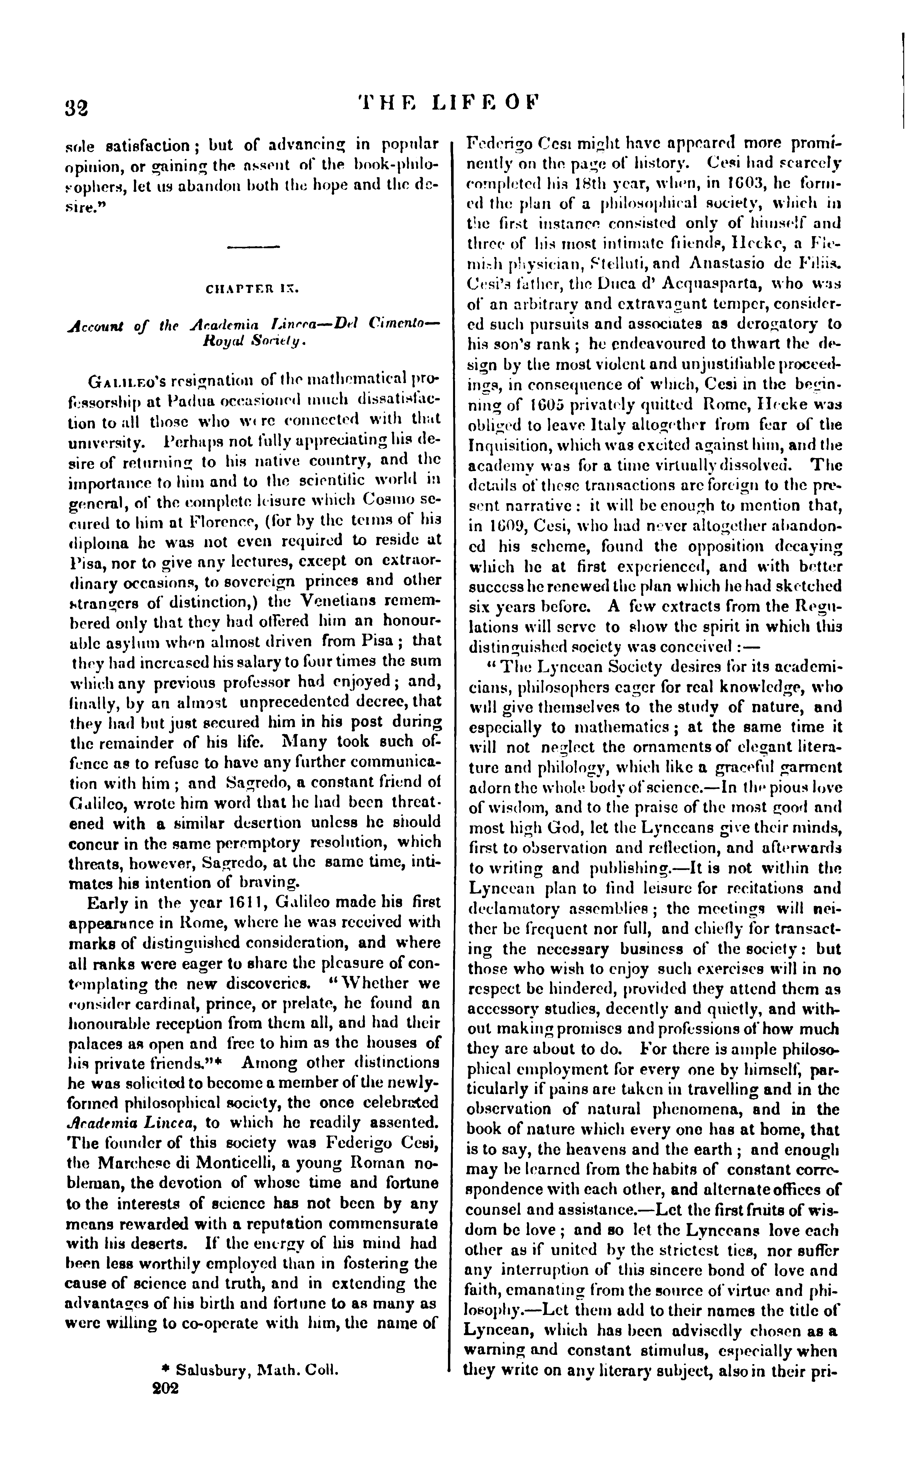
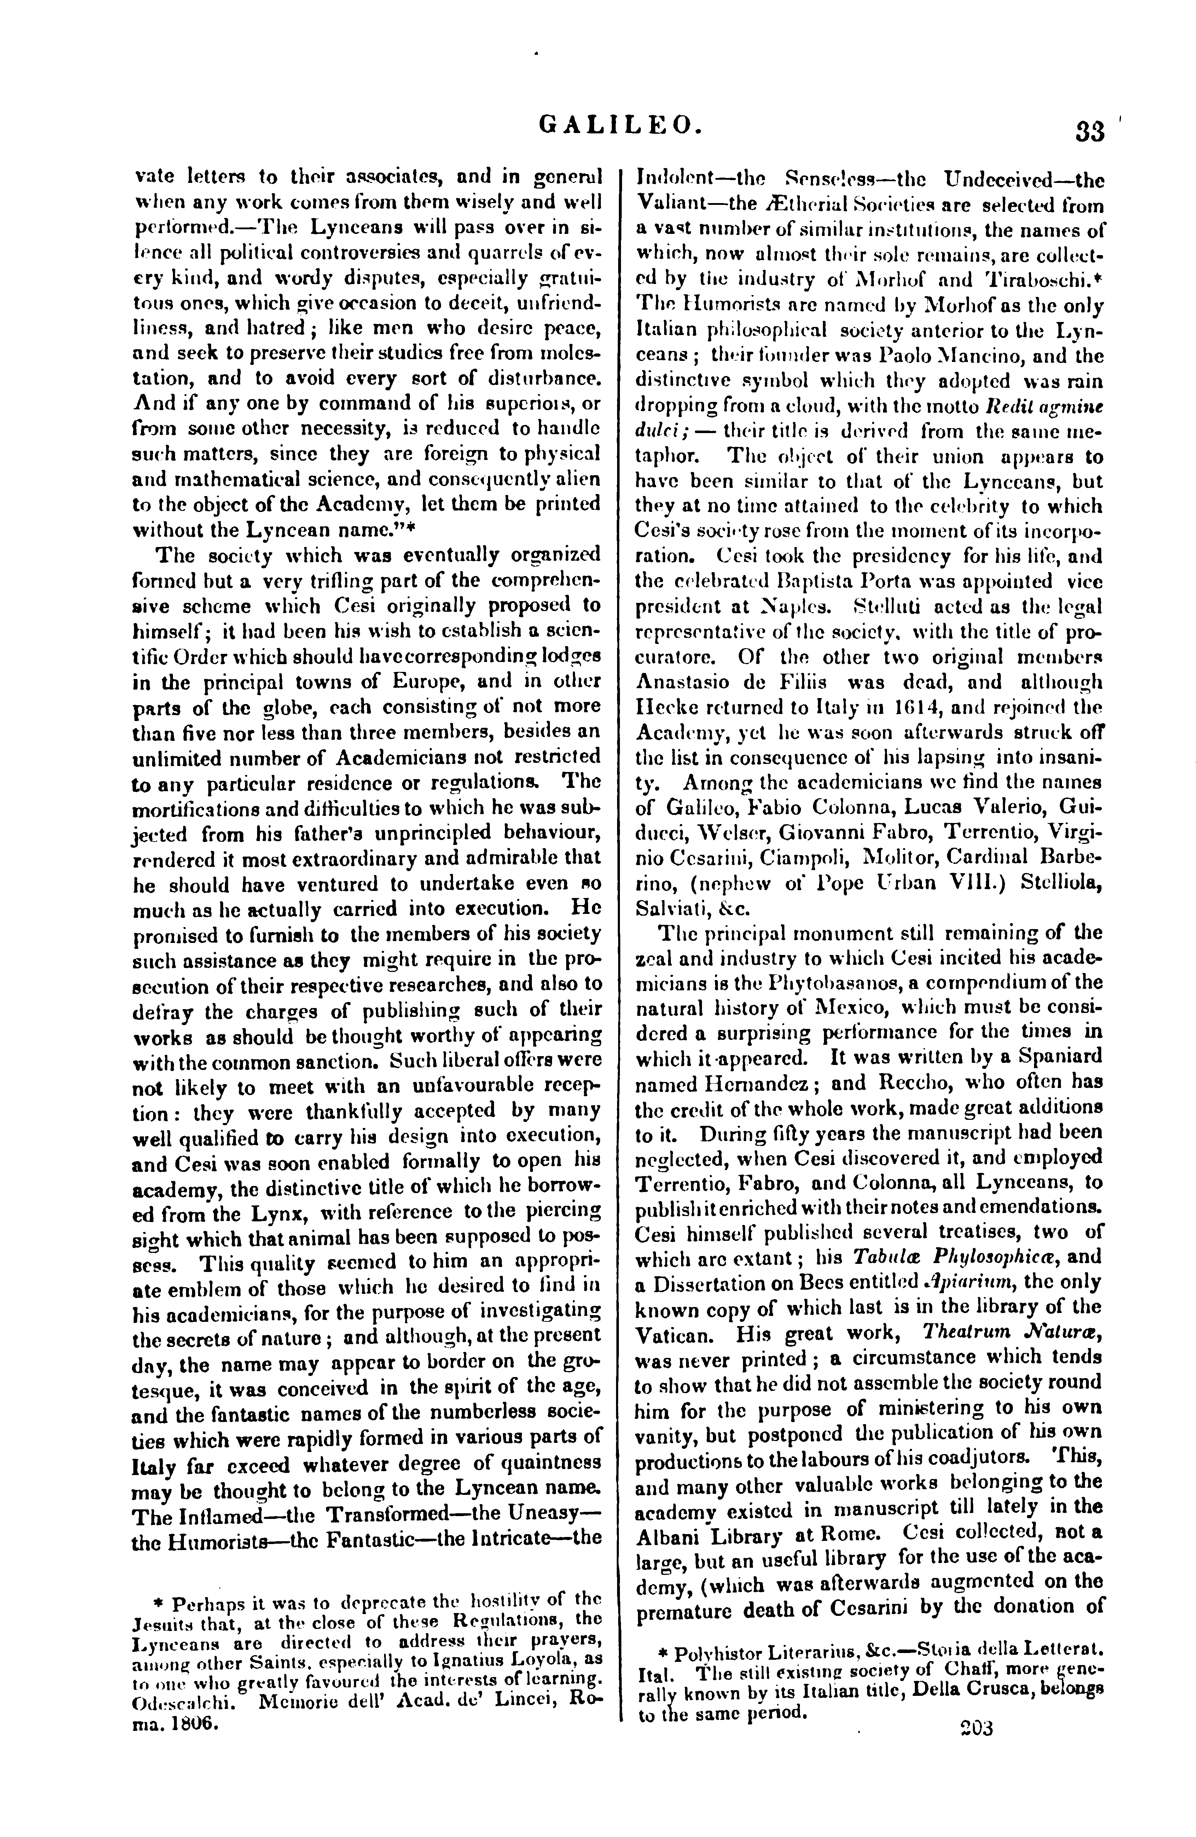
“The Lynceans will pass over in silence all political controversies and quarrels of every kind, and wordy disputes, especially gratuitous ones, which give occasion to deceit, unfriendliness, and hatred; like men who desire peace, and seek to preserve their studies free from molestation, and to avoid every sort of disturbance.”
“Early in the year 1611, Galileo made his first appearance in Rome, where he was received with marks of distinguished consideration, …”
“Among other distinctions he was solicited to become a member of the newly-formed philosophical society, the once celebrated Academia Lincea, to which he readily assented. The founder of this society was Federigo Cesi, …”

Slide 15
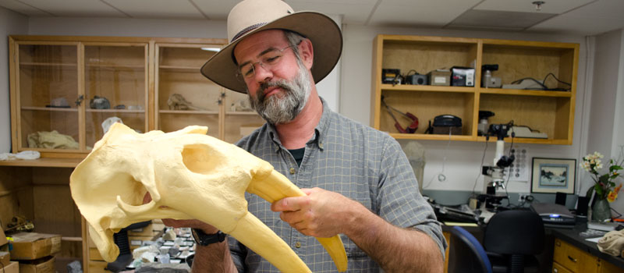
  Future California: if you know what’s coming, you can change it
  Richard Norris
  Professor, Geosciences Research Division
  Scripps Institution of Oceanography
  UC San Diego
  https://rnorris.scrippsprofiles.ucsd.edu

Slide 16
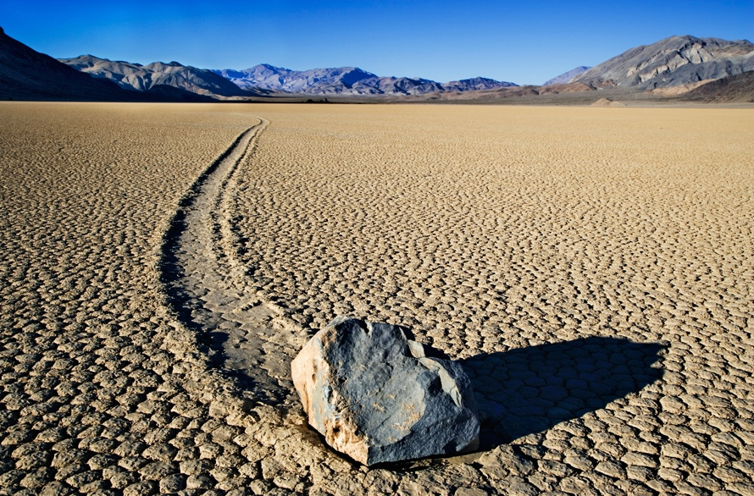
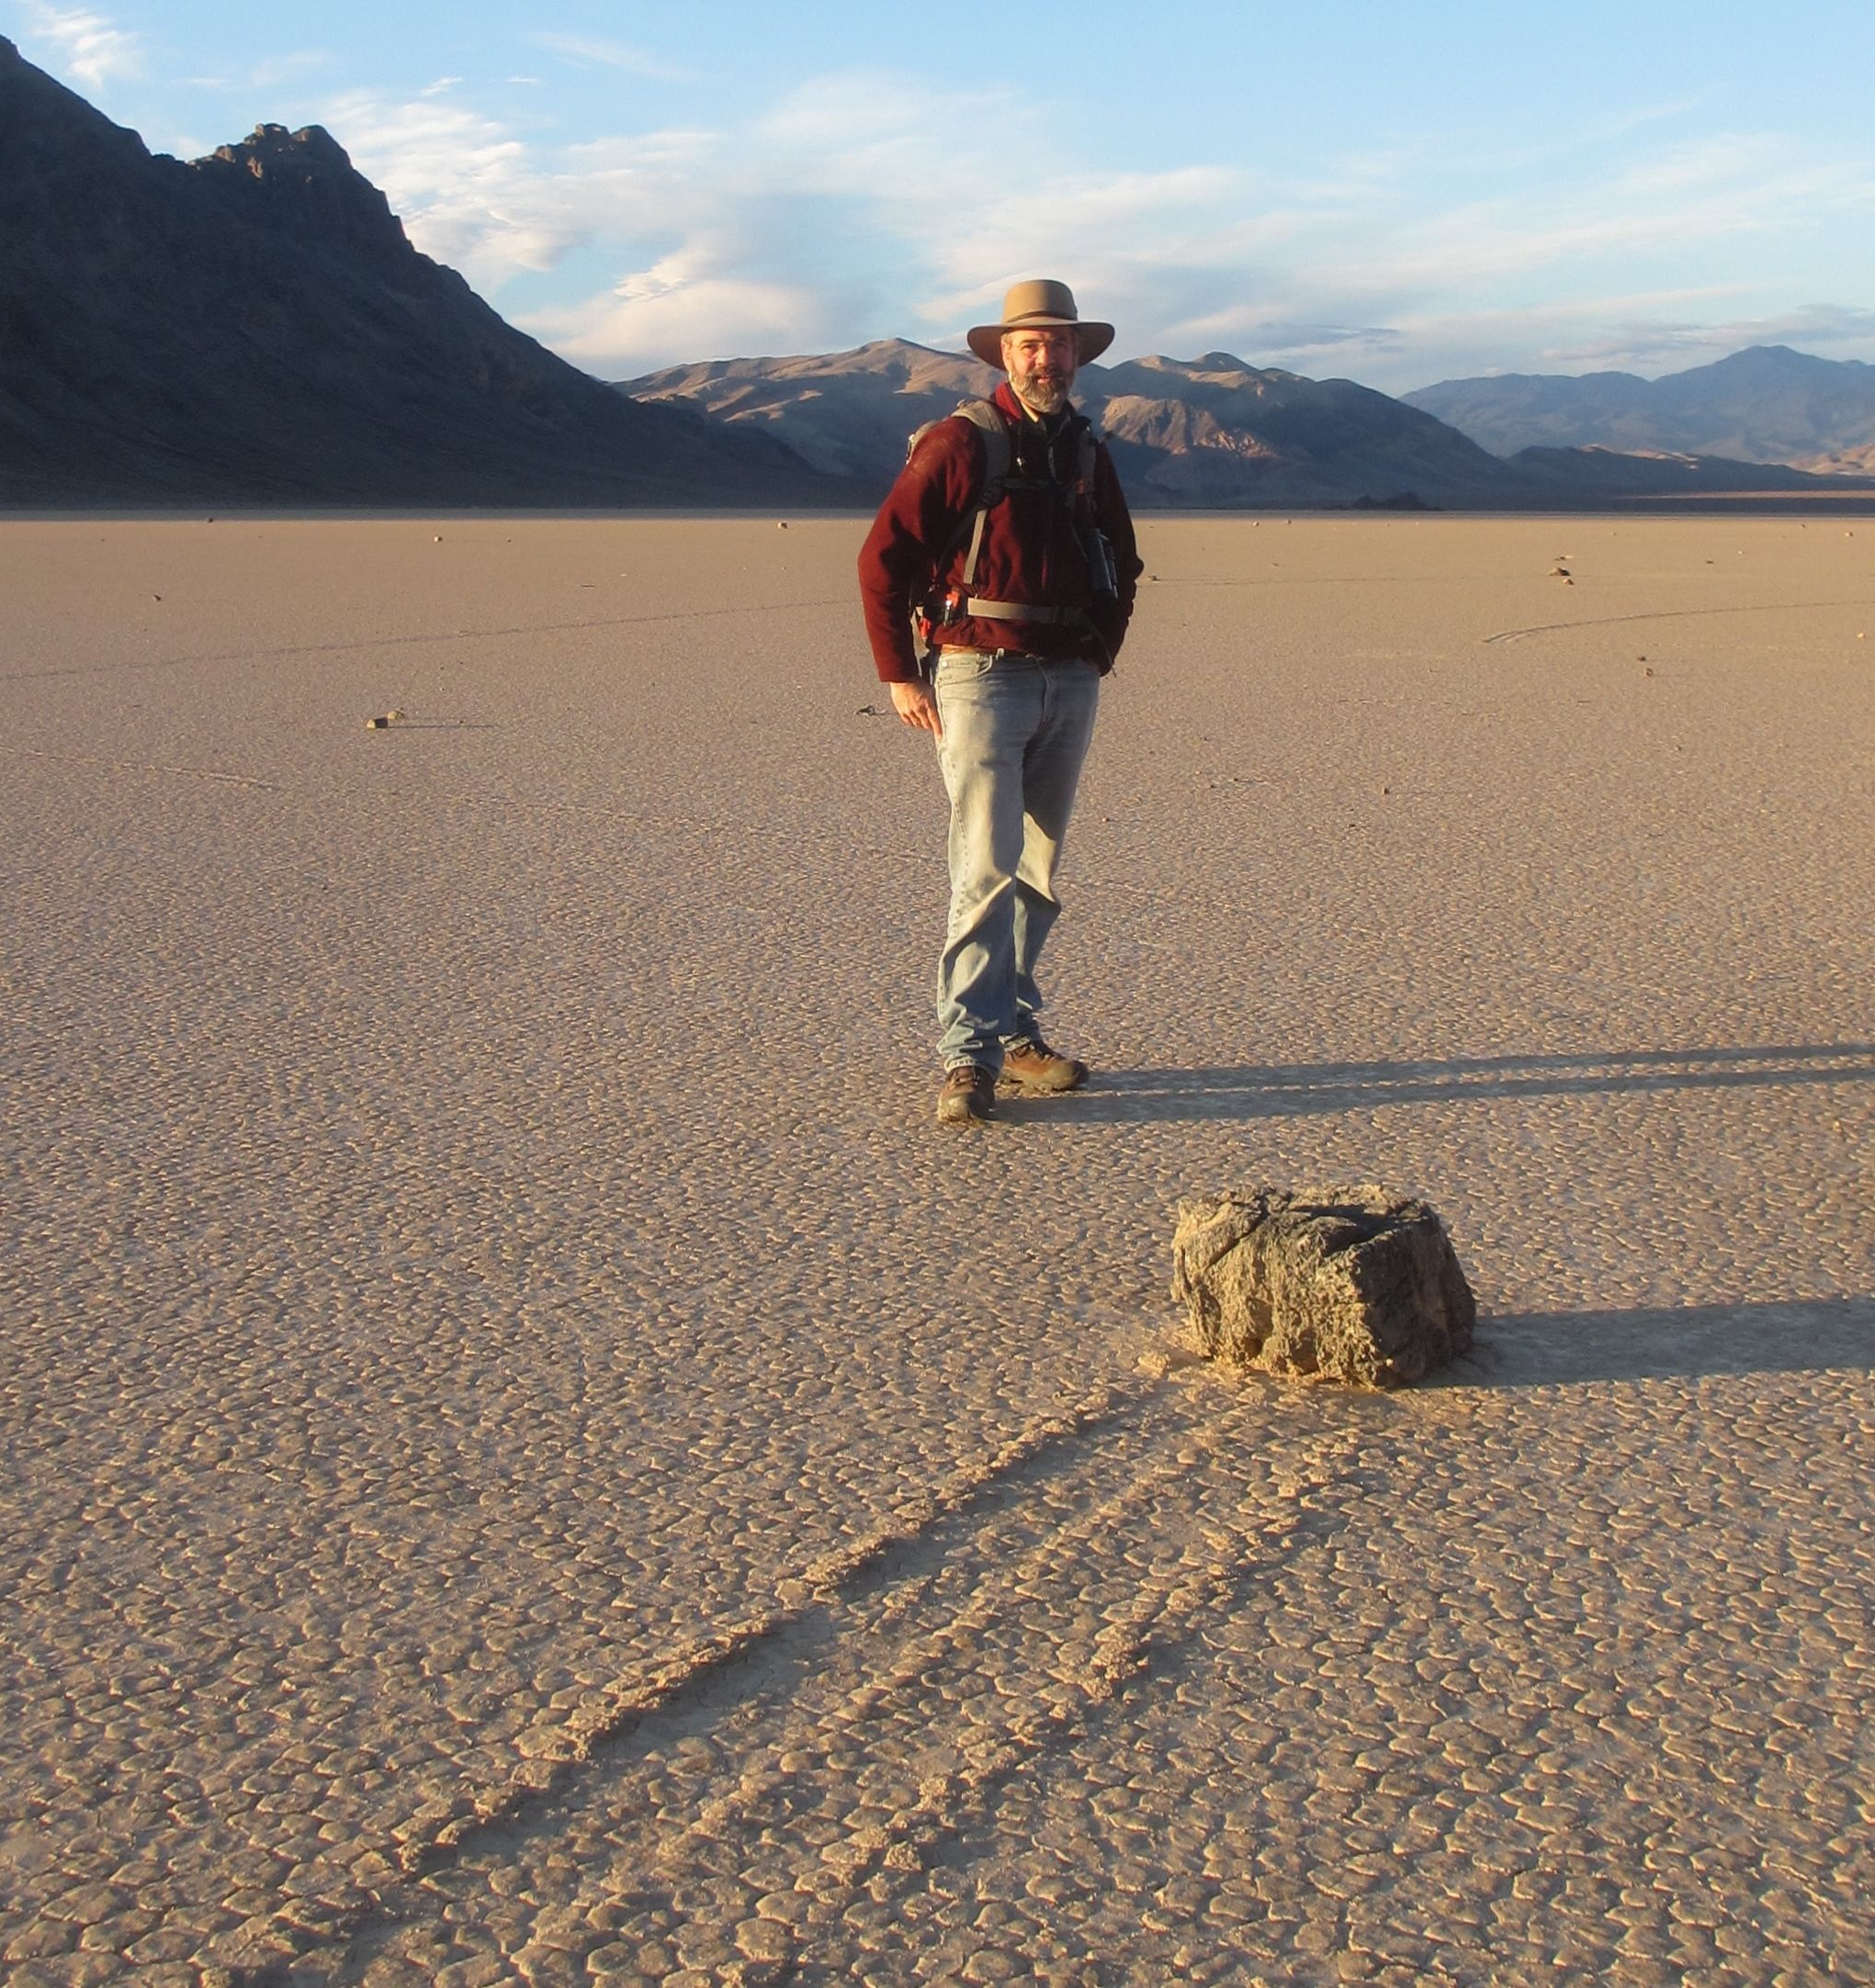
Wandering Stones of Death Valley
'Wandering stones' of Death Valley explained
https://www.nature.com/news/wandering-stones-of-death-valley-explained-1.15773
Mystery of how rocks move across Death Valley lake bed solved
https://www.latimes.com/local/lanow/la-me-ln-rocks-move-death-valley-lake-bed-20140827-story.html
Slithering Stones | Racetrack Playa (video)
https://youtu.be/uyHcs7B27Zk

Slide 17
  Future California: if you know what’s coming, you can change it
  Richard Norris
  Professor, Geosciences Research Division
  Scripps Institution of Oceanography
  UC San Diego
  https://rnorris.scrippsprofiles.ucsd.edu

Slide 18
Speaker Appreciation
We are here

Slide 19

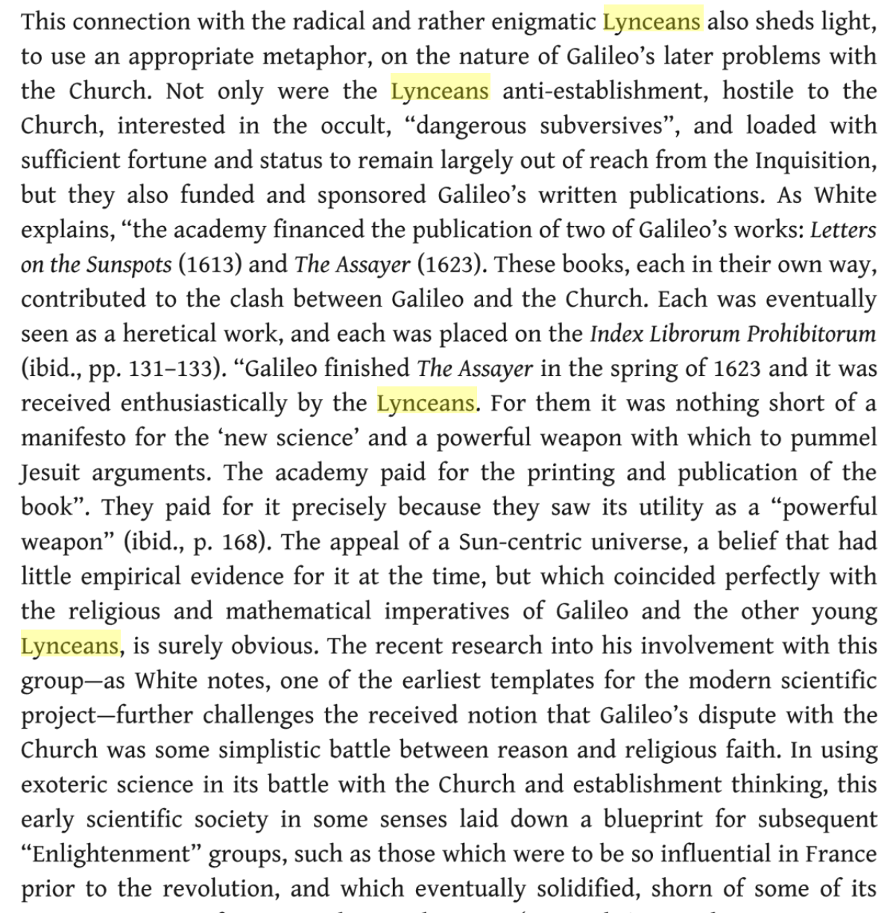
The God of the Left Hemisphere: Blake, Bolte Taylor and the Myth of Creation, by Roderick Tweedy, published by Taylor & Francis; May 1, 2018
“Not only were the Lynceans anti-establishment, hostile to the Church, interested in the occult, ‘dangerous subversives’, and loaded with sufficient fortune and status to remain largely out of reach from the Inquisition, but they also funded and sponsored Galileo’s written publications. As White explains, ‘the academy financed the publication of two of Galileo’s works: Letters on the Sunspots (1613) and The Assayer (1623) [the emphasis is mine].”

Slide 20
Lyncean Funding Since 1623
Things didn’t work out so well for Galileo after the Lynceans funded his publications
  Went on trial for his life, barely avoided execution
  Under house arrest until he died
  Catholic church did not agree that he was right about the solar system until 1992
So the Lynceans have been reluctant to fund anyone else since Galileo …
Professor Norris: just like Galileo, the Lyncean Group will pay all your publication costs for the rest of your career
  Note: house arrest and/or legal expenses are NOT included
Check is in the mail
UNTIL NOW

Slide 21
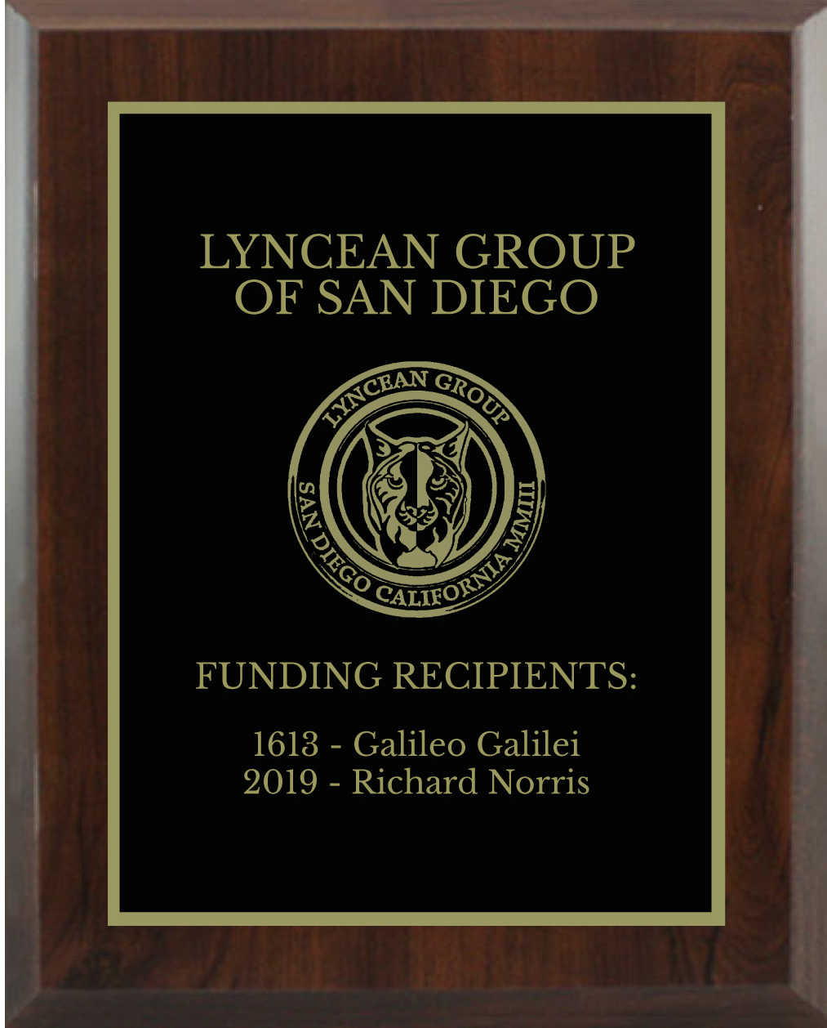
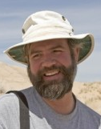
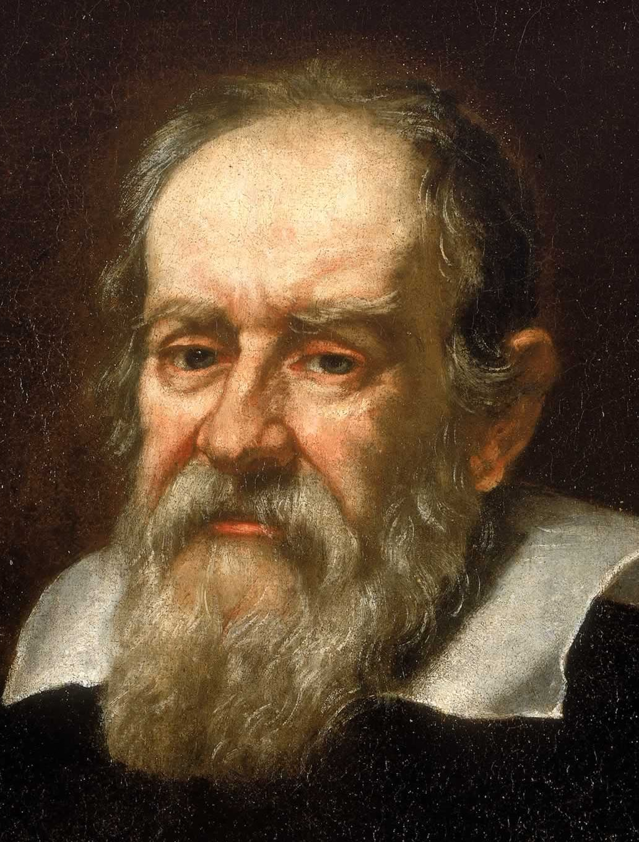
Congratulations
Professors Galileo and Norris!
“dangerous subversives”

Slide 22

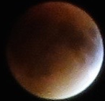
Lynxea
Don’t forget to drop off your badges when you leave!

