Slide 1
Sliding, not Rolling Stones
The icy secrets of rocks on-the-move on
Death Valley's Racetrack and other dry lakes
Richard Norris
Scripps Institution of Oceanography
UNC-Chapel Hill
Notes:
In my day job, I am a paleontologist working in the deep sea. But in 2010, my cousin, Jim Norris, an engineer, came to me to start up a study of the Racetrack phenomenon. His dad, my uncle, Robert Norris had hauled all of us out to see the famous moving stones of the Racetrack. As Bob was still alive then, it seemed a great family project that could entice many friends and relations to join in. We were also fortunate enough to have two former park service rangers in the family—Cousin Betsy Dodson and her husband Bob. It turned out very important to have both of them, since they smoothed the way for our group, “The Slithering Stones Research Initiative” into the the good graces of the NPS.

Slide 2
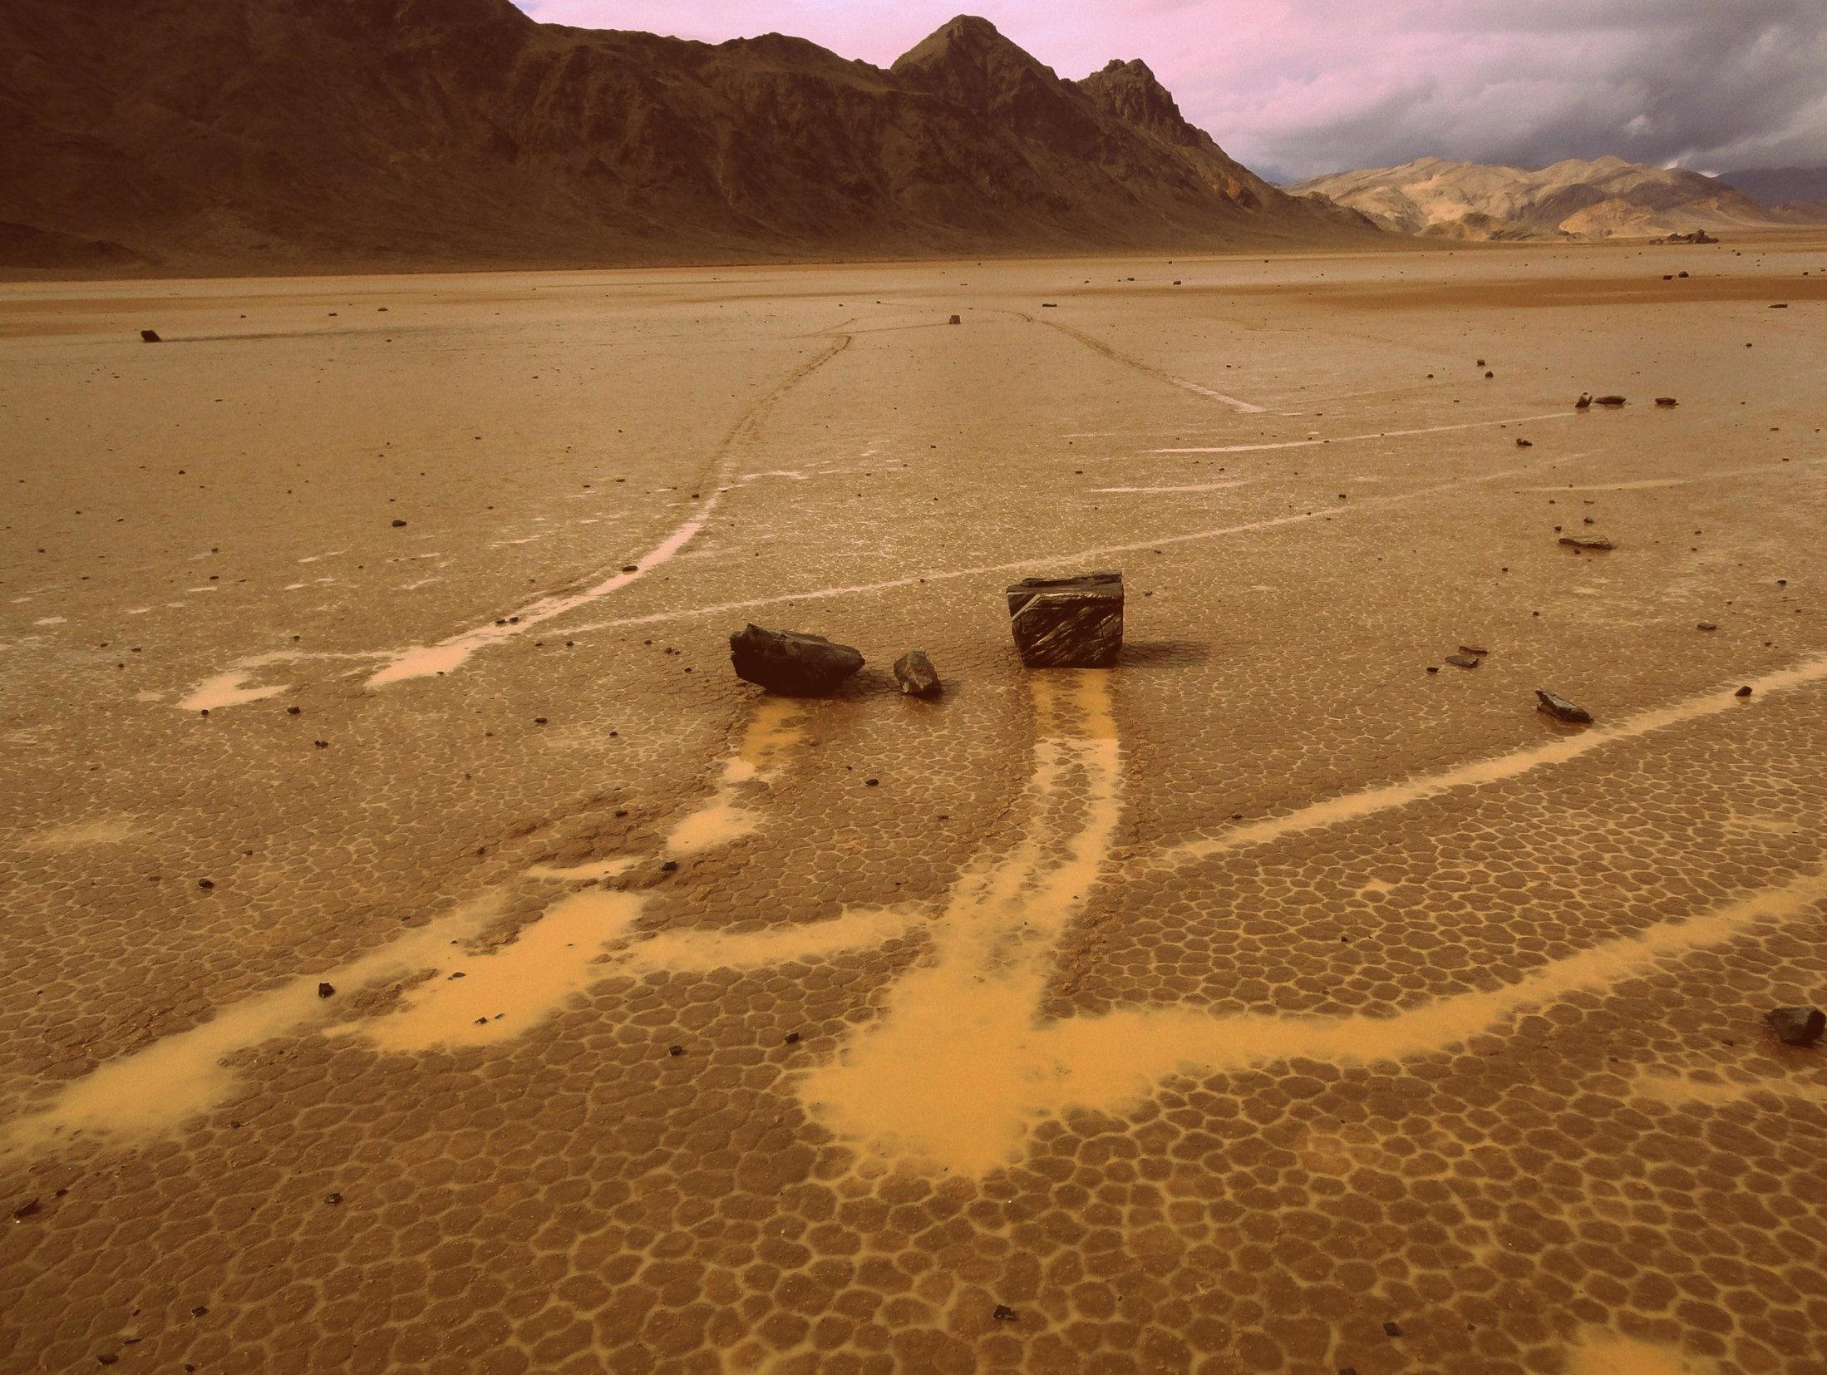
Notes:
The Racetrack phenomenon: Fleets of rocks following remarkably similar paths across a flat, mostly dry, lake bed. Some rocks move farther than others and some do not move at all

Slide 3
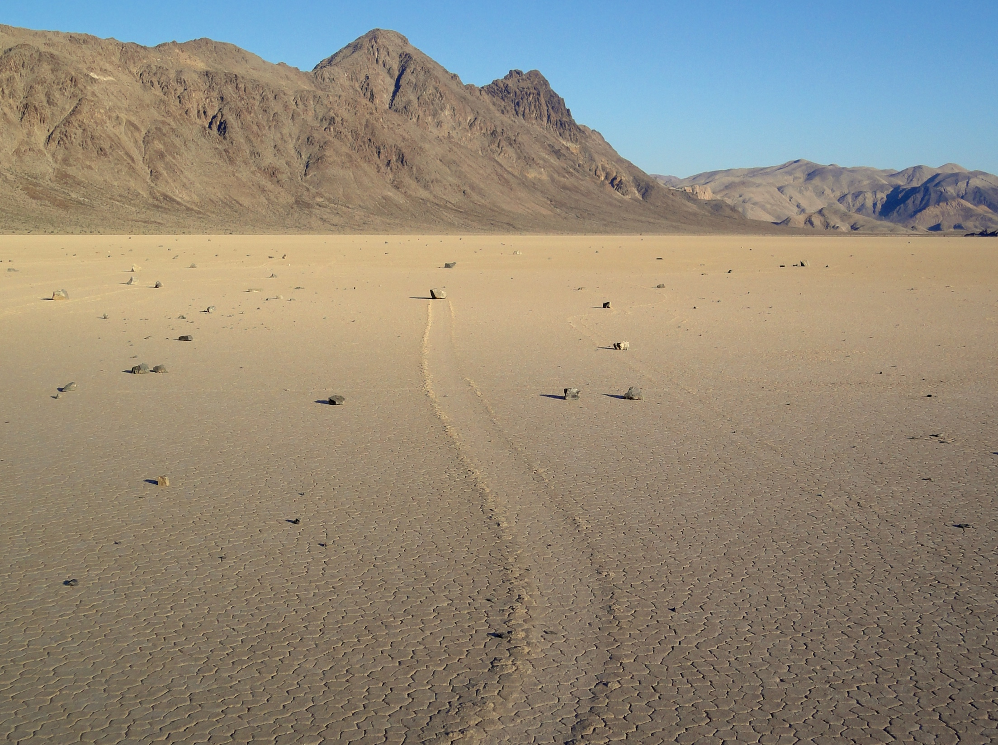
Notes:
Rocks commonly leave shallow trails ~1 cm deep in the mud surface, with levees on the sides of the trail; these indicate rocks are plowing through a muddy surface. Everyone who has studied the phenomenon agrees that rocks are moving over a wet, muddy surface. Again, note the numerous un-moving stones. Why do some move and other don’t?

Slide 4
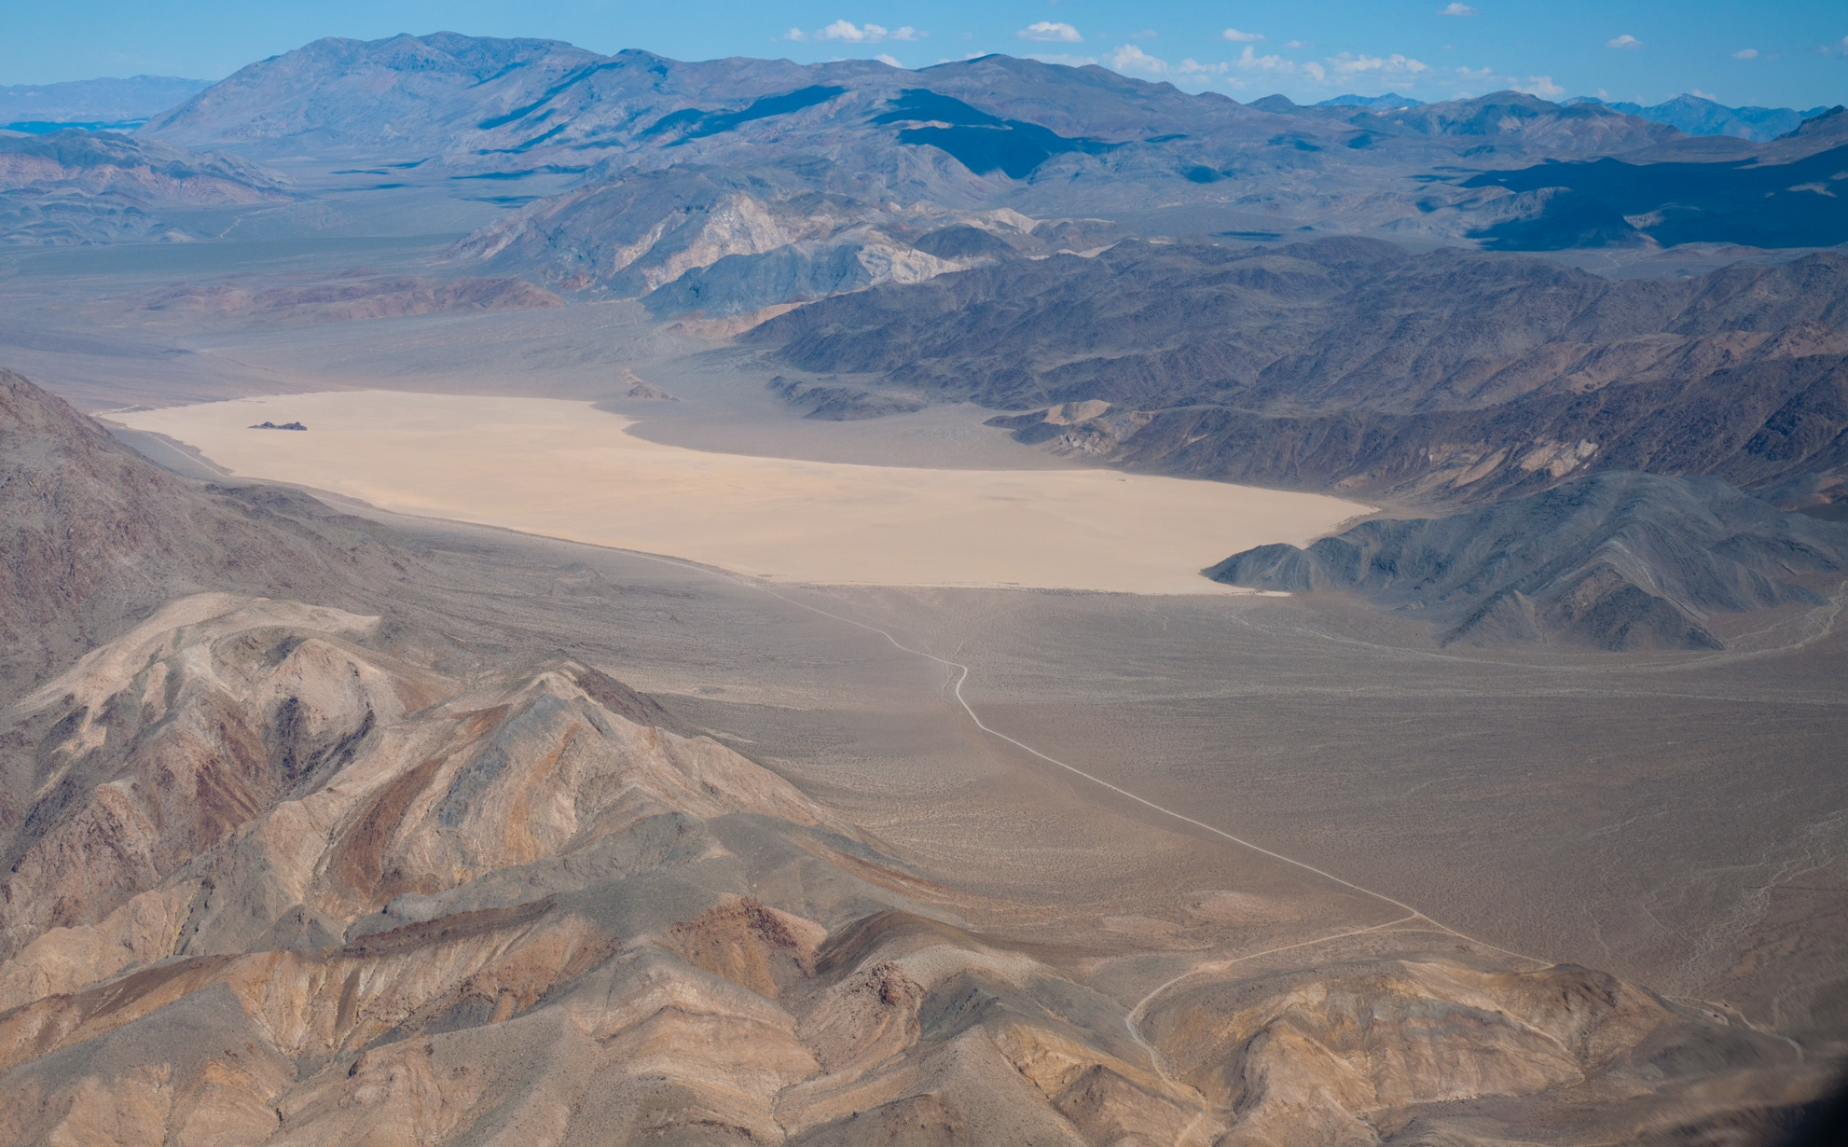
Racetrack Playa
March 2014;
Mike Hartmann
Notes:
Jim is a pilot so we have lots of good shots of the playa form the air. The Playa is ~1 mile x 3 miles, nearly flat, surrounded by broad bajadas that funnel wind from the SW and North; and there is a ‘source hill’ at the south end that supplies most of the rocks to the playa surface. Going into the study, Jim and I speculated that the bajadas would act like the surface of a wing, directing powerful downdrafts from passing thunder cells over the playa surface. The thunder systems would also produce rain and the movement of the cells could change the azimuth of the wind, changing the direction of rock movement.

Slide 5
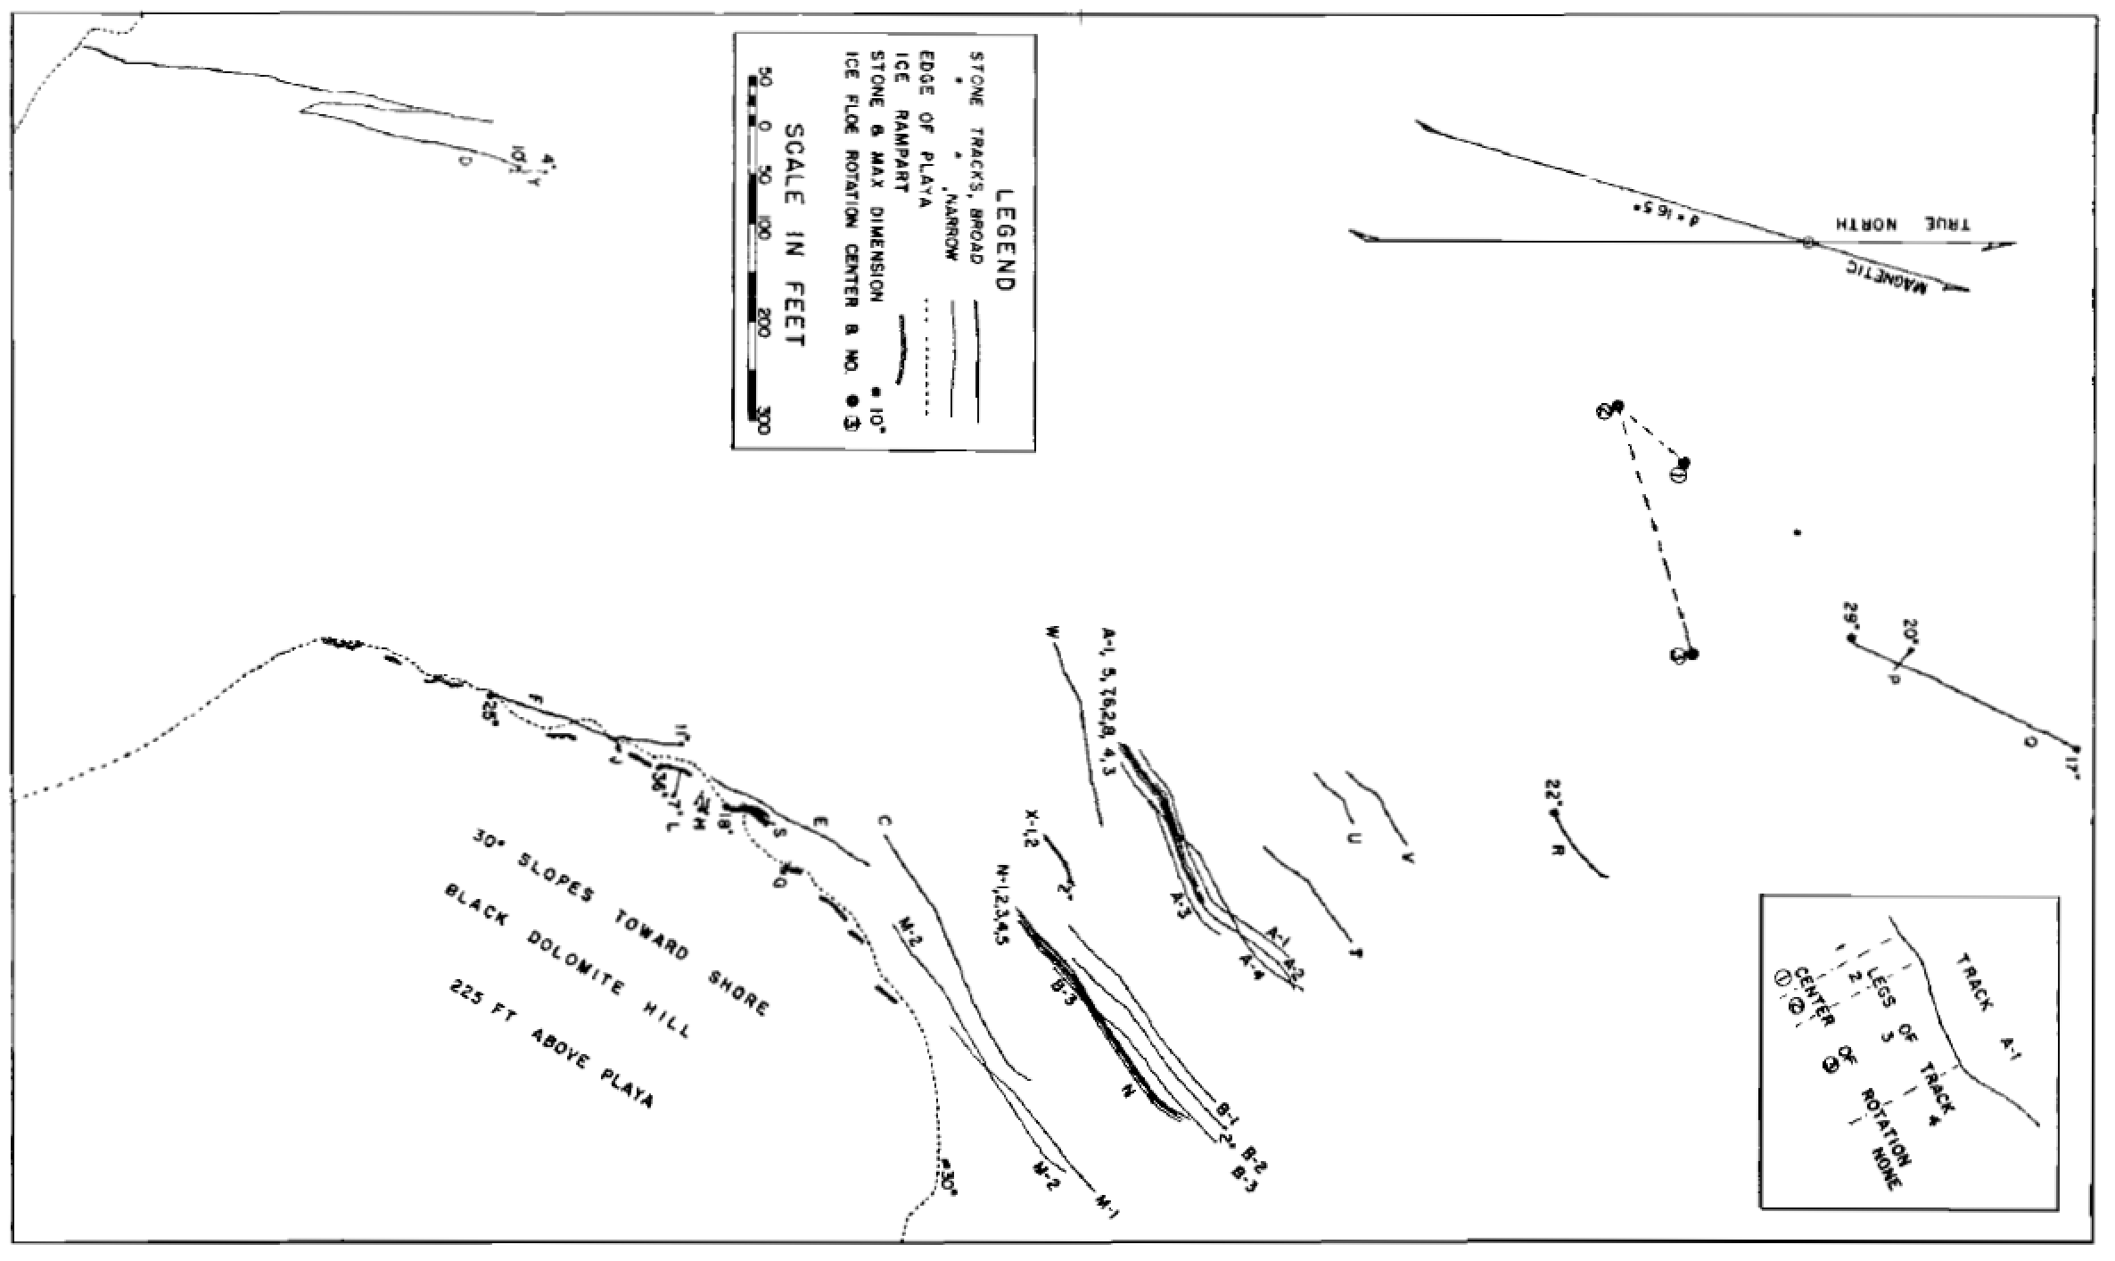
Stanley 1955
Ice as a mechanism of rock motion
Stanley G. 1955, GSA Bulletin 66:1329-1350
Notes:
One of the best early papers was by George Stanley, who mapped trails with a plane table. The phenomenon had first been reported by miners in 1915, so rock motion has clearly been a persistent feature of the playa. Stanley proposed that floating ice was the driving force.

Slide 6
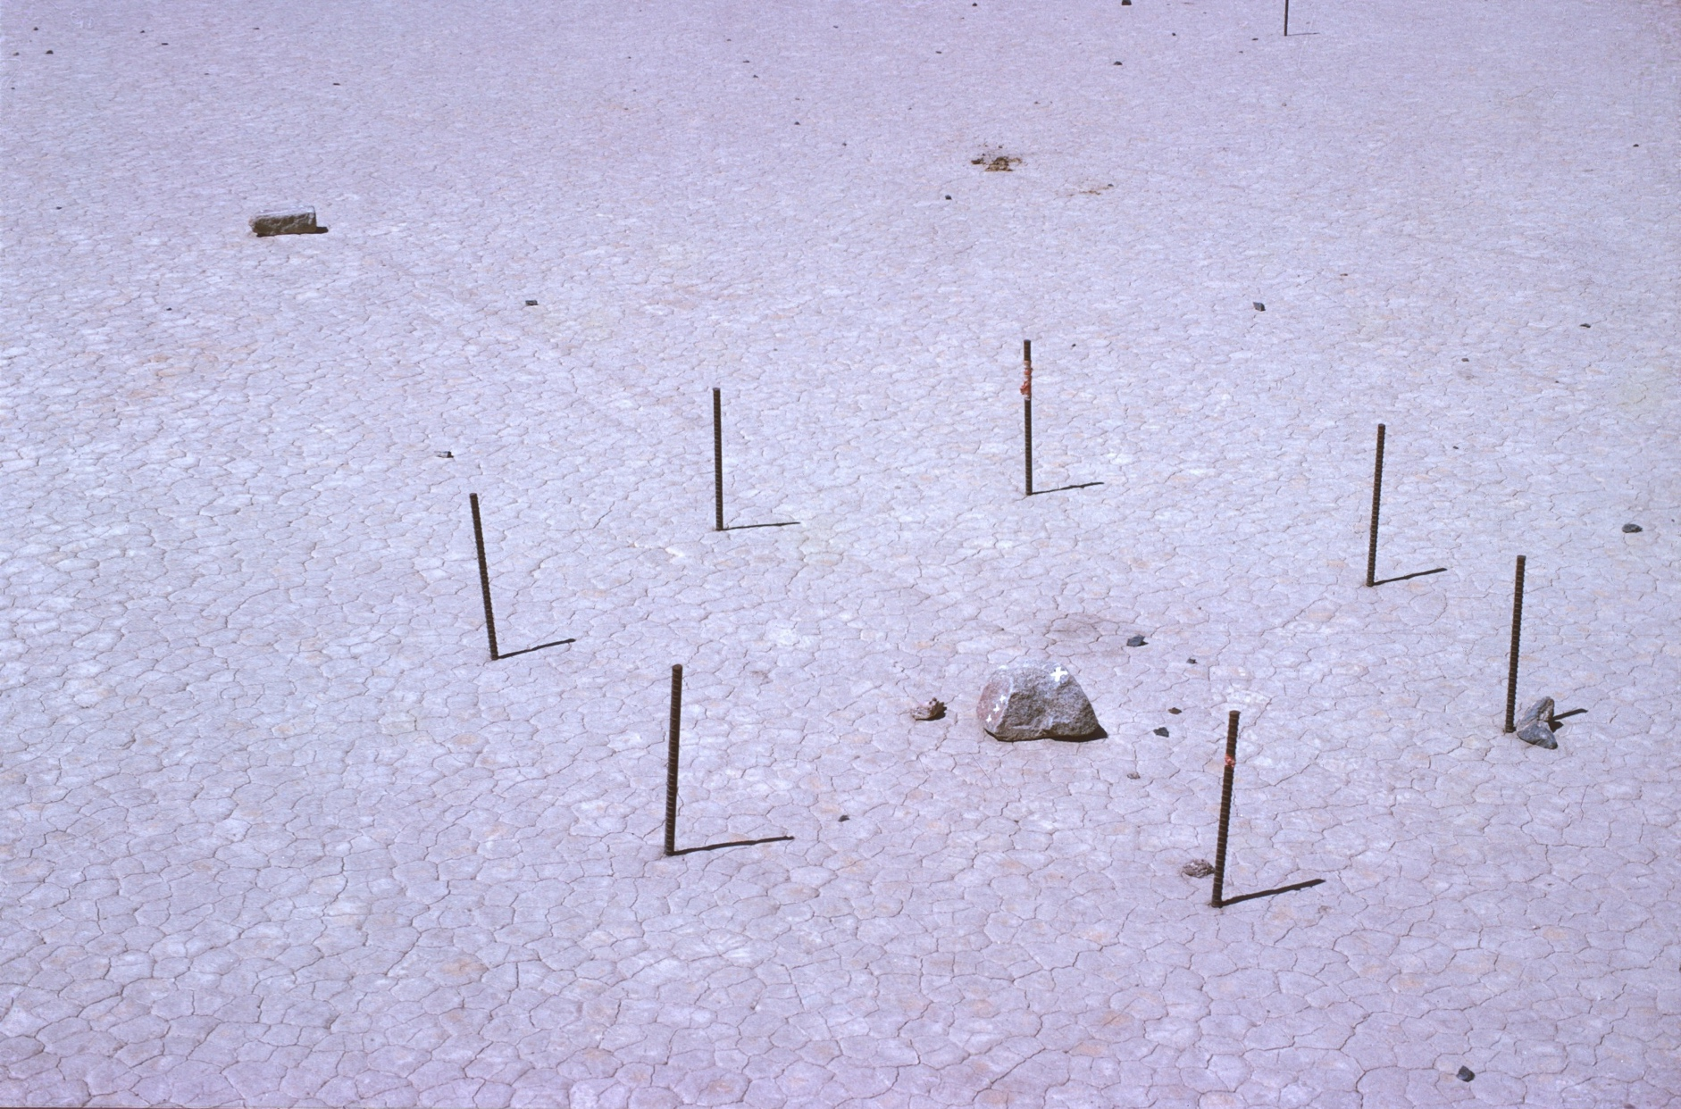
Sharp & Carey’s Corral Experiment—Ice is not involved….
Dwight Carey
Notes:
Later, Bob Sharp and Dwight Carey, studied the process and decided that wind, not ice, was the motive force. They performed a famous ‘corral experiment’ by driving rebar rods into the playa around some rocks. The next year one of the rocks had moved but not the other one. They argued that thick ice would be held in place by the rods and so could not move one rock without also moving the other. This was powerful evidence against ice.
Later, in 1995, John Reid showed that thin ice could explain Sharp’s data. Thin ice would tear around the stakes. The moving rock has no stake upstream of it, where as the non-moving stone has a stake upstream, The stake would create a open water lead in the ice and keep the rock downstream from moving. This was a prescient observation.

Slide 7
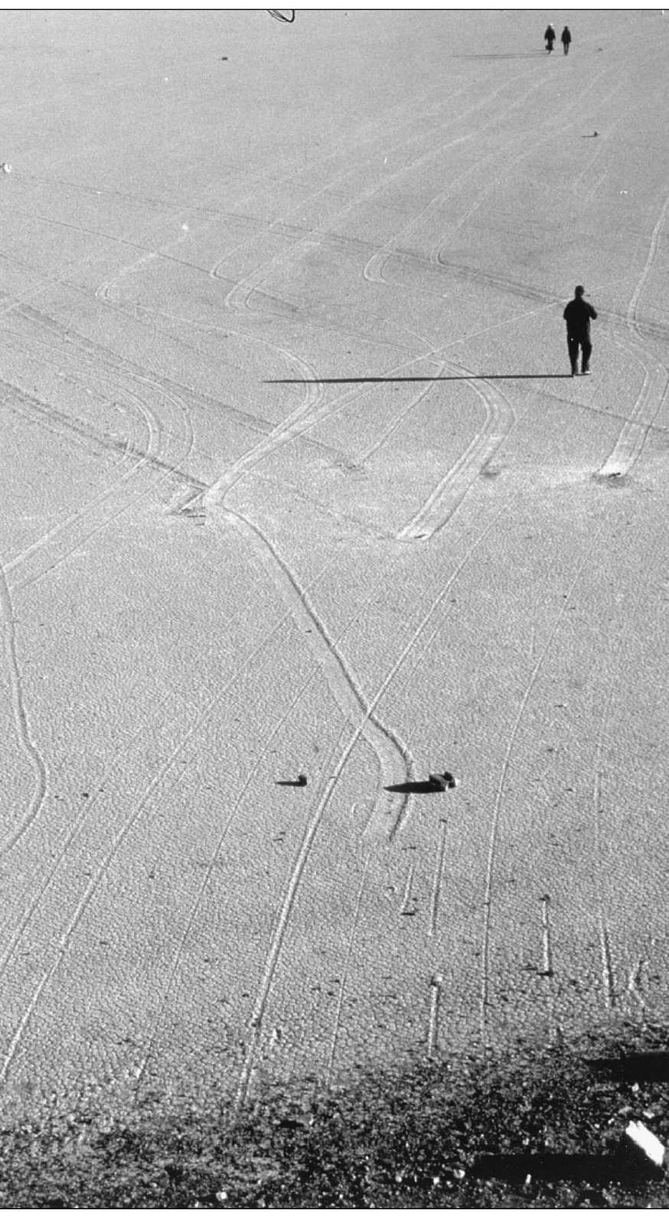
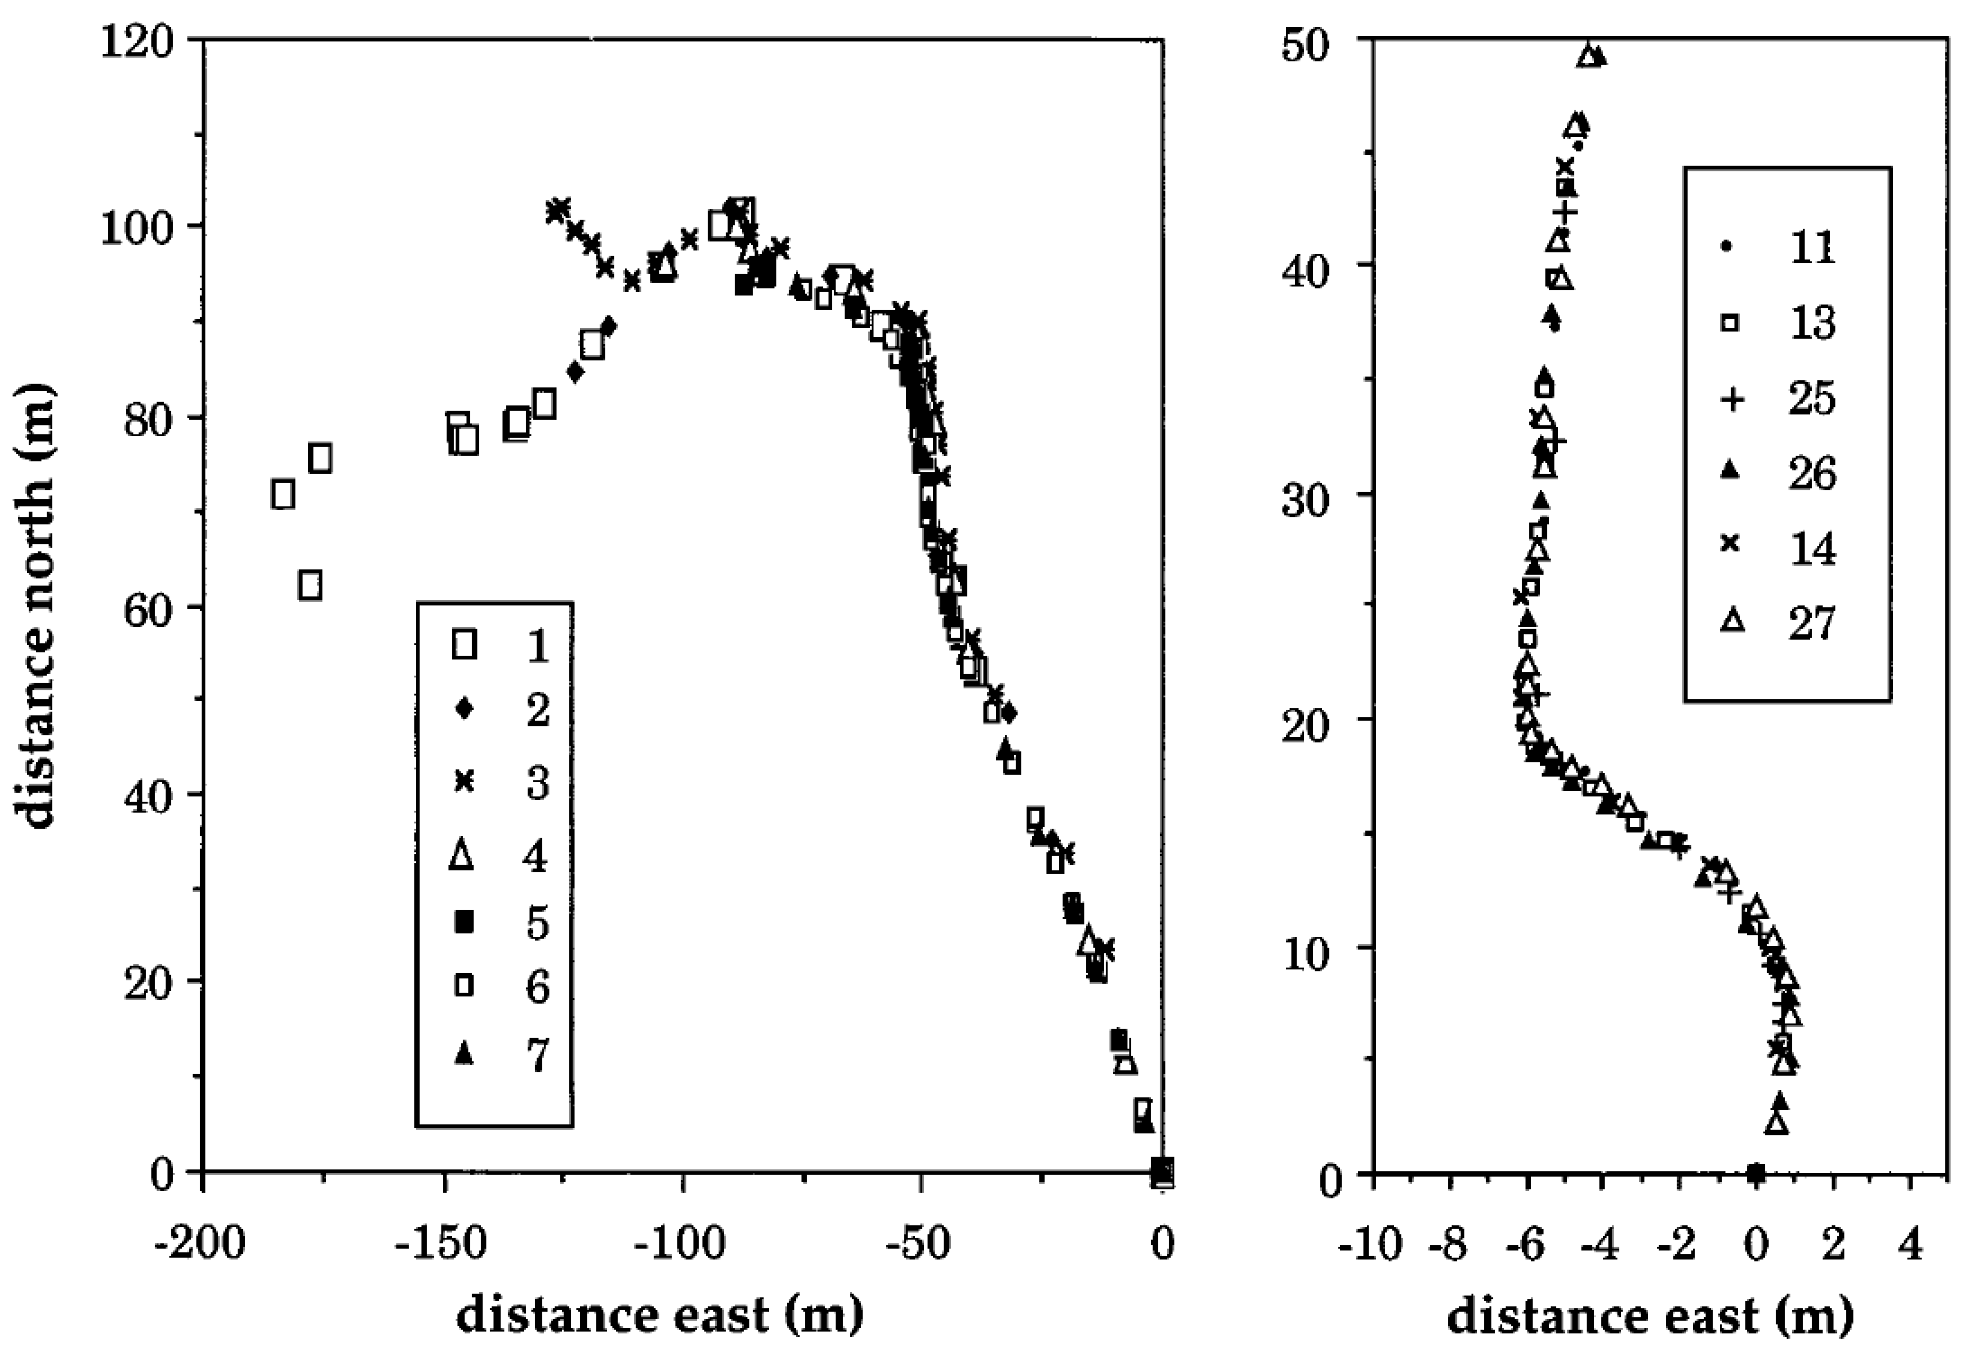
Reid et al. (1995)
Argue for ice
1980s Tracks
1992/93 Tracks
Notes:
Reid et al (1995) mapped rock trails and overlaid them on one another. They got remarkable fits, even for rocks more than 800 m apart! This must be due to ice in their view.

Slide 8
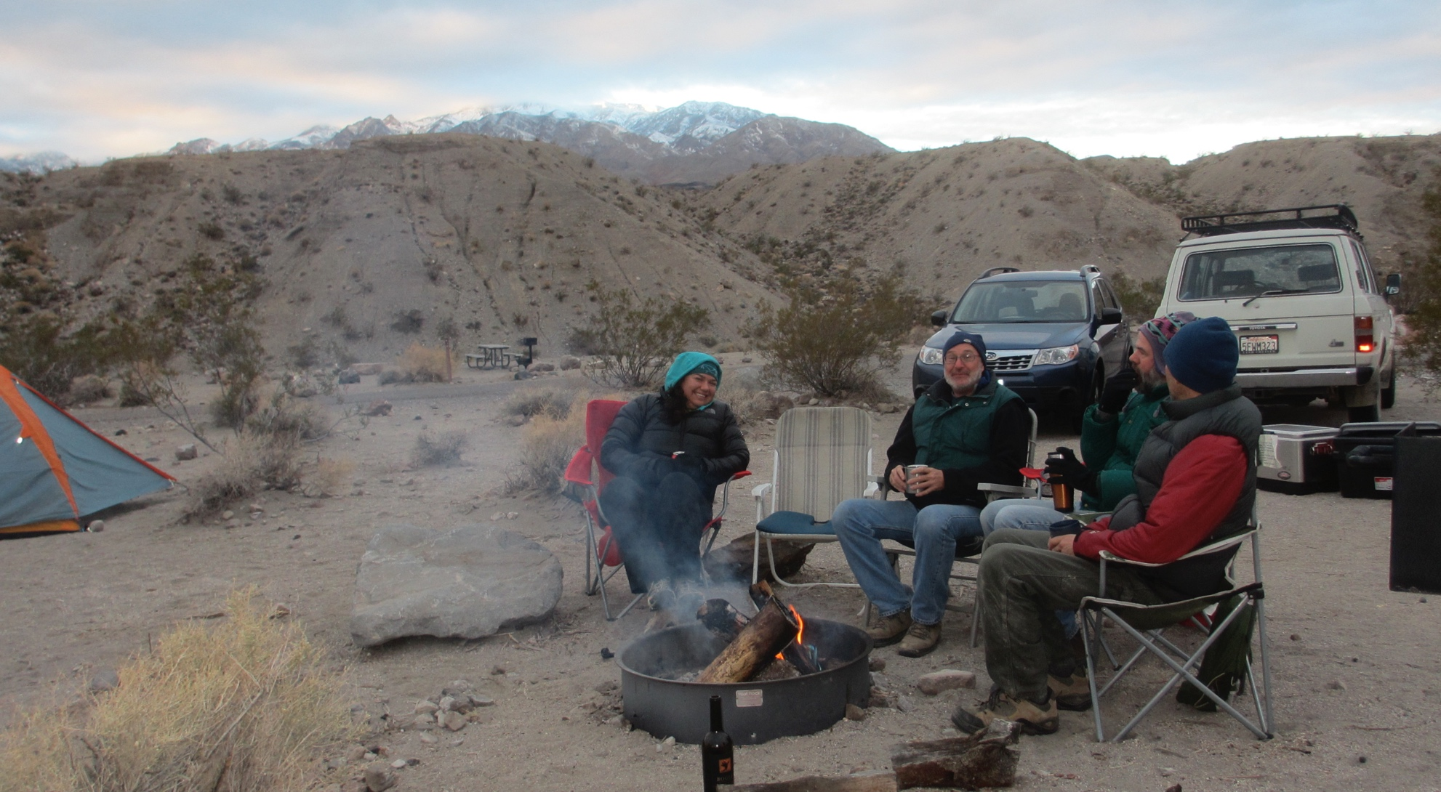
The Slithering Stones Research Initiative—an excuse to go camping
Photo by Teresa Norris
Notes:
We set up our experiment for some of the same reasons as previous researchers—a fun mystery and a reason to camp in Death Valley a lot. We got the Park to give us a permit thanks to having my cousin, Betsey and her husband Bob being former Death Valley rangers who knew the superintendent; aside from that connection, I think we would have been denied a permit since the resource staff have been frankly hostile to independent research in the park. Some park staff have told us they they would prefer not having to deal with the public at all, much less demanding researchers. But that is another conversation.

Slide 9
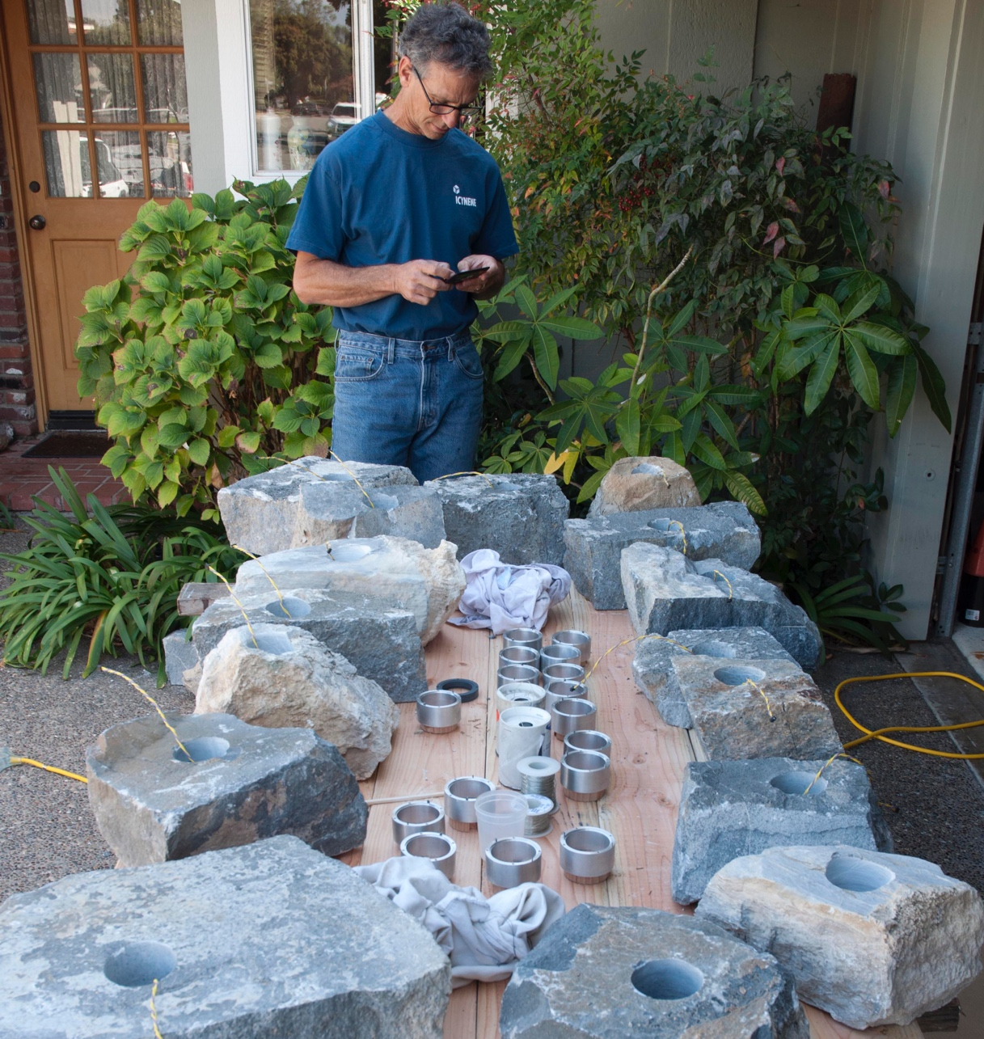
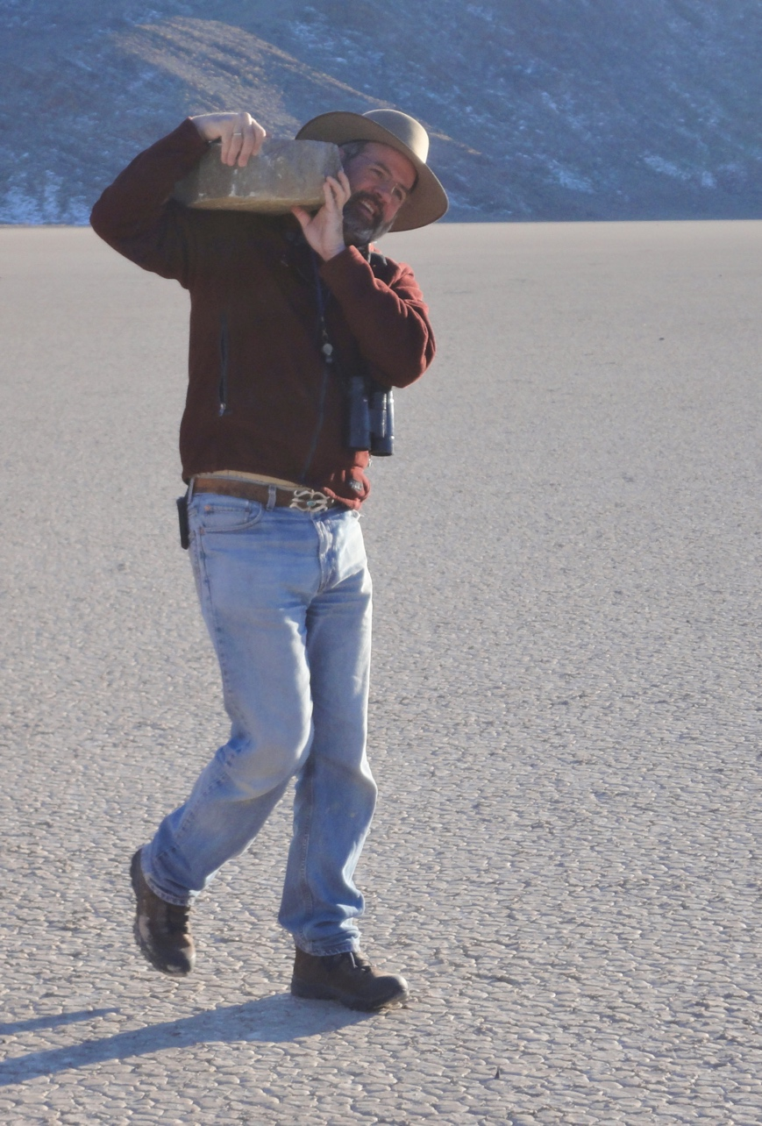
Manufacturing Instrumented Rocks
Notes:
The park would not let us instrument their stones, so Jim and friends mined their own outside the park. Furthermore, Jim knows lots of builders in Santa Barbara, and they were happy to use their concrete drills to modify the new rocks for the GPS packages. They were also happy to help hoof large instrumented stones a mile across the playa—truly a team effort!

Slide 10
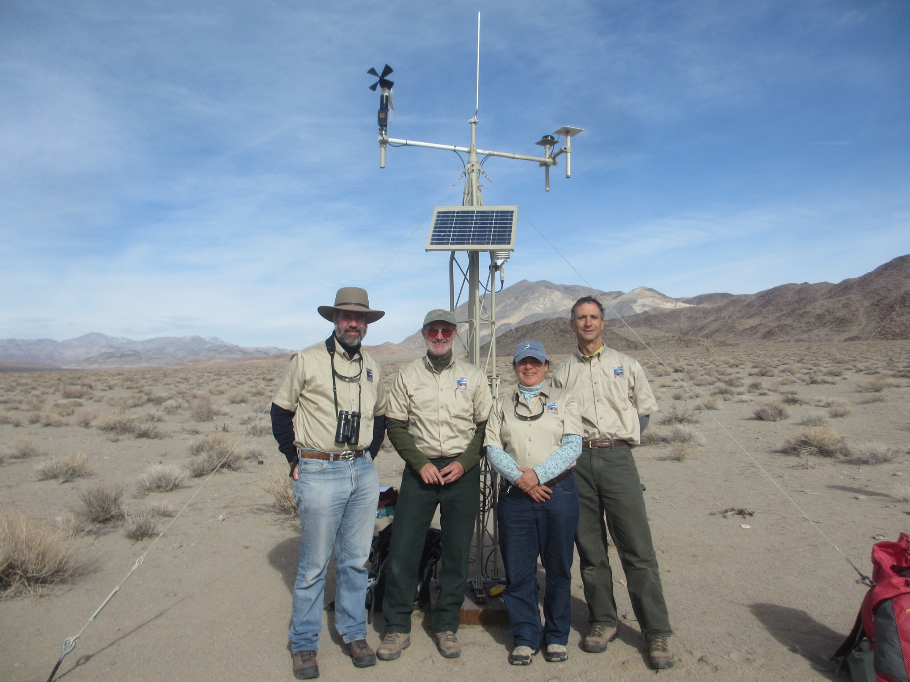
Notes:
We also set up a weather station to monitor the conditions at the time the GPS showed rock movement. The GPS rocks, of course record the time of movement, the direction traveled and the velocity—all data that could be compared with our weather records. That’s Jim second left, Teresa, my wife Teresa, and Russ Crane on the right in our SSRI swag.

Slide 11
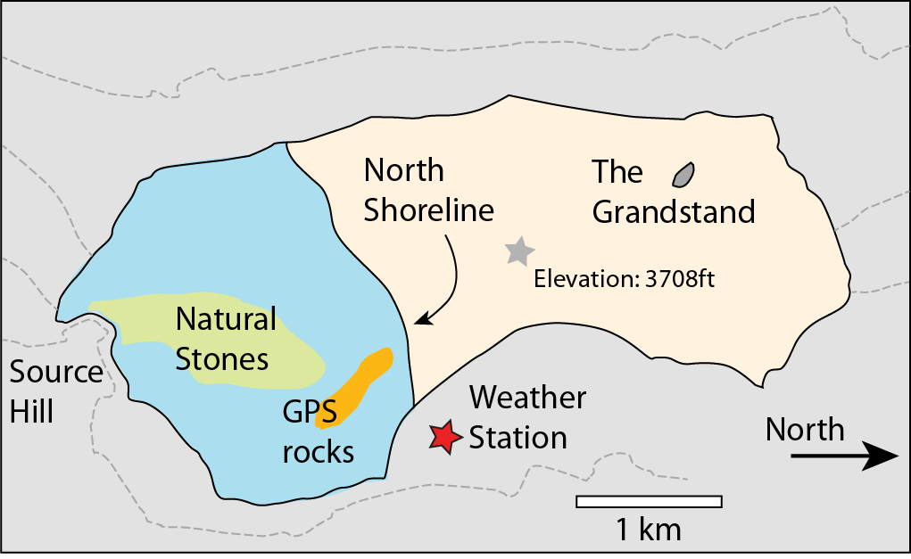
The Racetrack: Death Valley NP
Notes:
Our experiment was set up away from the natural stones. The park was concerned about the public finding our rocks and having their experience ruined by ‘non-natural stones’. People did find our rocks, but did not bug them. That was good, because lifting the rocks up would have set off a magnetic trigger that would have sent the GPS units into high data collection mode, and depleted the batteries. The fact that our rocks were out there for 1 year without disturbance shows that most of the public is very respectful of experiments in the park.

Slide 12
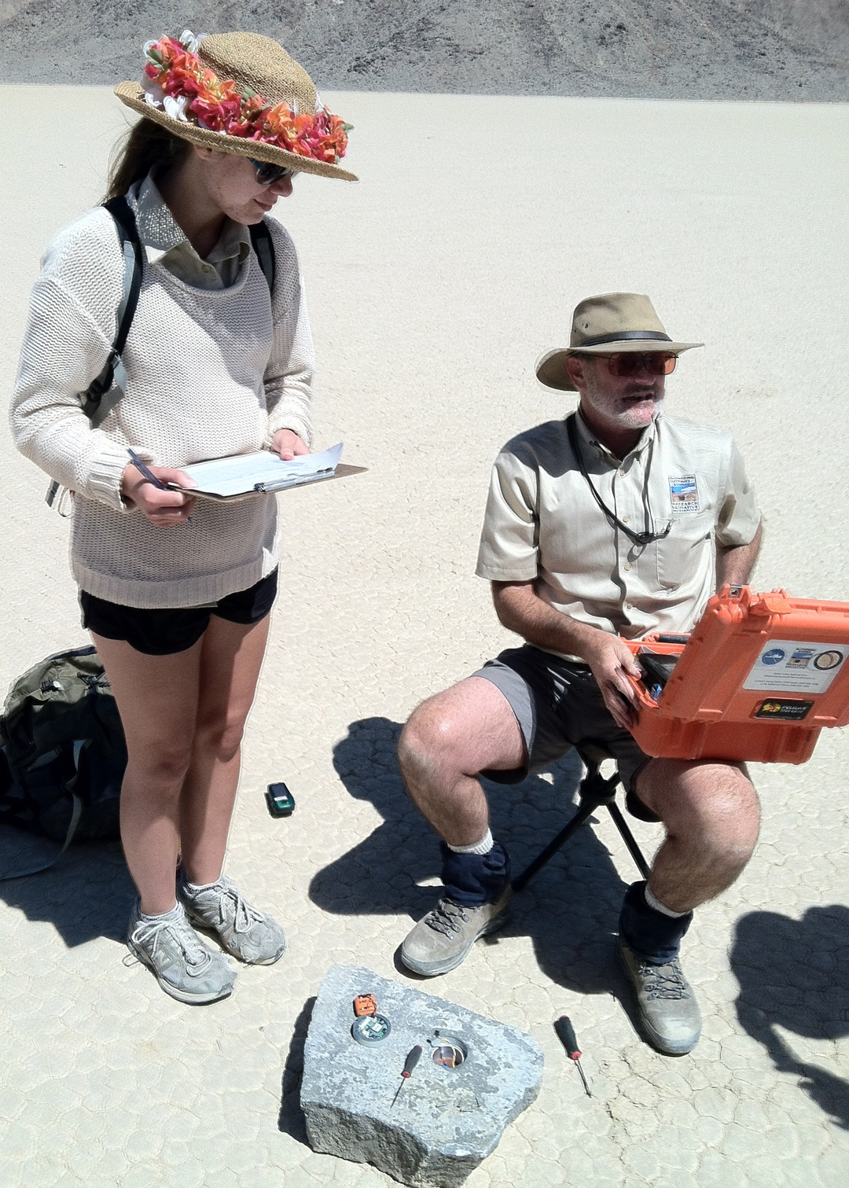
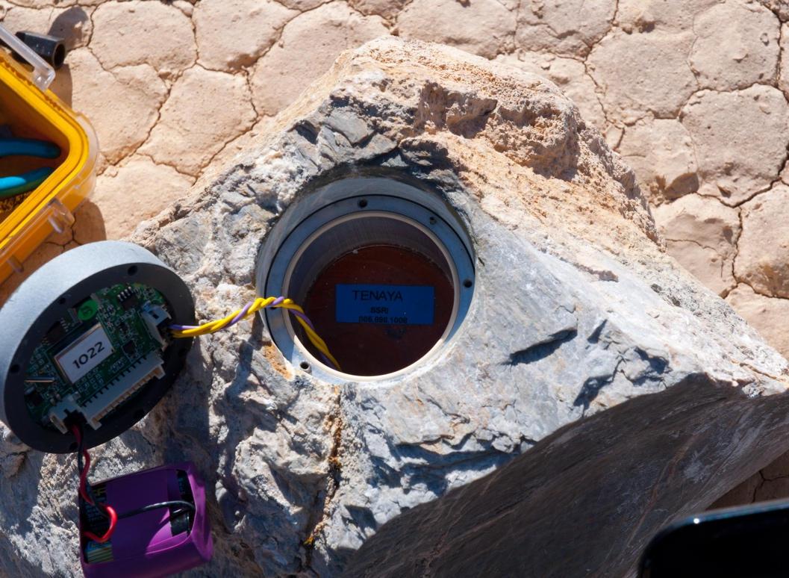
Instrumented
Rocks
Notes:
There followed 2 years of regular visits to visit the weather station, change the GPS batteries and check on the setup. The photo right shows the GPS unit, specially designed by Jim and software engineered by his business partner, Jib Ray. The GPS has a battery pack that had to be changed every couple months. In the bottom of the well is a magnetic trigger that would set the GPS unit into continuous data collection once the switch was thrown by rock movement.

Slide 13
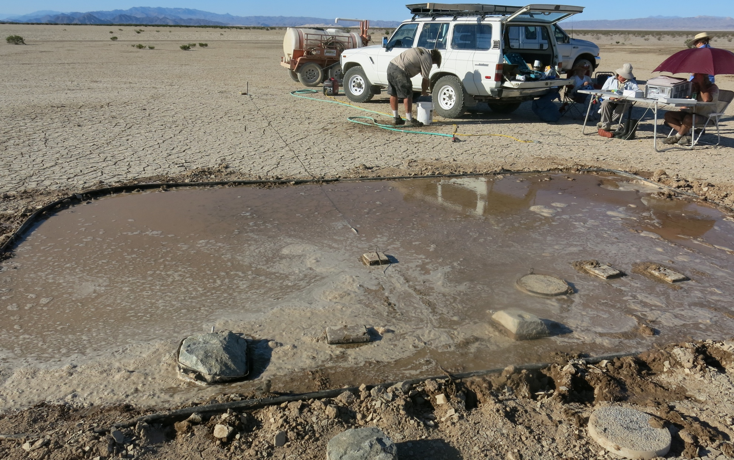
Force testing on Silurian Playa
Notes:
While we waited to rocks to move on the Racetrack, we were busy testing forces of rock movement outside the park. We towed rocks across an artificial pond made by dumping ~1000 gal of water on Silurian Dry lake. We studied both dynamic friction—the forces needed to keep a rock sliding—and static friction—the forces needed to get a rock moving. Most remarkable are the static friction tests on a damp surface; these show very high frictional forces since the rocks would stick to the muddy surface. This showed that our idea about wetting by passing thundershowers was false—there had to be a pond to get rocks in motion. We changed our expectations—now were were waiting for a pond to form.

Slide 14
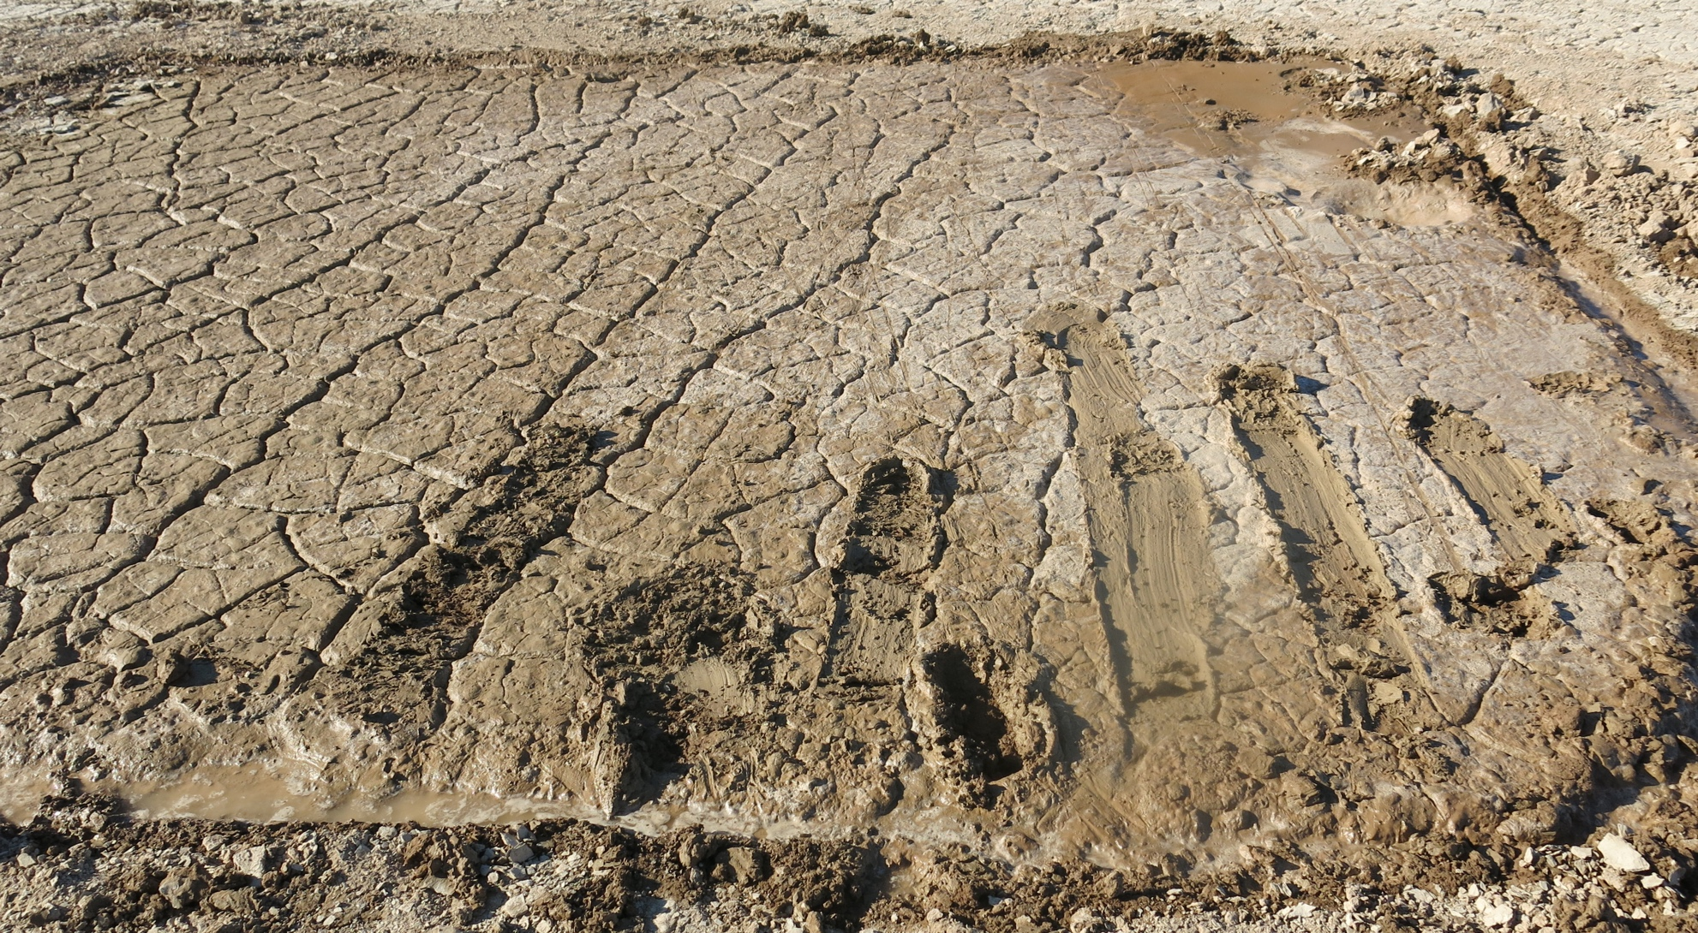
Turns out that trails only form in standing water….otherwise rocks stick
Notes:
Most remarkable are the static friction tests on a damp surface; these show very high frictional forces since the rocks would stick to the muddy surface. This showed that our idea about wetting by passing thundershowers was false—there had to be a pond to get rocks in motion. We changed our expectations—now were were waiting for a pond to form.

Slide 15
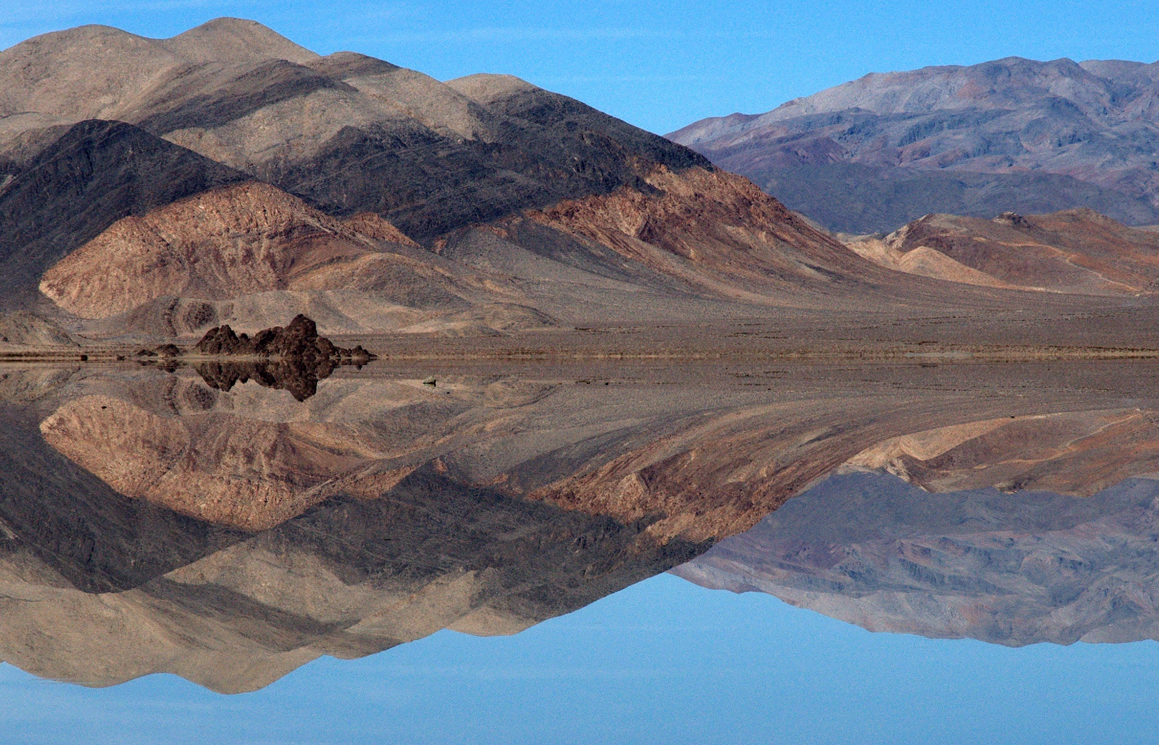
Racetrack Pond
Nov 2013-Feb 2014
Photo by Jim Norris
Notes:
About 2 weeks after the conference a regional storm deposited 2.5 inches of rain and snow-equivalent on the playa forming a pond. About 10 inches of this was snow, not recorded by either our weather station or the nearby Hunter Mt RAWS station. Fortunately, Ralph Lorenz had time lapse cameras recording conditions on the Playa—captured the snow depth.

Slide 16
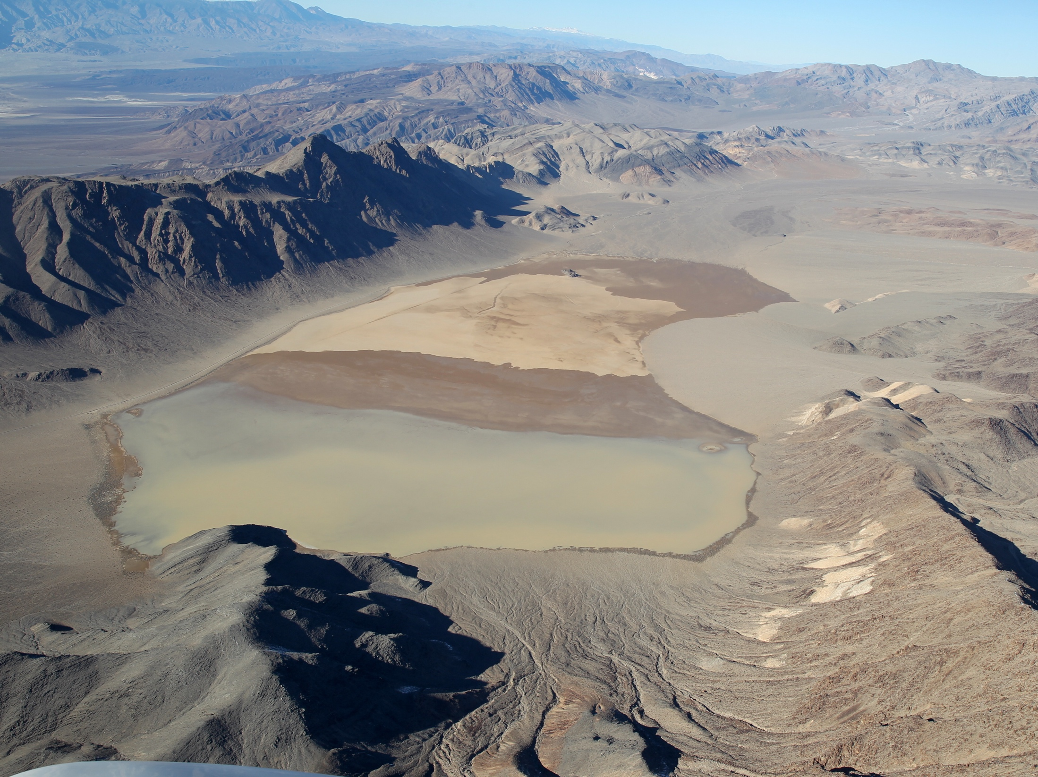
December 26, 2013
Photo by Mike Hartmann
Notes:
From the air, the playa was flooded on the southern end.

Slide 17
Conditions during rock movement
Notes:
Our weather record shows what happened next. There were several rock moves after cold snap; the first on Dec 4 recorded by GPS stones, the next two events on Dec 20-21 when Jim and I, by luck, were there in person, and a later event in Jan 9, when Jim, Betsy and Ralph Lorenz all turned up to see the action. There were a series of winter storms recorded by gusty conditions (winds ~5 m/sec) and cloud cover (low insolation). During the cold period between Dec 4-10, it appears that thick ice formed since we later found remnants of this in shadowed areas around the pond.

Slide 18
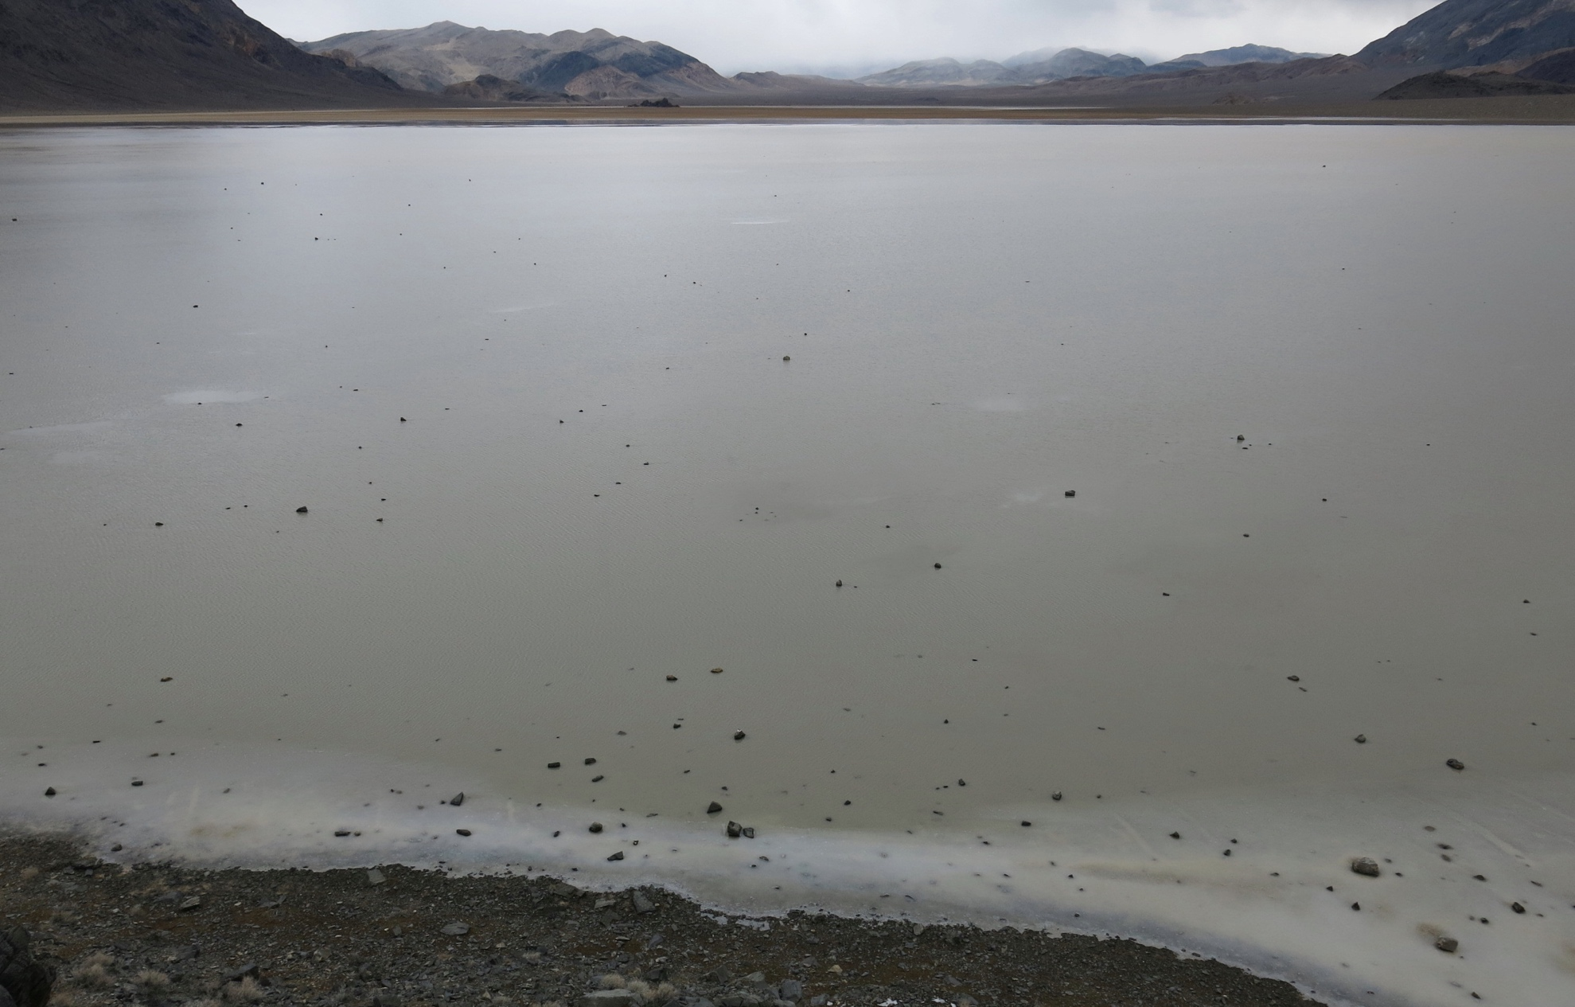
December 19…a snowy day
Notes:
Jim and I arrived the evening of Dec 18 to find a 7.5 cm deep pond with a 3-4 mm thick skim of ice on it. We were excited to finally see what ice does to the playa. However, the next day (the 19th) it snowed and the ice never broke up.

Slide 19
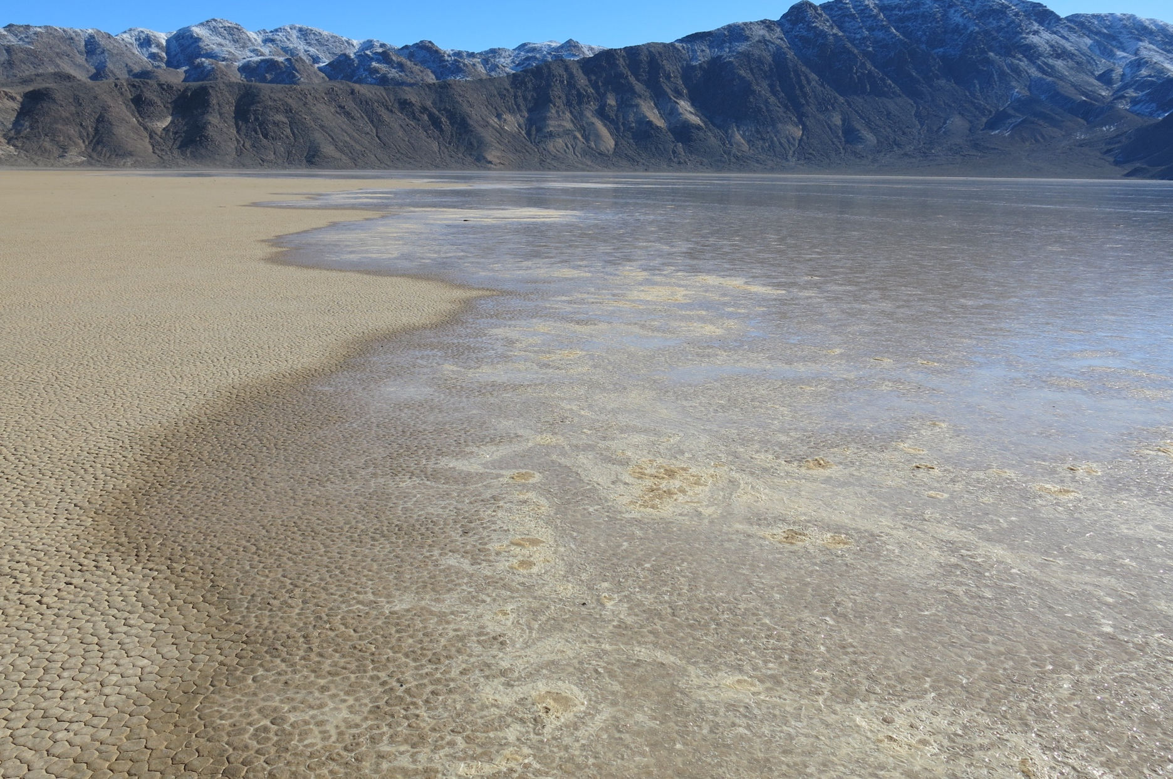
Winds blow pond onto the low-gradient north shore
Notes:
So the next day we decided to work around the north shore of the playa pond and visit the weather station. While were were there, a light wind began to blow and liquid water advanced over the north shore at ~60 cm/minute. We also noticed ice piles forming off shore.

Slide 20
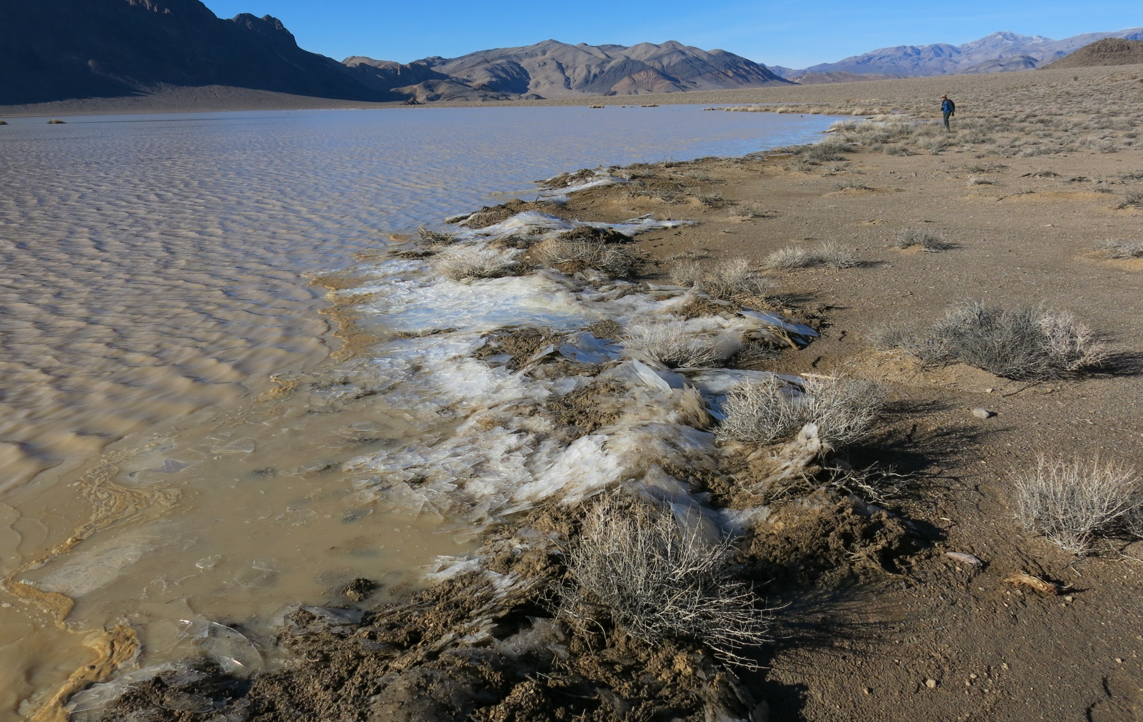
Ice-Push makes shoreline mud piles
Notes:
Walking around the pond, we found ice piles that had shoved mud and rocks onto the shoreline.

Slide 21
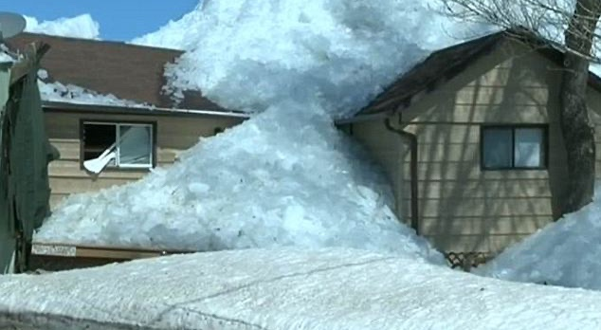
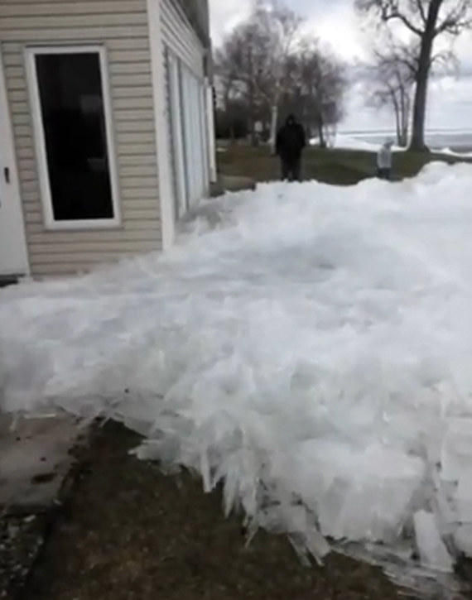
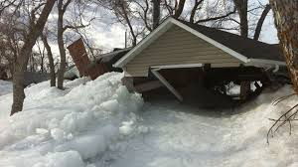
In Great Lakes, ice-push is a problem

Slide 22
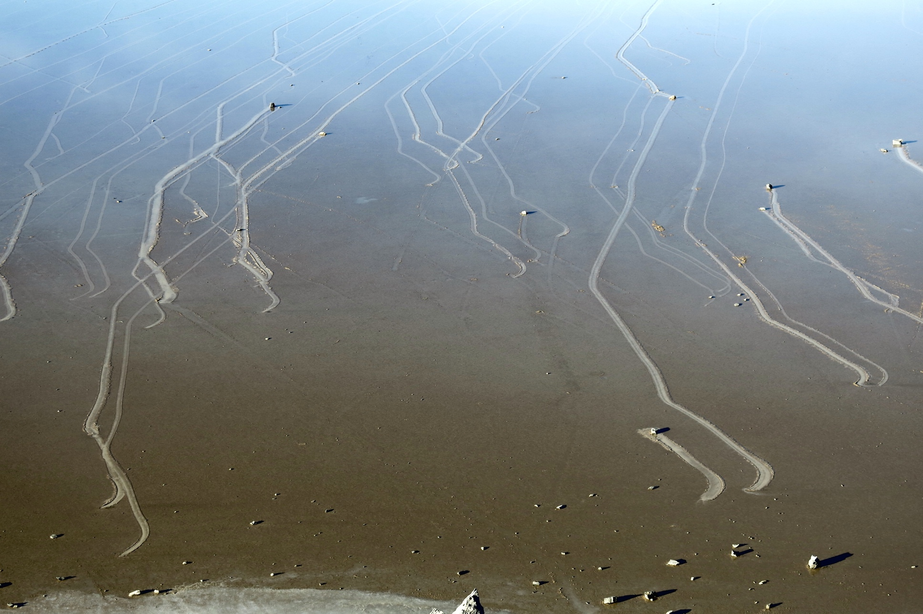
The December 20, 2013 move event
Notes:
By the time we made it to the source hill about 3 pm, the wind had blown the water to the north exposing ~70 rock trials. These were clearly brand new. We were kicking ourselves for missing what might be the first big rock move in a decade!

Slide 23
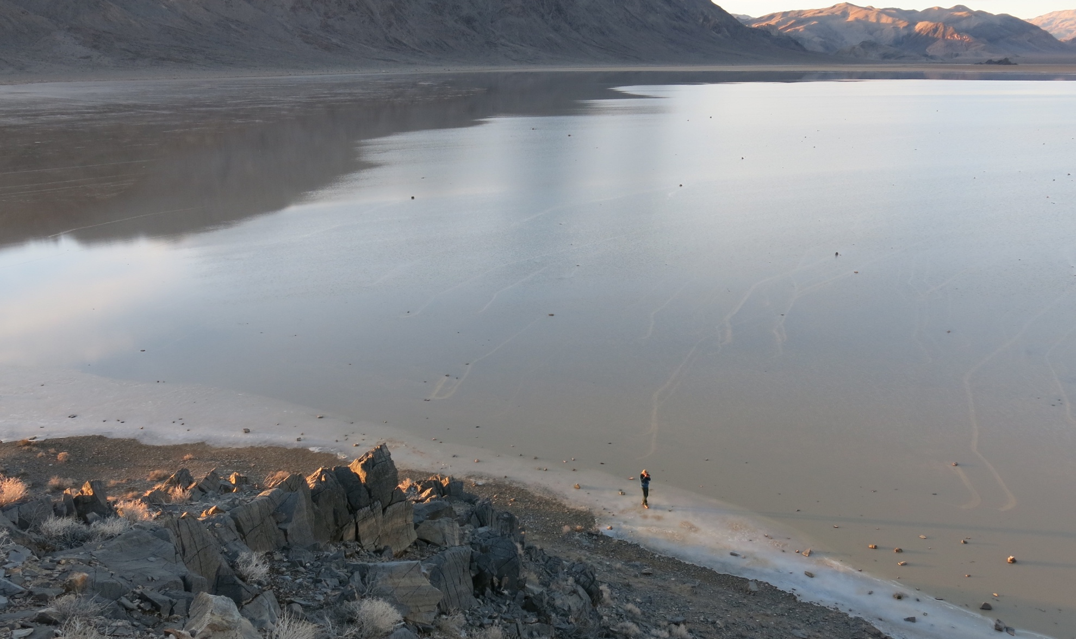
By late afternoon the wind slackened
Water refilled the pond edge
Notes:
By 4 pm the wind stopped and the pond re-flooded the area around the new rock trails.

Slide 24
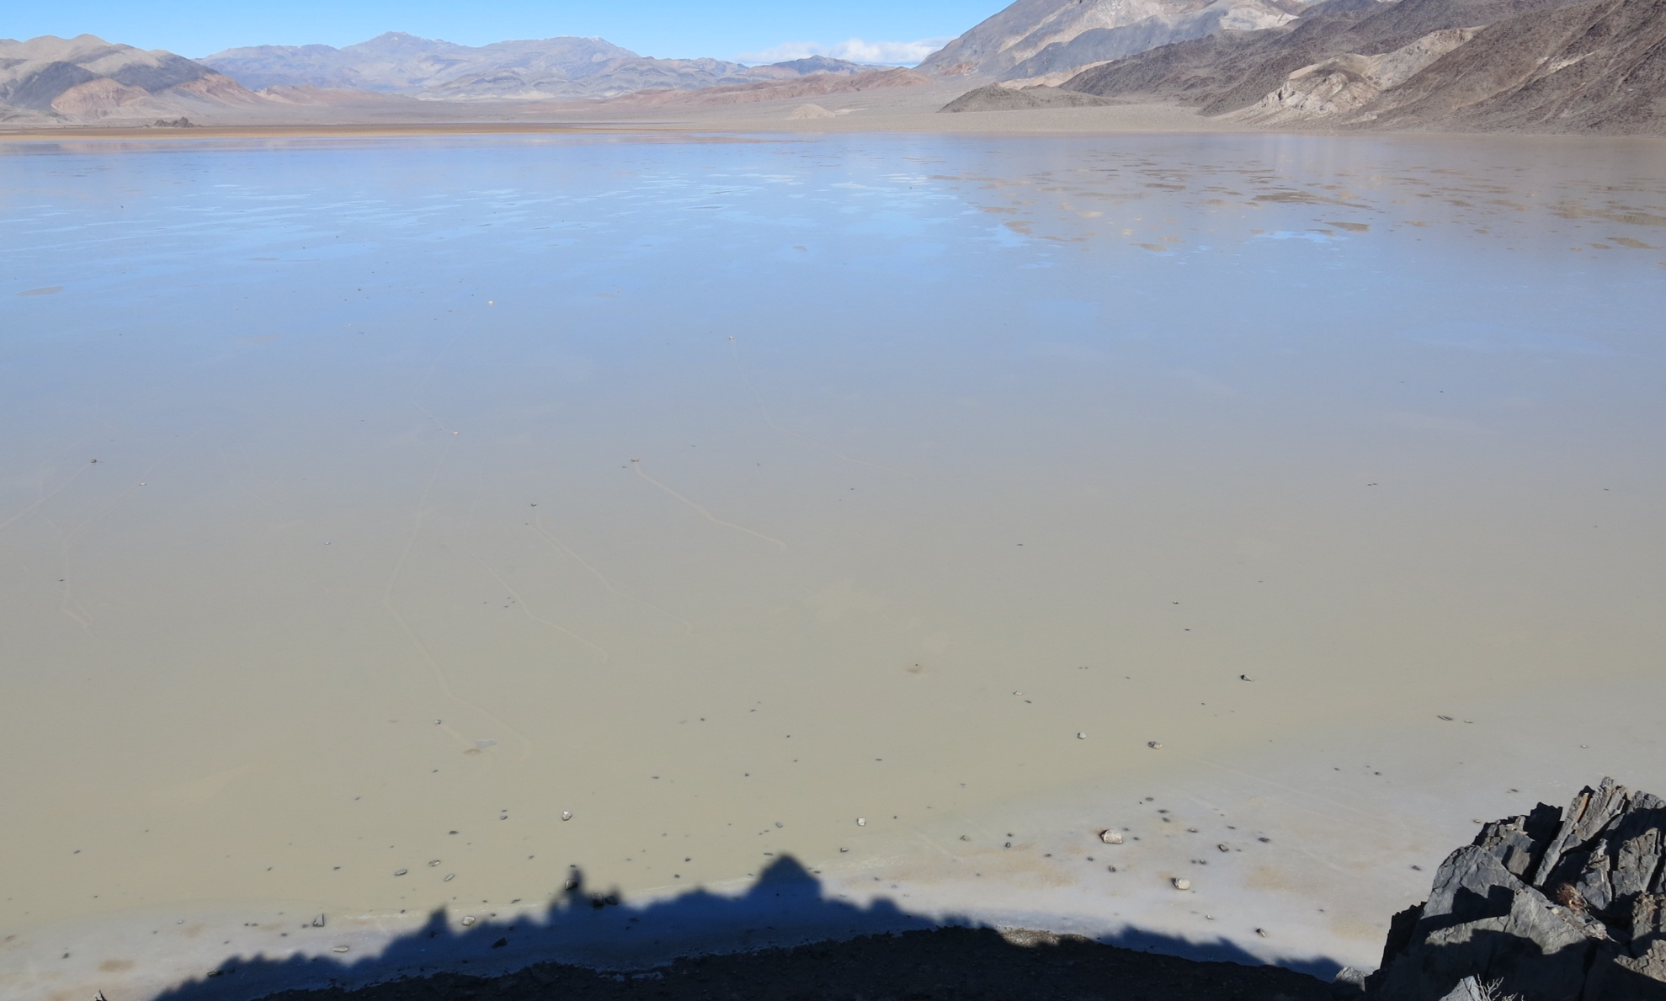
Dec 21, 2013
Early Ice breakup—a few melt ponds
Notes:
Although we had run out of food and it was Jim’s birthday, we decided to stay another day to hopefully see the process in person. Here is the scene at ~10 am; melt pools are starting to form and there is a light wind under sunny skies.

Slide 25
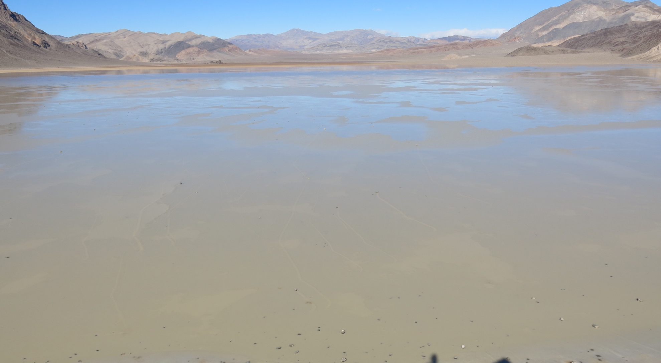
Dec 21, 2013
Late ice breakup, large leads are forming
Notes:
Bu 11:57 am, there was ice breakup with popping noises from across the ~1 km wide ice sheet. Leads of open water began to open and rocks began to move. The north shore was nearly completely ice free and water was blown, again onto that shore, displacing the floating ice to the north.

Slide 26
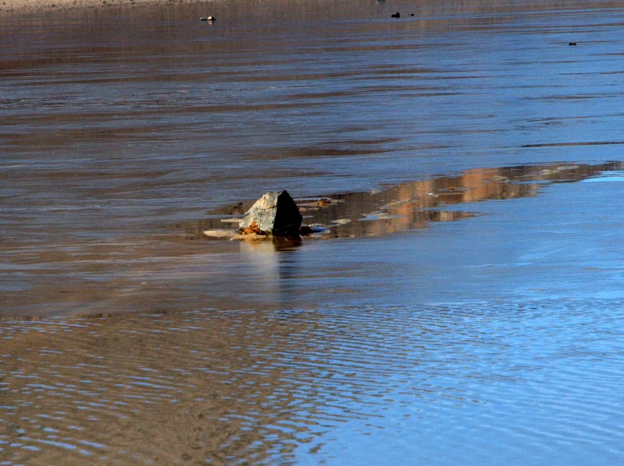
Notes:
Ice panels began to tear past stationary and moving rocks; a problem was that rock movement was so slow that it was hard to document movement.

Slide 27
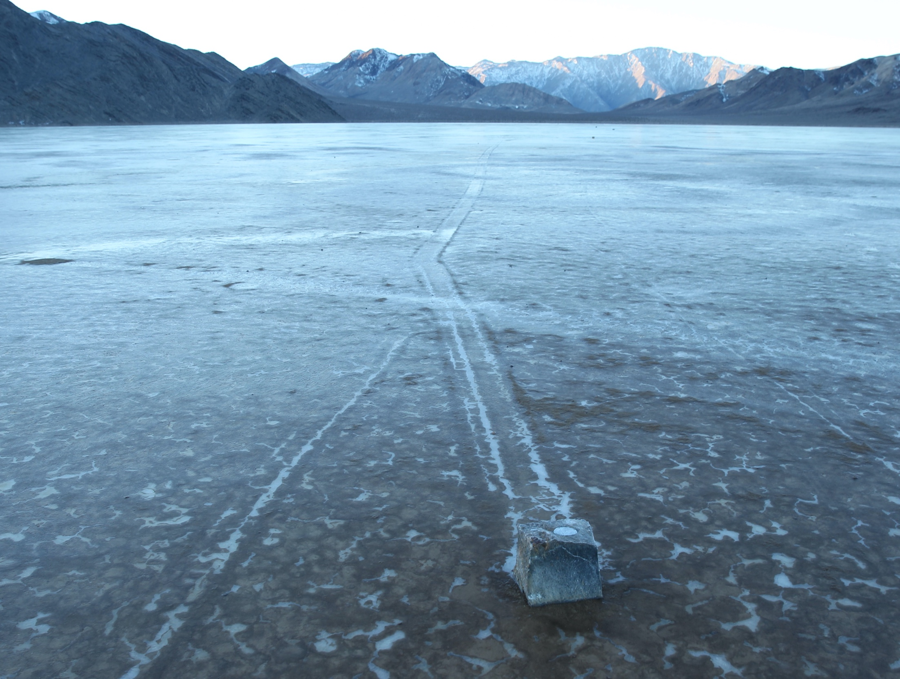
Photo by Mike Hartmann
Notes:
Our GPS stones also moved. This one traveled 224 m in several distinctive move events. The first 70 m of movement was captured by our GPS unit in the stone, but then the batteries were depleted for later moves. One problem was that the rocks were surrounded by water and mud, so we could not get to the GPS units to download the data. Jim and Russ solved this by putting on crampons and walking out to the stones in the wee hours of the morning before the ice melted.

Slide 28
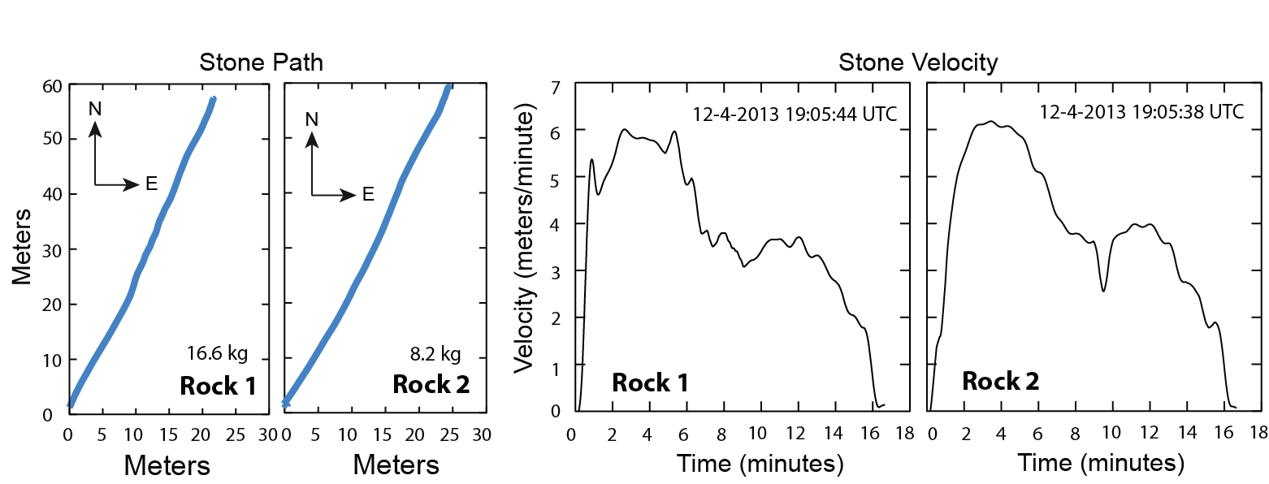
Rocks move together, but at a snail’s pace
Notes:
Here are two Dec 4 moves by rocks 153 m apart. They follow identical tracks for ~69 m, and do so at similar speeds. Remarkably, both rocks start moving within 6 seconds of each other, at ~11:05am—just an hour before noon. They creep along.

Slide 29
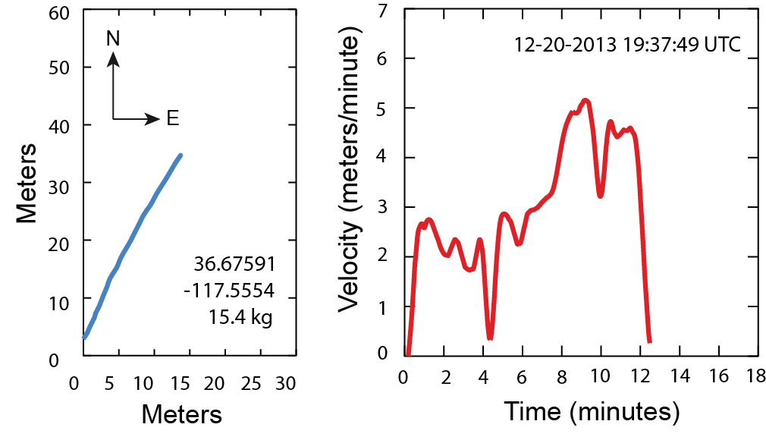
Happens again on Dec 20, 2013
Notes:
Another move was recorded on Dec 20 when we missed the big event. This rock travels for only 12 minutes, and nearly stops 4 minutes into the move. These data show that rocks do not move for long; if you are not vigilant, moves are very easy to miss.

Slide 30
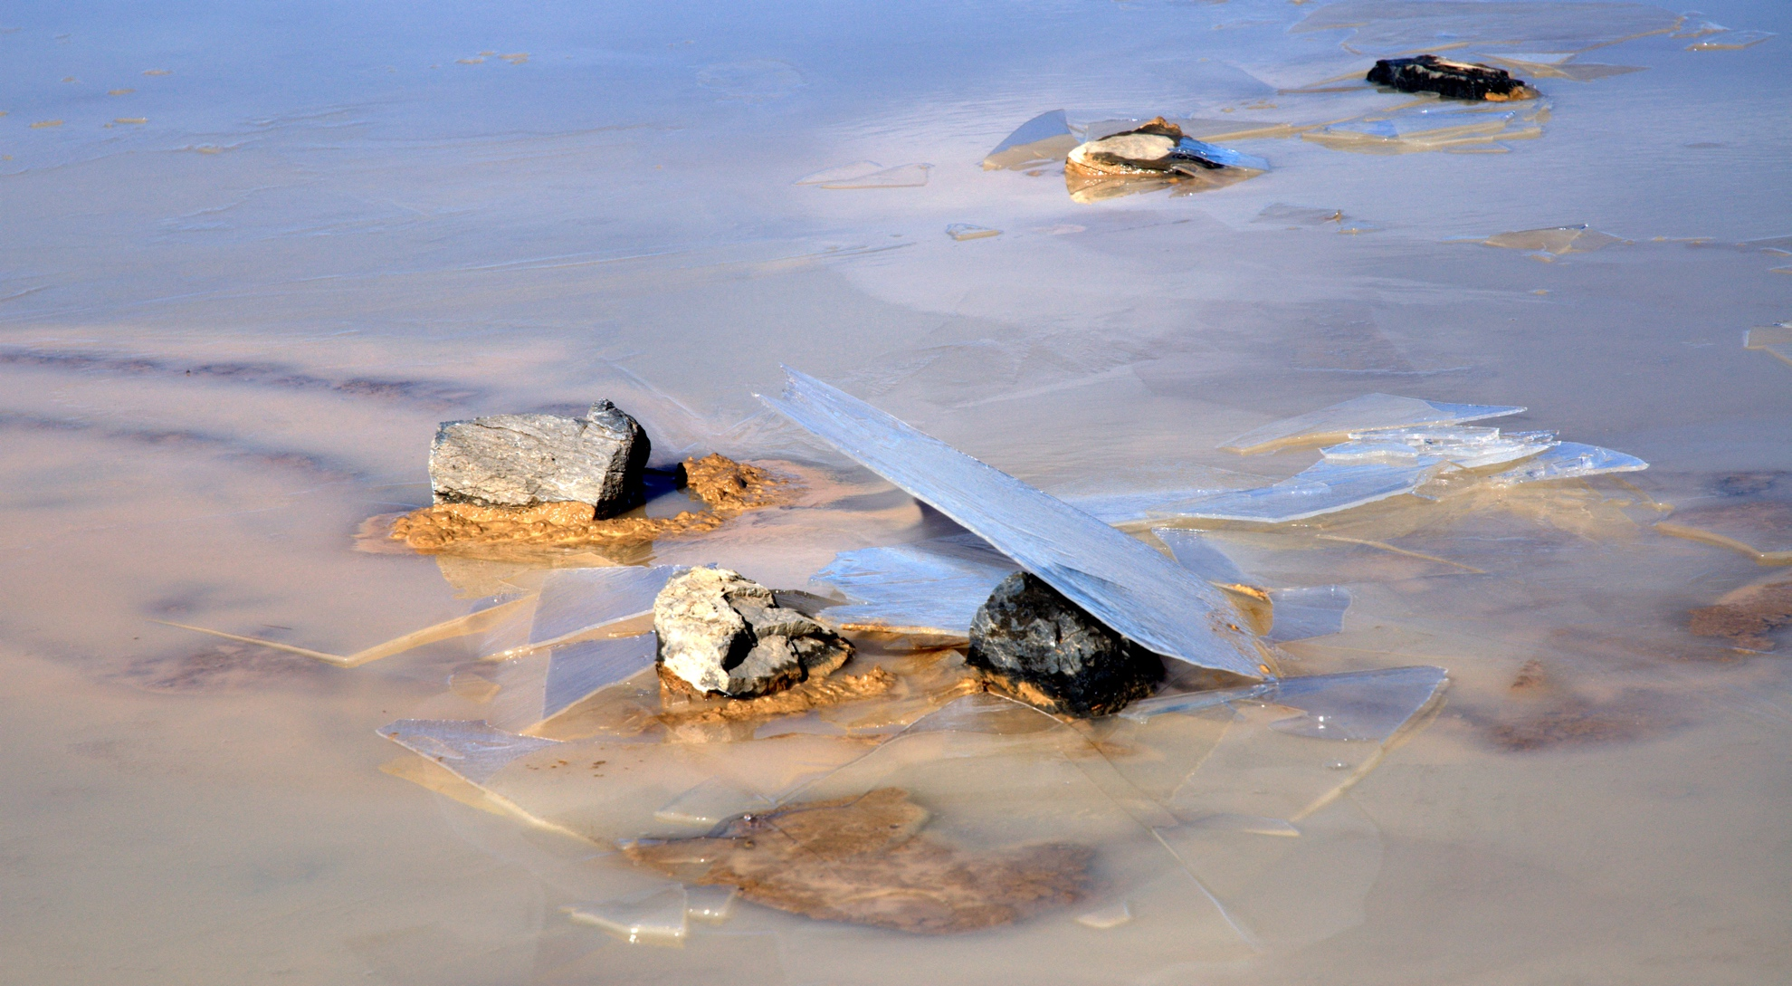
Rocks are moved by thin ice
Notes:
The ice involved is very thin and clear as glass. These rocks have all been shifted a few meters by ice, with the trials visible under the muddy water. The water is shallow enough (a few cm) that the mud levees are shoved up under the ice, flattening the tops of the levees.

Slide 31
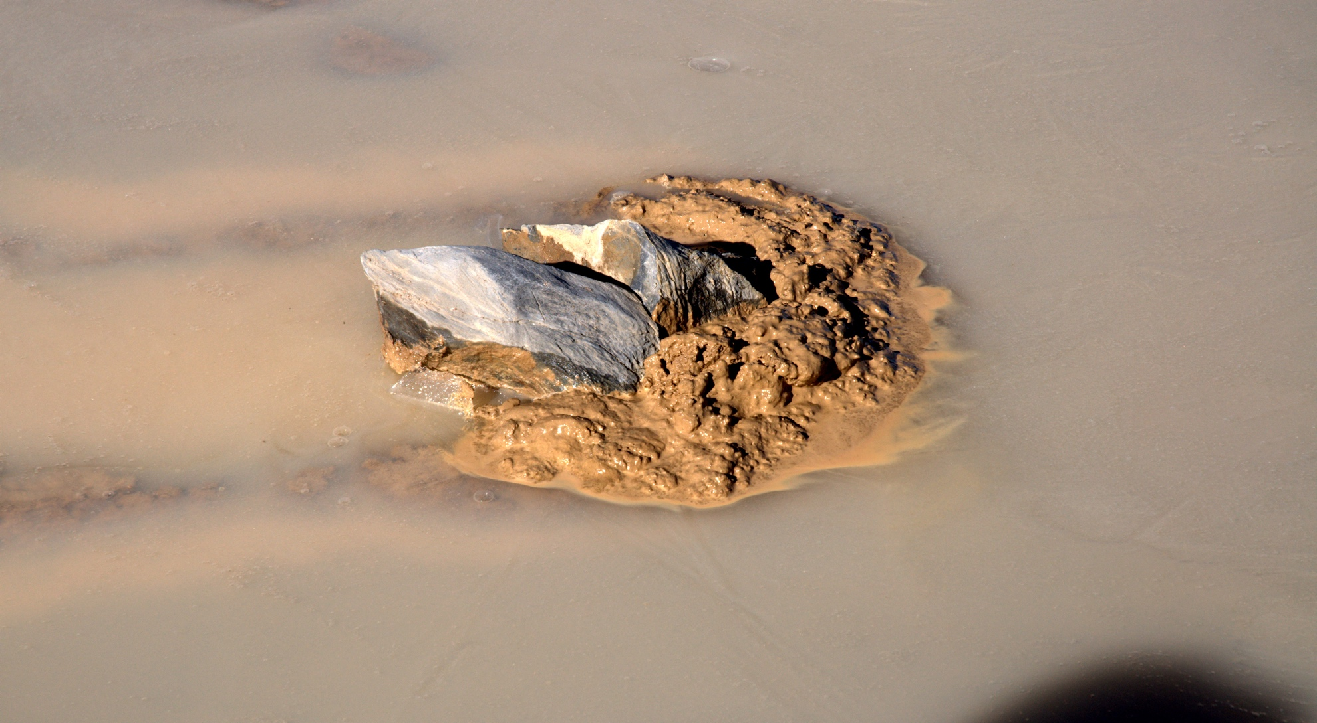
Even rock fragments move together
Notes:
This rock is one of many fractured by pervasive freeze-thaw, yet the two haves have moved together forming a trail (left) and mud pile (right). We think that rocks must be destroyed significantly when ponds are in existence since the ponds endure free-thaw cycles every day.

Slide 32
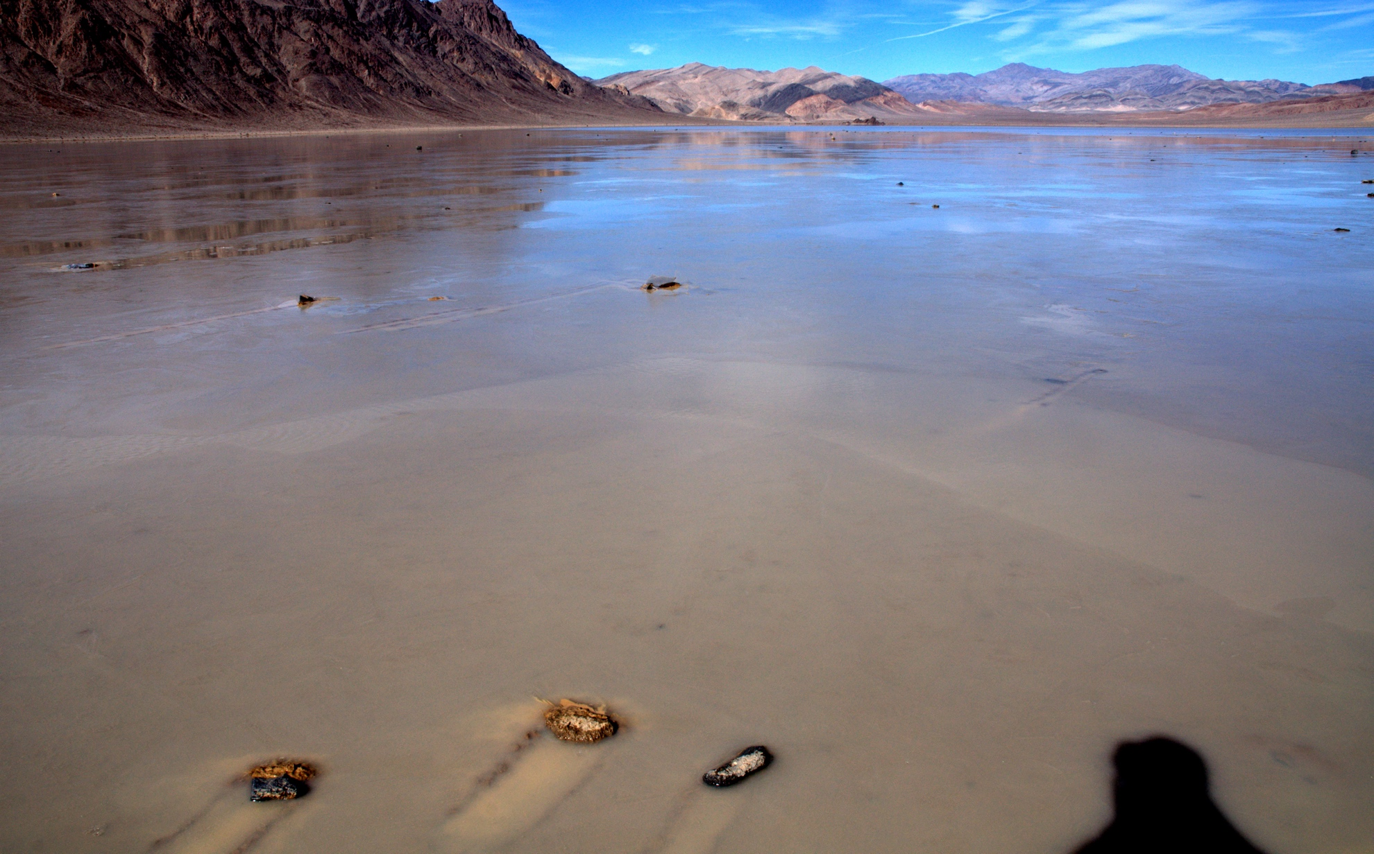
Start of Jan 9 2014 move… leads are opening
Notes:
On Jan 9 we see that leads opened near shore.

Slide 33
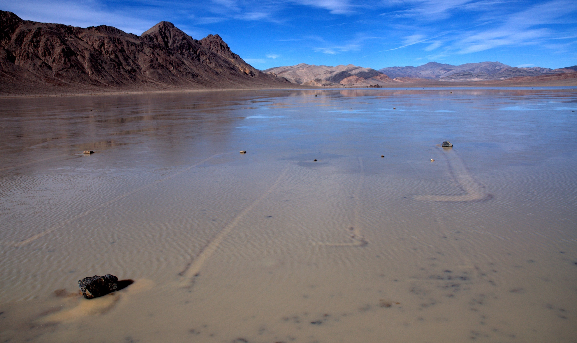
Later on Jan 9…
Ice has moved offshore
Notes:
These leads enlarged forming areas of open water but the floating ice pulled rocks away from the shore.

Slide 34
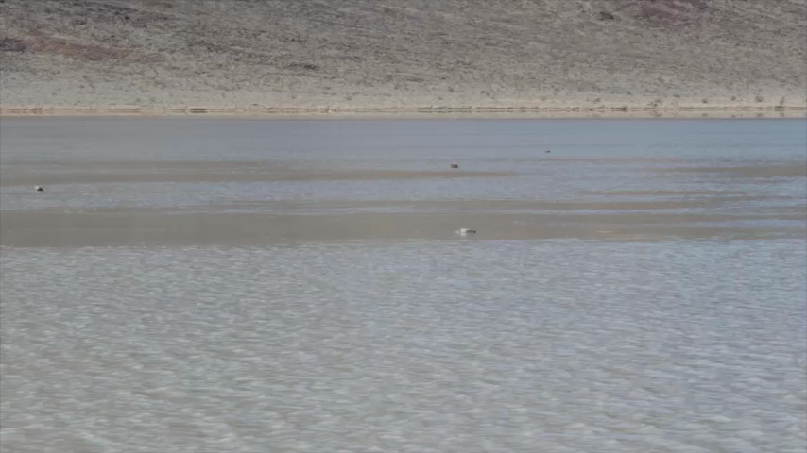
A Moving Rock
Notes:
Late in the Jan 9 move, Jim thought he detected a moving rock and took a series of still shots. I pieced them together to make this video.

Slide 35
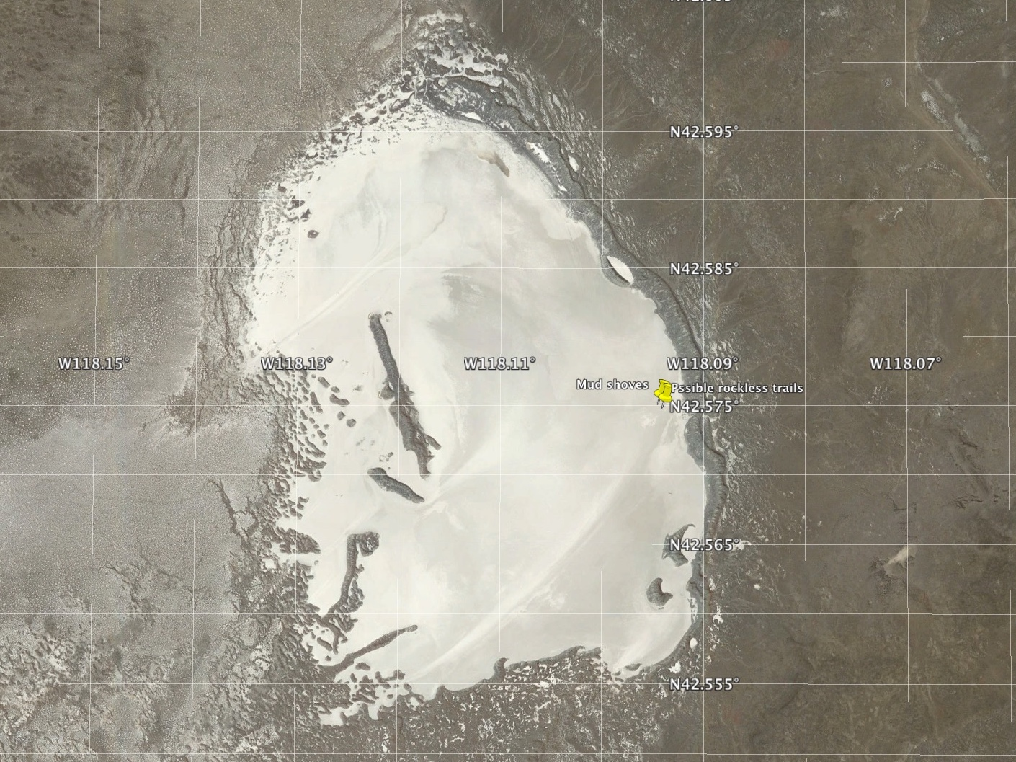
Coyote Lake, Oregon

Slide 36
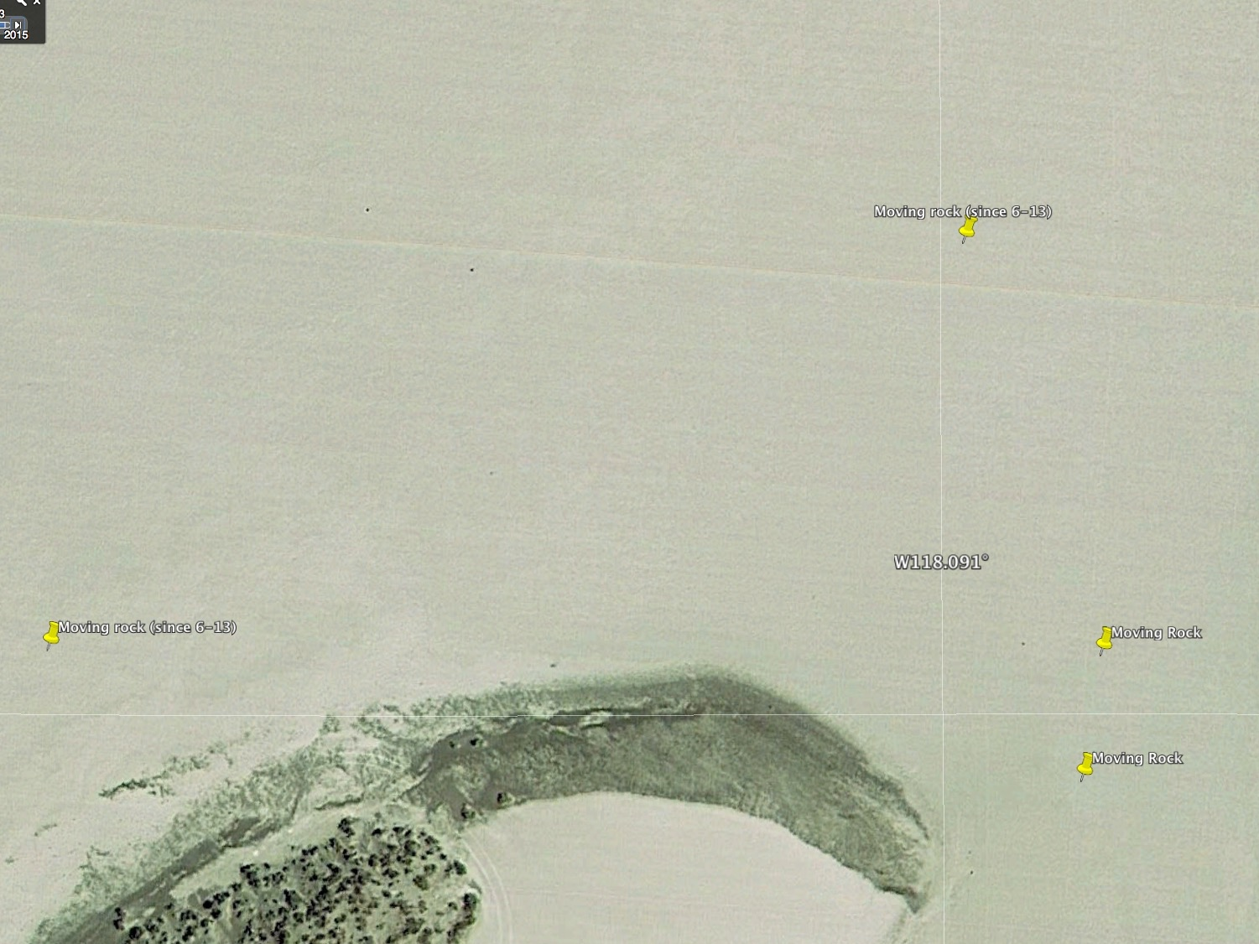
June 2013

Slide 37
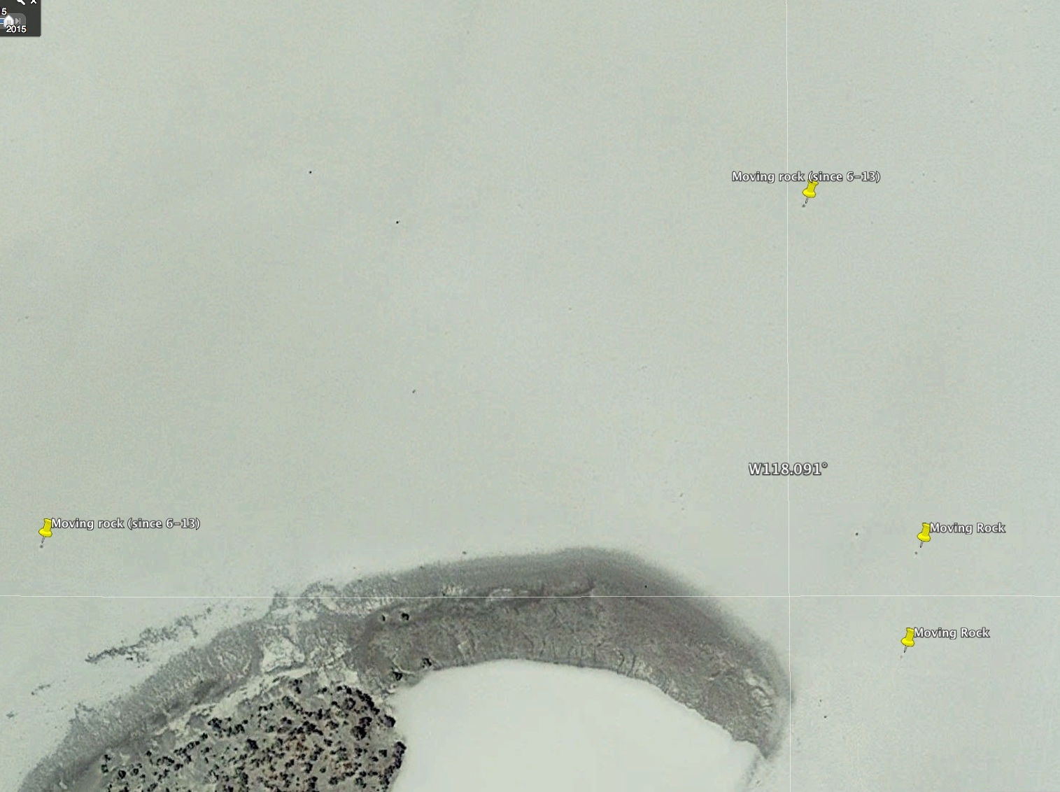
July 2015

Slide 38
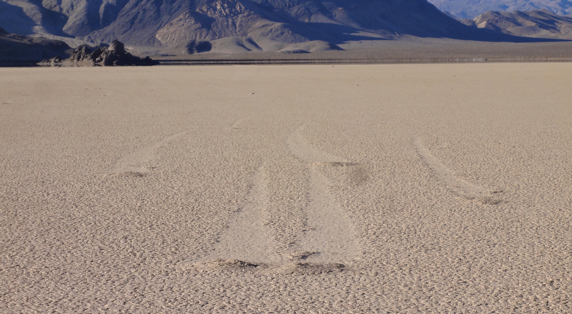
But there are still mysteries:
(1) hundreds of ‘rockless’ trails
Notes:
A remaining mystery is the origin of ‘rockless trails’. We think these are caused by mini-ice bergs, but the
Park staff sear that people steal their rocks. Still there are hundreds of these trails on the north shore of the Playa pond. This is a common phenomenon, by whatever mechanism.

Slide 39
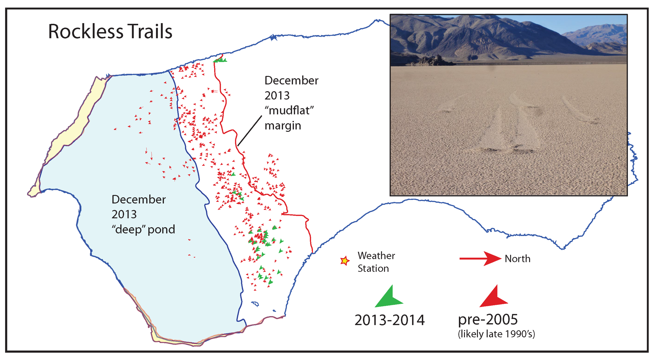
Rockless trails associated with pond edge

Slide 40
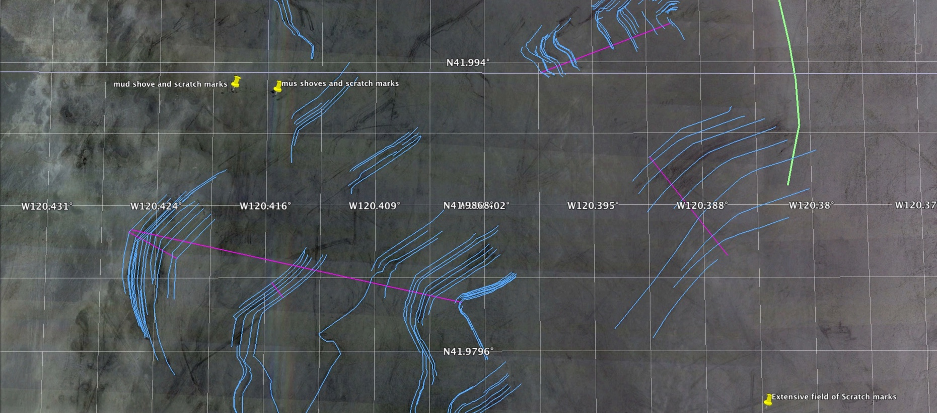
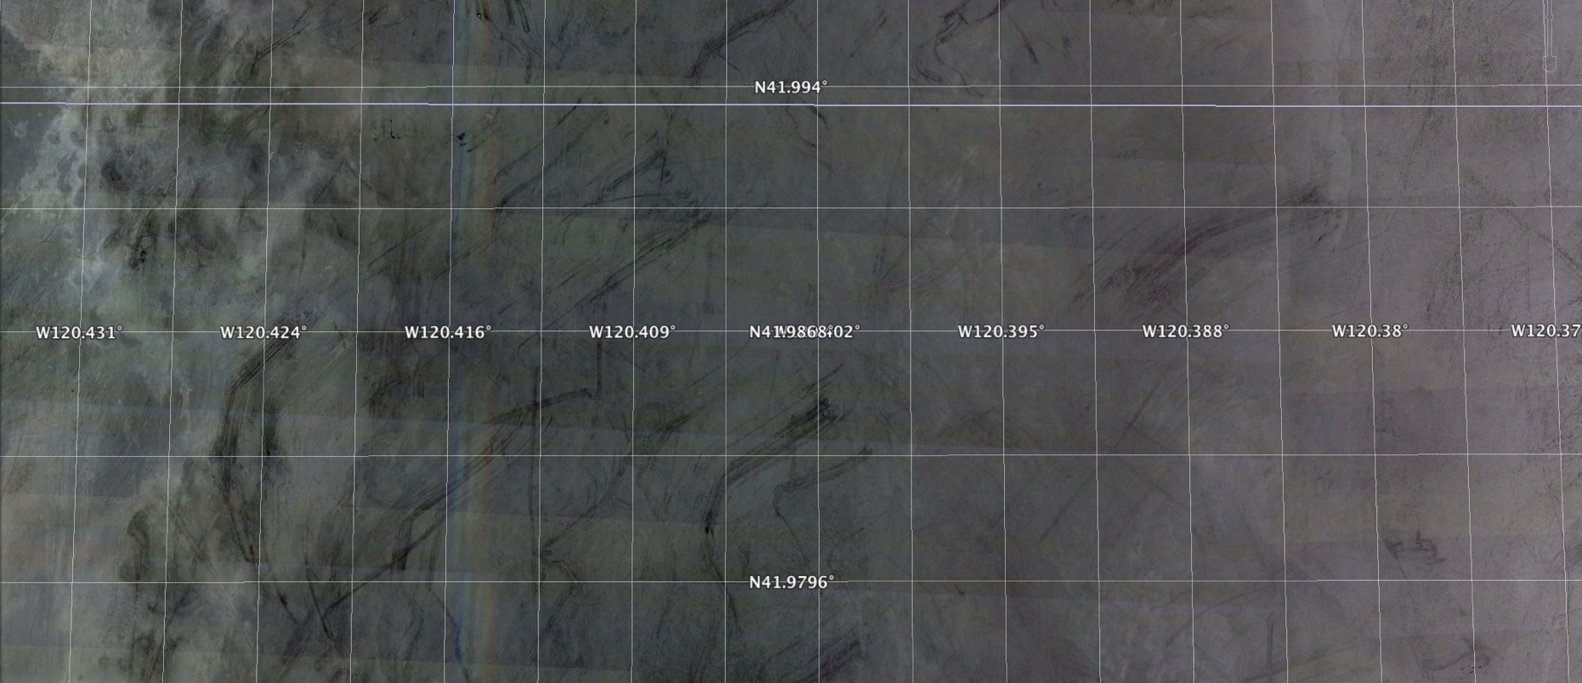
1 kilometer
(2) Goose Lake, California
1 kilometer
Notes:
1 km

Slide 41
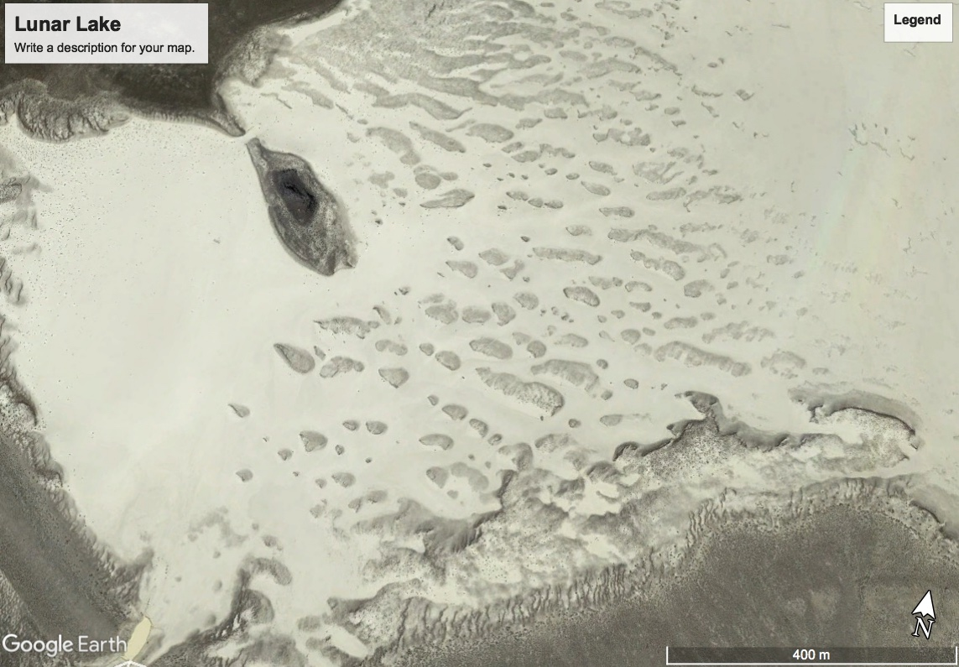
(3) Lunar Lake ‘Dunes”

Slide 42
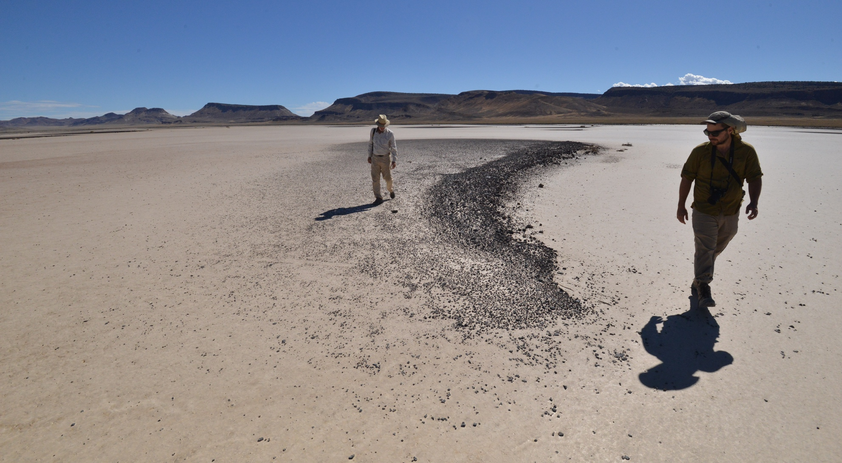
Rock “Dunes” on Lunar Lake, Nevada

Slide 43
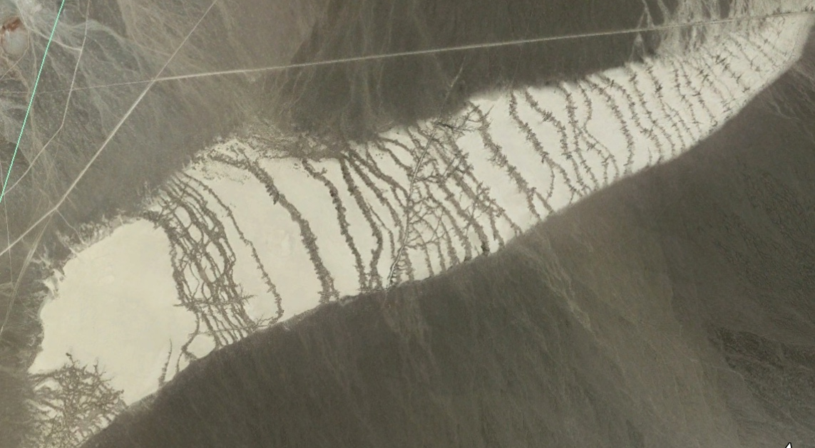
(4)”Tiger Stripes”, W. Nevada

Slide 44
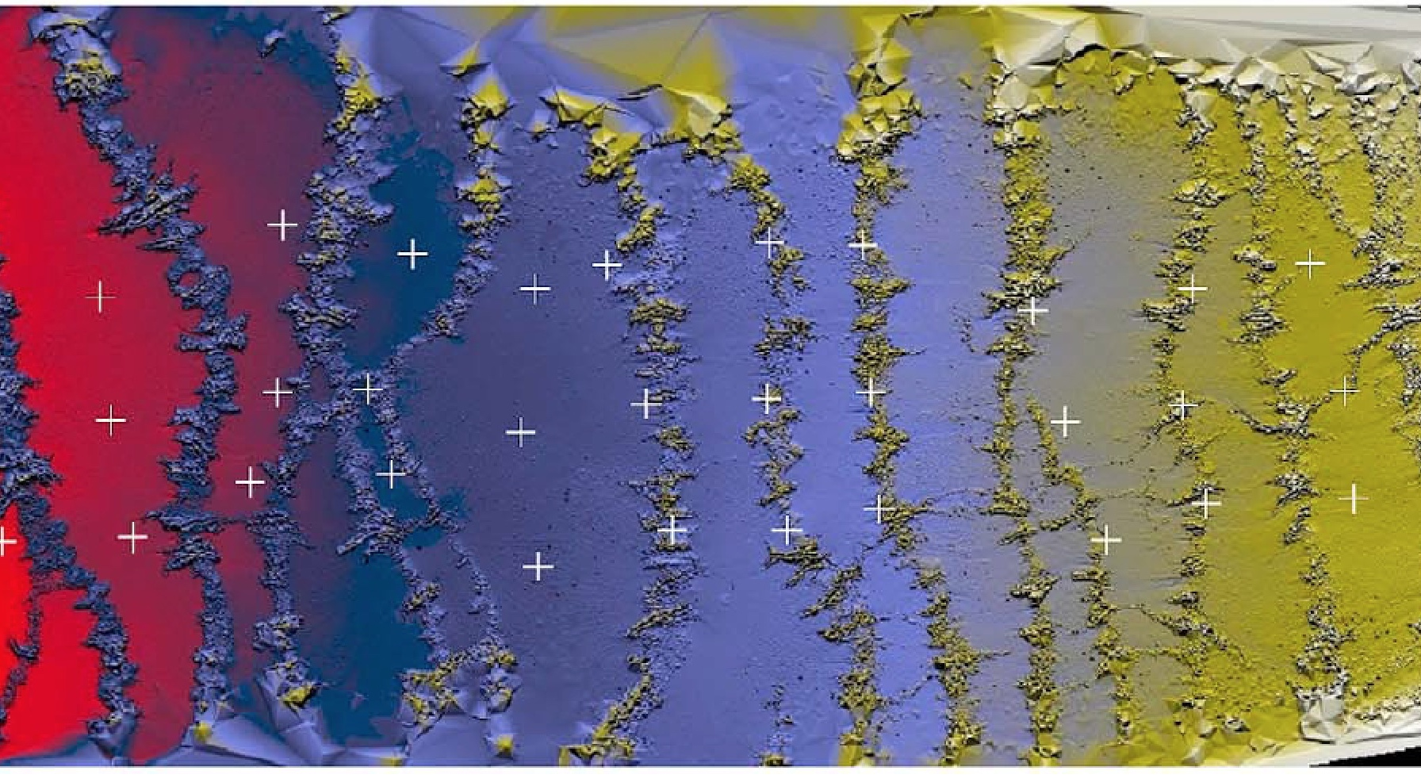
“Stair-steps” on Tiger Stripe
Pelltier et al. 2012.

Slide 45
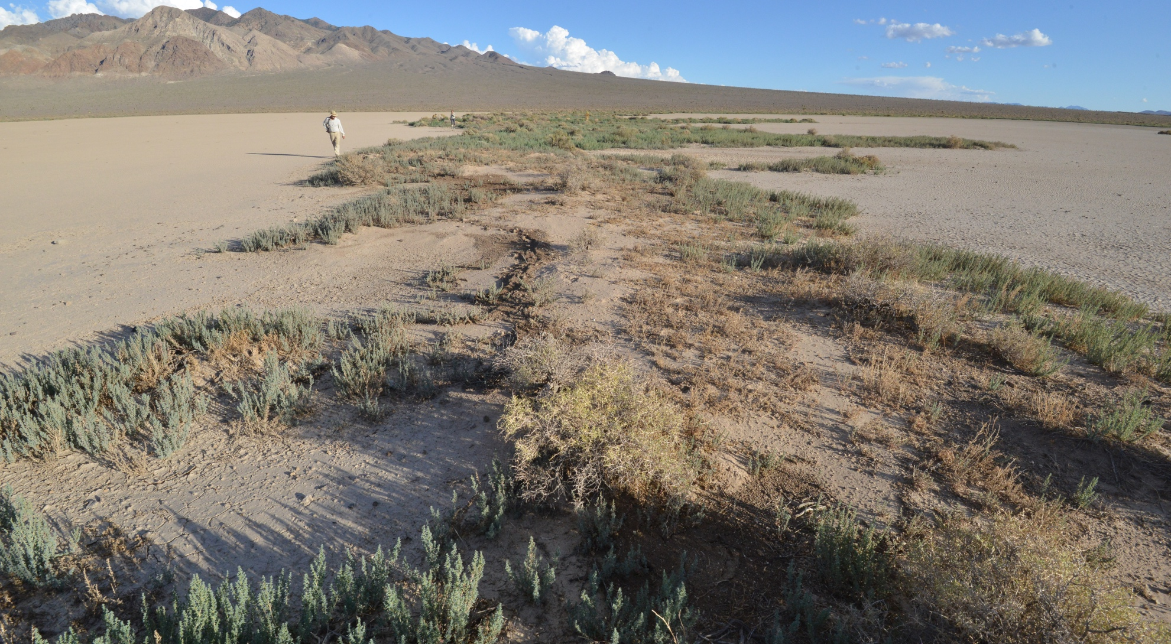
Tiger Stripe: Vegetation ‘stripe’

Slide 46
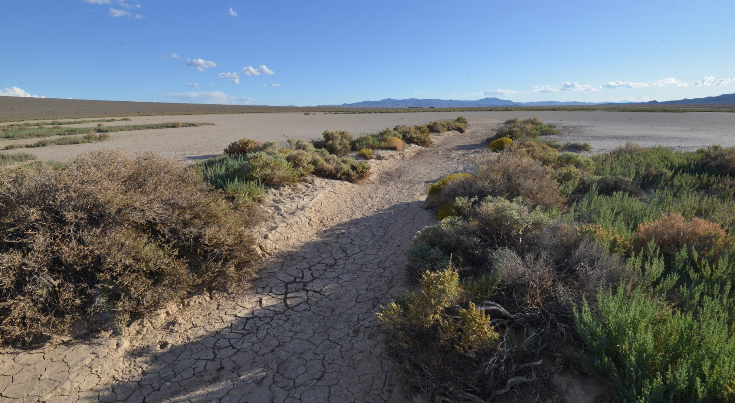
Tiger Stripe: Flood Channel

Slide 47

Tiger-Stripe:Flood channel delta

Slide 48
Conclusions
Rocks move when we get:
  a pond, freezing nights, light winds, sun to cause breakup
Speeds are slow—1-6 m/minute
Pushed by thin, but large, floating ice panels
In DV, ponds are rare so movement is rare
  ~Once per decade; but multiple times when the pond lasts
Rock movement is frequent in northern playas
  Where ponds form annually and freezing is common

Slide 49
Publication & Public Interest
Top journals (Science, Nature) uninterested
  Said, “we don’t expect many citations”
Published in open access (PLoS One)
  ~235,000 views
Made videos
  Every science writer asked, “Is there video?”
  ~1,600,000 views
Media from “Sudan Vision Daily” to Japanese TV (NKTV)
Death Valley NP:
  Says visitation increased by 1/3rd!

Slide 50
Winds during move events—light, and mostly consistent

Slide 51

February 11, 2014
Photo by Mike Hartmann
Notes:
By mid Feb the pond is gone and there is merely a damp spot in the lowest topographic part of the playa.

Slide 52



Ronja Spänke
Phaenovum, Lörrach

Slide 53

Rock Trails in the 2013-14 Pond

Slide 54

The typical weather pattern…
Notes:
In early November 2013, we went to the Death Valley Natural History association meeting and presented our first weather record. We showed that most rainfall is in the Spring and summer—suggestive evidence that ice was not involved. Ralph Lorenz was also there promoting his ice-lifting idea which we poo-pooed owing to our friction experiments that showed very low dynamic friction values for sliding rocks. In our view, the ice lifting idea was not needed.

Slide 55


Slide 56

Death Valley rainfall has el Niño Thumbprint—next event: 2015!
Notes:
We also looked at the frequency of pond-forming events by studying the rainfall record from Furnace Creek. This showed rainfall tied mostly to el Nino events with a ~6 year period. Since the last el Nino was in 2009-10, we anticipated another 2 years to wait for a pond-forming event. We were wrong by about 2 years!

Slide 57

Collecting the GPS recorders on a very cold morning
Photo by Russ Crane
Notes:
Jim then collected the instrument package to down load the GPS data on each rock move.

Slide 58

All the mapped features…

Slide 59

December 20 & Jan 9 trails
Notes:
Here we seeG PS data collected late March 2014 by a large mapping team (including Paula Messina who made the plot). Most the long trails on the right are Dec 20 move events; but the nearshore trails show longer trails to the top of the figure (west) than in the center of the map, indicating ice rotation against the shoreline during the Jan 9 move event.

Slide 60

January 26, 2014
Photo by Mike Hartmann
Notes:
The pond shrank considerably by late January as seen in the over-flight image. You can still see where the old shore line were as well as a new western ‘mudflat’

Slide 61

December 26, 2013
Photo by Mike Hartmann
Notes:
Notably, the northern shore of the pond is very shallow and extensive. We think that winds form the SW blow across the pond, moving the ice both by friction with the wind, but also displacing the liquid water on the shallow, northern ‘mudflat’. Wind movement of liquid water also displace water under the ice, shifting the whole ice sheet to the NE. But this is still a hypothesis.

Slide 62

Distinctive ice-push topography: Fjordland
February 11, 2014; Photo by Mike Hartmann
Notes:
The process of pond formation yields a number of distinctive features besides moving rocks. These include ‘fjordland’ topography formed by ice push and a large number of trails along the northern shore that indicate movement from North to South—perhaps by relaxation of the wind stress that allows the water to run back into the topographic low of the pond.

Slide 63

The whole ice sheet is rotating…
Notes:
Here we can see (Cousin, Betsy for scale), that a lead has opened along the shore as the ice sheet pivots near Betsy, riding up on the shore in front of her. Note ice shoved ashore in the foreground. This rotation causes arcing rock trails of varying length based on the stones position relative to the rotation center of the enclosing ice.

Slide 64

“Lorenzean Motion” of small ice-bound rocks
Notes:
We did observe movement of small rocks similar to the predictions of Ralph Lorenz. These little rocks are frozen into shore ice, which when displaced, carried rafts of pebbles a few 10’s of cm offshore. This mechanism may explain scatters of small pebbles in mid-playa.

Slide 65

Large rocks do not freeze to ice
Notes:
Contrary to Lorenz’s ideas of ice buoying, big rocks heat up in the sun too much to have ice frozen firmly to them. Hence, ice cannot lift big rocks to aid in reducing frictional forces with the lake bed.

Slide 66

GPS mapping trails

Slide 67


Slide 68

Messina & Stoffer 2000
Wind is the only driver
Messina & Stoffer, 2000, Geomorphology 35:253-265
Notes:
Paula Messina studied the Racetrack for her dissertation, but had the misfortune to have no rock movement during the years she studied the process. She used the first differential GPS to make detailed maps. These show predominant rock movement from the SW to NE, along one of the major paths of wind gusts.

Slide 69

Messina: If ice is the driver, why do trails converge?
Messina & Stoffer,
2000,
Geomorphology
35:253-265
Notes:
She documented remarkably similar, but not identical trails which she argued could not be formed by two rocks locked in floating ice. The trails, although similar have different, converging path lengths what could not happen if the rocks were in a single sheet of ice. Her results completed a pattern of Stanley arguing for ice, Sharp and Carey arguing for no ice, Reid, ice, and now Messina, no-ice. More recently, Ralph Lorenz—a NASA researcher who usually studies Titan—has argued that ice locks around rocks and buoys them off the playa surface to reduce drag—another ice theory.

Slide 70


Harney Lake, Oregon
Ice scratches?

Slide 71

Notes:
Later, tracing the trails and overlapping them on nearest neighbors, shows how similar most of them are. The Dec 20 trails are very distinctive, even now.

Slide 72

Ice-push sediment ridges
Notes:
Here is what fjordland looks like from the ground—note the mud piles and bushes established on the mounds formed by ice push. On a larger scale, ice push is capable of destroying houses in the northern US and Canada. There are dramatic videos on U-tube of this process.

Slide 73
“Fjordland” near Rachel, Nevada
Notes:
A Google Earth image of a playa near Rachel, NV shows fjordland topography on the western and southern shores. This playa also has moving rocks, as reported to us by a local resident. Such features are present on at least 16 playas in the Western US. The unusual bit about the Racetrack may be the abundance of moving rocks since most playas do not have a large local source of stones.

Slide 74

Distribution of “Rockless Trails”

