Slide 1
Welcome to the 135th meeting of the Lyncean Group
3 March 2020

Slide 2
Agenda for 135th Meeting 3 March 2020
Reminder: please turn off or mute cell phones
Announcements & upcoming talks
ARCS: June Chocheles
Today’s Talk: We Have No Idea: Big Unanswered Questions about the Universe and Its Particles
Daniel Whiteson, Professor of Physics & Astronomy, UC Irvine
Speaker Appreciation

Slide 3
Miscellaneous Items
Sound system (donations welcome!)
Name tags
John Asmus
ARCS – June Chocheles

Slide 4
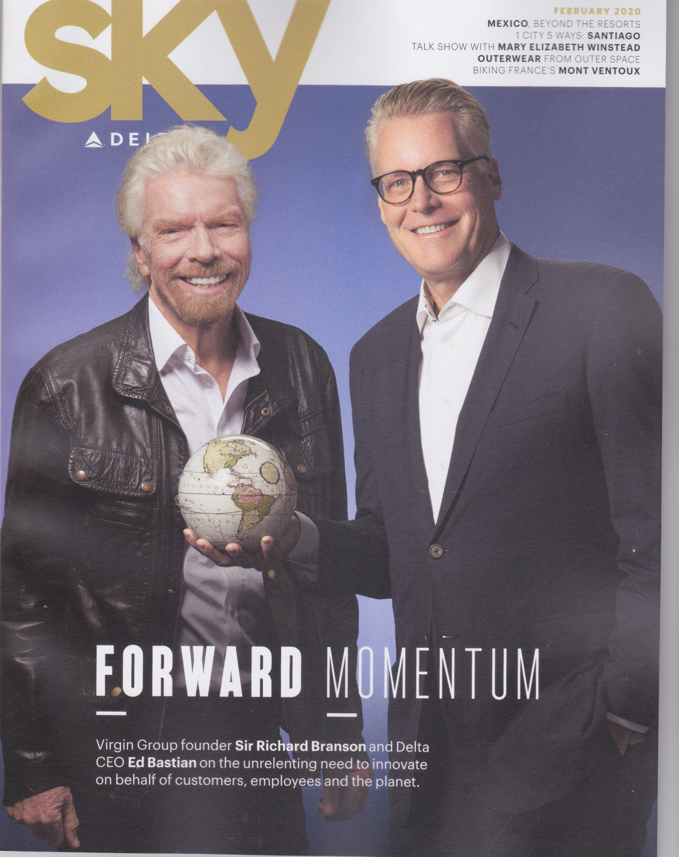
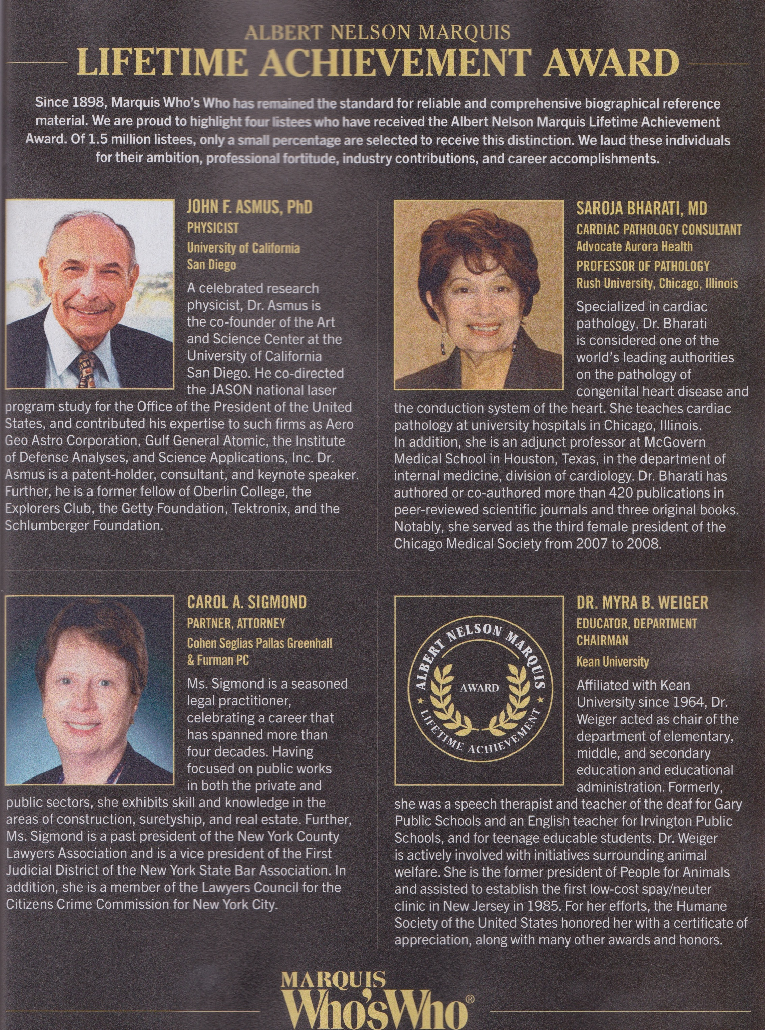
Lyncean John Asmus Featured in Delta Airlines SKY Magazine for Who’s Who Lifetime Achievement Award
Dr. Asmus has given a total of 8 Lyncean talks from 2007 through 2015. He has given more talks, by far, than anyone else. Thank you, John!

Slide 5
Achievement Rewards for College Students (ARCS) June Chocheles

Slide 6
Upcoming Talks
SUBJECT TO CHANGE
This information is also on the website under “Upcoming Talks”
Date | Speaker | Topic/Title
3/3/20 Note that this talk is on a Tuesday | Daniel Whiteson Professor of Physics & Astronomy, UC Irvine | We Have No Idea: Big, Unanswered Questions about the Universe and Its Particles
4/15/20 | Gresham Bayne Former Critical Care Consultant to STRATOS, Former medical consultant to Bird Aerospace Industries, Former CMO & Chair of the Technical Advisory Committee for NantHealth | What really happened during the STRATOS stratospheric parachute jump and what we still don’t know
5/27/20 | Ryan Kastner Professor of Computer Science and Engineering UC San Diego | Engineers for Exploration
7/8/20 | TBD | TBD

Slide 7
Upcoming Talks
SUBJECT TO CHANGE
This information is also on the website under “Upcoming Talks”
Date | Speaker | Topic/Title
8/19/20 | Joe Valenzuela Director of Business Development for Tactical Systems & Deputy CTO KRATOS Defense & Security Solutions | Autonomous air vehicle evolution and applications
9/23/20 | Katherine de Kleer Assistant Professor Division of Geological and Planetary Sciences Caltech | Dynamic Processes in the Solar System (tentative title)
11/18/20 | TBD | TBD
1/6/21 | Shana Gofreddi Associate Professor Biology Department Occidental College and Visiting Scientist Division of Geological and Planetary Sciences Caltech | General topic will be beneficial symbiotic partnerships between bacteria and invertebrates. More detail is TBD.
NEW

Slide 8
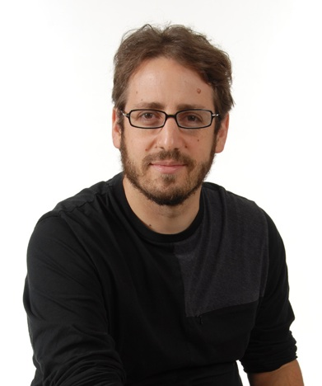
We Have No Idea: Big Unanswered Questions about the Universe and Its Particles
Daniel Whiteson
Professor of Physics & Astronomy
UC Irvine

Slide 9
Speaker Appreciation

Slide 10
Speaker Appreciation

Slide 11
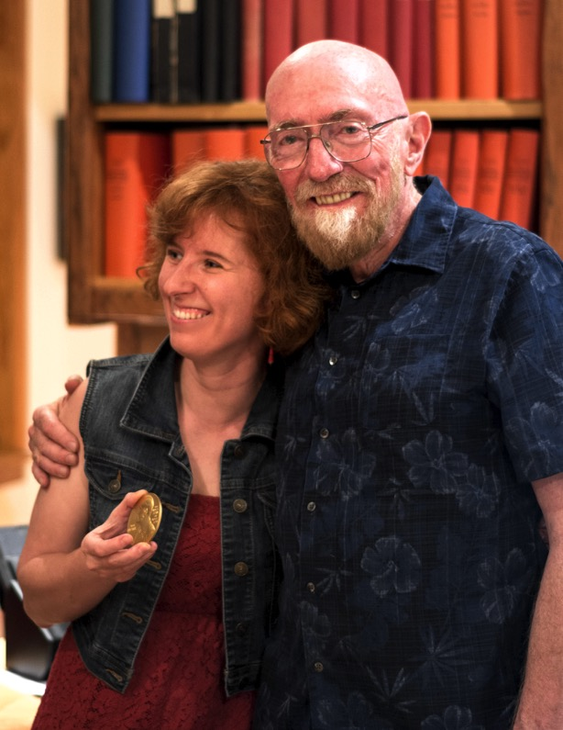
Elena Murchikova and Kip Thorne Celebrate Having Both Been Awarded Lyncean Coins
Elena Murchikova earned her coin by speaking to the Lynceans in 2015
Kip Thorne spoke to the Lynceans in 2010 (and won the Nobel Prize in Physics in 2017)
Photo date: June 2018 (note lack of Nobel Prize medal)

Slide 12
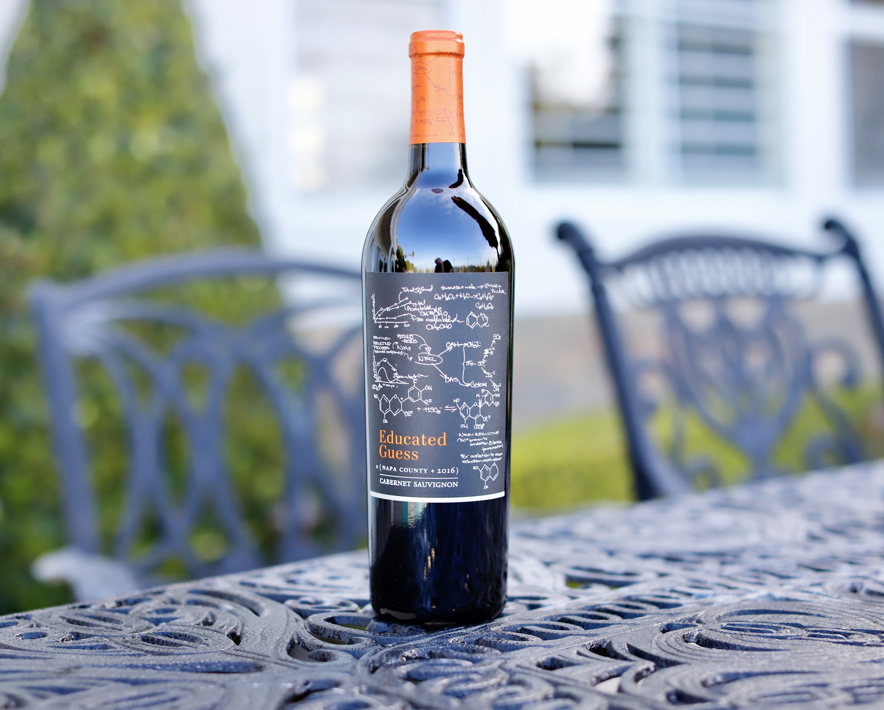
A Three-Question Quiz for the author of We Have No Idea
From the bottle: “This Napa Valley Cabernet Sauvignon is the richest, ripest, and most complex Cabernet you can buy for the money.”
Consolation Prize to be awarded regardless of quiz score

Slide 13
Three Big, Unanswered Questions*
Is red wine really good for you?
Is it better to take Social Security at age 65 or wait until 70?
When driving through the LA area, is it better to take the 5 or the 405?
CONGRATULATIONS!
You’re in the coin club!
✓
✓
✓
*HINT: While an Educated Guess would be appreciated,
“We have no idea” is an acceptable answer.

Slide 14
Lynxea
Don’t forget to drop off your name tags when you leave!
Next Meeting: April 15

